Slide 1
Water We Doing? Wet treatment in conservation
By Nylah Byrd and Joanna hurd

Slide 2
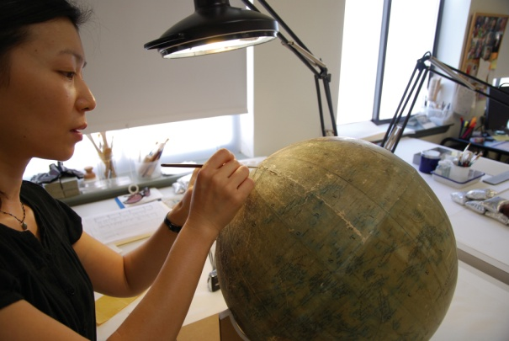
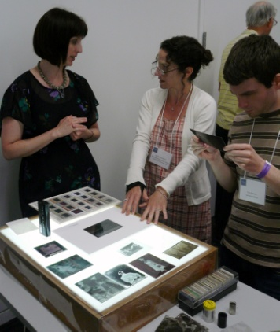
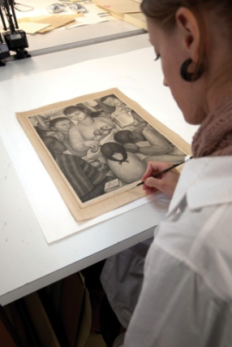
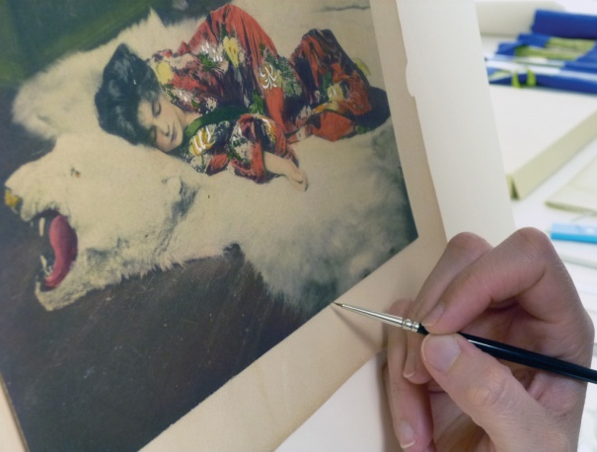
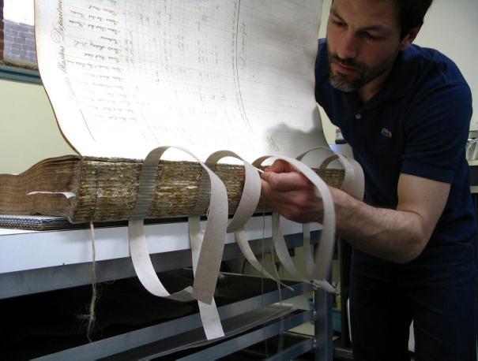
Conservation Center for Art & Historic Artifacts
In a typical year:
Preservation Services specialists complete over 50 survey projects.
Approximately 60 CCAHA-sponsored workshops, conferences, webinars, and training sessions are presented.
The Digital Imaging Services staff digitizes thousands of pages of fragile archival documents, books, and photographs.
Conservators assess and treat more than 6,000 individual artifacts, from over 400 clients.
Housing & Framing Services house approx. 75% of the artifacts treated (folder, sleeve, box, mat and frame, or sealed package).
Notes:
And one quick note about the organization I work for, the Conservation Center is a regional conservation lab and preservation services facility. We are based in Philadelphia, but we work with organizations and clients all across the country. Our conservators treat paper-based objects like books, photographs, documents, artwork on paper, and more. Our preservation services staff work in the field, providing education programs and helping institutions plan for the future of their collections.
As a preventive conservator, I work with both the conservation department and the preservation department to support preventive conservation projects and teaching. CCAHA also offers a wide range of digitization services, as well as fundraising assistance, housing and framing, and more. You can learn more about us and what we do at our website, ccaha.org.

Slide 3
Water We Doing? Wet treatment in conservation
By Nylah Byrd and Joanna hurd

Slide 4
When to get wet?
Notes:
To start we want to introduce why and item might receive wet treatment. We often do it to >>> reduce staining >>> reduce brittleness in the paper, >>> or to stabilize iron gall ink which often degrades over time when unstable.

Slide 5
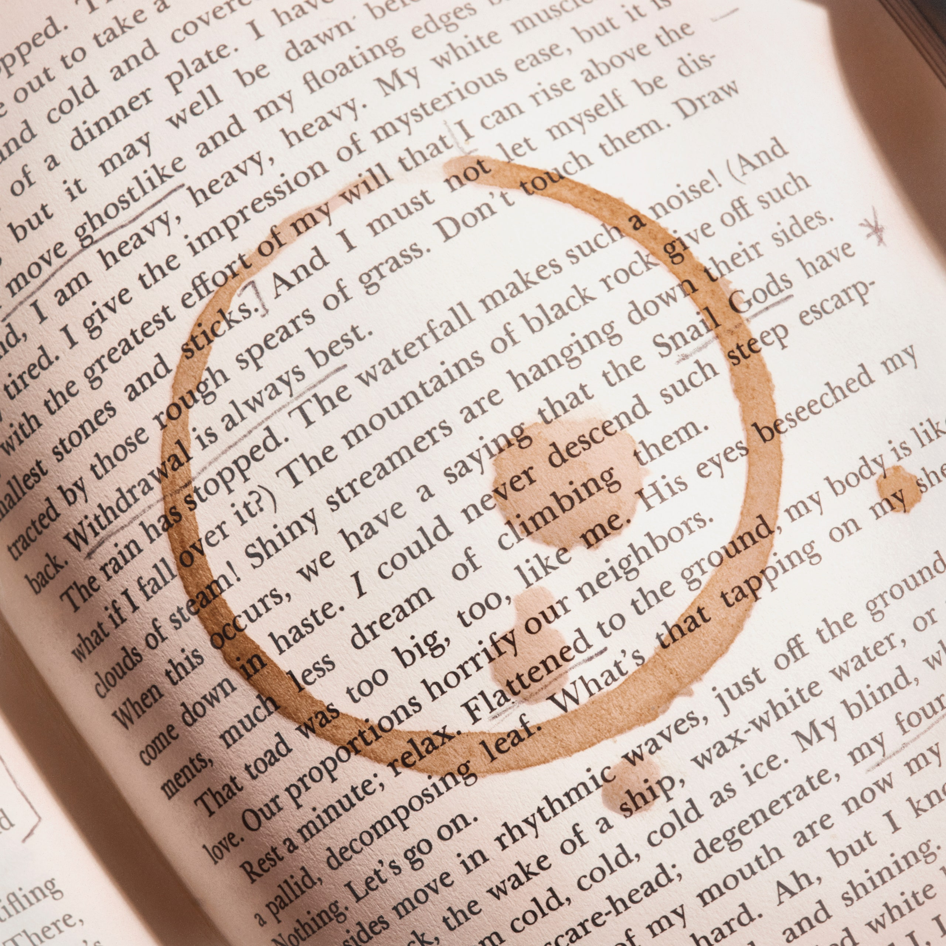
When to get wet?
Reduce staining
Example photos acquired from the internet
Notes:
To start we want to introduce why you might need to perform wet treatment. We often do it to >>> reduce staining >>> reduce brittleness in the paper, >>> or to stabilize iron gall ink which often degrades over time when unstable.

Slide 6
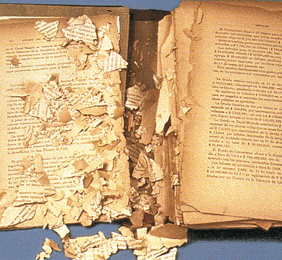
When to gET wet?
Reduce staining
Reduce Brittleness
Example photos acquired from the internet
Notes:
To start we want to introduce why you might need to perform wet treatment. We often do it to >>> reduce staining >>> reduce brittleness in the paper, >>> or to stabilize iron gall ink which often degrades over time when unstable.

Slide 7
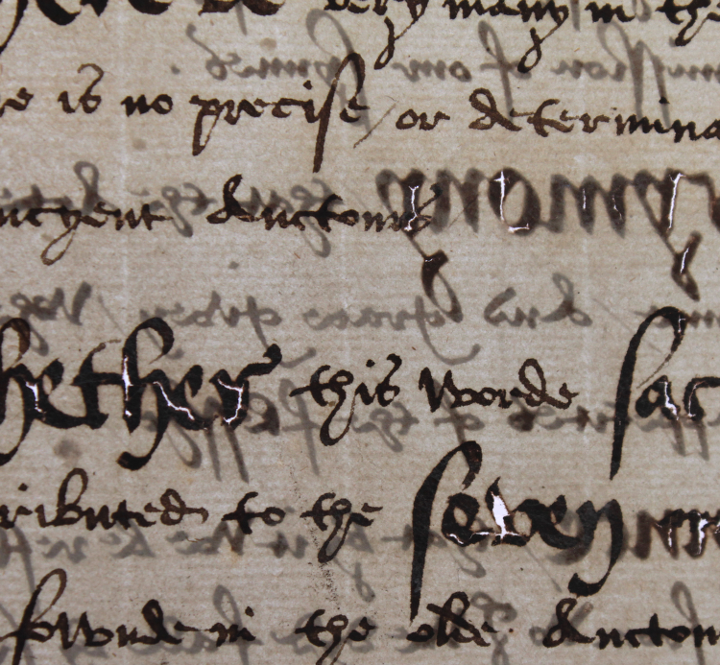
When to gET wet?
Reduce staining
Reduce Brittleness
Stabilize Iron gall Ink
Example photos acquired from the internet
Notes:
To start we want to introduce why you might need to perform wet treatment. We often do it to >>> reduce staining >>> reduce brittleness in the paper, >>> or to stabilize iron gall ink which often degrades over time when unstable.

Slide 8
Comparing two Wet treatments
New York Public Library
21.076.06
21.076.11
PC: Andy Pinkham
Notes:
To further illustrate the intricacies of wet treatment, we're going to discuss two different wet treatments I conducted on two books from the New York Public library. Both books experienced a water event and the book on the left (0.6) had staining throughout the book, covering the majority of each page. The book on the right (.11) however showed staining mostly along the bottom edge of each page. Both books got baths and I'm going to pass it to Joanna to explain a bit about bath set up and factors involved.

Slide 9
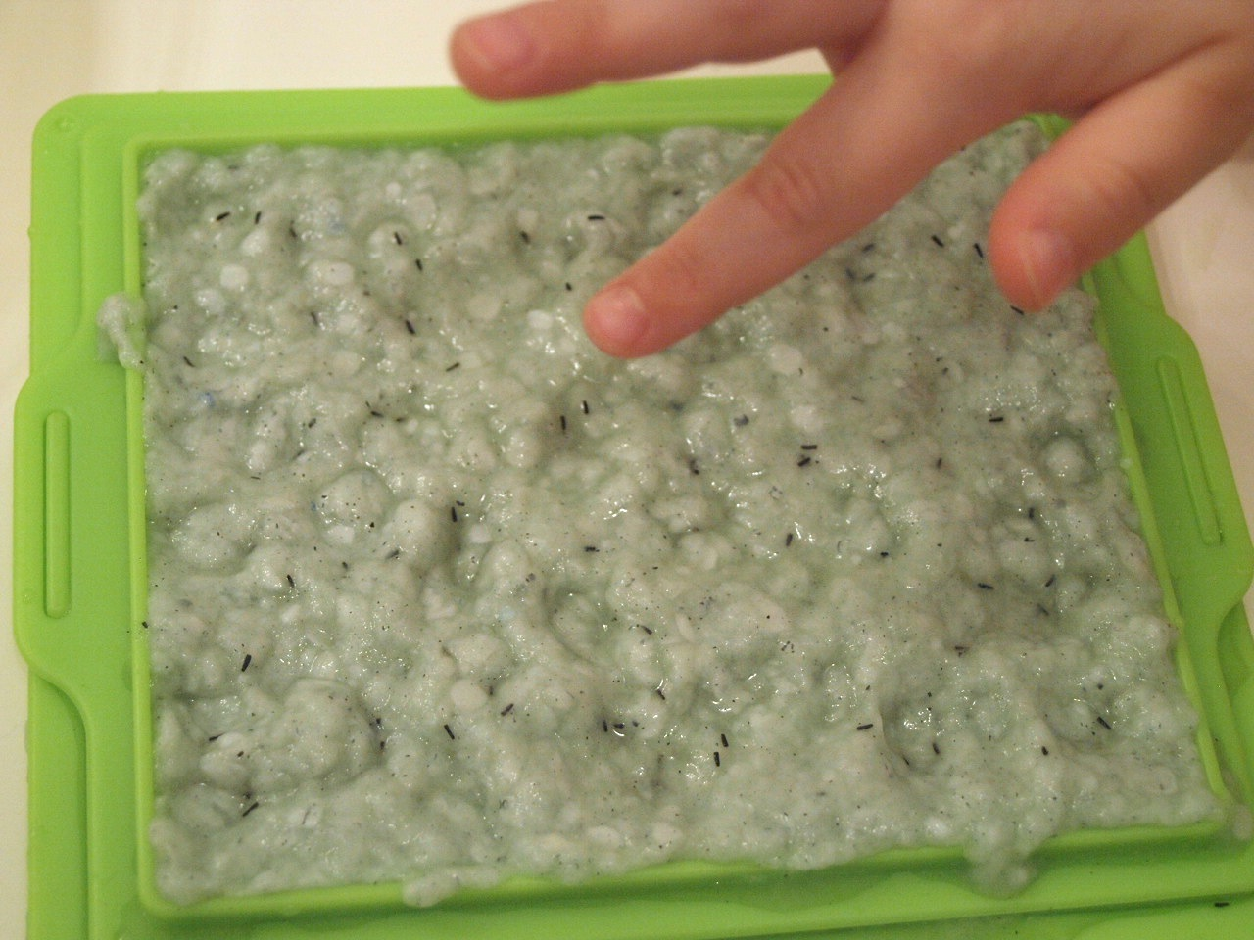
Fibers and Water
This Photo by Unknown Author is licensed under CC BY-SA-NC

Slide 10
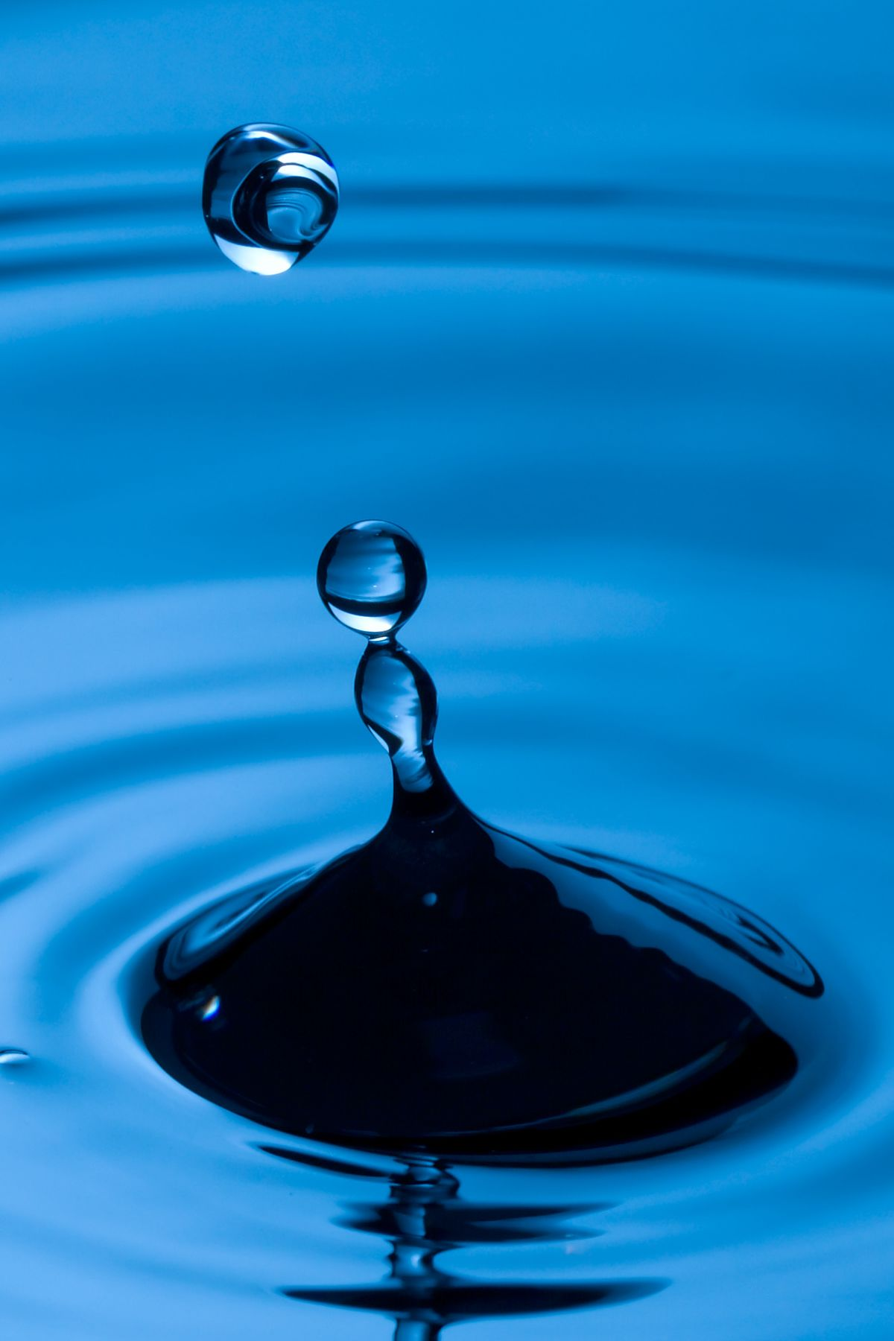
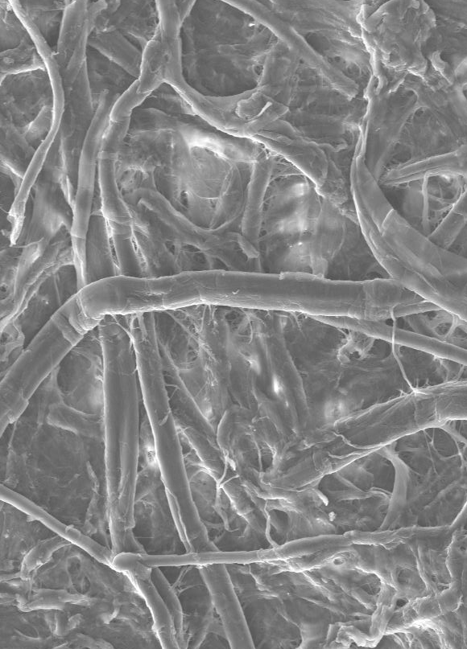
Paper as a gel
GELS: Colloidal systems with a dispersion phase (cellulose fibrils) and a dispersion medium (water). Typically a solid dispersed in liquid.
This Photo by Unknown Author is licensed under CC BY-SA

Slide 11
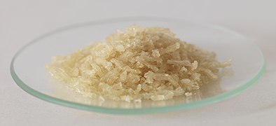
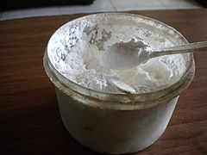
Sizing & Additives
Gelatin
Rosin
Starch

Slide 12
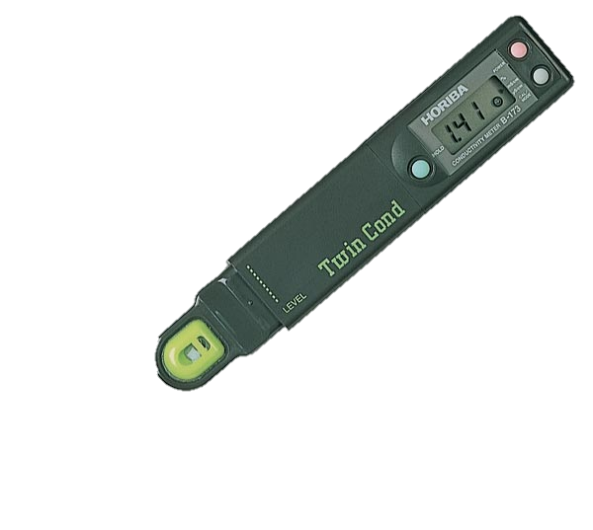
WHAT IS WATER?
Components and considerations:
Water treatment (filtration, deionization, distillation)
Total dissolved solids (TDS), Total organic carbon (TOC), concentration of Ca and Mg ions (water hardness)
pH and conductivity
SCIENCE

Slide 13
Bathing Adjustments
pH and conductivity
Buffers
Surfactants/wetting agents
Chelators
Method
This Photo by Unknown Author is licensed under CC BY-SA-NC

Slide 14
Comparing two Wet treatments
TREATMENT STEP | 21.076.06 | 21.076.11
Notes:
Alright, now I'm going to walk you through all the steps involved in the wet treatment. I'll go through the treatment steps one by one and talk about what I did the same or differently, and why.

Slide 15
Comparing two Wet treatments
TREATMENT STEP | 21.076.06 | 21.076.11
Selecting a pH
Notes:
First, we had to select a ph. Paper becomes more acidic as it degrades over time and you do not want to further encourage than degradation in the bath. [briefly explain pH, what's acidic and what's basic only if Joanna didn't touch on it].

Slide 16
Comparing two Wet treatments
TREATMENT STEP | 21.076.06 | 21.076.11
Selecting a pH | ~8.5 | ~8.5
Notes:
So I used a pH of about 8.5 for both of the books. This is slightly on the basic side in order to neutralize some of the acidic degradation, but not basic enough to cause any adverse reactions.

Slide 17
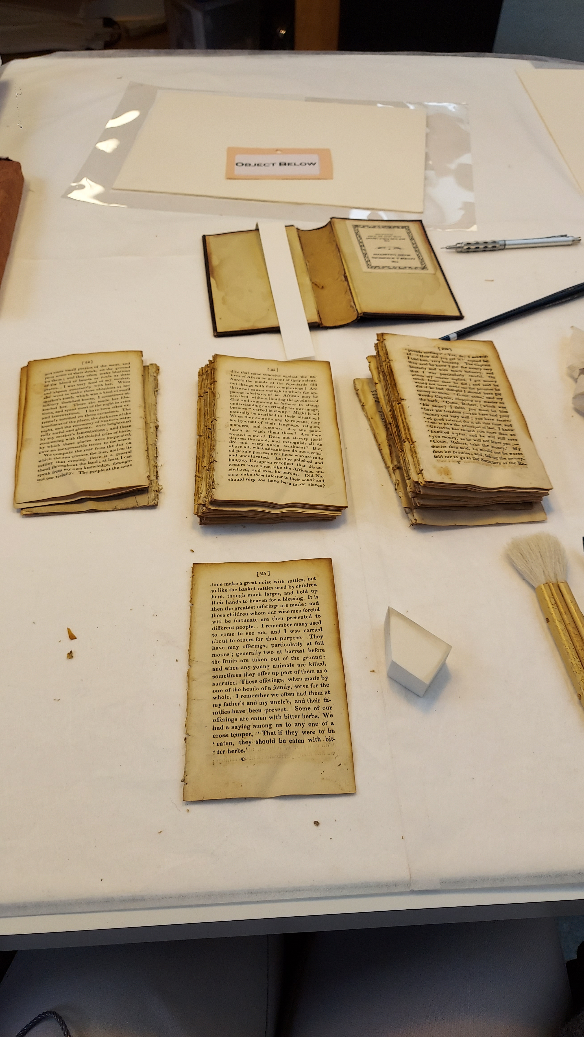
Comparing two Wet treatments
TREATMENT STEP | 21.076.06 | 21.076.11
Selecting a pH | ~8.5 | ~8.5
Barrier layers
Notes:
Before the books go in the bath, they are disassembled into *click* gatherings (or a group of folded leaves). These get wrapped in a barrier layer before going into the bath and we handle the gatherings by the barrier layer so we're not putting pressure on the wet pages.

Slide 18
Comparing two Wet treatments
TREATMENT STEP | 21.076.06 | 21.076.11
Selecting a pH | ~8.5 | ~8.5
Barrier layers
Notes:
Before the books go in the bath, they are disassembled into *click* gatherings (or a group of folded leaves). These get wrapped in a barrier layer before going into the bath and we handle the gatherings by the barrier layer so we're not putting pressure on the wet pages.
[reset page so the slide change is noticeable]

Slide 19
Comparing two Wet treatments
TREATMENT STEP | 21.076.06 | 21.076.11
Selecting a pH | ~8.5 | ~8.5
Barrier layers | Wet strength paper | Pellon
Notes:
As you can see, I used two different barrier layers for these treatments. For the book with overall staining I used wet-strength paper, which is somewhat self explanatory. It's a paper that maintains strength when it's wet. Dollar bills are printed on this kind of paper so your money is durable. For the book with bottom edge staining I used Pellon, which is a non woven fabric made from polyester fibers.

Slide 20
Barrier Layers
Wet strength paper
Pellon
Notes:
In addition to handling the gatherings, the barrier layer also helps draw staining out of the book during drying. Because the gatherings are many sheets of paper folded around each other, the water moves from the inside out in order to dry. This means there's staining also moving inside out with the water. Without a barrier layer, that staining would remain in the outer sheet of the gathering. That's why I used the wet strength paper for the more heavily stained book. You can even see a faint brown rectangle inside the paper, and that's from residual staining that came out during drying. The Pellon is regularly used in wet treatments because it's strong, but also translucent so you can see the paper through it pretty well when it's in the bath which is especially advantageous for materials with written media, so you can easily see if something unpredictable starts to happen.

Slide 21
Comparing two Wet treatments
TREATMENT STEP | 21.076.06 | 21.076.11
Selecting a pH | ~8.5 | ~8.5
Barrier layers | Wet strength paper | Pellon
Number of baths
Notes:
So we've chosen a pH for the water and chosen a barrier layer for the gatherings and now it's time to start bathing. I'm going to talk about the number of baths and the >>> water temperature at the same time because they play off of each other.

Slide 22
Comparing two Wet treatments
TREATMENT STEP | 21.076.06 | 21.076.11
Selecting a pH | ~8.5 | ~8.5
Barrier layers | Wet strength paper | Pellon
Number of baths
Water temperature
Notes:
So we've chosen a pH for the water and chosen a barrier layer for the gatherings and now it's time to start bathing. I'm going to talk about the number of baths and the >>> water temperature at the same time because they play off of each other.

Slide 23
Number of Baths and Water Temp
Washing .06
First bath - tap temperature
Second bath - warm
Notes:
For .06 I did two baths. The first bath was at the temperature that the deionized water comes out of the facet. I didn't change the temperature because I didn't want the staining to move out too fast and potentially draw out too much from the paper. The difference is slight but the water in the first bath yellow from the staining coming out. But because that water is yellow, it means the staining isn't completely out so it gets one more bath at a warmer temperature to get as much staining out as possible, before the gatherings are set to dry. One factor I didn't put in the chart is bathing time, because it really depends on what you're seeing. With this book, I let the gatherings sit in the first bath until the water was sufficiently yellow and I couldn't see the streams of staining coming off the gatherings much anymore. They were in the second bath for a shorter period of time because most of the staining was out at that point and like mentioned before, we don't want to draw too much other components out of the paper.

Slide 24
Comparing two Wet treatments
TREATMENT STEP | 21.076.06 | 21.076.11
Selecting a pH | ~8.5 | ~8.5
Barrier layers | Wet strength paper | Pellon
Number of baths | 2 | 1
Water temperature | Tap temp, then warm | Tap temp
Notes:
For .11, I only needed one bath a tap temperature and that bath was shorter than .06's first bath because the staining came our very readily.

Slide 25
Comparing two Wet treatments
TREATMENT STEP | 21.076.06 | 21.076.11
Selecting a pH | ~8.5 | ~8.5
Barrier layers | Wet strength paper | Pellon
Number of baths | 2 | 1
Water temperature | Tap temp, then warm | Tap temp
Percentage of gelatin in size
Notes:
Next step in the process is re-sizing the paper. [see what Joanna adds then build this part from there].

Slide 26
Comparing two Wet treatments
TREATMENT STEP | 21.076.06 | 21.076.11
Selecting a pH | ~8.5 | ~8.5
Barrier layers | Wet strength paper | Pellon
Number of baths | 2 | 1
Water temperature | Tap temp, then warm | Tap temp
Percentage of gelatin in size | 2.5% | 5%
Notes:
[also write after Joanna's slide to know how much background to give]. We determine the percentage of gelatin to use when making our size based on the texture of the paper before washing. The goal is to return the paper to it's original texture as best as possible. .06 was a relatively soft paper which is why we used 2.5% gelatin and 0.11 was a thicker, firmer paper so we went with 5% gelatin. Usually we resize papers with between 2 and 5% gelatin.

Slide 27
Comparing two Wet treatments
TREATMENT STEP | 21.076.06 | 21.076.11
Selecting a pH | ~8.5 | ~8.5
Barrier layers | Wet strength paper | Pellon
Number of baths | 2 | 1
Water temperature | Tap temp, then warm | Tap temp
Percentage of gelatin in size | 2.5% | 5%
When to re-size
Notes:
For clarification, re-sizing happens after washing always. But you can re-size directly after washing, when the paper is still wet or you can let the paper dry first then re-size, >>> which is what I did for both. I wanted to make sure all the pages absorbed the same amount of sizing, so it was easier to let everything dry and go back in and resize, then to size right out of the bath with this many gatherings.

Slide 28
Comparing two Wet treatments
TREATMENT STEP | 21.076.06 | 21.076.11
Selecting a pH | ~8.5 | ~8.5
Barrier layers | Wet strength paper | Pellon
Number of baths | 2 | 1
Water temperature | Tap temp, then warm | Tap temp
Percentage of gelatin in size | 2.5% | 5%
When to re-size | After drying | After drying
Notes:
For clarification, re-sizing happens after washing always. But you can re-size directly after washing, when the paper is still wet or you can let the paper dry first then re-size, >>> which is what I did for both. I wanted to make sure all the pages absorbed the same amount of sizing, so it was easier to let everything dry and go back in and resize, then to size right out of the bath with this many gatherings.

Slide 29
Comparing two Wet treatments
TREATMENT STEP | 21.076.06 | 21.076.11
Selecting a pH | ~8.5 | ~8.5
Barrier layers | Wet strength paper | Pellon
Number of baths | 2 | 1
Water temperature | Tap temp, then warm | Tap temp
Percentage of gelatin in size | 2.5% | 5%
When to re-size | After drying | After drying
Humidification/flattening
Notes:
Finally, the pages do cockle when they are left to airdry without any additional pressure. So the last step is to humidify and flatten the gatherings. There's a few options when it comes to this step and it really depends on how much material you’re working with and how flat the end result should be. Like with sizing, we are trying to mimic the original flatness of the paper as much as possible.

Slide 30
Humidification and Flattening Options
humidification
flattening
Chamber
Through Gore-tex
Between felts
Between blotters
How much weight?
Notes:
For humidifying the gatherings you can use a humidification chamber, or use a semi permeable membrane like Goretex. One side absorbs water while the other side only lets water vapor through, resulting in a controlled, even amount of moisture being released onto the paper. Since I had a sufficient amount of material I opted for the humidification chamber because it would be faster than using the goretex. For flattening, you have to consider what barrier layers to use and how much weight to put on top. It is possible to make something too flat.

Slide 31
Comparing two Wet treatments
TREATMENT STEP | 21.076.06 | 21.076.11
Selecting a pH | ~8.5 | ~8.5
Barrier layers | Wet strength paper | Pellon
Number of baths | 2 | 1
Water temperature | Tap temp, then warm | Tap temp
Percentage of gelatin in size | 2.5% | 5%
When to re-size | After drying | After drying
Humidification/flattening | In chamber/Between felts | In chamber/Between felts
Notes:
I chose felts to flatten these gatherings because the felts are softer than the blotter and it would be easier to avoid over flattening with the felts.

Slide 32
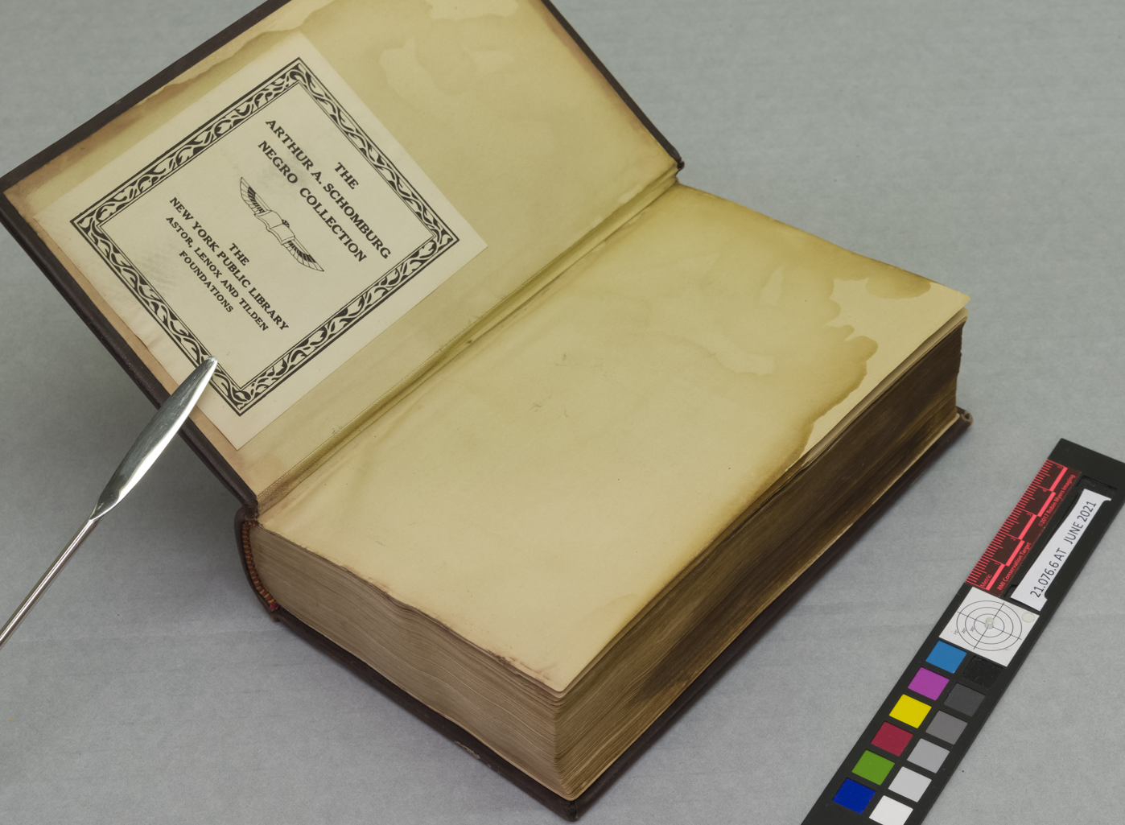
BEfore and After Treatment
21.076.06
Before
After
PC: Andy Pinkham
Notes:
So here is point six before and after the entire treatment. And the endleaves you see in the after picture are new and were sewed in when I rebound the book. However, you can see the difference in the foredge of the book and how the staining has been dramatically reduced.

Slide 33
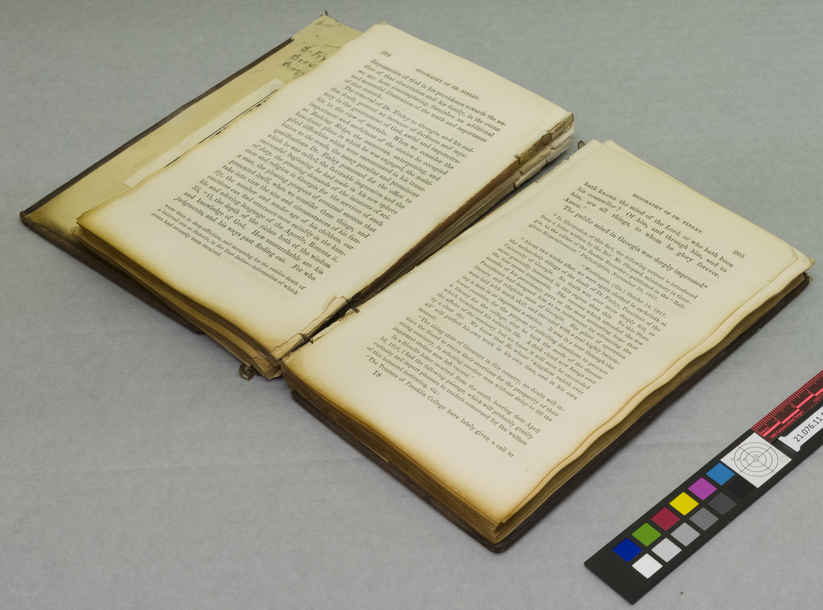
BEfore and After Treatment
21.076.11
Before
After
PC: Andy Pinkham
Notes:
Same with point eleven, you can see along the bottom that the staining is no longer concentrated there.

Slide 34
Thank you any questions?

