Slide 1
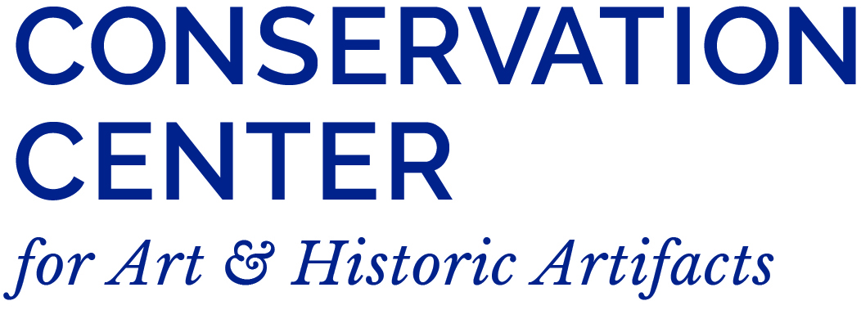
A Little Help from My Friends: Working with Emergency Service Providers

Slide 2
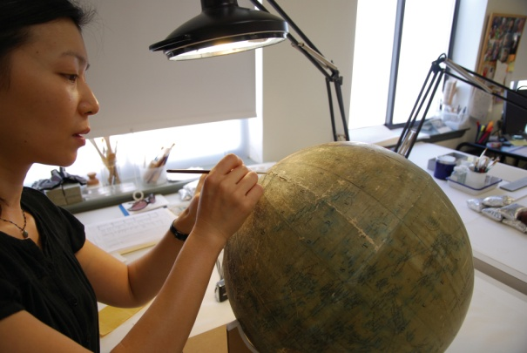
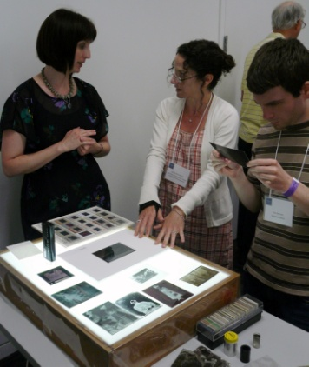
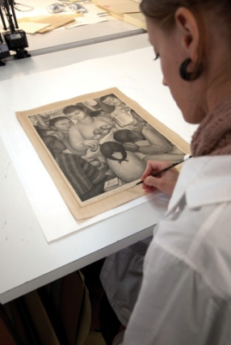
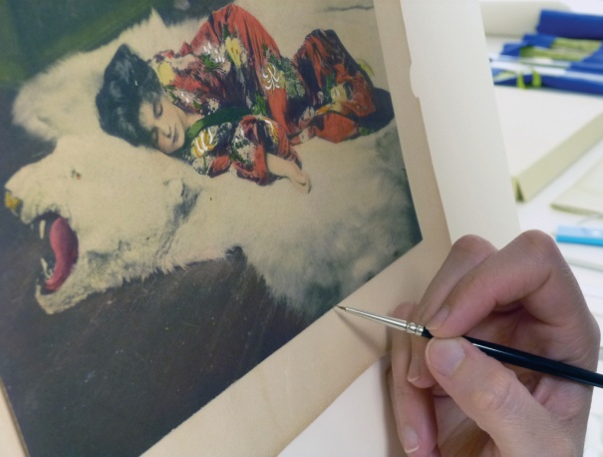
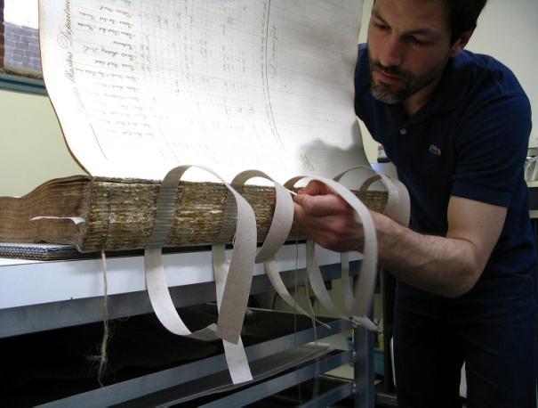
Conservation Center for Art & Historic Artifacts
In a typical year:
Preservation Services specialists complete over 50 survey projects.
Approximately 60 CCAHA-sponsored workshops, conferences, webinars, and training sessions are presented.
The Digital Imaging Services staff digitizes thousands of pages of fragile archival documents, books, and photographs.
Conservators assess and treat more than 6,000 individual artifacts, from over 400 clients.
Housing & Framing Services house approx. 75% of the artifacts treated (folder, sleeve, box, mat and frame, or sealed package).
Notes:
And one quick note about the organization I work for, the Conservation Center is a regional conservation lab and preservation services facility. We are based in Philadelphia, but we work with organizations and clients all across the country. Our conservators treat paper-based objects like books, photographs, documents, artwork on paper, and more. Our preservation services staff work in the field, providing education programs and helping institutions plan for the future of their collections.
As a preventive conservator, I work with both the conservation department and the preservation department to support preventive conservation projects and teaching. CCAHA also offers a wide range of digitization services, as well as fundraising assistance, housing and framing, and more. You can learn more about us and what we do at our website, ccaha.org.

Slide 3
Disaster Preparedness and Recovery Services for Archives and Records
Preparedness Services
Site/Risk Assessment
Emergency Preparedness Profile
Master Service Agreements
Inventory Development
Training/Workshops
Project Consulting
Remote Climate Monitoring
Recovery Services
Freezer Stabilization
Vacuum Freeze Drying
Desiccant Drying
Archive Cleaning
Mold Remediation
Sterilization
Pest Eradication
Deodorization

Slide 4
Do your records look like this?

Slide 5
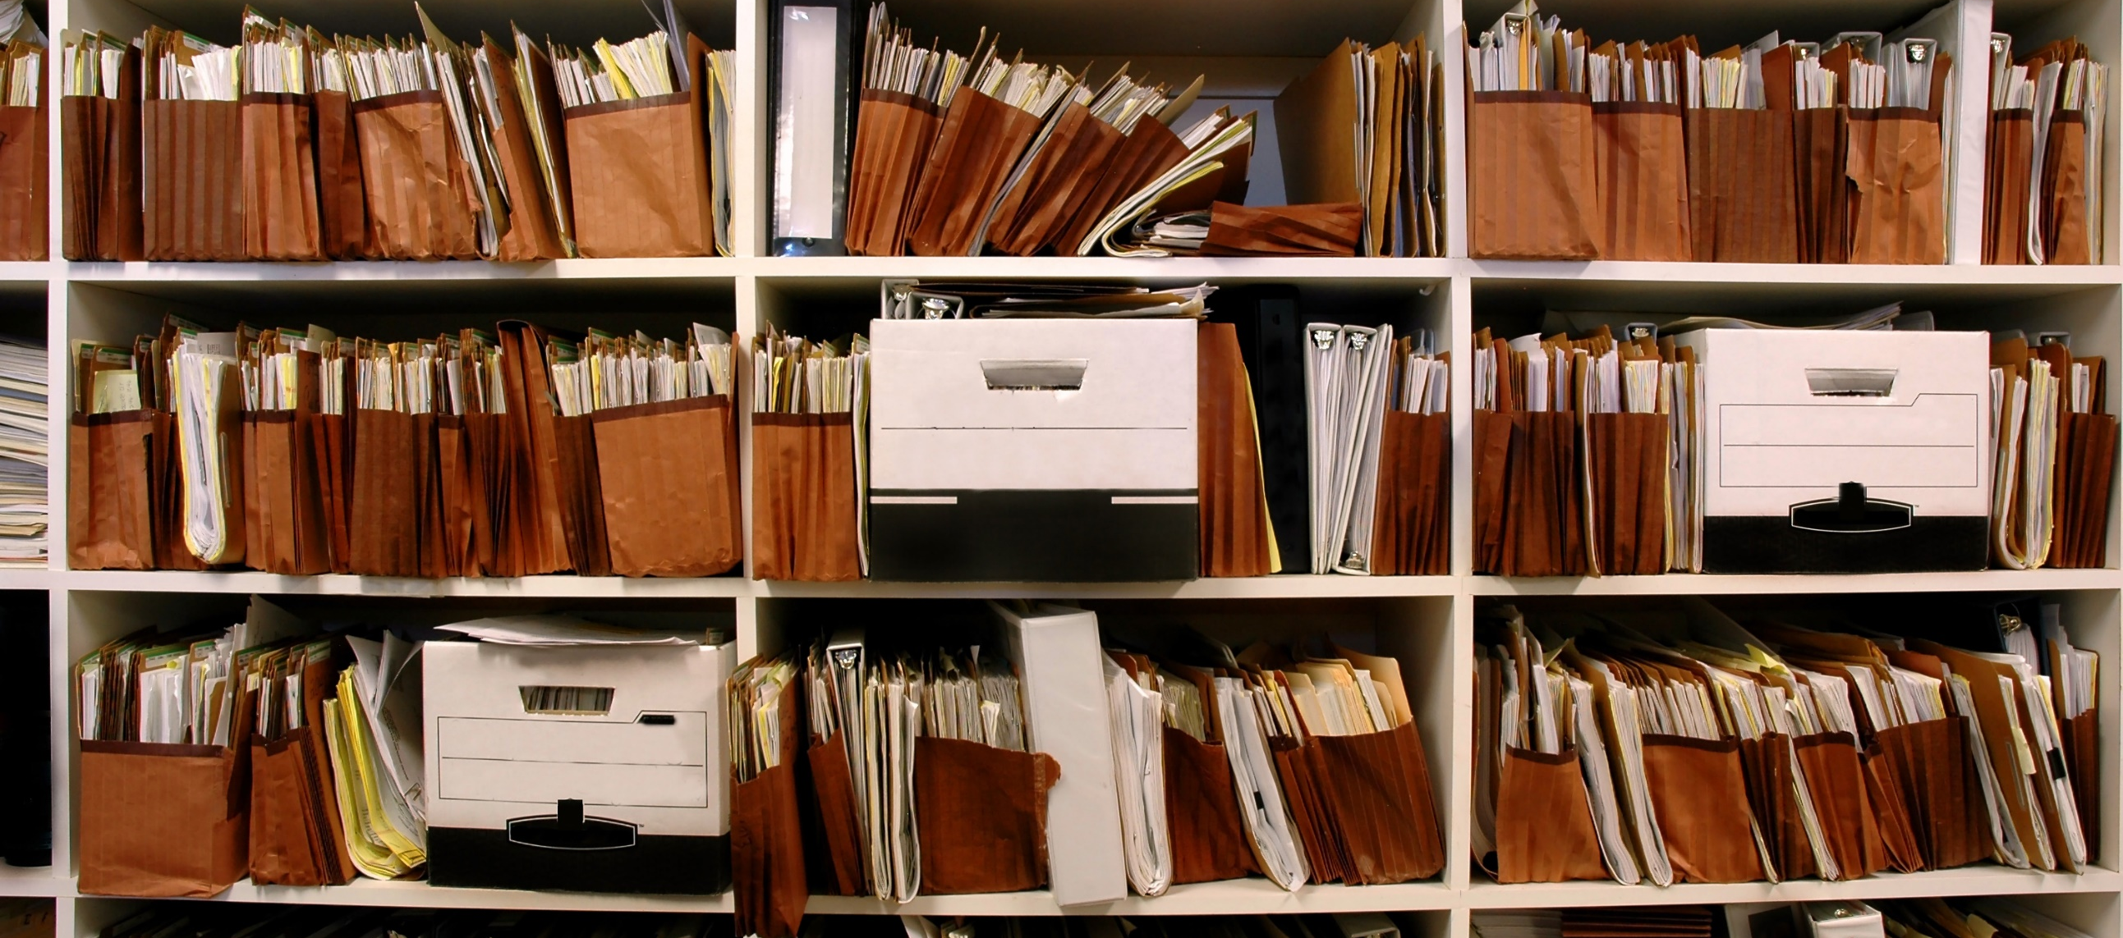
Or Like This………..

Slide 6
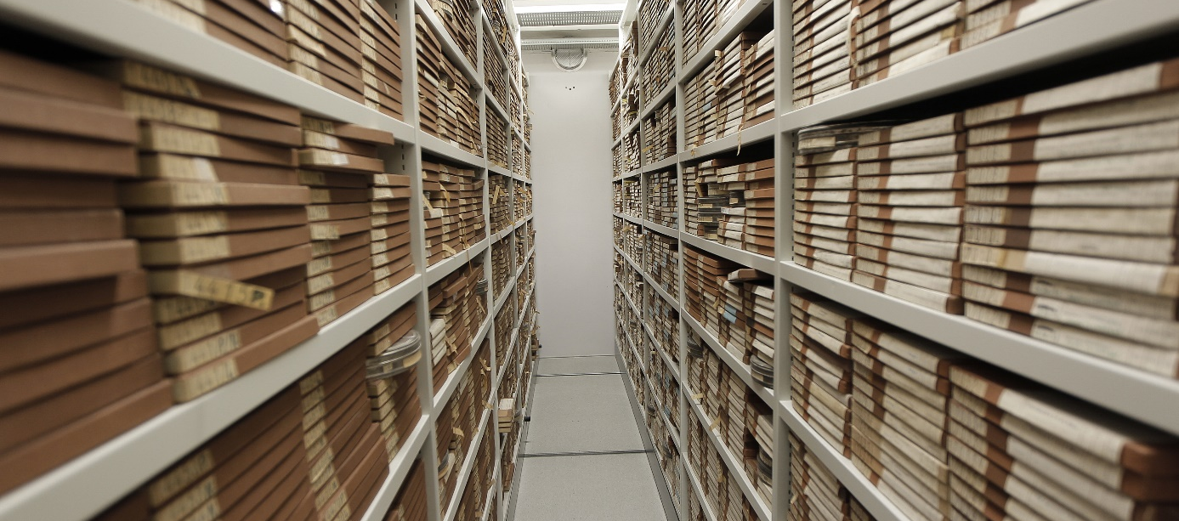
Or Maybe Like This…….

Slide 7
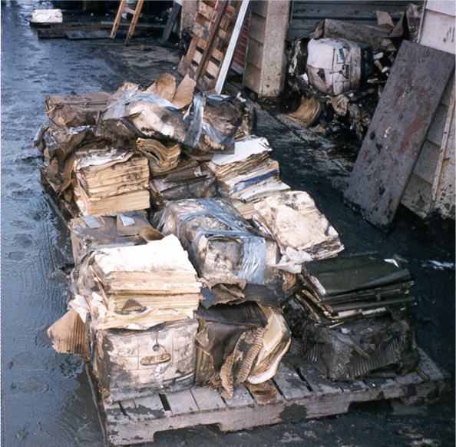
Flood Damage
Plan for Worst…
….Hope for Best

Slide 8
Restoration Methods
of Success
Time is of the Essence – Response Time is key in emergency situation
Secondary damage can occur in as little as 48 – 72 hours
(mold, swelling, staining, etc..)
Maintain a process for controlling custody
Prioritize health and safety of everyone involved
Vet Vendors prior to emergency situation (develop relationship)
Identify/Isolate the problem area
Protect undamaged archives from the problem

Slide 9
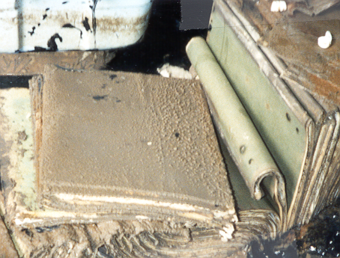
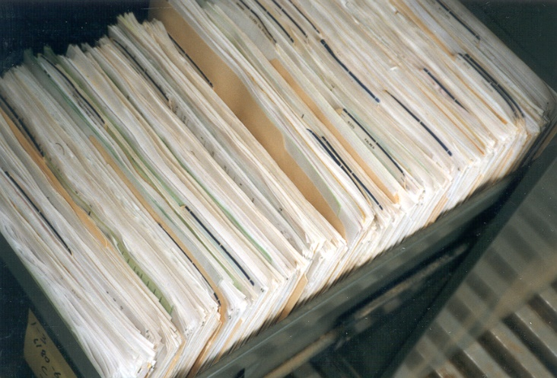
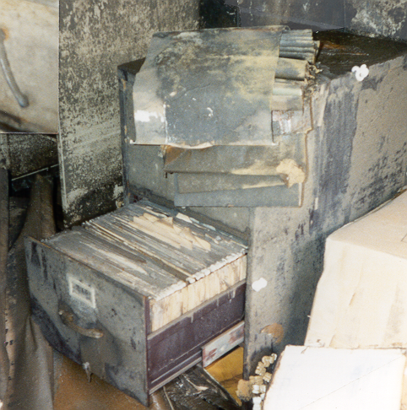
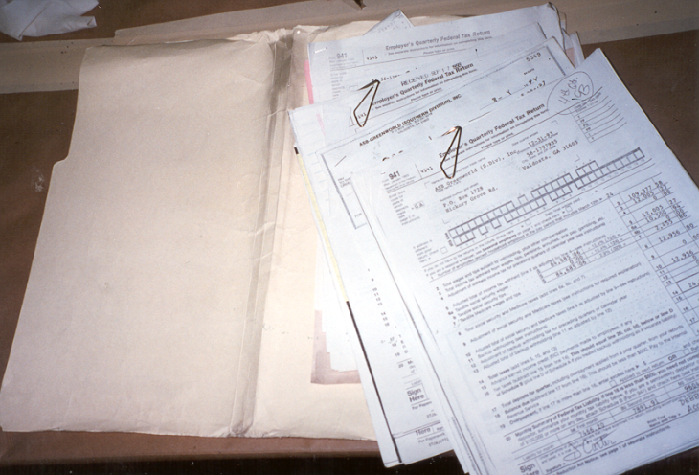
Importance of Response Time
Best Case Scenario
Worst Case Scenario

Slide 10
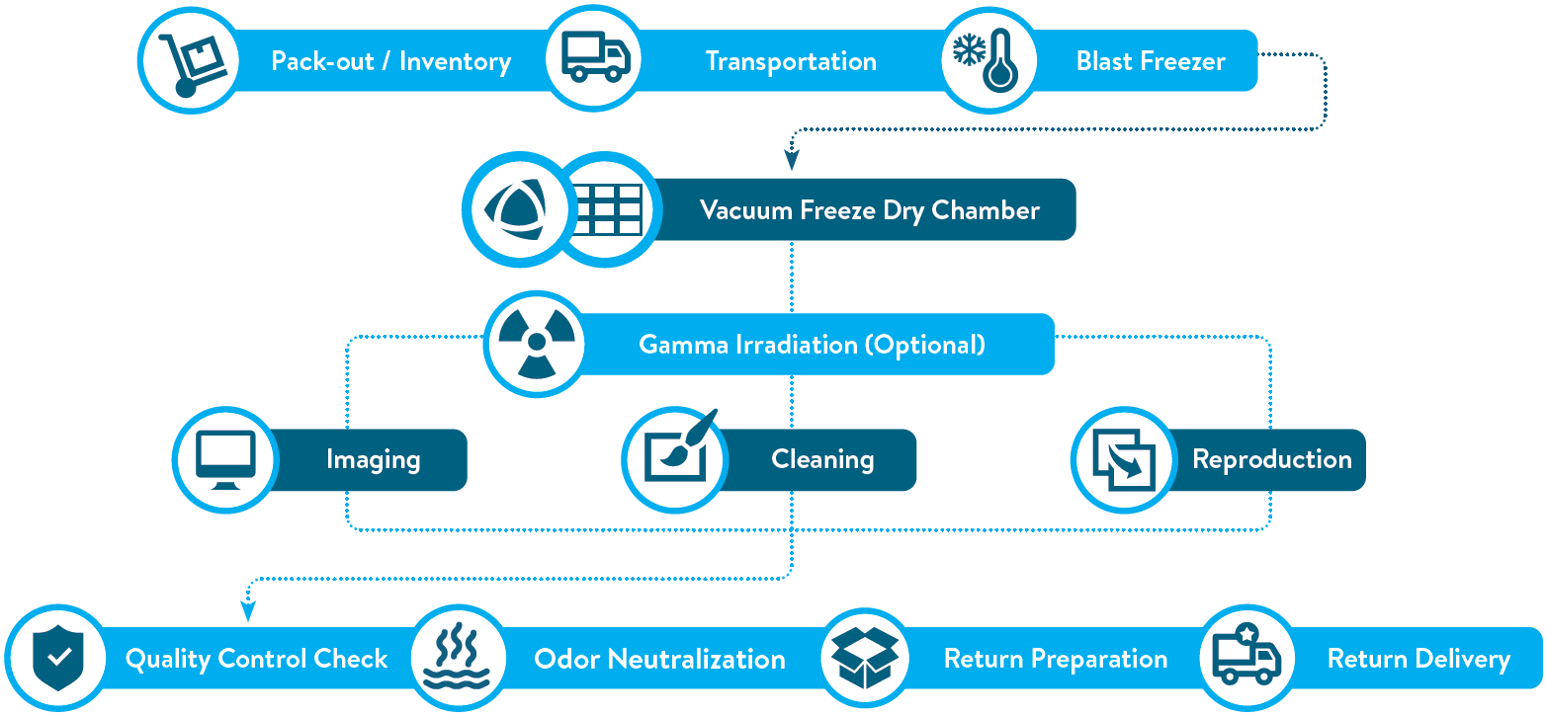
PROCESS
Click the icons to learn more
Pack-out / Inventory
Slide 8iiiiiiiiiiiiiiiiiiiiiii
Slide 10iiiiiiiiiiii
Slide 9iiiiiiiiiiiiiiiiiiiiiiiiiiiiiiiiiiiiiiiiiiiiiiiiii
Slide 11iiiiiiiiiiiiiiiiiiiiiiiiiiiiiiiiiiiiiiiii
Imaging
Slide 13iiiiiiiiiiiii
Slide 14iiiiiiiiiiii
Slide 16iiiiiiiiiiiiiiiiiiiiii
Slide 1 Odor Nlilli5
Slide 17iiiiiiiiiiiiiiiiiiii
Slide 18iiiiiiiiiiiiiii
SERVICE
PROCESS
RESULTS
CHAMBER
REGISTER

Slide 11
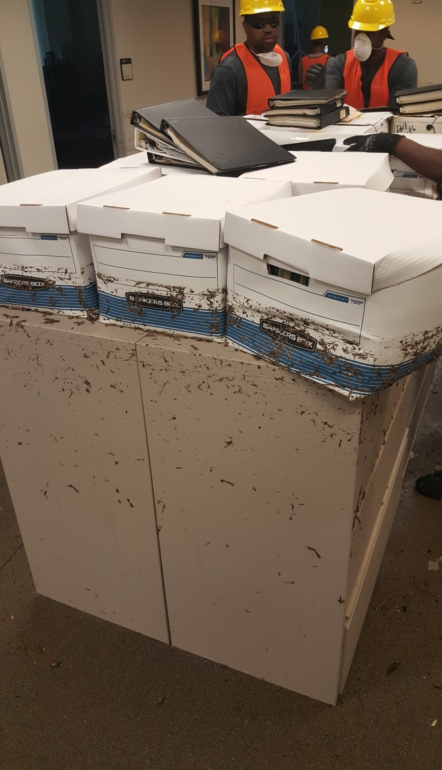
Recovery Process – Pack Out and Inventory
Creating an inventory and packaging damaged collections

Slide 12
Recovery Process – Pack Out and Inventory

Slide 13
Recovery Process – Pack Out and Inventory

Slide 14
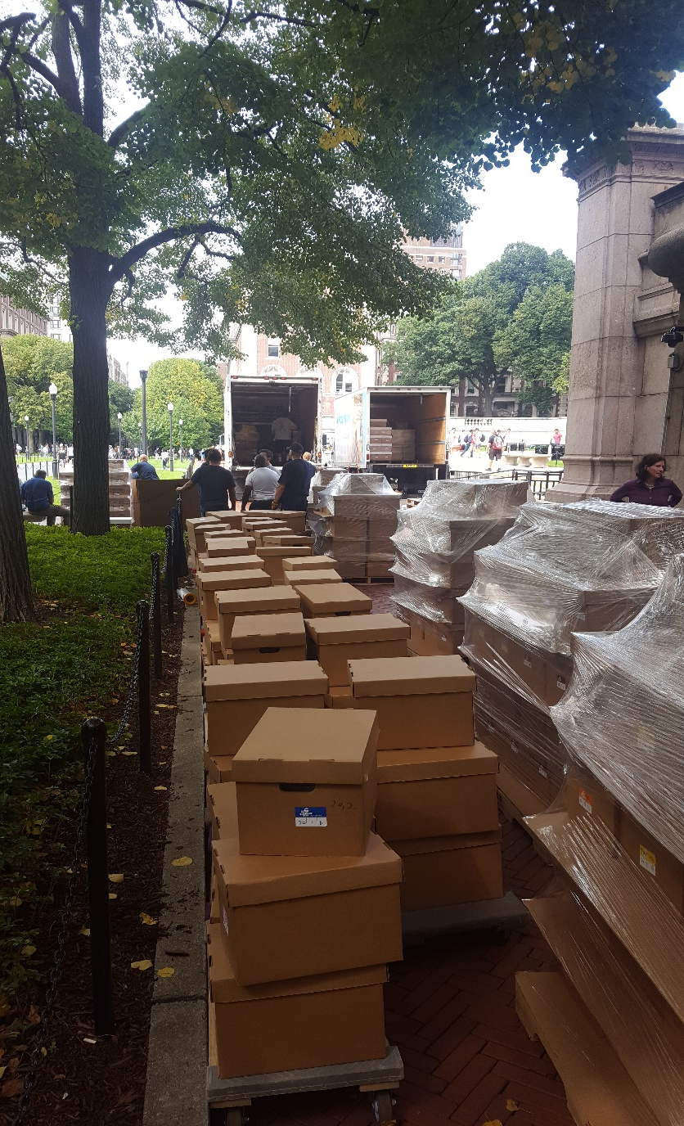
Recovery Process – Pack Out/Shipping

Slide 15
Recovery Process – Shipping

Slide 16
Recovery Process – Freezer Stabilization

Slide 17
Recovery Process – Drying

Slide 18
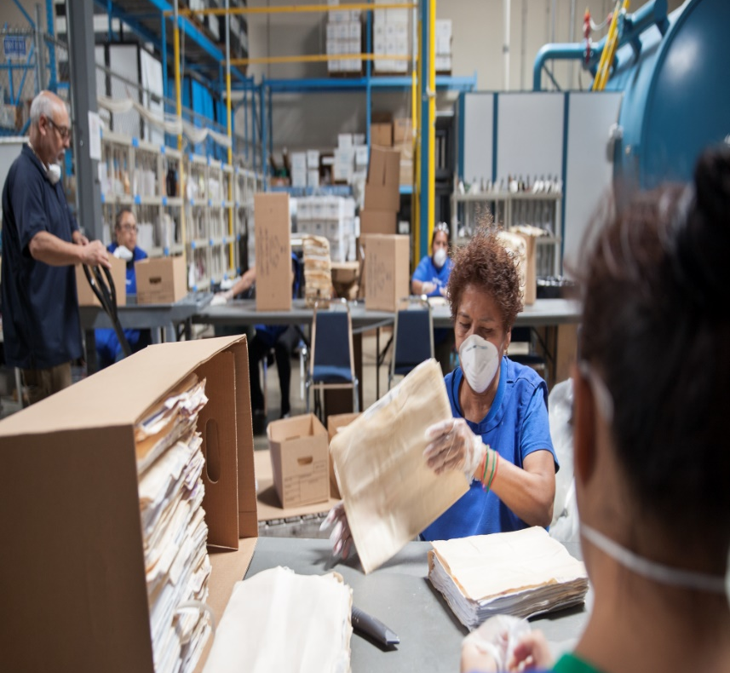
Recovery Process – Cleaning

Slide 19
Recovery Process – Secondary Services
Gamma Irradiation – Mold Remediation
Odor Neutralization
Disinfectant Fogging
Scanning, Digital Imaging
Destruction – Shredding, Incineration
Pest Eradication

Slide 20
Thank you!! Questions and Comments Maddie Cooper CCAHA mcooper@ccaha.org mcooper@mcccaha.org Matt DeCirce Polygon matt.decirce@polygongroup.com

