Slide 1
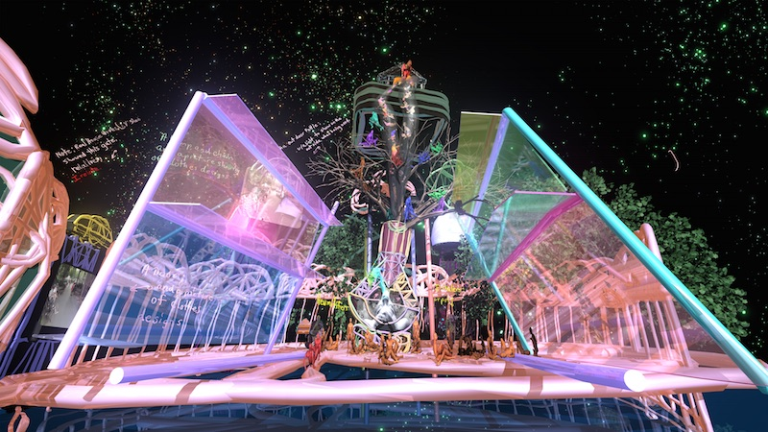
Jacolby Satterwhite
Reifying Desire 6: Island of Treasure, 2014

Slide 2
Porpentine Charity Heartscape, Neotenomie,
and Sloane
Psycho Nymph Exile, 2016

Slide 3
Zach Blas
Queer Technologies, 2010

Slide 4
The Magazine
Bookstore, San Francisco
Courtesy R. Rinehart

Slide 5
Amir Nikravan
Rep/Set 3, 2014

Slide 6
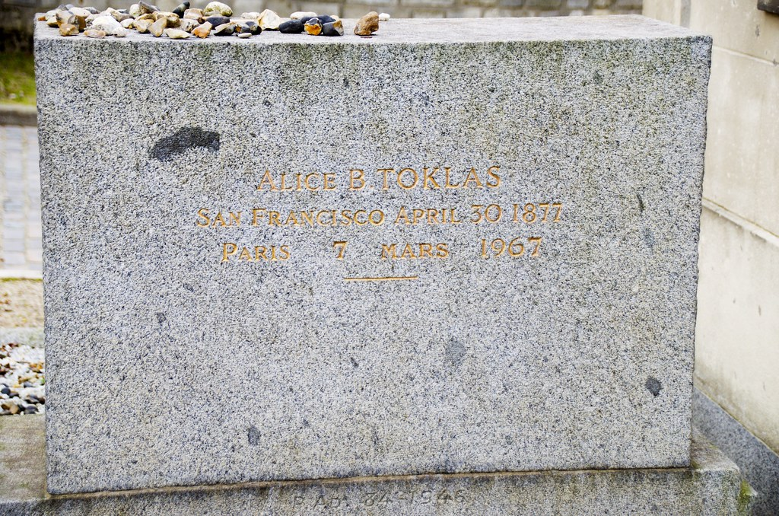
Stein / Toklas Tombstone
Père Lachaise cemetery, Paris
Courtesy jimread99, 2015

Slide 7
This has been….
Richard Rinehart
Director
Samek Art Museum, Bucknell University
r.rinehart@Bucknell.edu

