Slide 1
Succession Planning for Cultural Institutions: Pt. 3
Case Studies

Slide 2
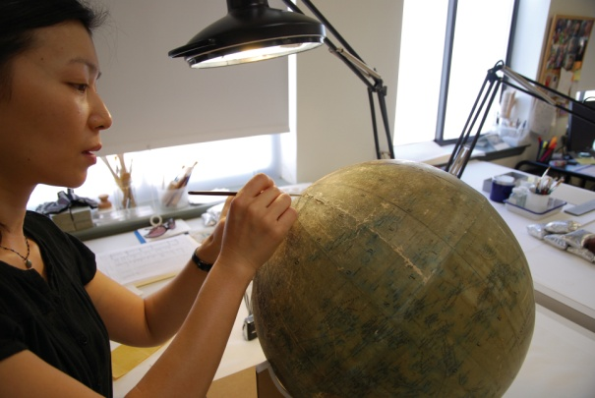
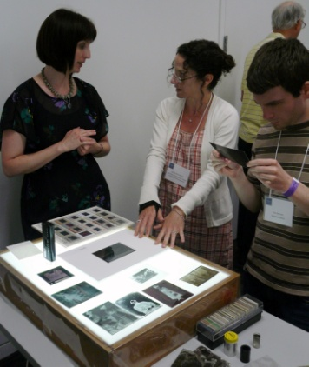
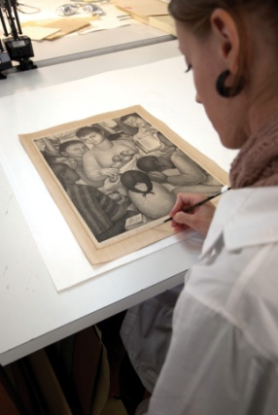
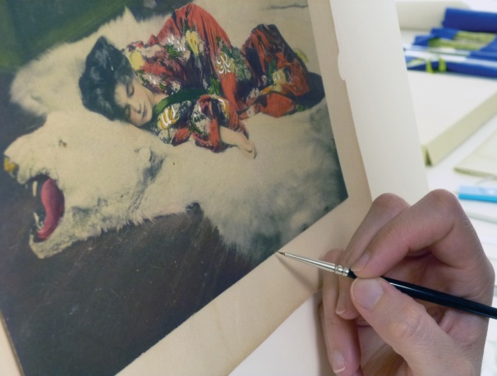
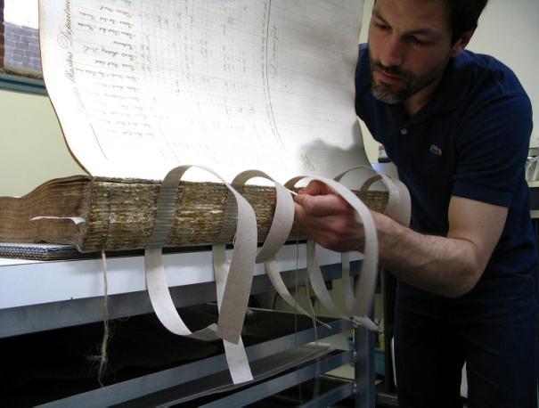
Conservation Center for Art & Historic Artifacts
In a typical year:
Preservation Services specialists complete over 50 survey projects.
Approximately 60 CCAHA-sponsored workshops, conferences, webinars, and training sessions are presented.
The Digital Imaging Services staff digitizes thousands of pages of fragile archival documents, books, and photographs.
Conservators assess and treat more than 6,000 individual artifacts, from over 400 clients.
Housing & Framing Services house approx. 75% of the artifacts treated (folder, sleeve, box, mat and frame, or sealed package).
Notes:
And one quick note about the organization I work for, the Conservation Center is a regional conservation lab and preservation services facility. We are based in Philadelphia, but we work with organizations and clients all across the country. Our conservators treat paper-based objects like books, photographs, documents, artwork on paper, and more. Our preservation services staff work in the field, providing education programs and helping institutions plan for the future of their collections.
As a preventive conservator, I work with both the conservation department and the preservation department to support preventive conservation projects and teaching. CCAHA also offers a wide range of digitization services, as well as fundraising assistance, housing and framing, and more. You can learn more about us and what we do at our website, ccaha.org.

Slide 3
Succession Planning Case Study
Chorus America:
Catherine Dehoney, President and CEO

Slide 4
Vision
Chorus America envisions a vibrant society in which diverse singing communities affirm and share the full range and depth of our humanity.
Mission
Chorus America strengthens singing communities with the advocacy, connections, and resources they need to be a vital part of society.

Slide 5
Succession Candidates and High Potentials | Succession Candidates and High Potentials | Succession Candidates and High Potentials | Succession Candidates and High Potentials | Succession Candidates and High Potentials
 | Succession Candidates Ready In: | Succession Candidates Ready In: | Succession Candidates Ready In: | Succession Candidates Ready In:
Position | Incumbent | Ready Now | 1-2 years | 2+ years
Planning tools & templates: [links]
Names of professional search firms & consultants
Names of peer organizations to consult, share job announcement
Places to post job announcement (espec. to attract diverse lived experience)
Names of potential candidates (confidential list)

Slide 6
Succession Plan Components
Part I: Start of the Process Questions for Discussion (page 8)
Note the “Ever-green Succession Readiness Questions,” which the Board/Exec Committee/CEO should periodically review (page 7)
Part II: Draft Timeline for Hiring Process
Part III: Updated Job Description - Exec. Co. to discuss:
The top 3 – 5 Strategic Plan Objectives that fall to Executive leadership
Competencies, expertise, and experience required
Desired leadership style (and traits to avoid)

Slide 7
Plan Components Con’t
Part IV: Communications Plan
Who/What/When (internal and external)
Part V: Key Stakeholders List for phased communications
Part VI: Interim Executive Job Description
i.e. key responsibilities and limitations

Slide 9
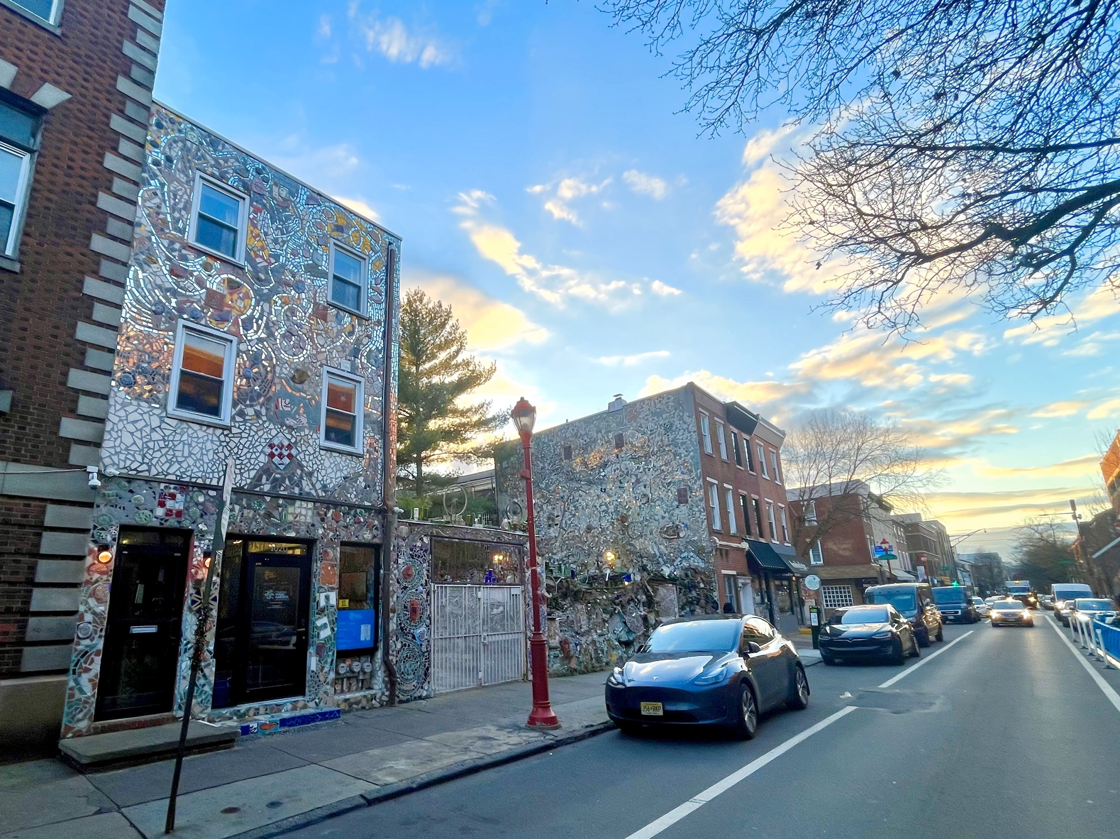
PMG facade
Succession Planning with a Living Artist

Slide 10
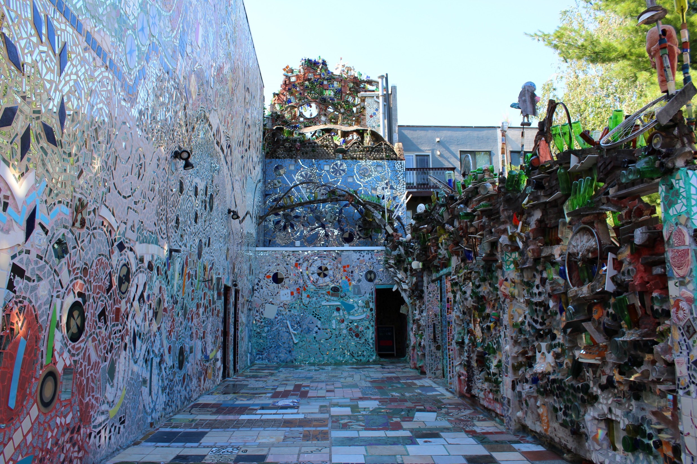
Inside

Slide 12
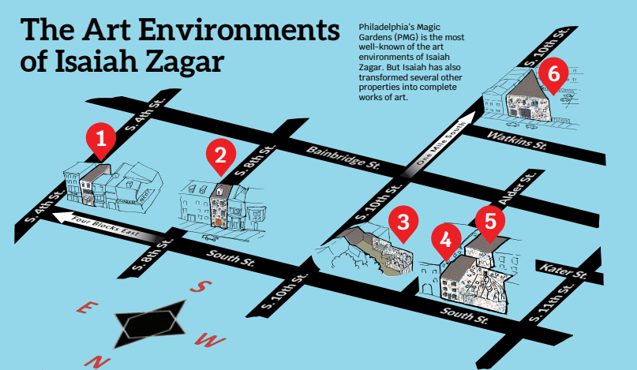

Slide 13
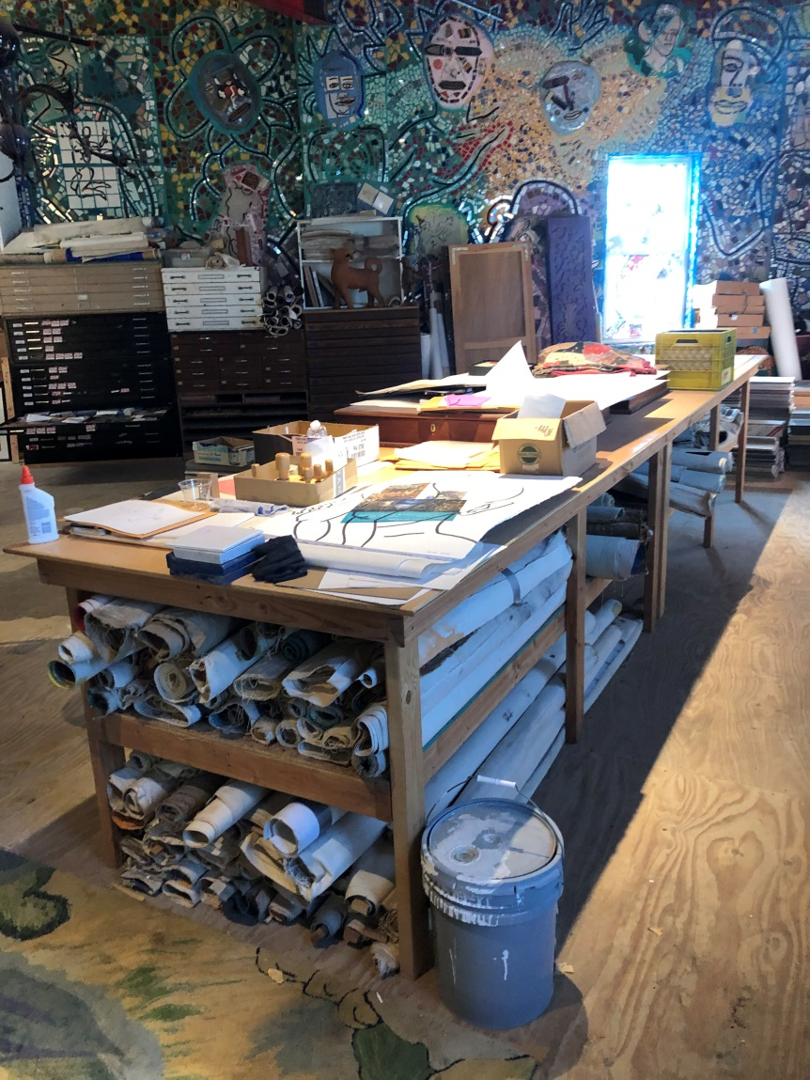
More than 200 public mosaics in Philadelphia
100s of thousands of pieces of individual artworks, photographs, drawings, sketchbooks,
mosaics, etc.

Slide 14
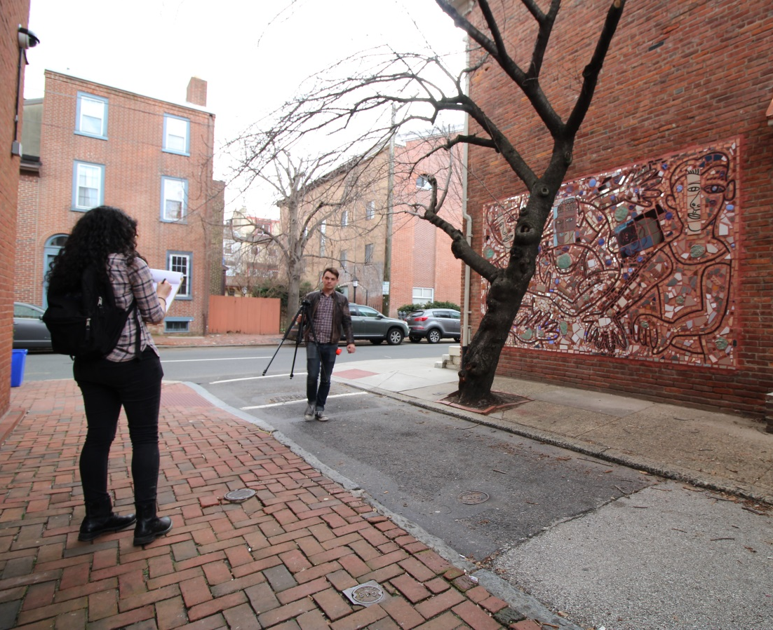
1. Observing & Understanding
Listening
Absorbing
Being non-judgmental
DOCUMENTING!!
(as is)
Photos
Video
Learning about archival objects

Slide 15
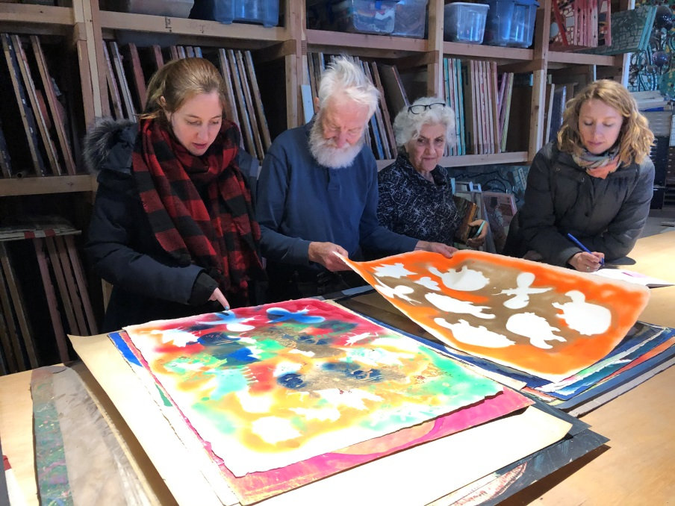
2. Investigating & Training
Asking questions & diving deeper
Interviews with historic stakeholders
Founders (artists, board members, directors, staff)
Lawyers, community members
During key moments (current)
Hands-on training from those with more experience or institutional knowledge(Founders, consultants)
Organizing if needed
Archival materials stored safely? Digitized? Can other people understand systems in place?
DOCUMENT EVERYTHING!!!!

Slide 16
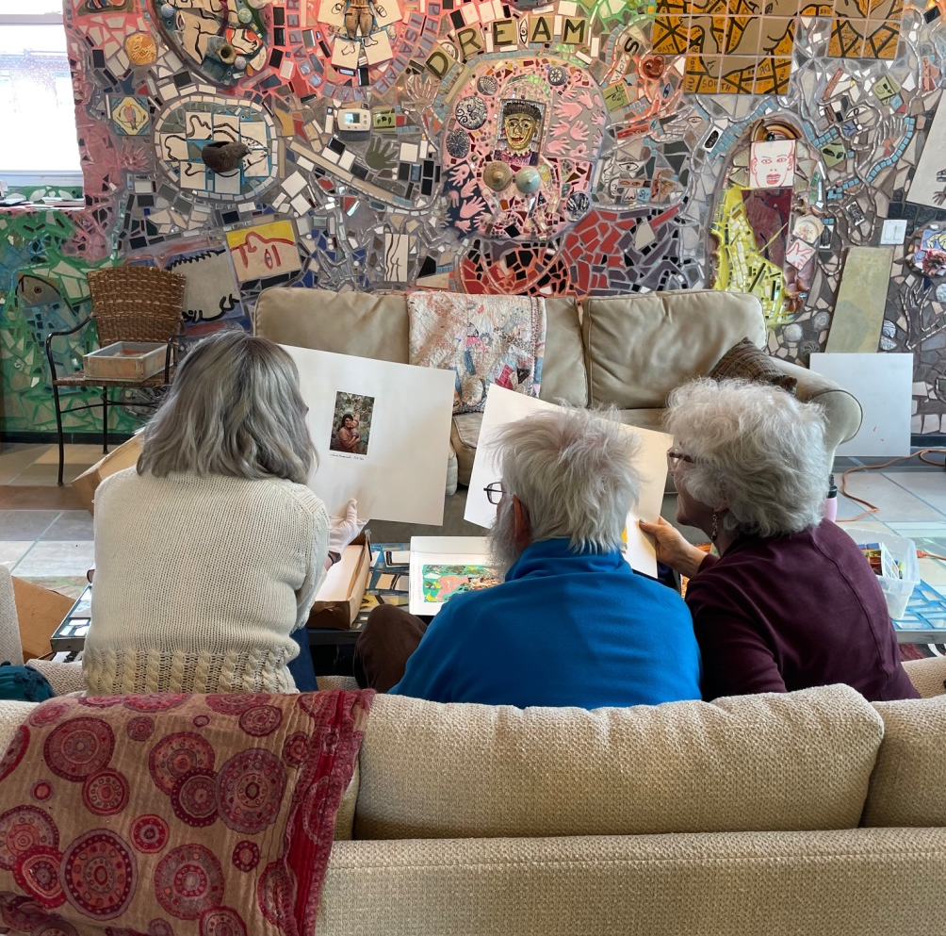
3. Dreaming & Building Trust
Dream about the future
What do the stakeholders envision (realistic or not)?
Create the world you want to see
Write it down & get legal assistance if needed
Allow for shifting ideas over time just….
DOCUMENT EVERYTHING!!!!!!!!!!!

Slide 17
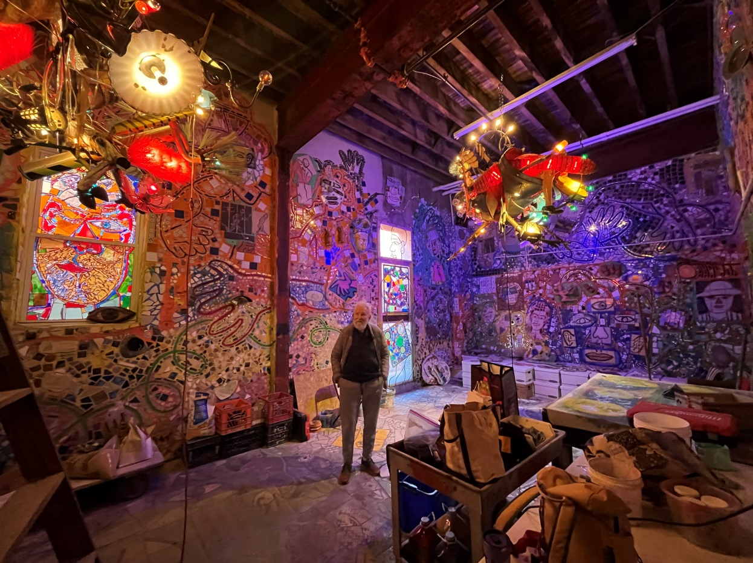
4. Keeping Your Word
Honor the work & original vision
What were the dreams and promises made?
Make good on your plans
Work with community for positive outcomes
KEEP DOCUMENTING!!!

