Slide 1
Emergency Planning Roundtable

Slide 2
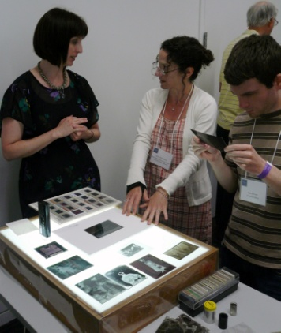
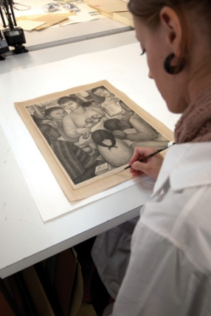
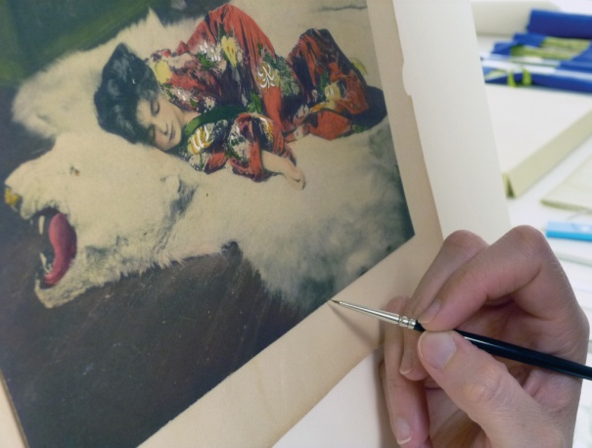
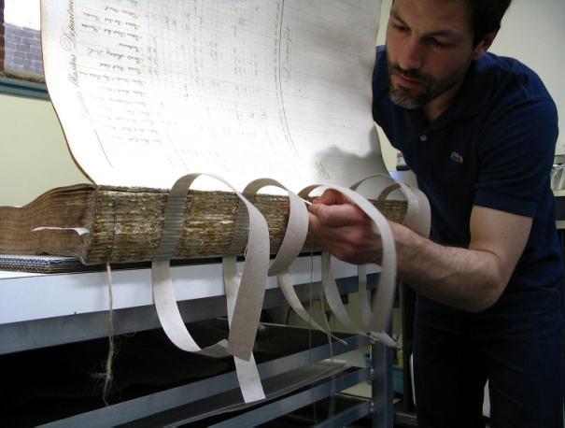
Conservation Center for Art & Historic Artifacts
In a typical year:
Preservation Services specialists complete over 50 survey projects.
Approximately 60 CCAHA-sponsored workshops, conferences, webinars, and training sessions are presented.
The Digital Imaging Services staff digitizes thousands of pages of fragile archival documents, books, and photographs.
Conservators assess and treat more than 6,000 individual artifacts, from over 400 clients.
Housing & Framing Services house approx. 75% of the artifacts treated (folder, sleeve, box, mat and frame, or sealed package).
Notes:
And one quick note about the organization I work for, the Conservation Center is a regional conservation lab and preservation services facility. We are based in Philadelphia, but we work with organizations and clients all across the country. Our conservators treat paper-based objects like books, photographs, documents, artwork on paper, and more. Our preservation services staff work in the field, providing education programs and helping institutions plan for the future of their collections.
As a preventive conservator, I work with both the conservation department and the preservation department to support preventive conservation projects and teaching. CCAHA also offers a wide range of digitization services, as well as fundraising assistance, housing and framing, and more. You can learn more about us and what we do at our website, ccaha.org.

Slide 3
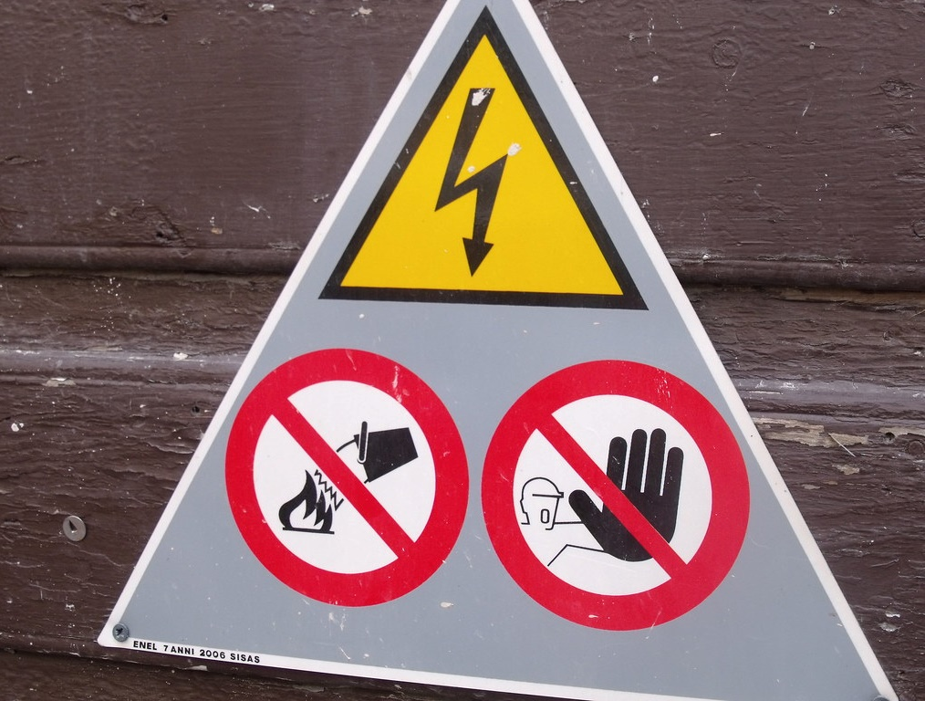
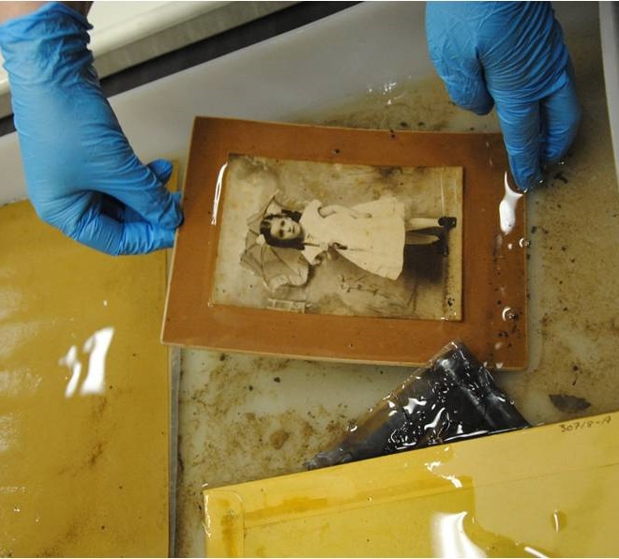
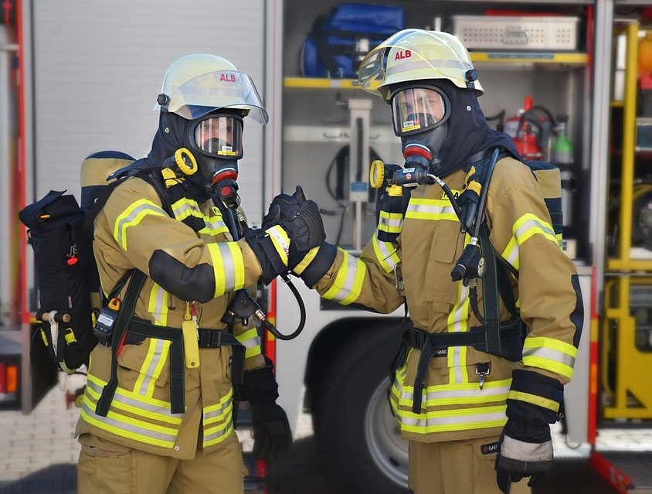
Collections Emergency Management Cycle
Risk Assessment
Planning
Response
Recovery
Image by pixabay via pixabay license
Image courtesy of the Washington Conservation Guild

Slide 4
Risk Assessment
Identify hazards and risk factors
Evaluate the risks associated with those hazards
Determine ways to eliminate the hazard, or control the risk when the hazard cannot be eliminated
Notes:
If we start at the top of the cycle, we’re starting at risk assessment, which is the systematic process by which we examine issues - from flash flooding to the leaky roof - and then determine a game plan. With risk assessment, we are answering the question: What is there in our systems, collection, building, and geographic area that could cause damage?
The ideal outcome of a risk assessment is to come up with methods to either eliminate or mitigate, or make less severe, the risks that you identify.

Slide 5
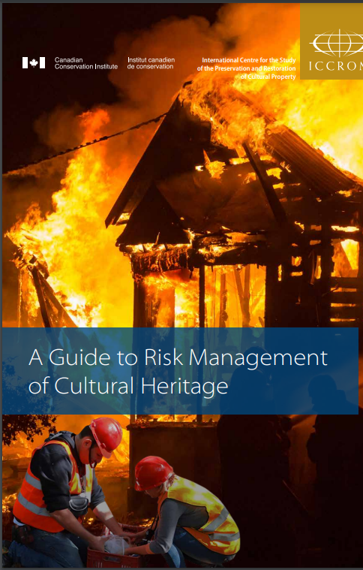
Where to Start
Methods
Internal assessment
External Assessor
Models
Heritage Preservation’s Risk Evaluation and Planning Program: https://www.culturalheritage.org/resources/emergencies/risk-evaluation-and-planning-program
The National Parks Service’s Fillable Risk Assessment Worksheet: https://www.nps.gov/museum/publications/MHI/Fillable_Risk_Assessment_Worksheet.pdf
ICCROM and CCI’s Guide to Risk Management of Cultural Heritage: https://www.iccrom.org/publication/guide-risk-management
Notes:
There are a few different ways to approach a risk assessment. It can be done internally or with the help of an external assessor. There are also several different models for risk assessment, that help us do it in a semi-quantitative way. At the Conservation Center, we use a version of the ABC Method of Risk Assessment; the workbook that covers this method is pictured here, and despite the intimidating cover image, it’s a really user-friendly and approachable workbook that is freely available online.

Slide 6
Conducting a Risk Assessment
Location
Facilities
Notes:
There are a number of ways you can begin to think about risks, but I find it’s often helpful to divide potential risks into categories. Broadly, there are two main categories that risks that can fall into: Location and Facilities, and then there can be sub-categories within those.
Risks that may be associated with location could include the obvious, like flood hazard, or something less immediately obvious. For example, if you have to cross train tracks to access the facility, that may affect the response time of local first responders.
Risks based on the facilities are often more maintenance issues, like a leaky roof or faulty electrical wiring - things I am sure you all are very used to dealing with.

Slide 7
Gathering Data
Internal Sources
External Sources
Policies & procedures
Facilities information
Storage & display practices
Emergency event history
Natural disasters
FEMA National Risk Index
Manmade disasters
State and local hazard mitigation plans
Climate Resilience
FAIC’s Climate Resilience Resources for Cultural Heritage
Notes:
Risks to collections can originate either internally or externally. To identify those internal risks, you’ll want to assess policies and procedures, information about the facilities, storage and display practices, and crucially- emergency event history.
External risks include natural and manmade disaster history and probability. I really love the FEMA national risk index, which is a tool that assesses the risk of 18 natural hazards to every county and census tract in the US and territories.
I also recommend reading state, county, and local hazard mitigation plans. States and counties are required to have hazard mitigation plans to receive certain types of federal emergency assistance, so they are pretty common and largely freely available online. These plans often include detailed event histories and are good measures of the risk of manmade disasters like attacks.

Slide 8
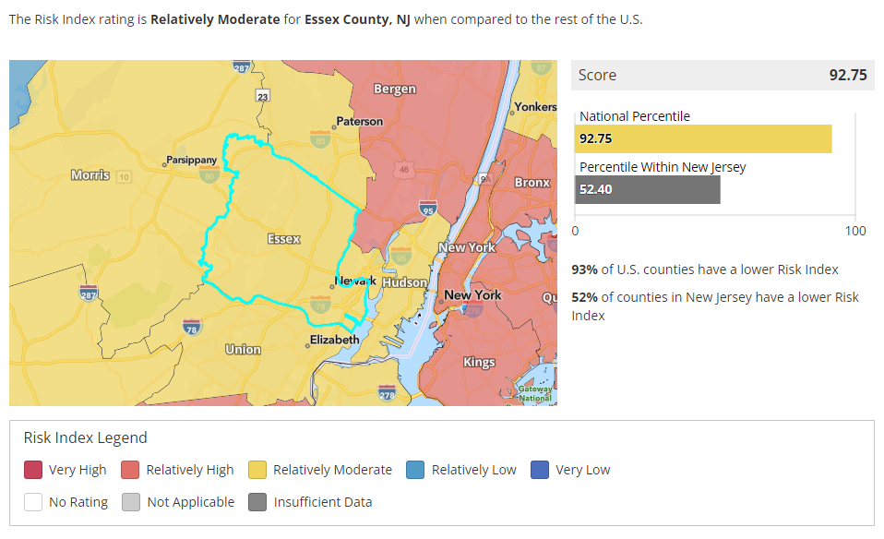
National Risk Index
Notes:
Let’s take a look at Essex County in the National Risk Index. According to FEMA, Essex County has an overall Risk Index Score that is higher than 93% of U.S. Counties. – this really emphasizes the need for emergency planning in your organizations. You may be located in a high risk area, but there are steps you can take to mitigate that risk.
Let’s consider the individual hazards that we are looking at in Essex County

Slide 9
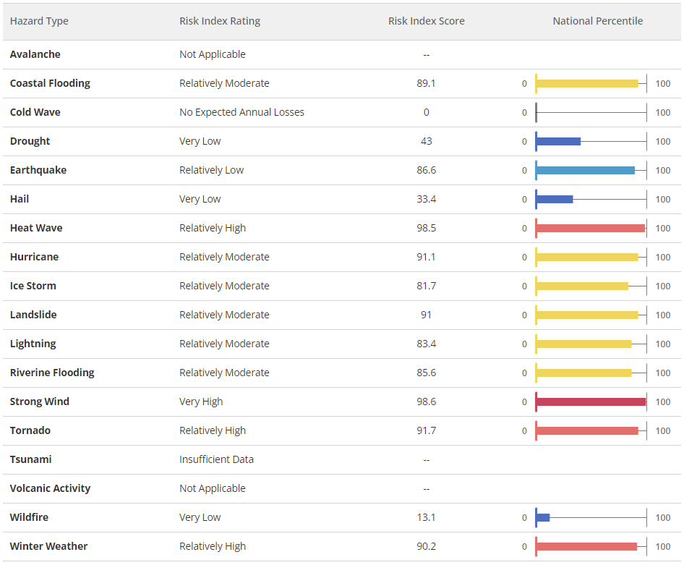
National Risk Index
Notes:
This table includes all the natural hazards that the NRI looks at. Relative to the rest of the country, the risk of Strong Wind, Heat Wave, Tornado, and Winter Weather are high. What does that mean for us in terms of emergency planning for cultural organizations?
Well, a heat wave may put a lot of stress on HVAC systems and lead to an increased risk of condensation and leaks.
If strong wind and tornado is an issue, are we making sure to do responsible landscaping- making sure to remove dead trees and trim branches close to the building? Do we have a designated place in the building to go in case of a tornado warning?
If the risk of winter weather is high, are we taking steps to take care of the roof? Is there a plan for snow removal?
These are the types of questions that these location-specific risk tools can help us generate.
It’s important to keep in mind that the NRI is national, and so it gives us a general idea of the hazards that may affect a place, but it’s good practice to consider risk assessments on a smaller, more local scale as well.

Slide 10
Essex County Hazard Mitigation Plan 2020
Natural Hazards of Concern
Human-Caused Hazards of Concern
Coastal erosion and sea level rise
Coastal storm
Drought
Earthquake
Extreme temperature
Flood
Geological Hazards
Severe Weather
Wildfire
Civil disorder
Cyber attack
Disease outbreak
Economic collapse
Hazardous substances
Terrorism
Transportation failure
Utility interruption
Notes:
A quick google will lead you to the Essex County Hazard Mitigation Plan, which was last updated in 2020. The county did its own risk assessment, and these are the natural and manmade hazards that the County is concerned about. In addition to having information about natural hazards that is more closely related to this particular area of NJ, the assessment also looks at the risk of human-caused hazards.
This list is a good starting place for you as you consider the risks to your organization.

Slide 11
Emergency Preparedness and Response: the Digital Context
https://bit.ly/DigiPresQuiz

Slide 12
Building Resilience Training Toolkit: Disaster Risk Management for Documentary Heritage and Digital Archives
https://unesdoc.unesco.org/ark:/48223/pf0000391132

Slide 13
Emergency Preparedness for Digital Collections
Risk assessment
Collection policies
Storage management
Community involvement
Digital preservation
Climate change

Slide 14
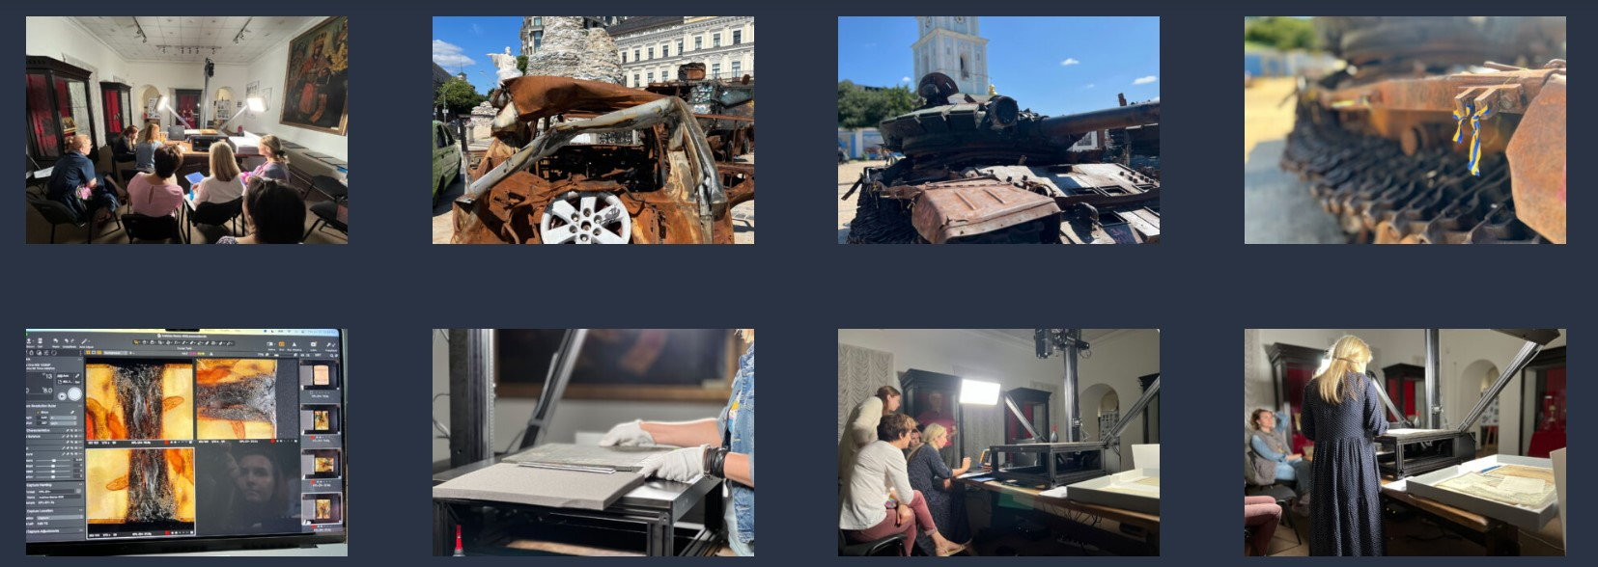
Digitization as Emergency Response: Ukraine
https://gallery.sucho.org/
https://heritage-digitaltransitions.com/ukraine-digitization-project/

Slide 15
Digital Collections and Climate Change
“Environmentally Sustainable Digital Preservation” https://www.dpconline.org/digipres/discover-good-practice/environmentally-sustainable-digital-preservation
“Climate Change Means Change: Long-term Planning for Long-term Digital Preservation” https://www.cni.org/topics/digital-curation/climate-change-means-change-long-term-planning-for-long-term-digital-preservation
“Energy, Digital Preservation, and the Climate: Proactively Planning for an Uncertain Future” https://ipres2024.pubpub.org/pub/1sm257xx/release/2

Slide 16
The Best Laid Plans… A Case Study Analysis

Slide 17
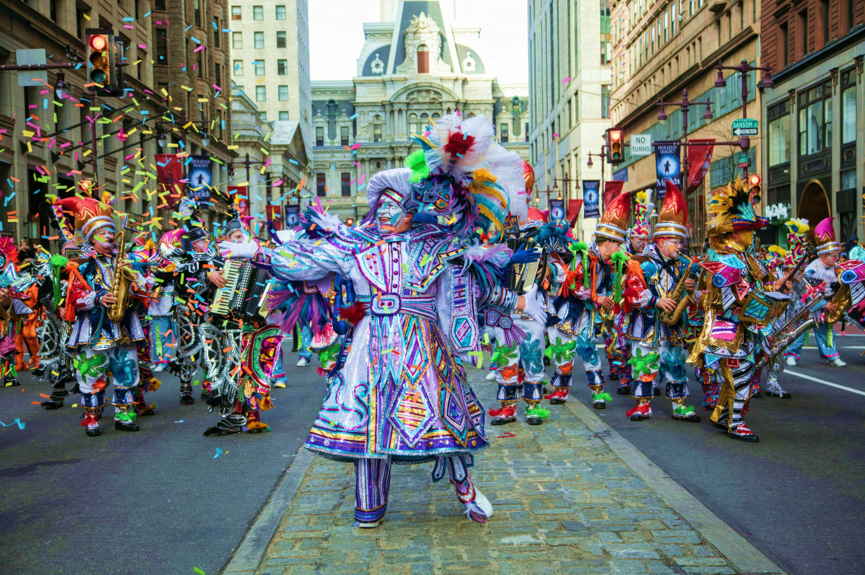
The Mummers Museum

Slide 18
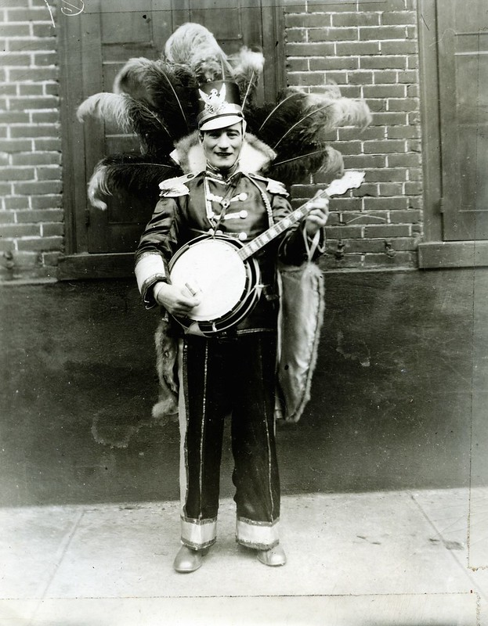
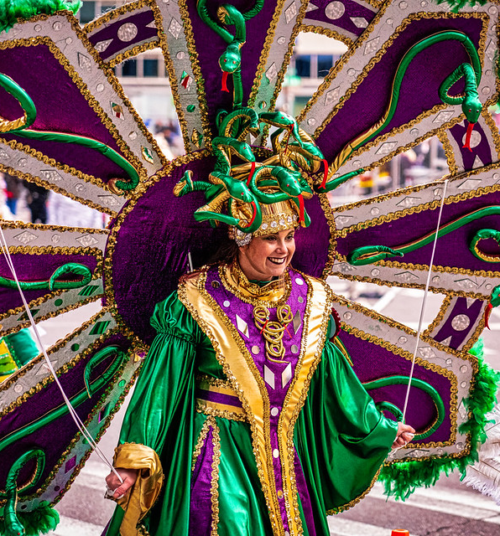
The Mummers Museum
A mid-sized museum in South Philadelphia, celebrating and interpreting the history of Mummery in the city. Collections are very focused on costumes (you can see why!)

Slide 19
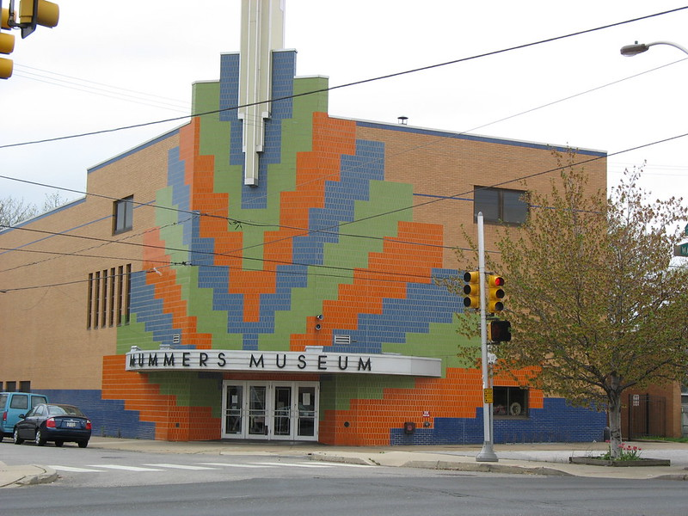
Risks & Disaster History
History of leaks in storage & exhibit areas
History of mold development
Flat roof, failing brick pointing
“relatively high” NRI rating
The event
Pooling water from leaky A/C unit on the roof
Leaked into The Library
Mold as a secondary issue

Slide 20
The Cycle
Preparedness
Recently completed first Emergency Plan
Response
Objects relocated
Recovery
Contacted CCAHA
Planned Mitigation
Emergency supplies on hand
No salvage priorities or staff training
Disposal of mold-affected items
Costumes placed outside to dry
Object stabilization
Began roof replacement plans
Began A/C replacement plans
Faulty unit switched off
Replace roof & flooring
Install HVAC
Identify salvage priorities
Identify safe salvage areas
Paint Library roof
Install water sensors & begin regular walkthroughs
Identify methods for immediate salvage & recovery (PReP)

Slide 21
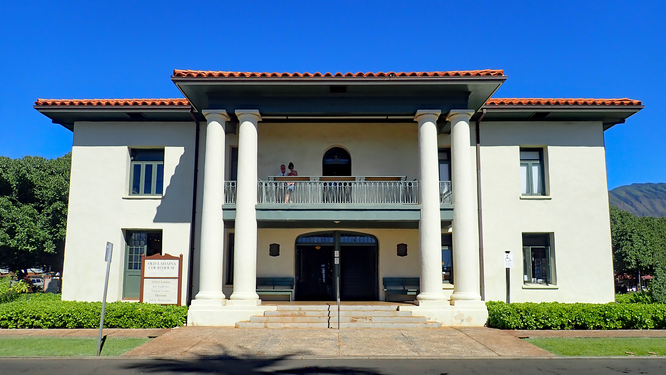
Lahaina Restoration Foundation

Slide 22
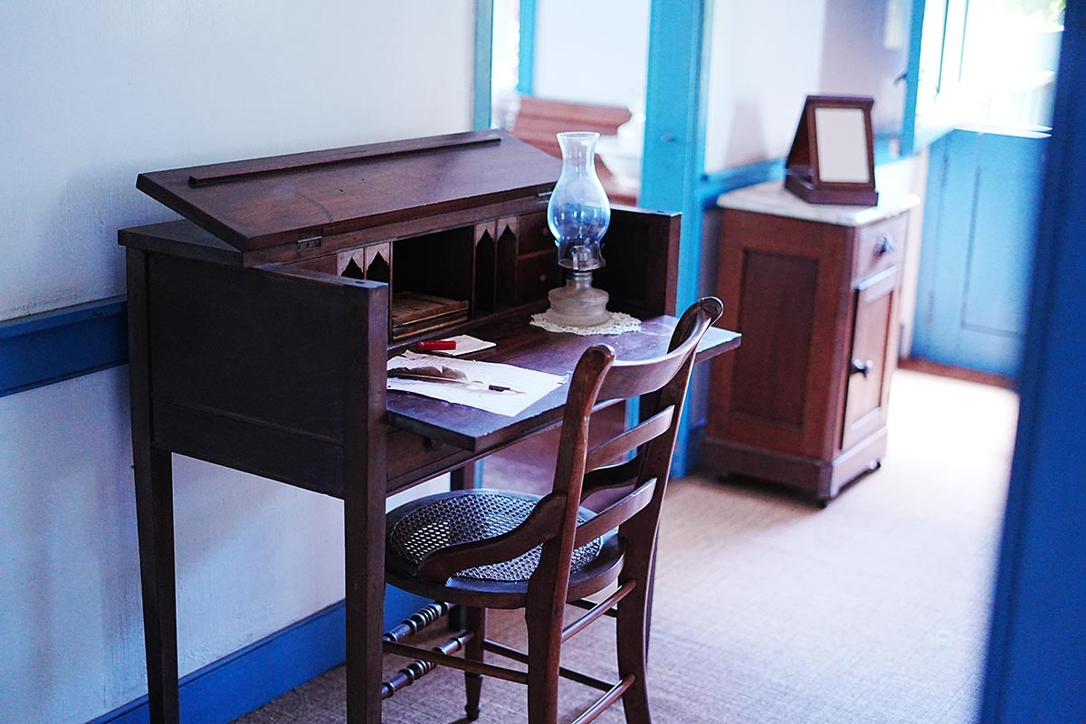
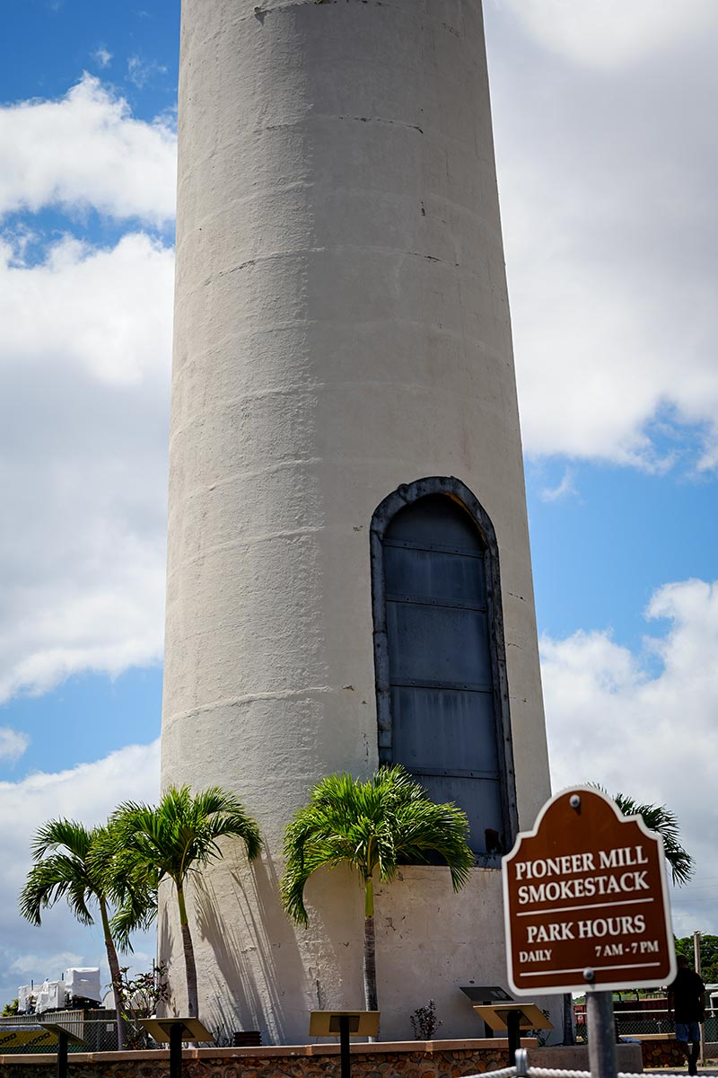
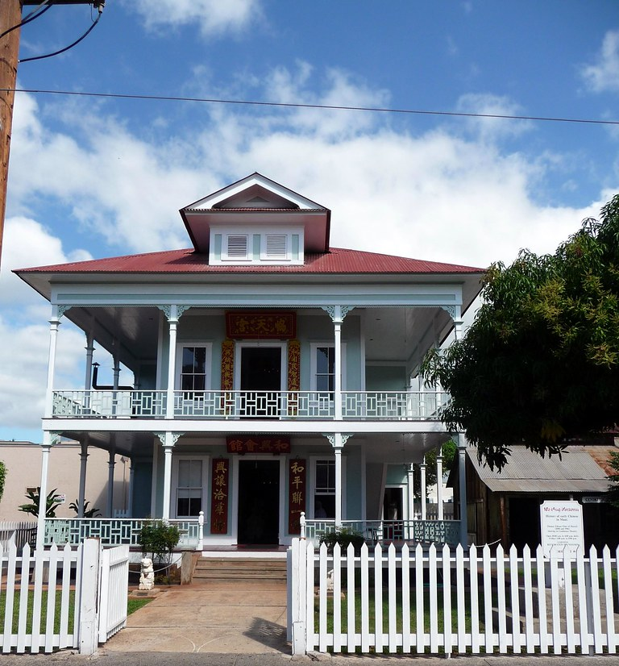
The Foundation
Chartered in 1962, the foundation cares for and interprets Lahaina’s places of historic and cultural heritage. Site type and collections were/are extremely diverse.

Slide 23
The Event

Slide 24
Lessons Learned
“My memory is nowhere near as good as I think it is.”
What’s your wallpaper?
Think like a reluctant insurance adjustor
Inventory is not limited to your collections
Off-site means off-site
Record items that may seem unusual for your organization to own
Images = fundraising power
Photograph and/or video everything FOR APPRAISALS AND CLAIMS
Follow a path: anchor image --? side → zoom for detail → side → zoom for detail → anchor image
Update after big changes/purchases or annually
Establish consistent file naming conventions
Training takes time
Community = quick and effective progress

Slide 25
The Hard Questions
What happens if we lose an essential element of our mission?
What would a staffing restructure look like? What staff positions be pivoted or adjusted?
How might a large-scale disaster change what our institution is capable of?

Slide 26
Lahaina Recovery

Slide 27
Wrapping Up
Knowledge is power → Know your collection, your resources, and your first, second, and third backup plans. Be thorough!
Take small steps, and don’t panic/you’re not behind → Accept that this work is cyclical and ongoing; you will always be learning new things, and sometimes that knowledge will come as the result of an incident.
All systems have space for improvement…and just because something can be improved doesn’t mean it’s bad/wrong/insufficient -→ Don’t be afraid to just start with the basics and improve over time. Don’t let perfectionism stop you from taking any action at all.

