Slide 1
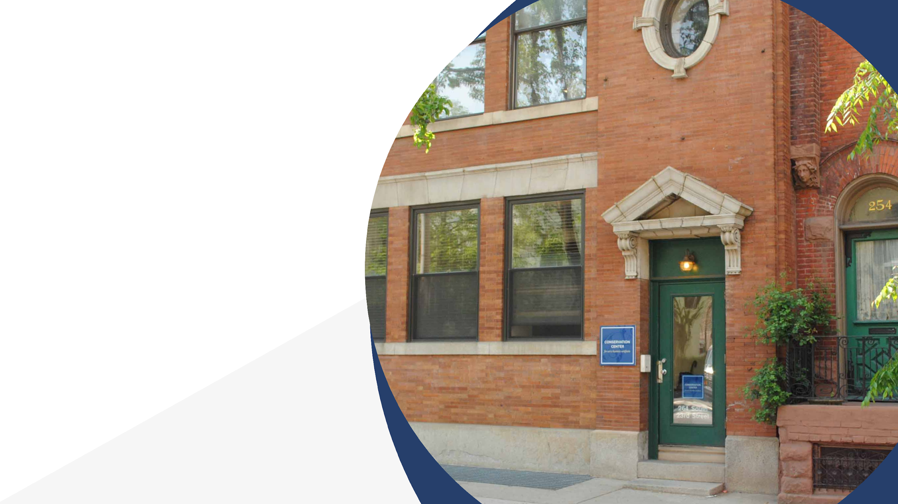

Paper and Memory with the People’s Paper Co-op

Slide 2
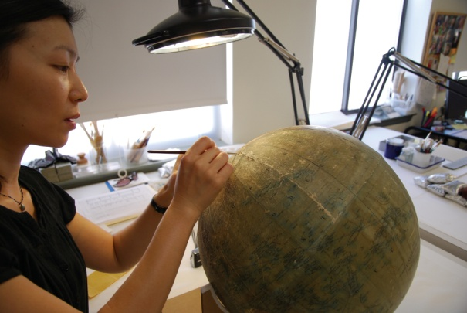
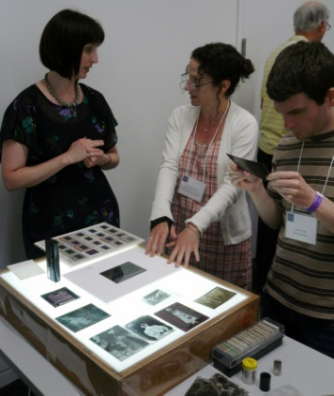
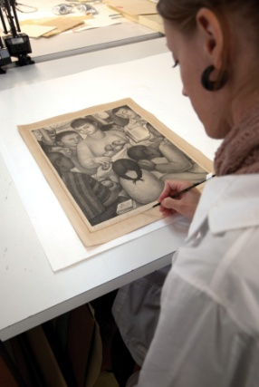
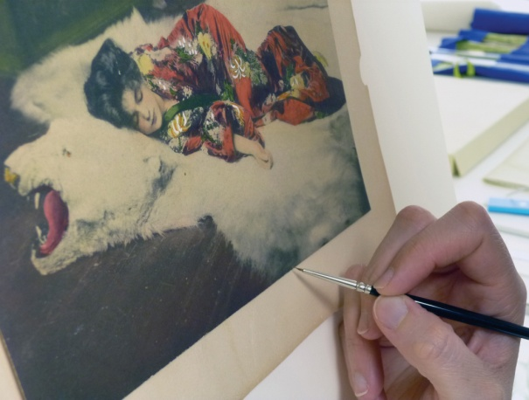
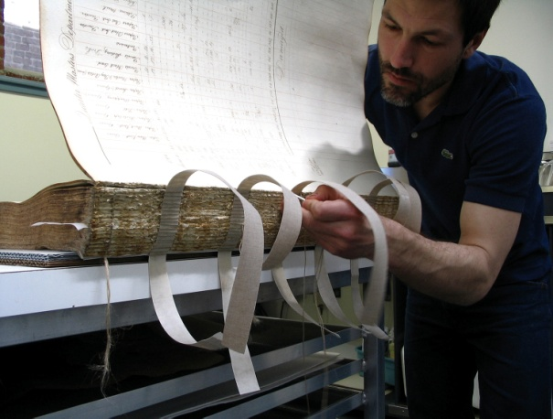
Conservation Center for Art & Historic Artifacts
In a typical year:
Preservation Services specialists complete over 50 survey projects.
Approximately 60 CCAHA-sponsored workshops, conferences, webinars, and training sessions are presented.
The Digital Imaging Services staff digitizes thousands of pages
of fragile archival documents, books, and photographs.
Conservators assess and treat more than 6,000 individual
artifacts, from over 400 clients.
Housing & Framing Services house approx. 75% of the artifacts treated (folder, sleeve, box, mat and frame, or sealed package).
Notes:
And one quick note about the organization I work for, the Conservation Center is a regional conservation lab and preservation services facility. We are based in Philadelphia, but we work with organizations and clients all across the country. Our conservators treat paper-based objects like books, photographs, documents, artwork on paper, and more. Our preservation services staff work in the field, providing education programs and helping institutions plan for the future of their collections.
As a preventive conservator, I work with both the conservation department and the preservation department to support preventive conservation projects and teaching. CCAHA also offers a wide range of digitization services, as well as fundraising assistance, housing and framing, and more. You can learn more about us and what we do at our website, ccaha.org.

Slide 3
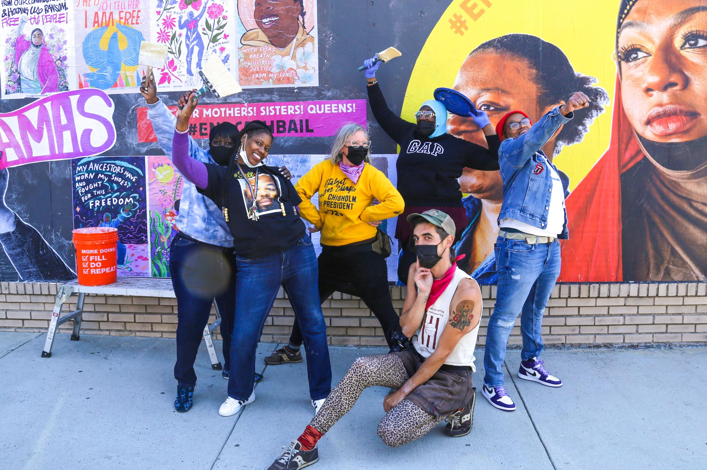
THE PEOPLE’S PAPER CO-OP

Slide 4
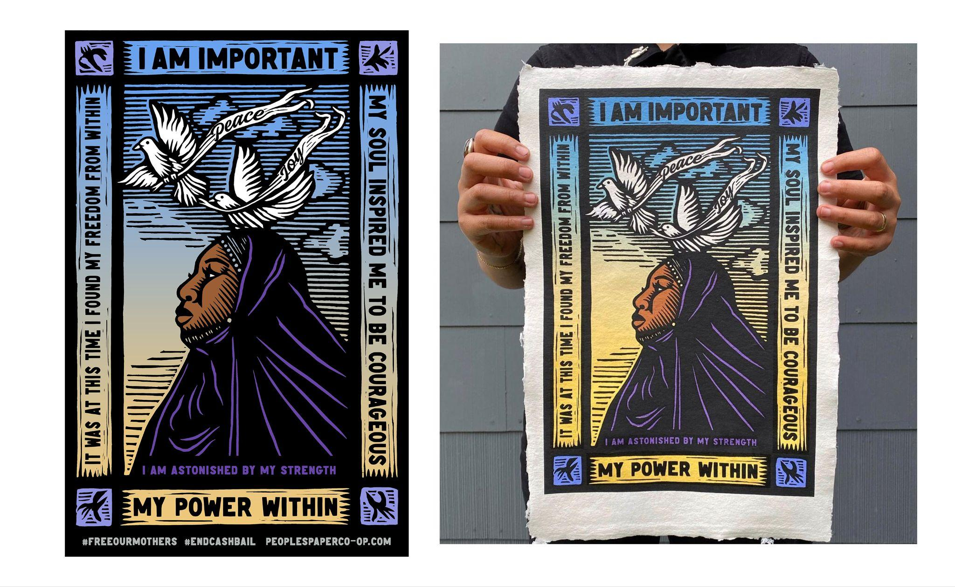
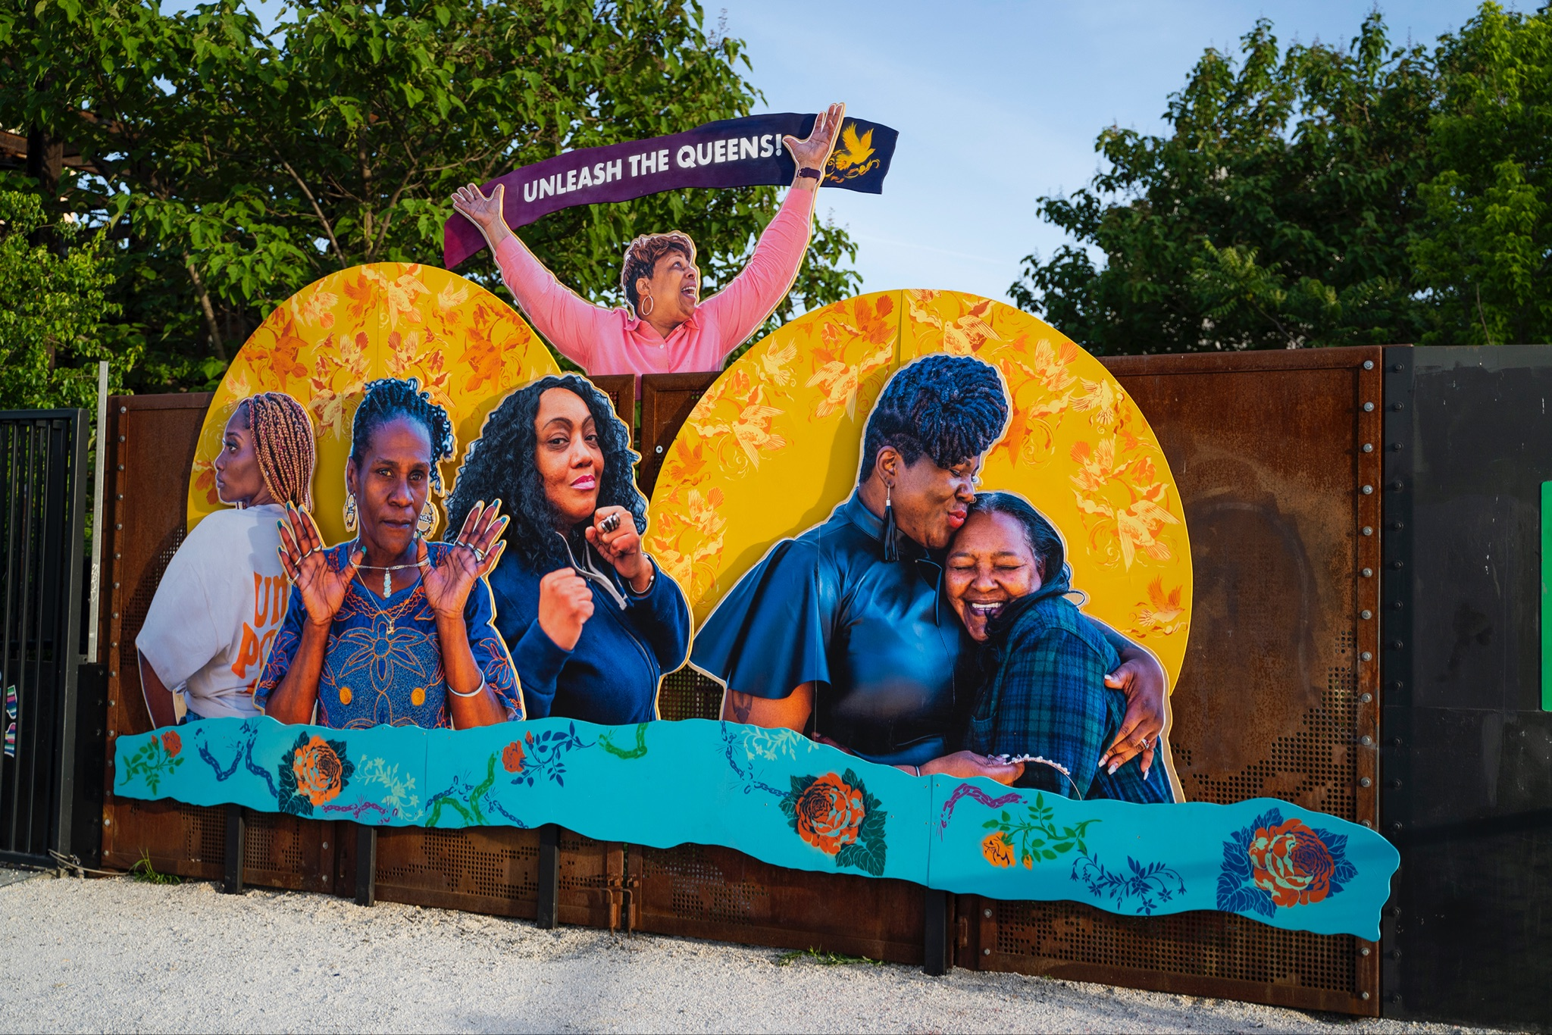

Slide 5
“Remember to imagine and craft the worlds you cannot live without, just as you dismantle the ones you cannot live within.”
- Ruha Benjamin

Slide 6
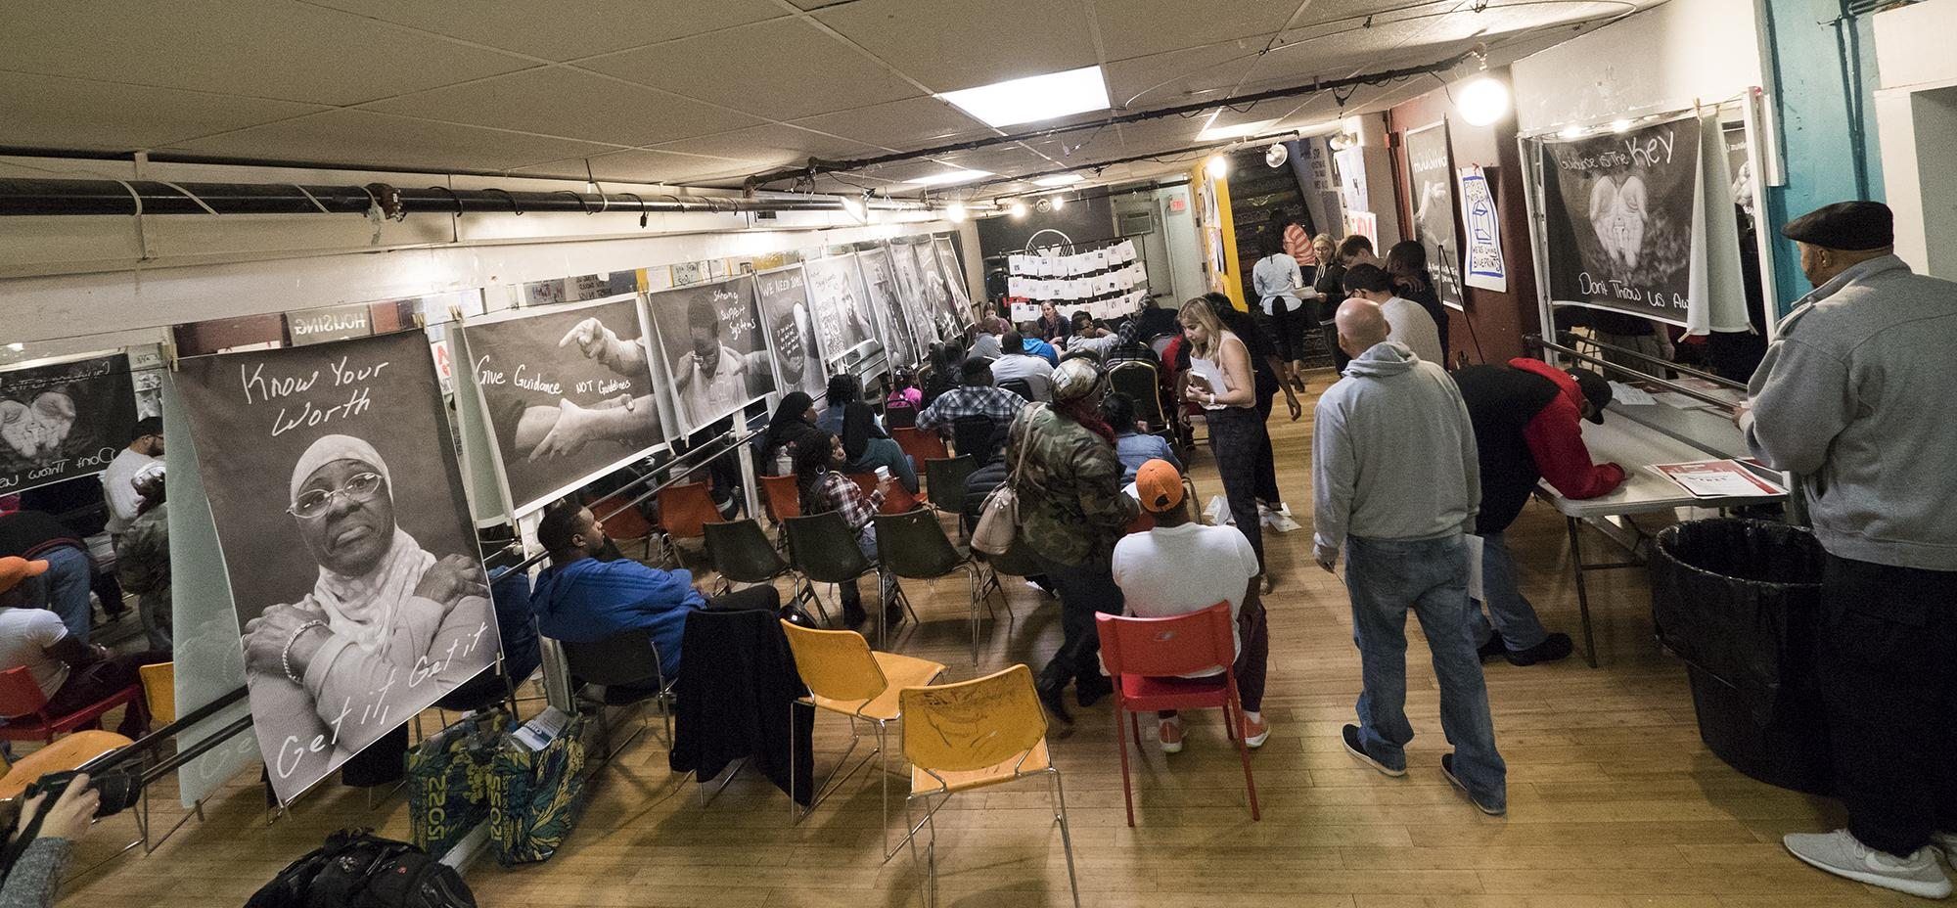

Slide 7
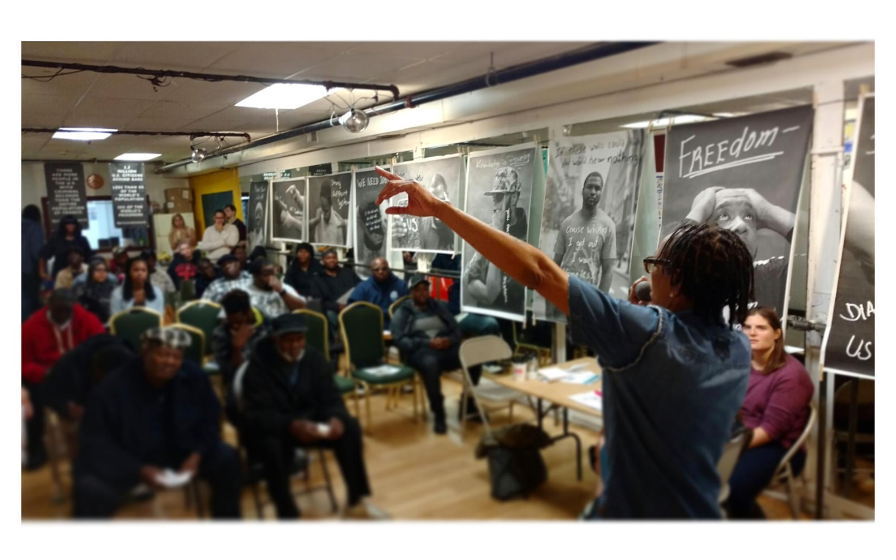
Creating leadership roles that transform social services spaces into empowering and peer led environments

Slide 8
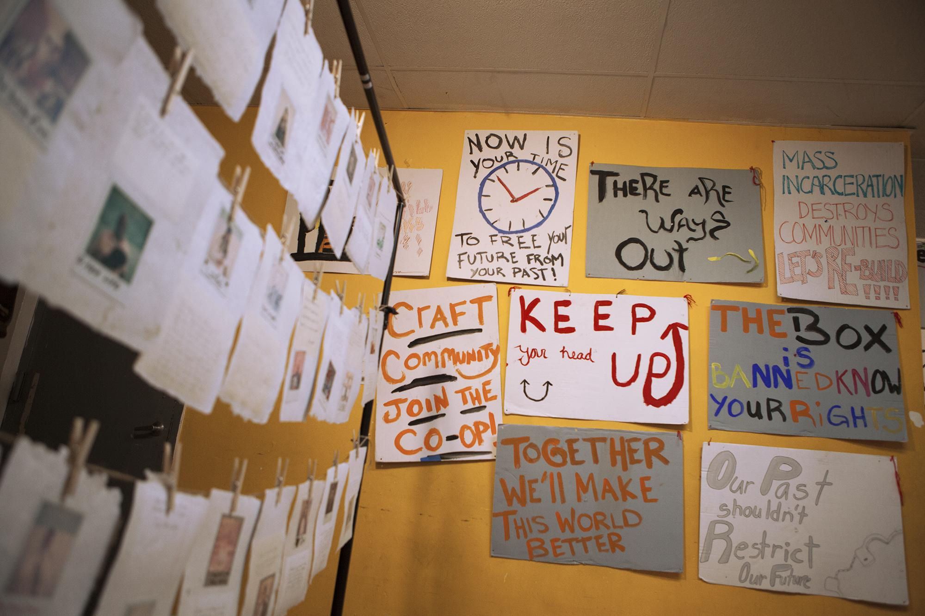
Working with communities to design / facilitate the services that they access
Notes:
Here are some community generated support signs that are also hung in expungement intakes and other social service spaces

Slide 9
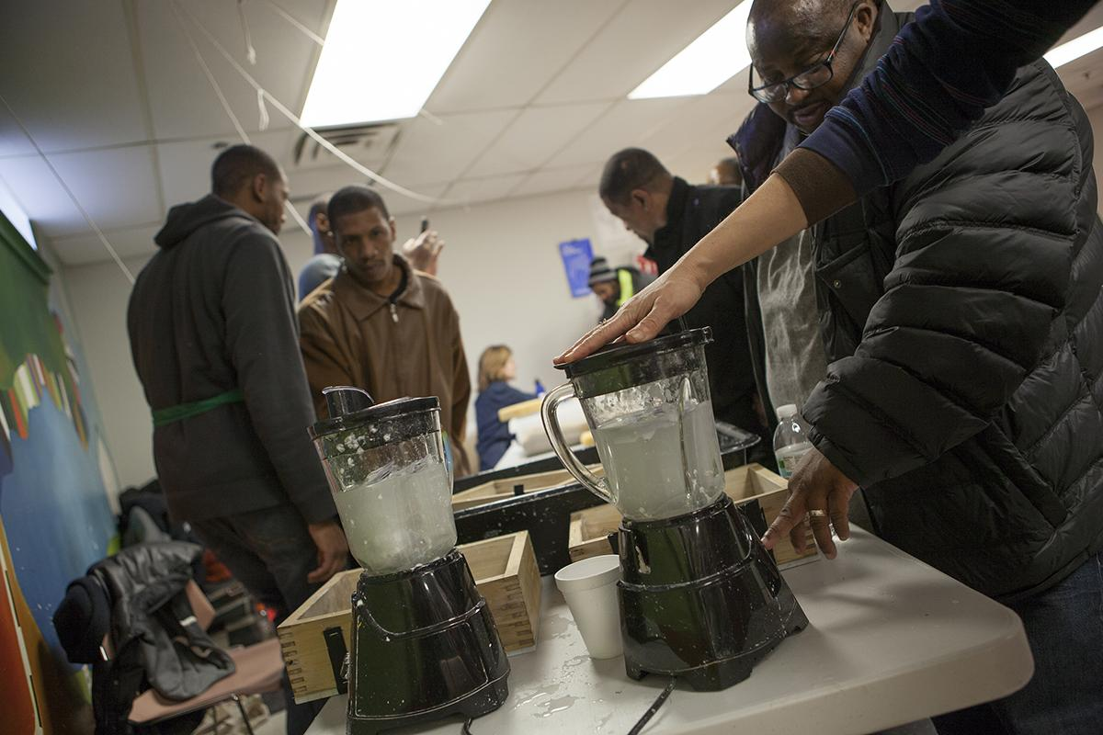
Notes:
After participants meet with the lawyers and go through their records, looking at some of the darkest days of their lives, interested folks come to where we set up, tear up their record, put it into a blender, make a paper smoothie, and turn this object that’s been holding them back, into a new sheet of paper

Slide 10
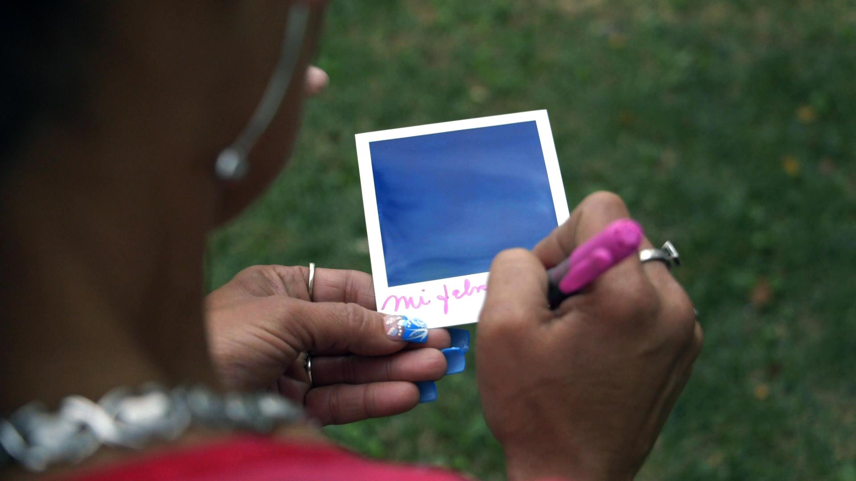
Notes:
We take a polaroid portrait, what we call a reverse mugshot. Mugshots tell the same story over and over again, “this person is a criminal.” we pose a prompt, “When people see your criminal record, what about you as an individual don’t they see?”

Slide 11
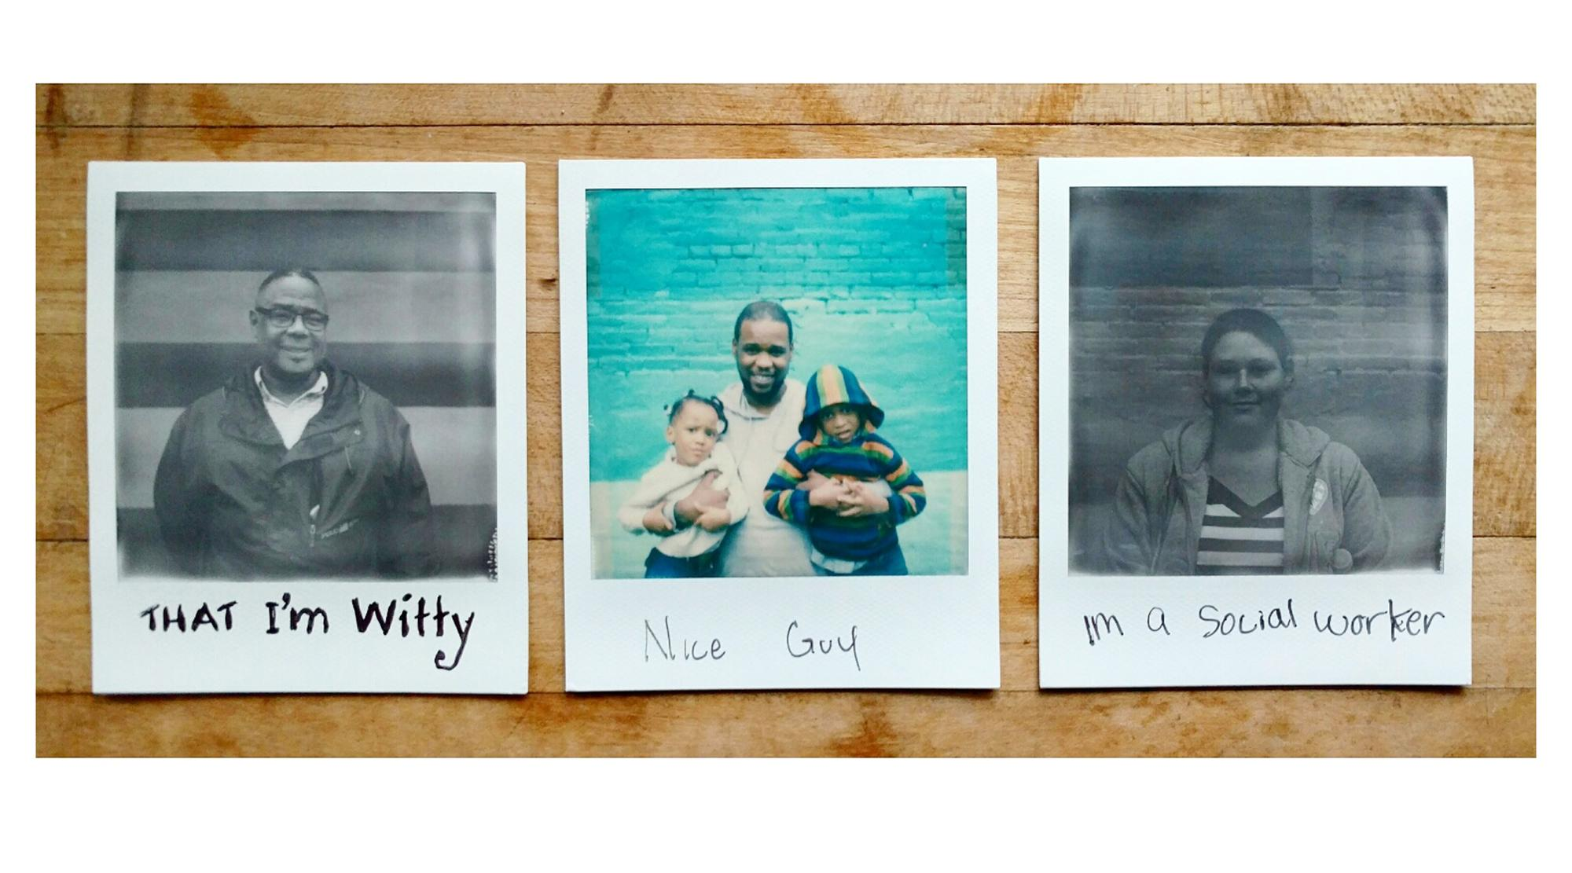
“I came in not knowing a single person, I’m leaving feeling like I went to a family reunion” - Clinic Participant

Slide 12
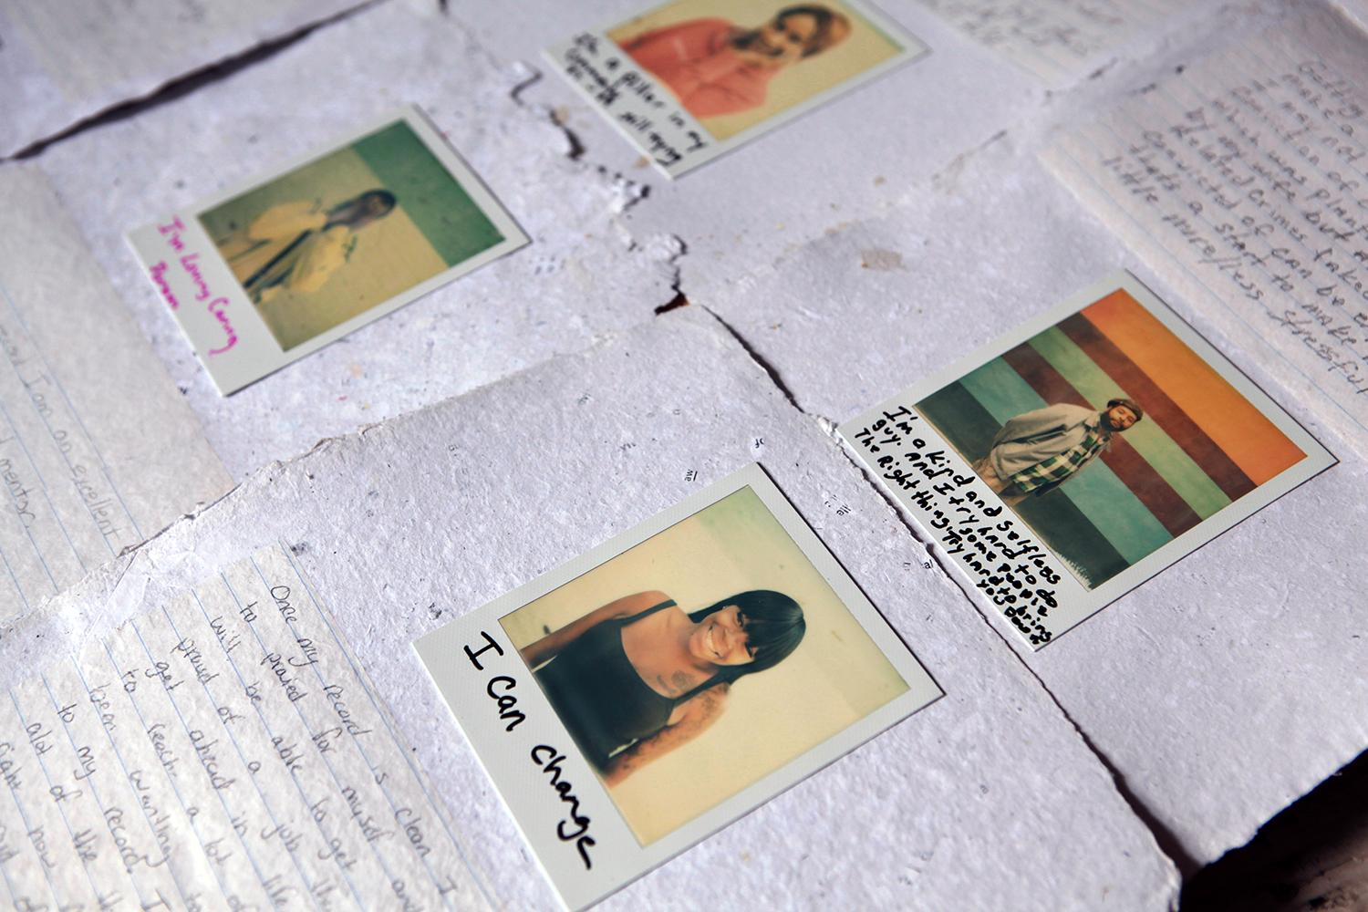
Notes:
We also ask a forward thinking prompt, “Without my criminal record, I am…”

Slide 13
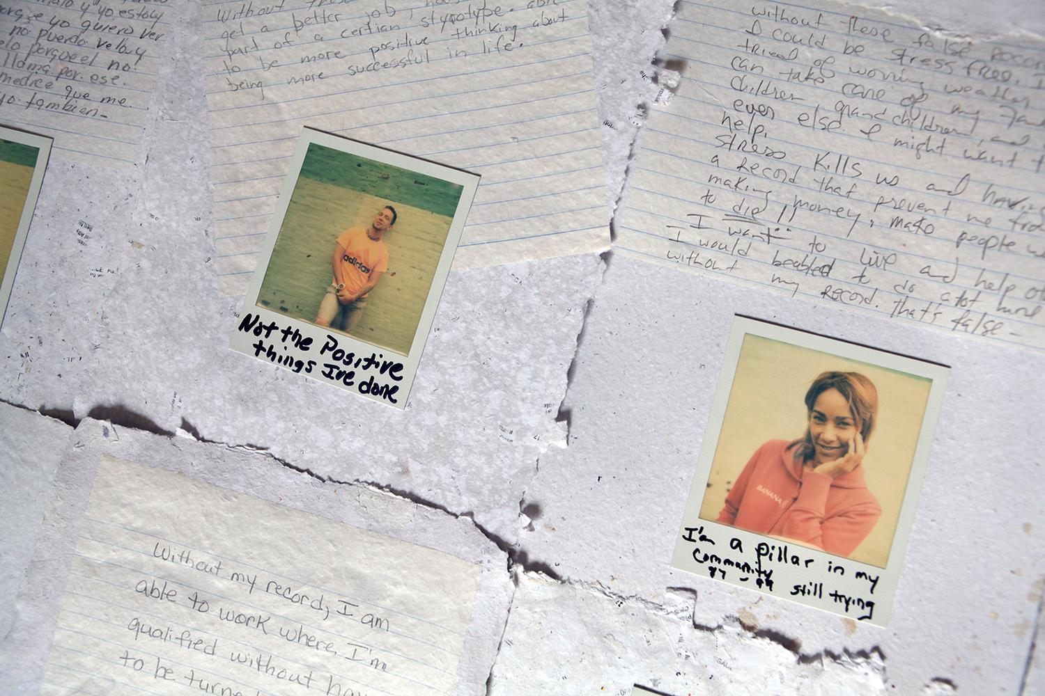
Notes:
These 2 objects become embedded into the new sheet of paper. Each sheet becomes a blank slate for self representation, and is a literal and figural transformation of their criminal record.

Slide 14
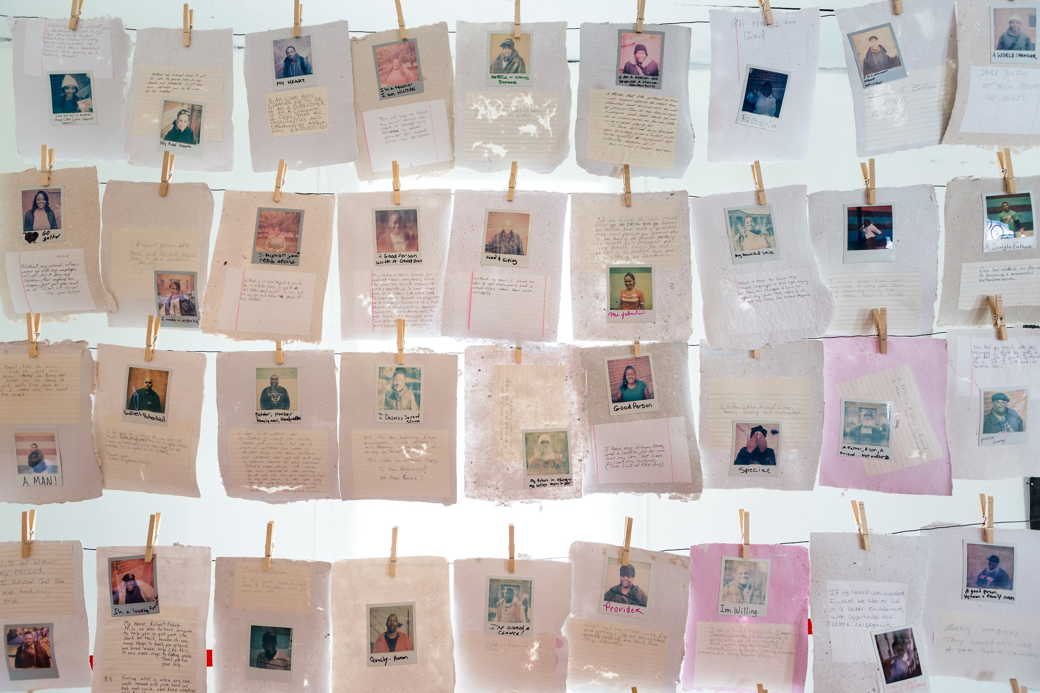

Slide 15
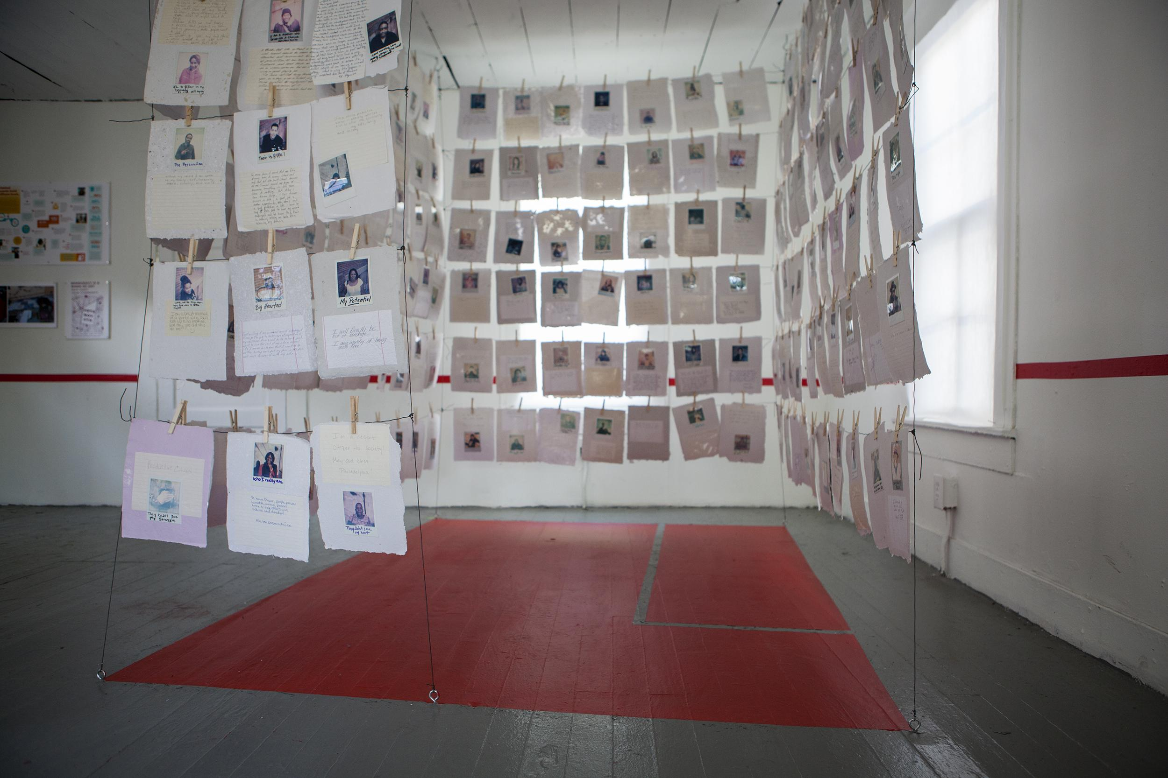
Notes:
The process is as important as the product. Their are politics to the model, but we’d like to share our model

Slide 16
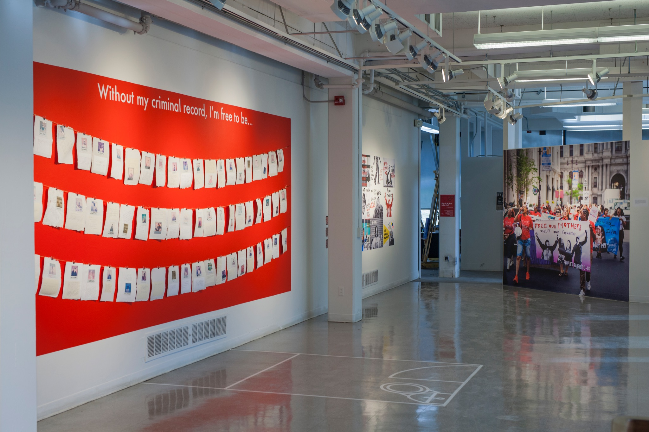

Slide 17
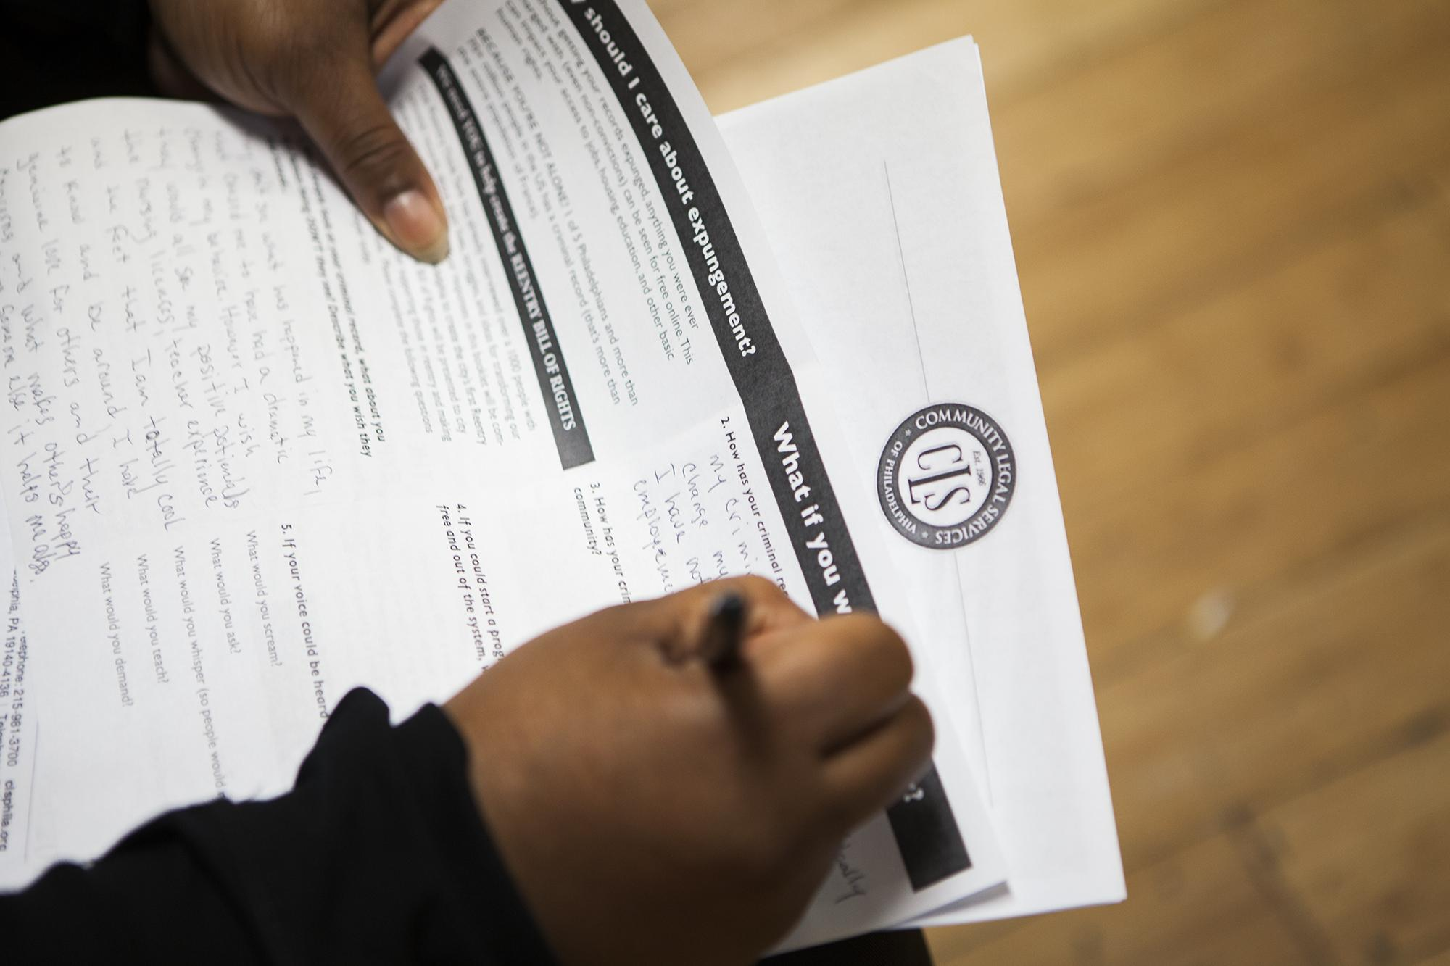
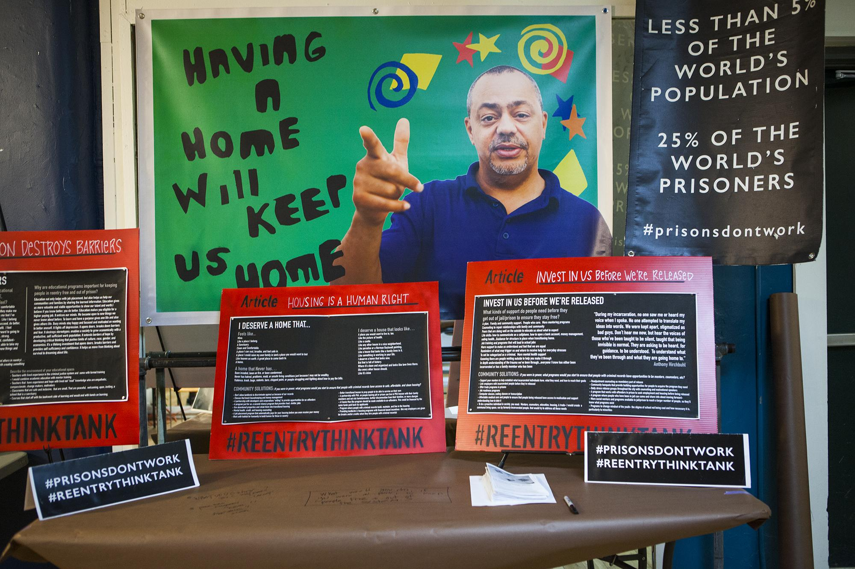
The Reentry Bill of Rights: A Blueprint for keeping us free

Slide 18
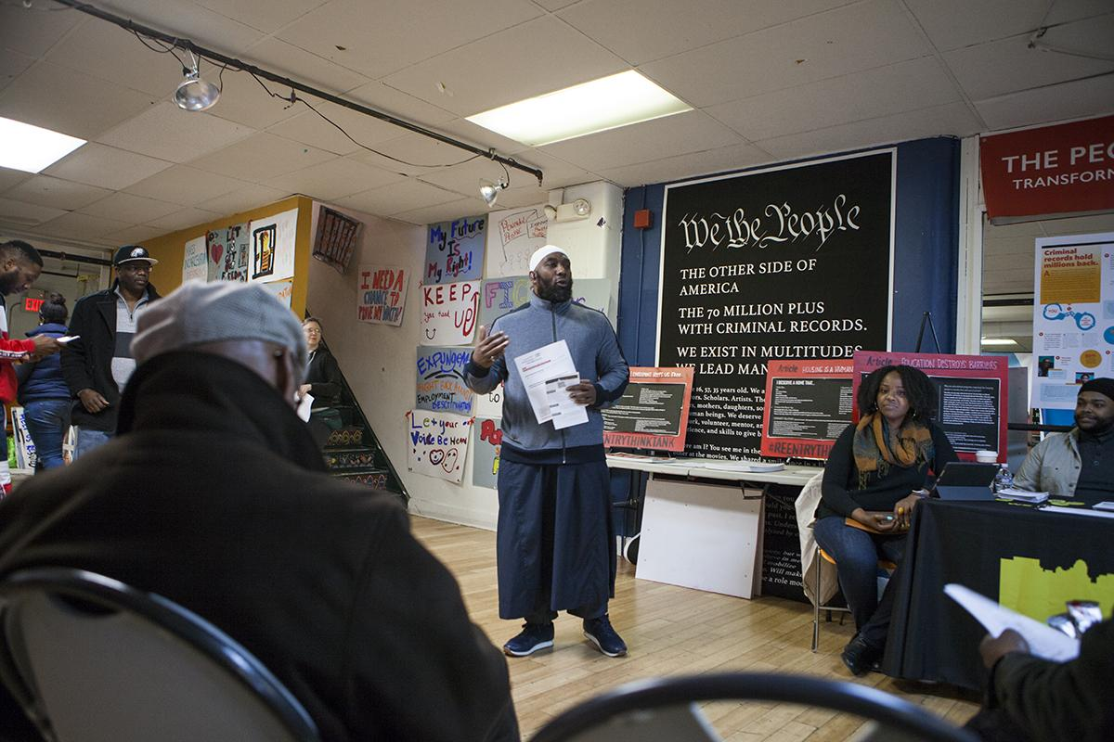

Slide 19
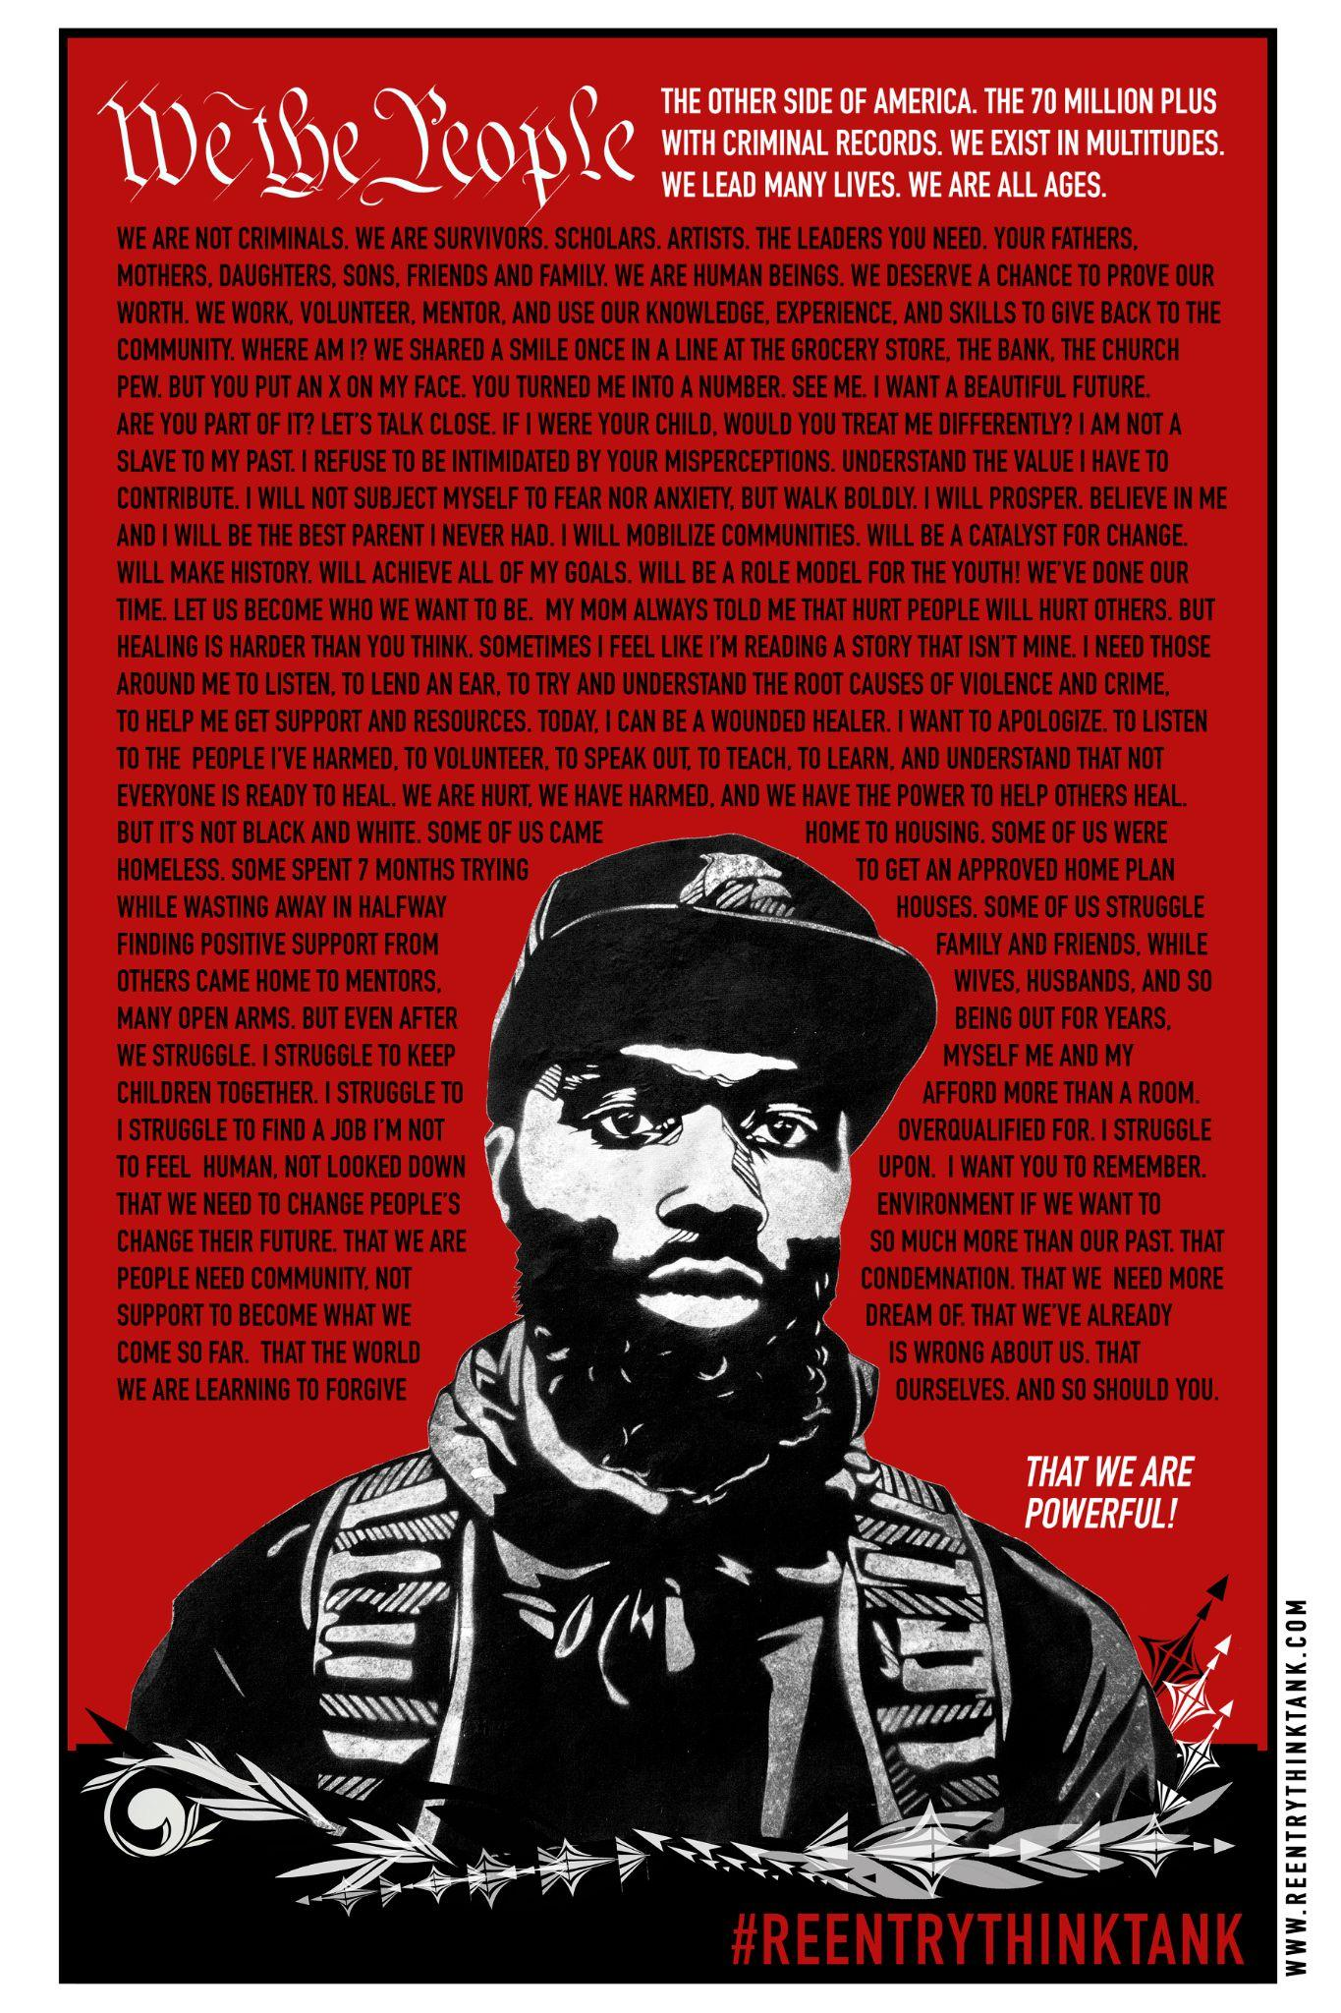
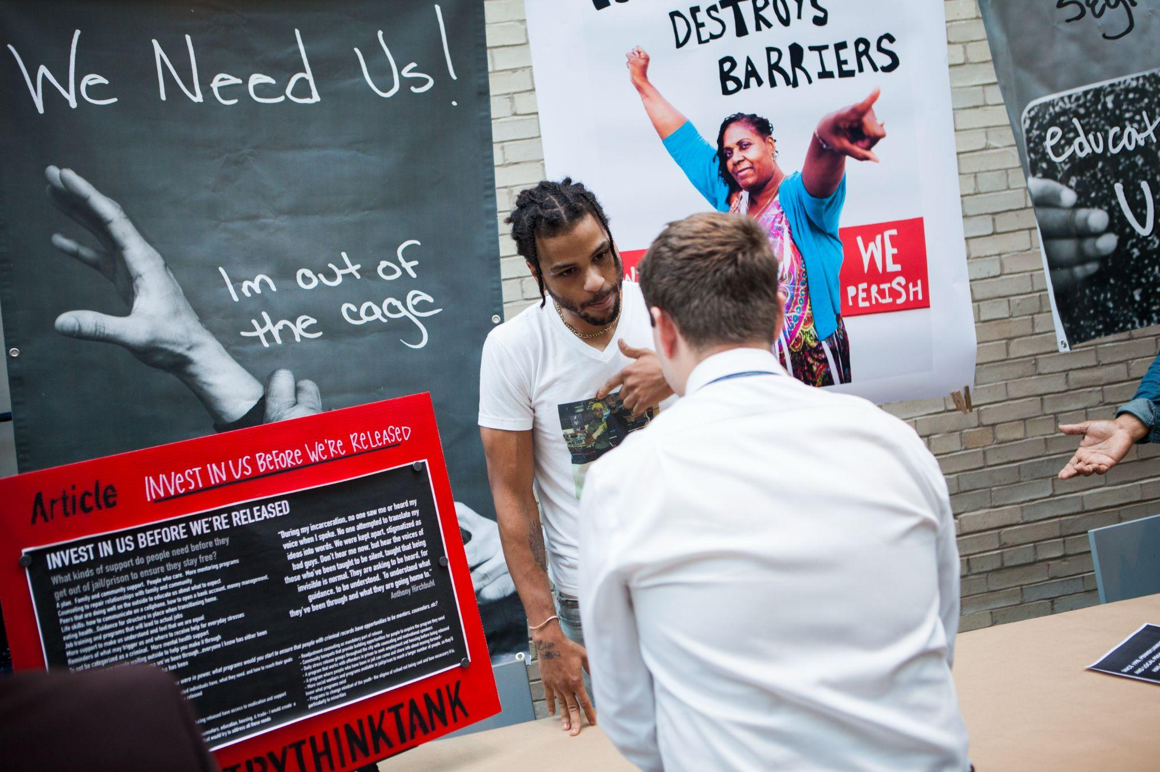

Slide 20
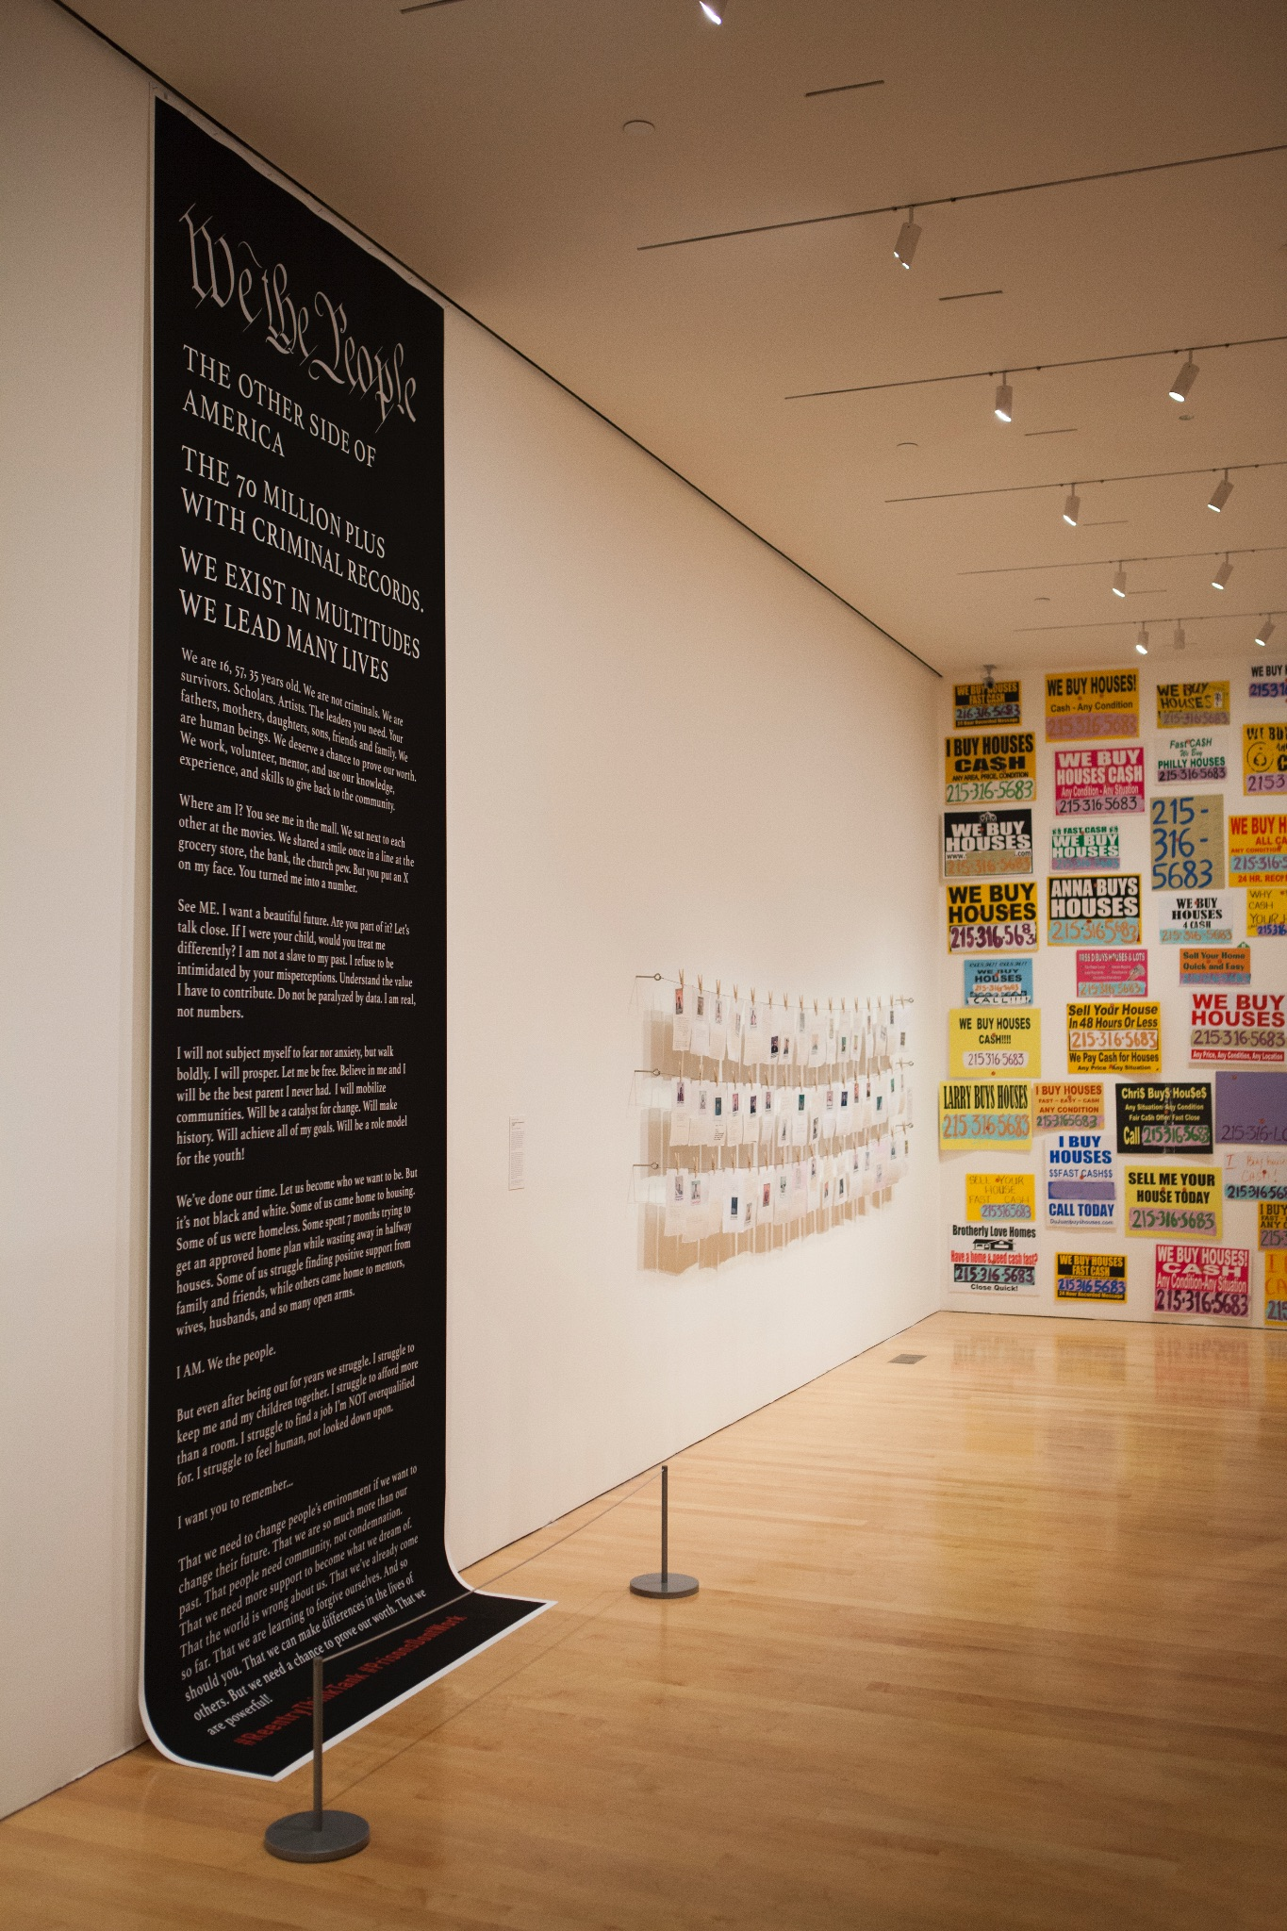
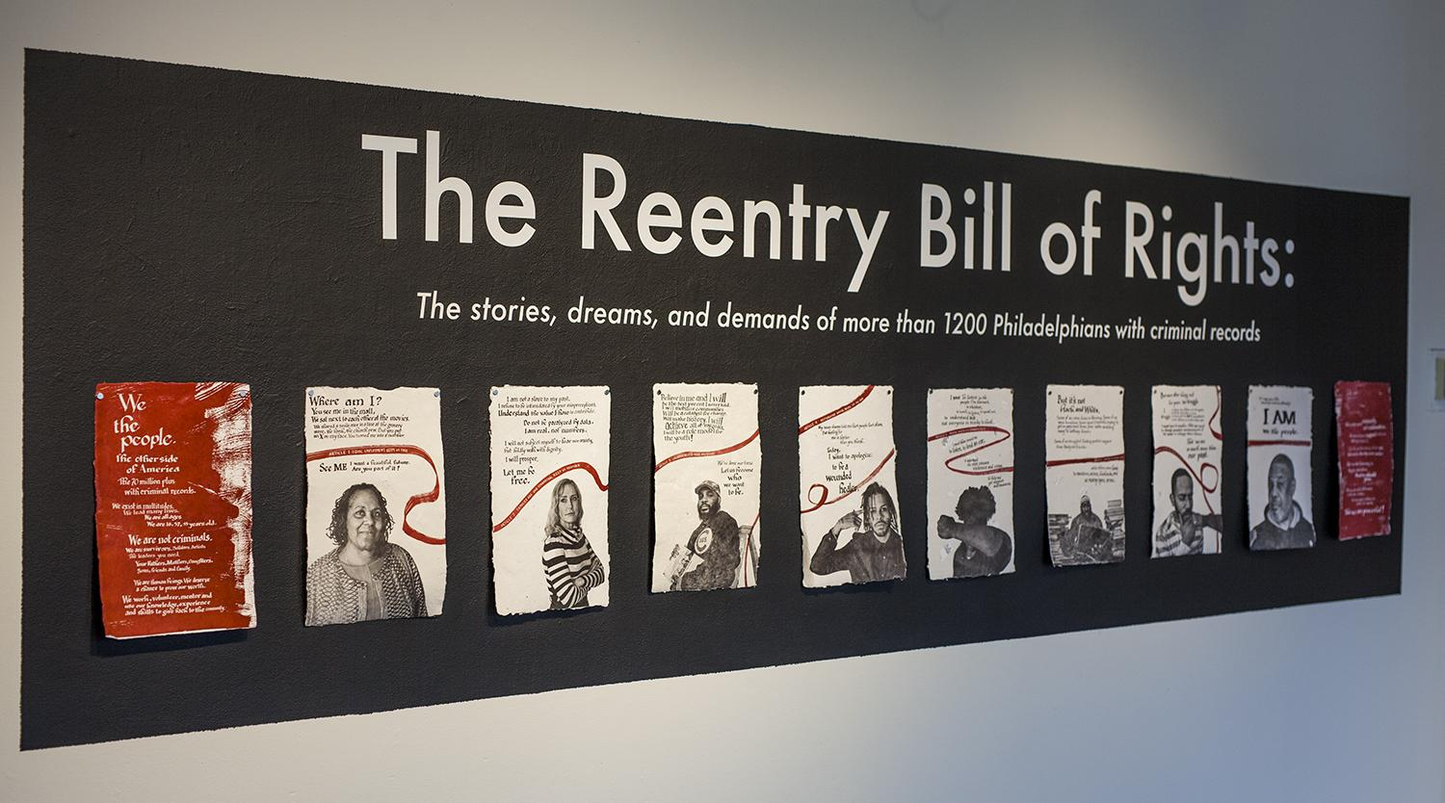

Slide 21
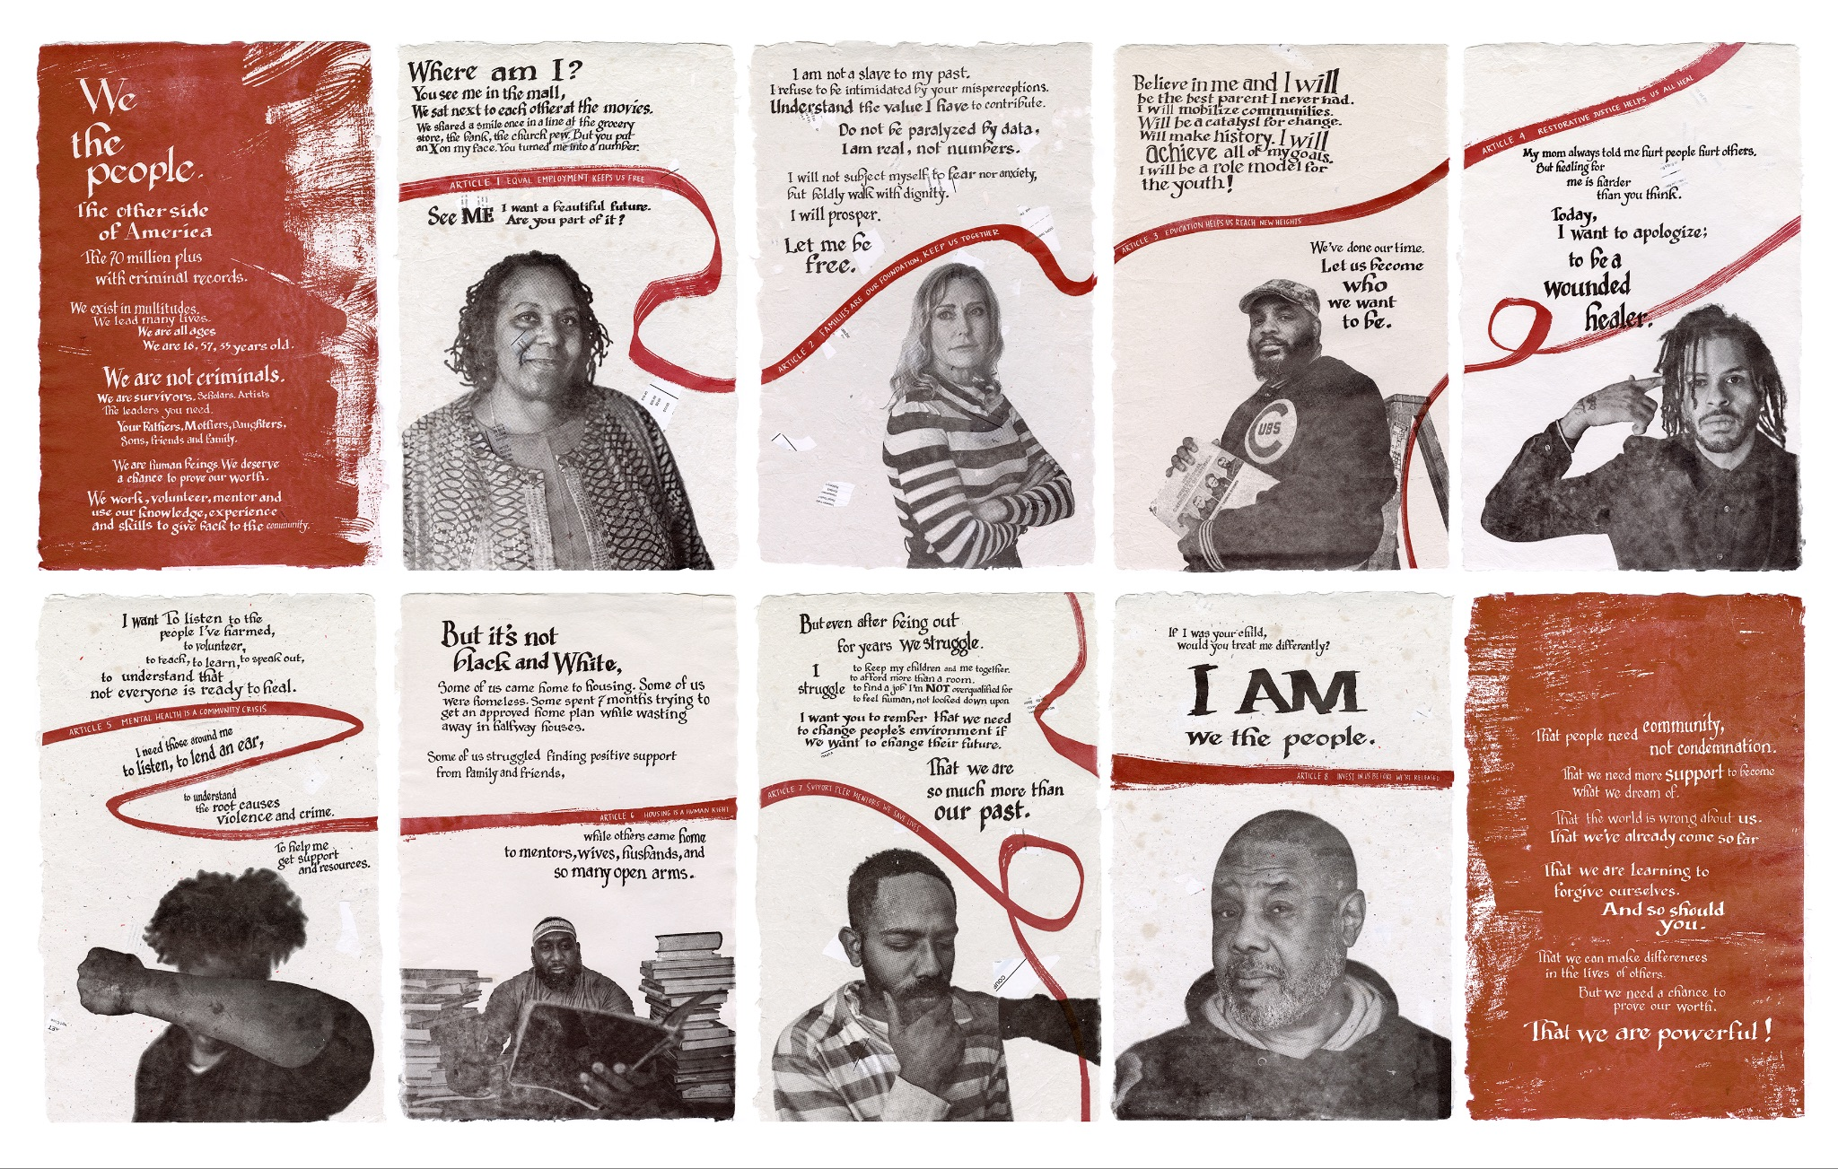

Slide 22
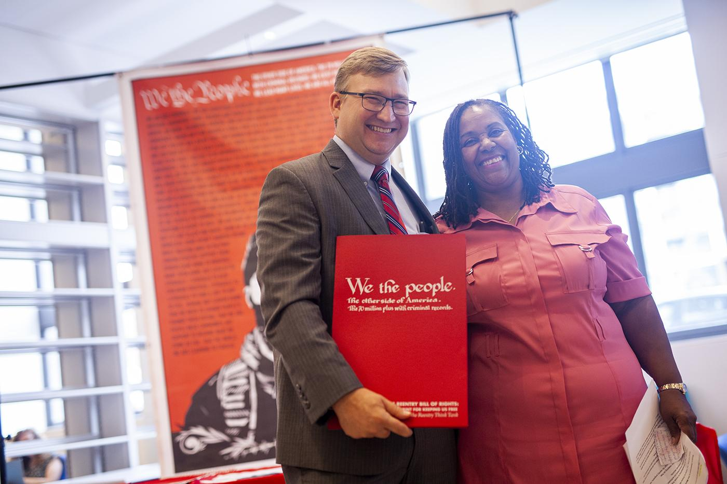

Slide 23


Slide 24
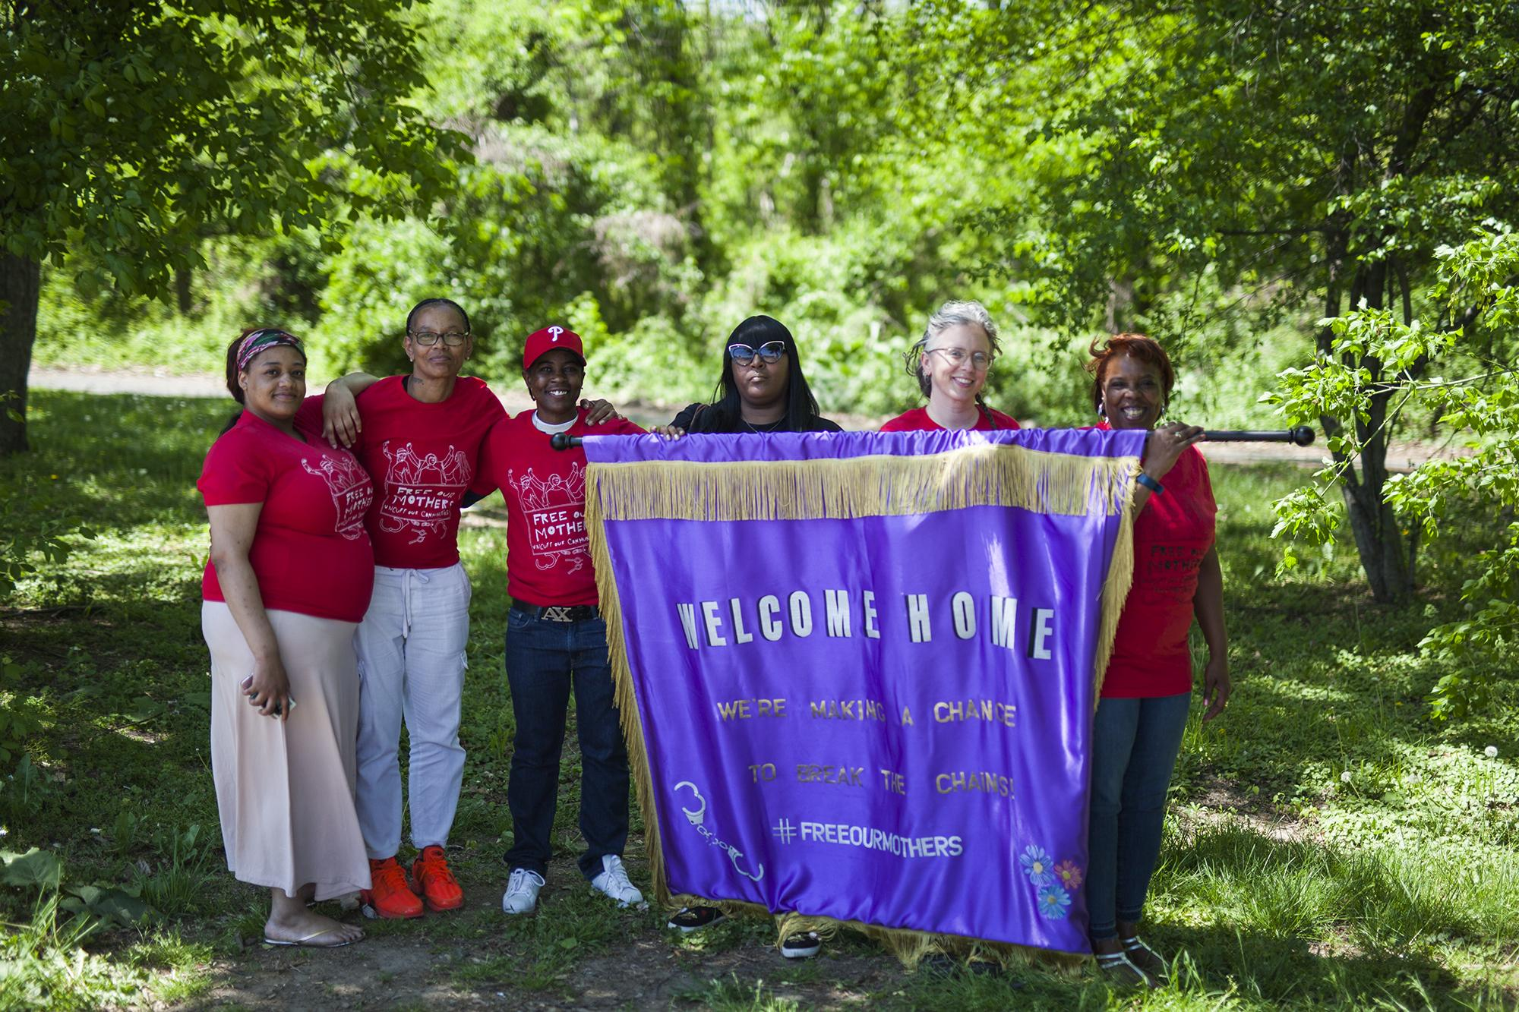

Slide 25
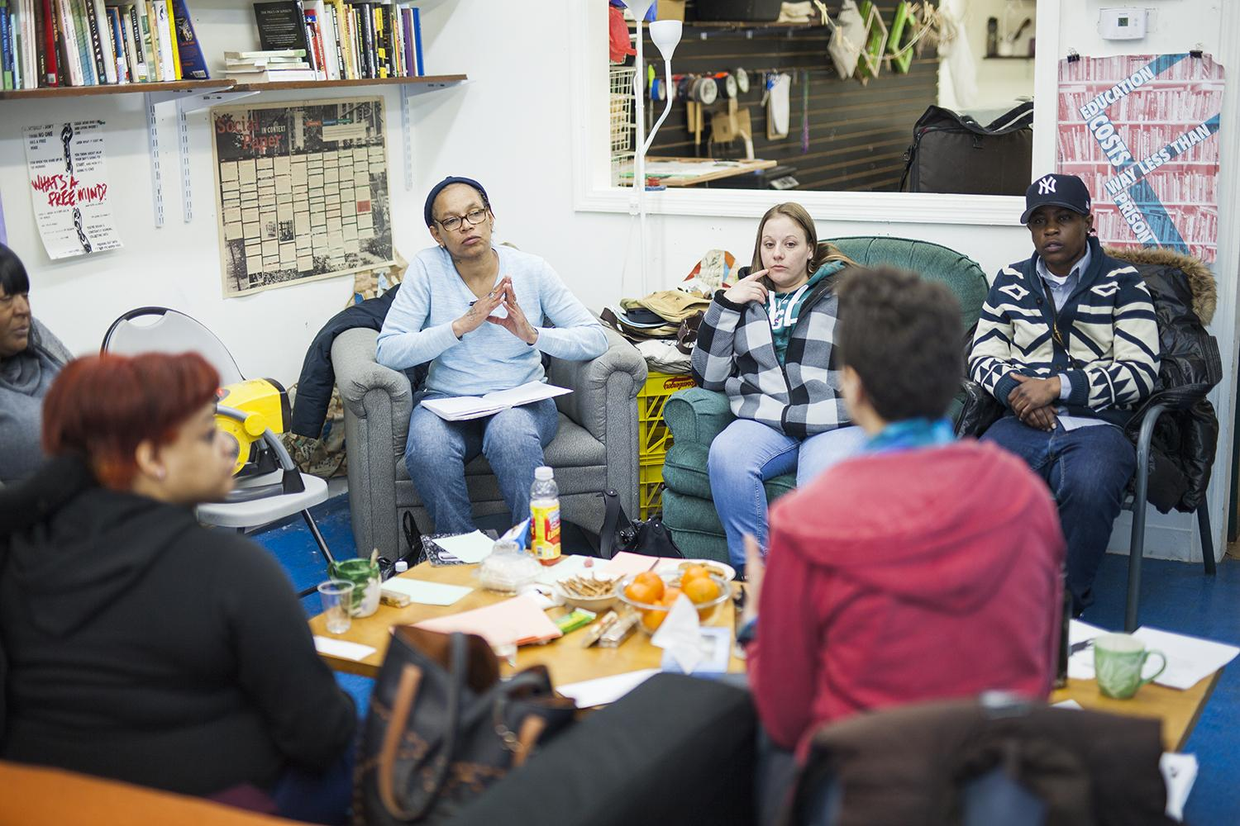

Slide 26
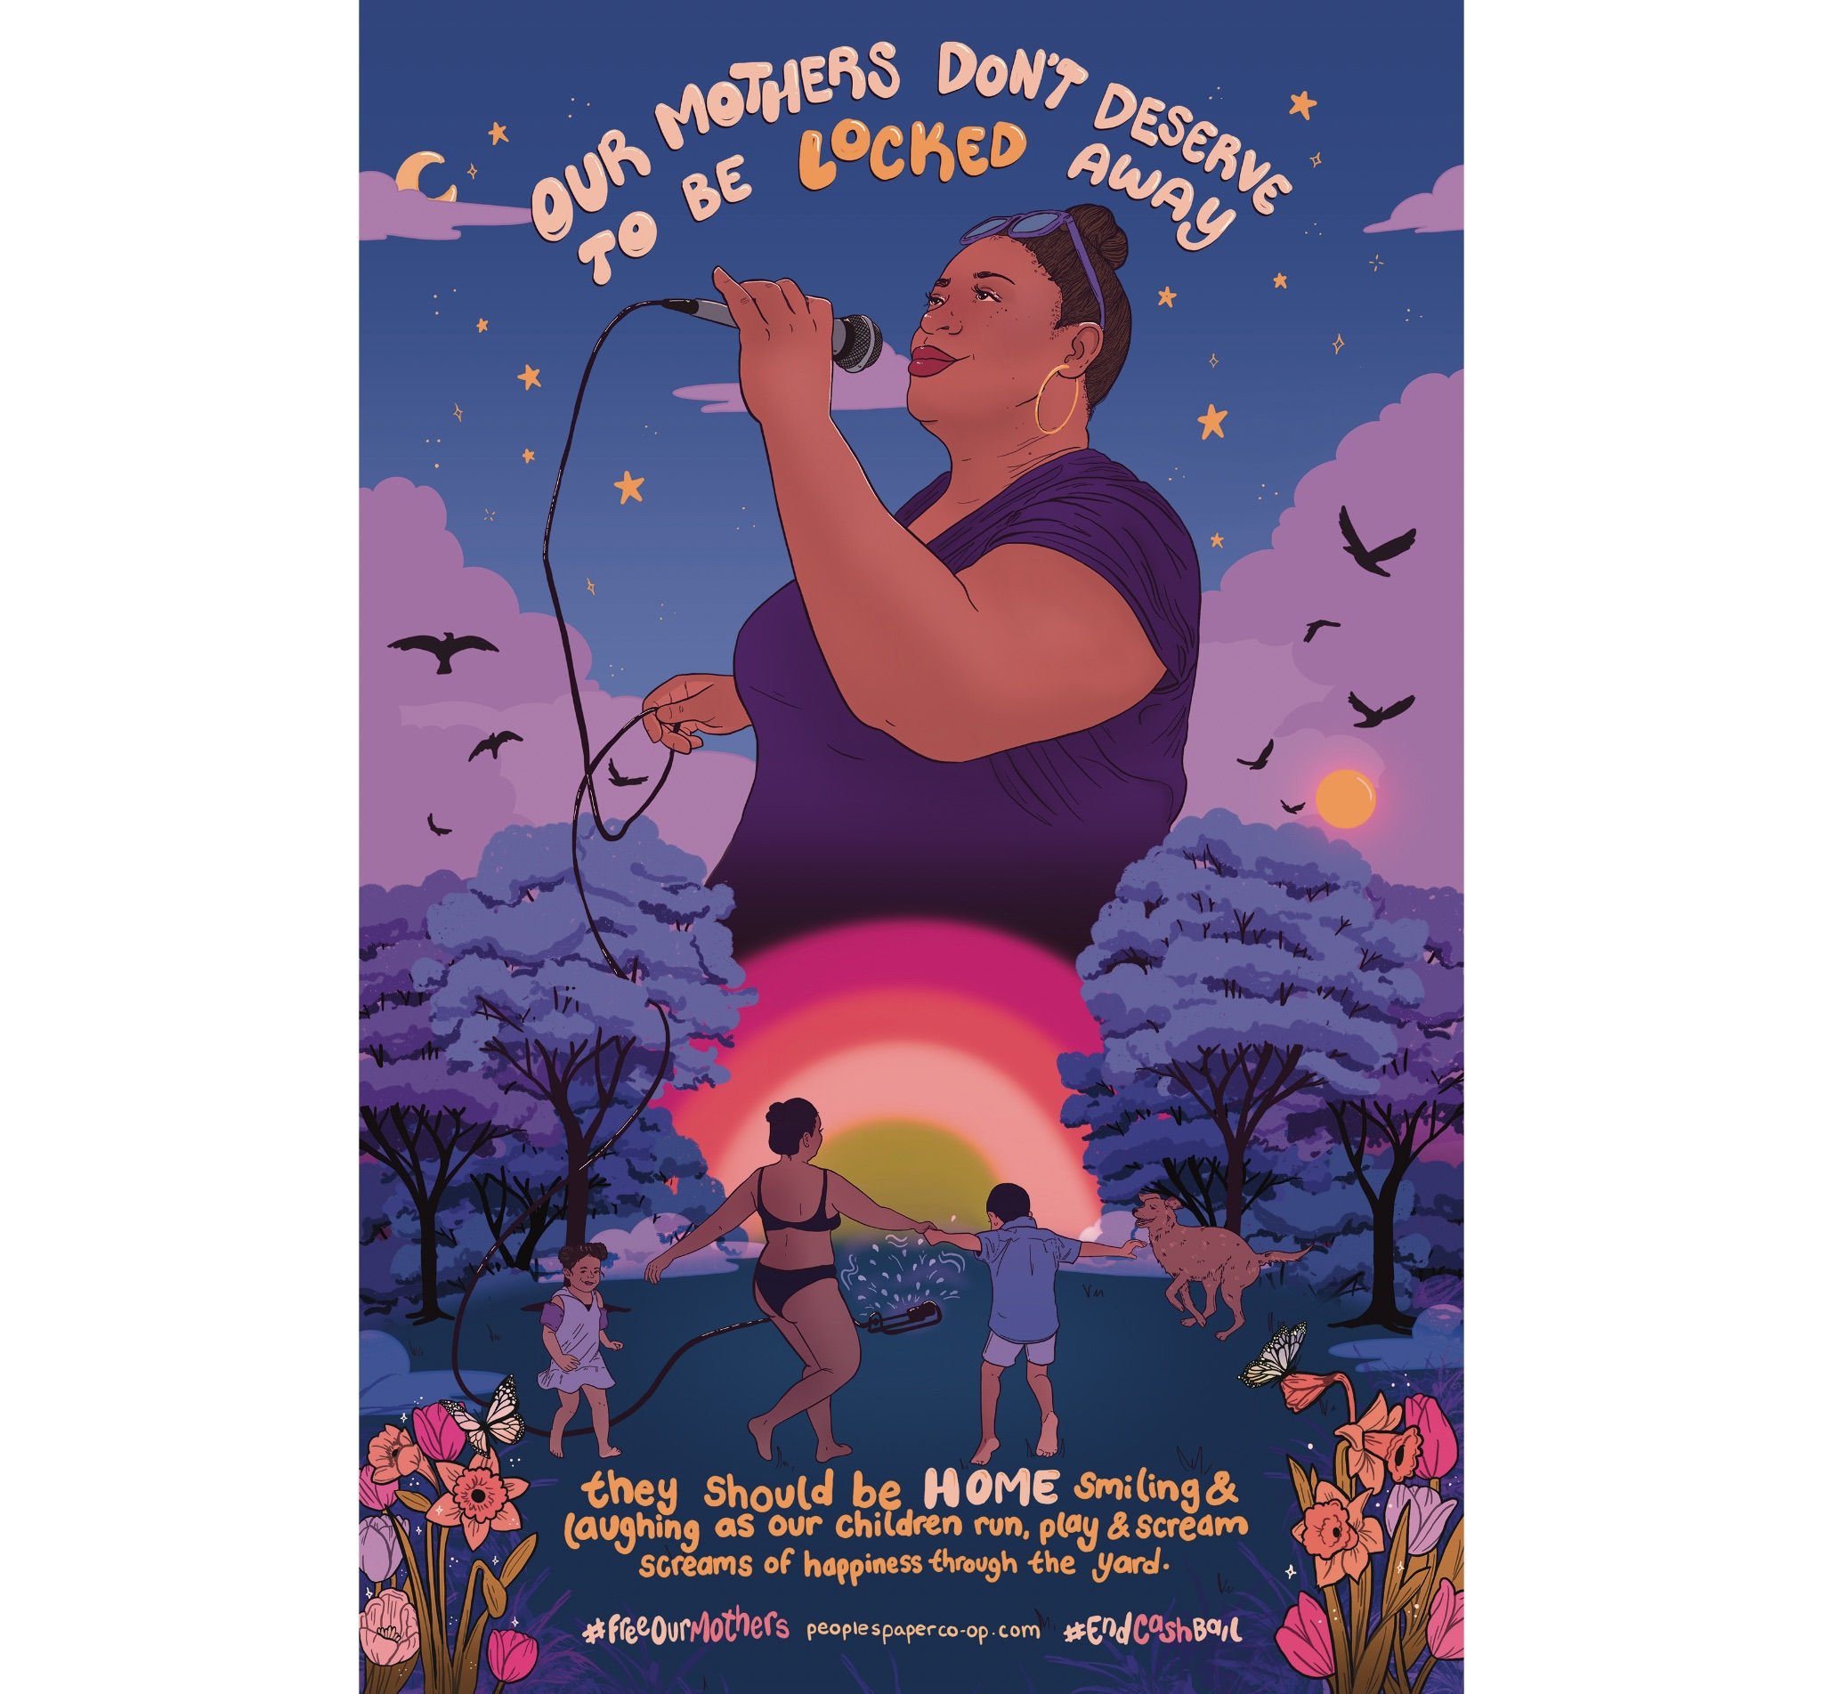
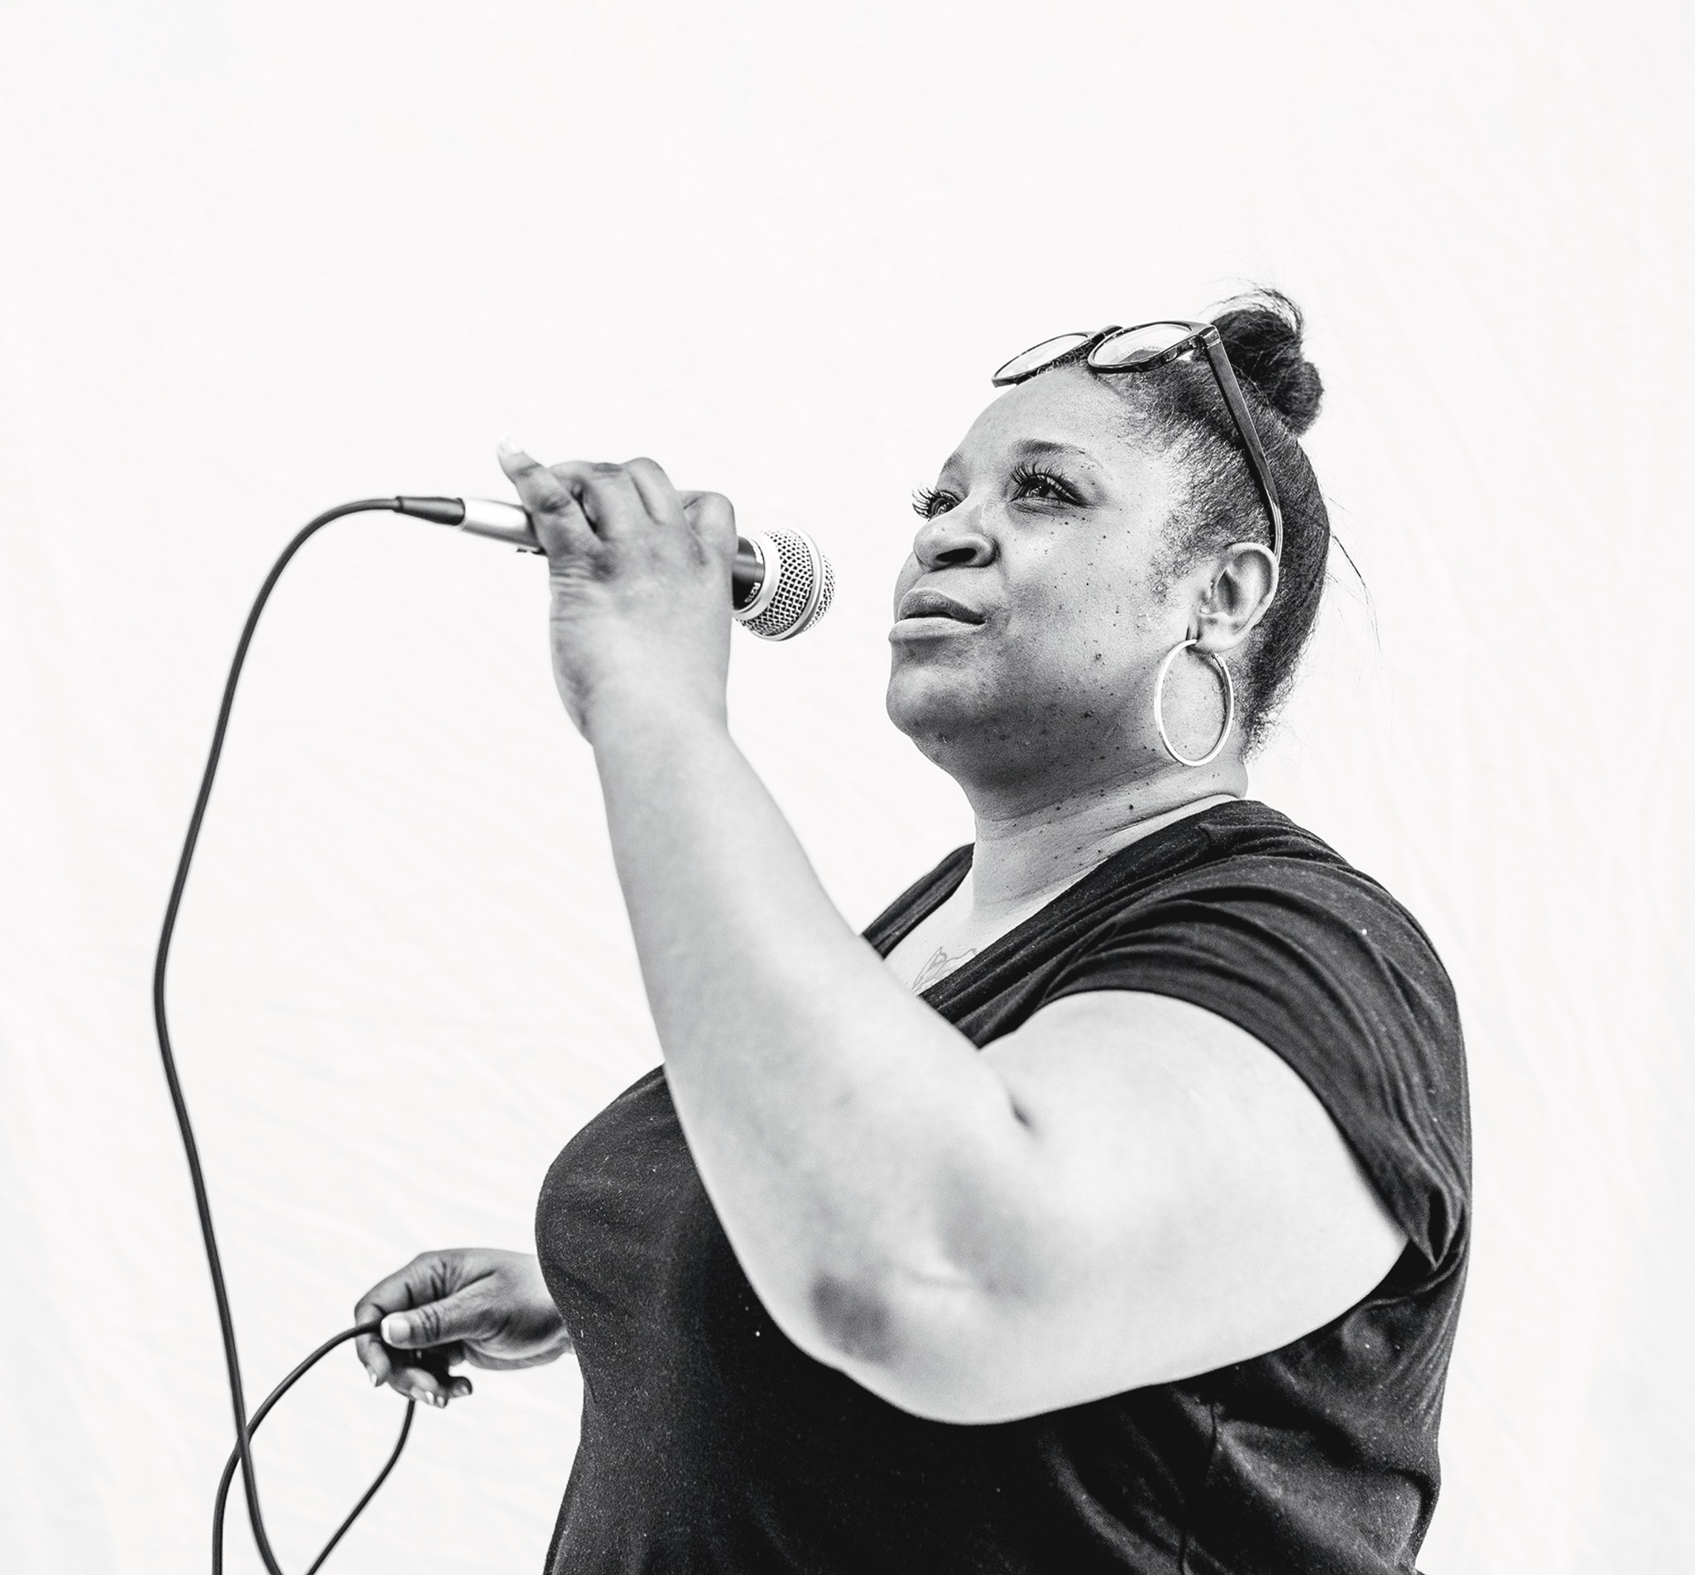

Slide 27
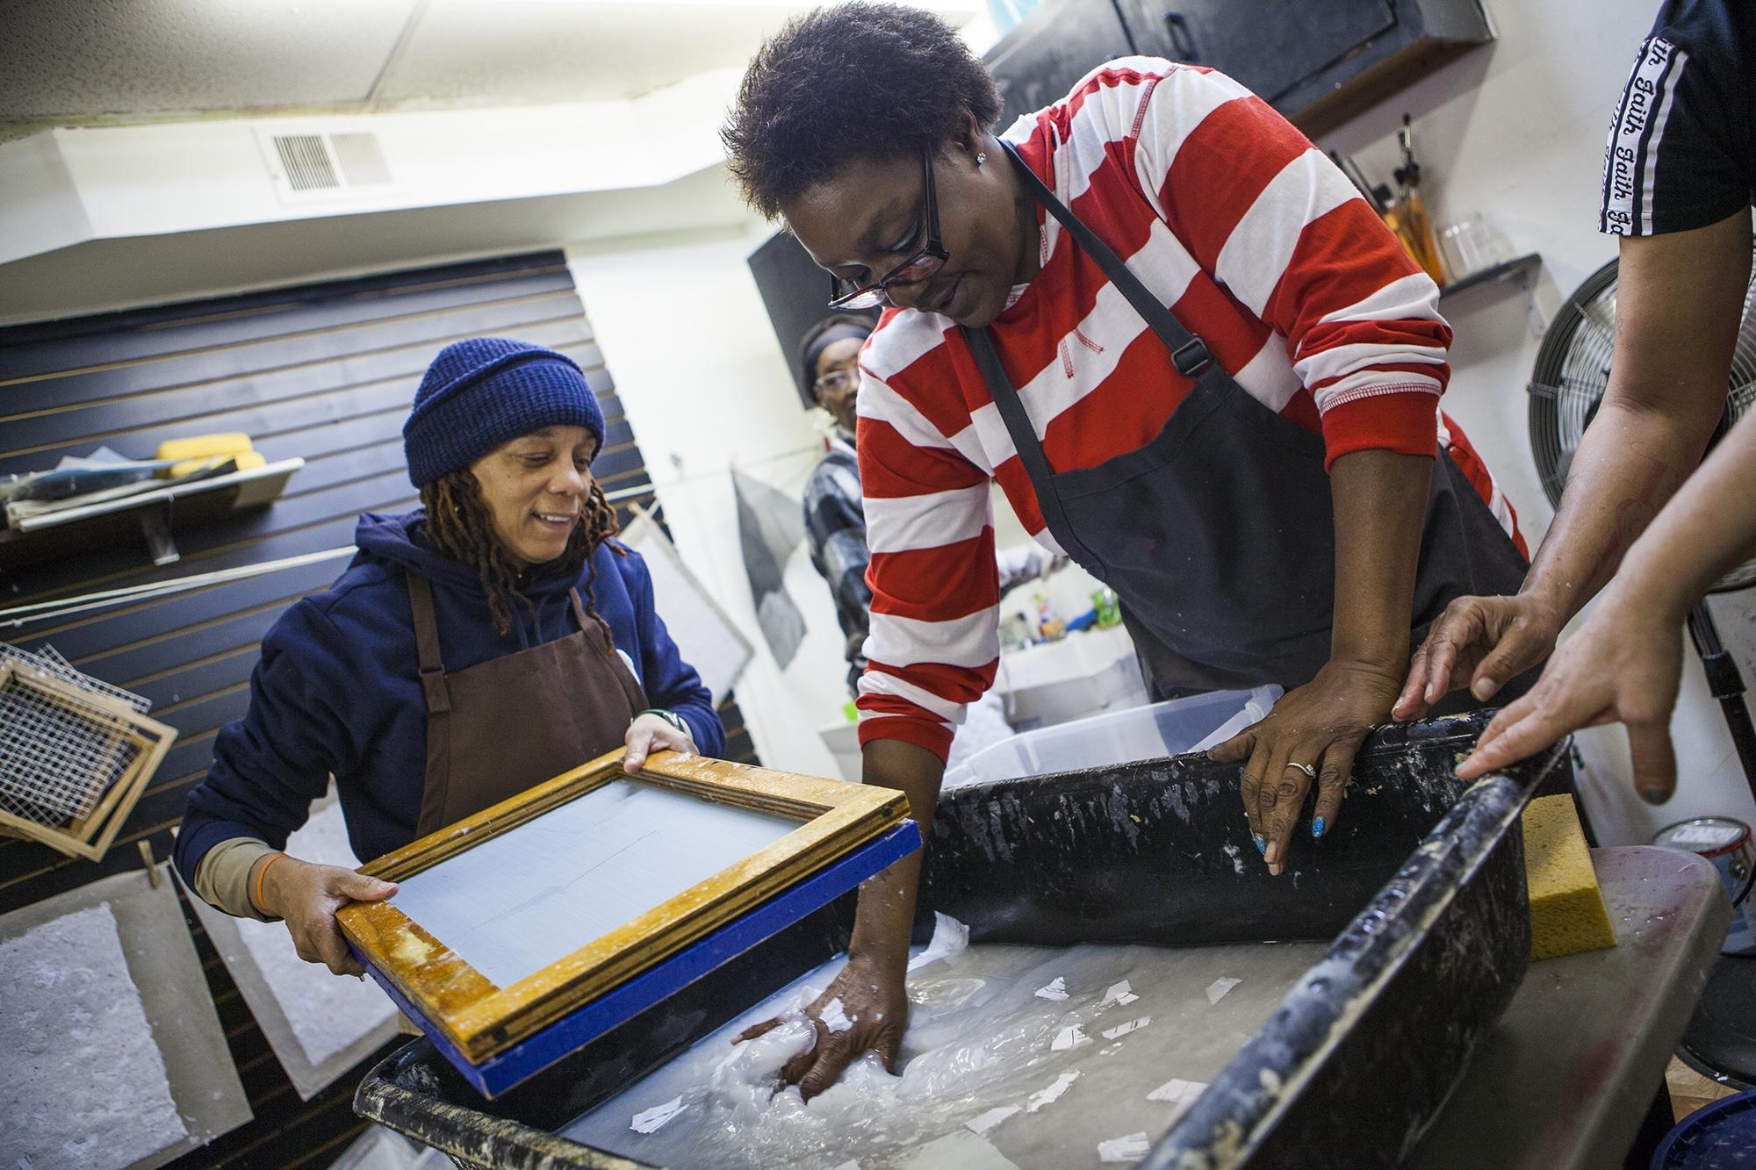

Slide 28
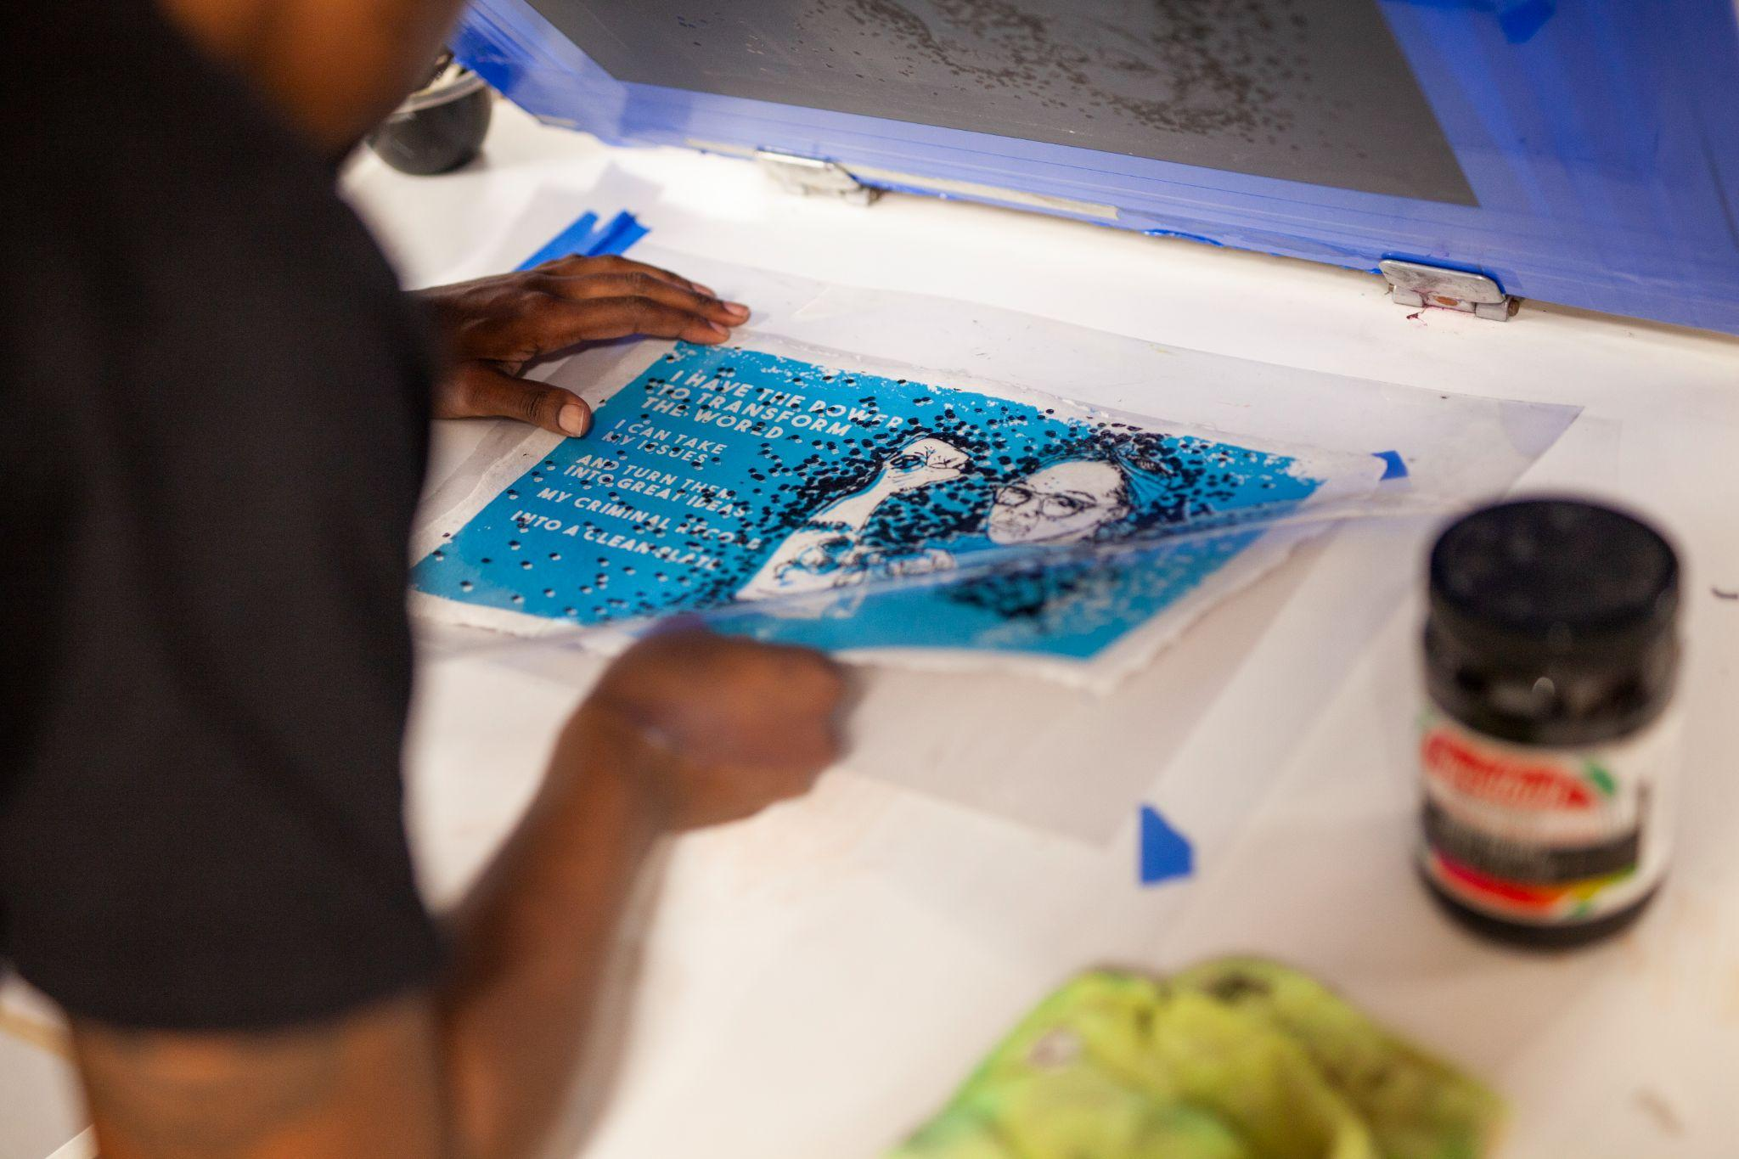
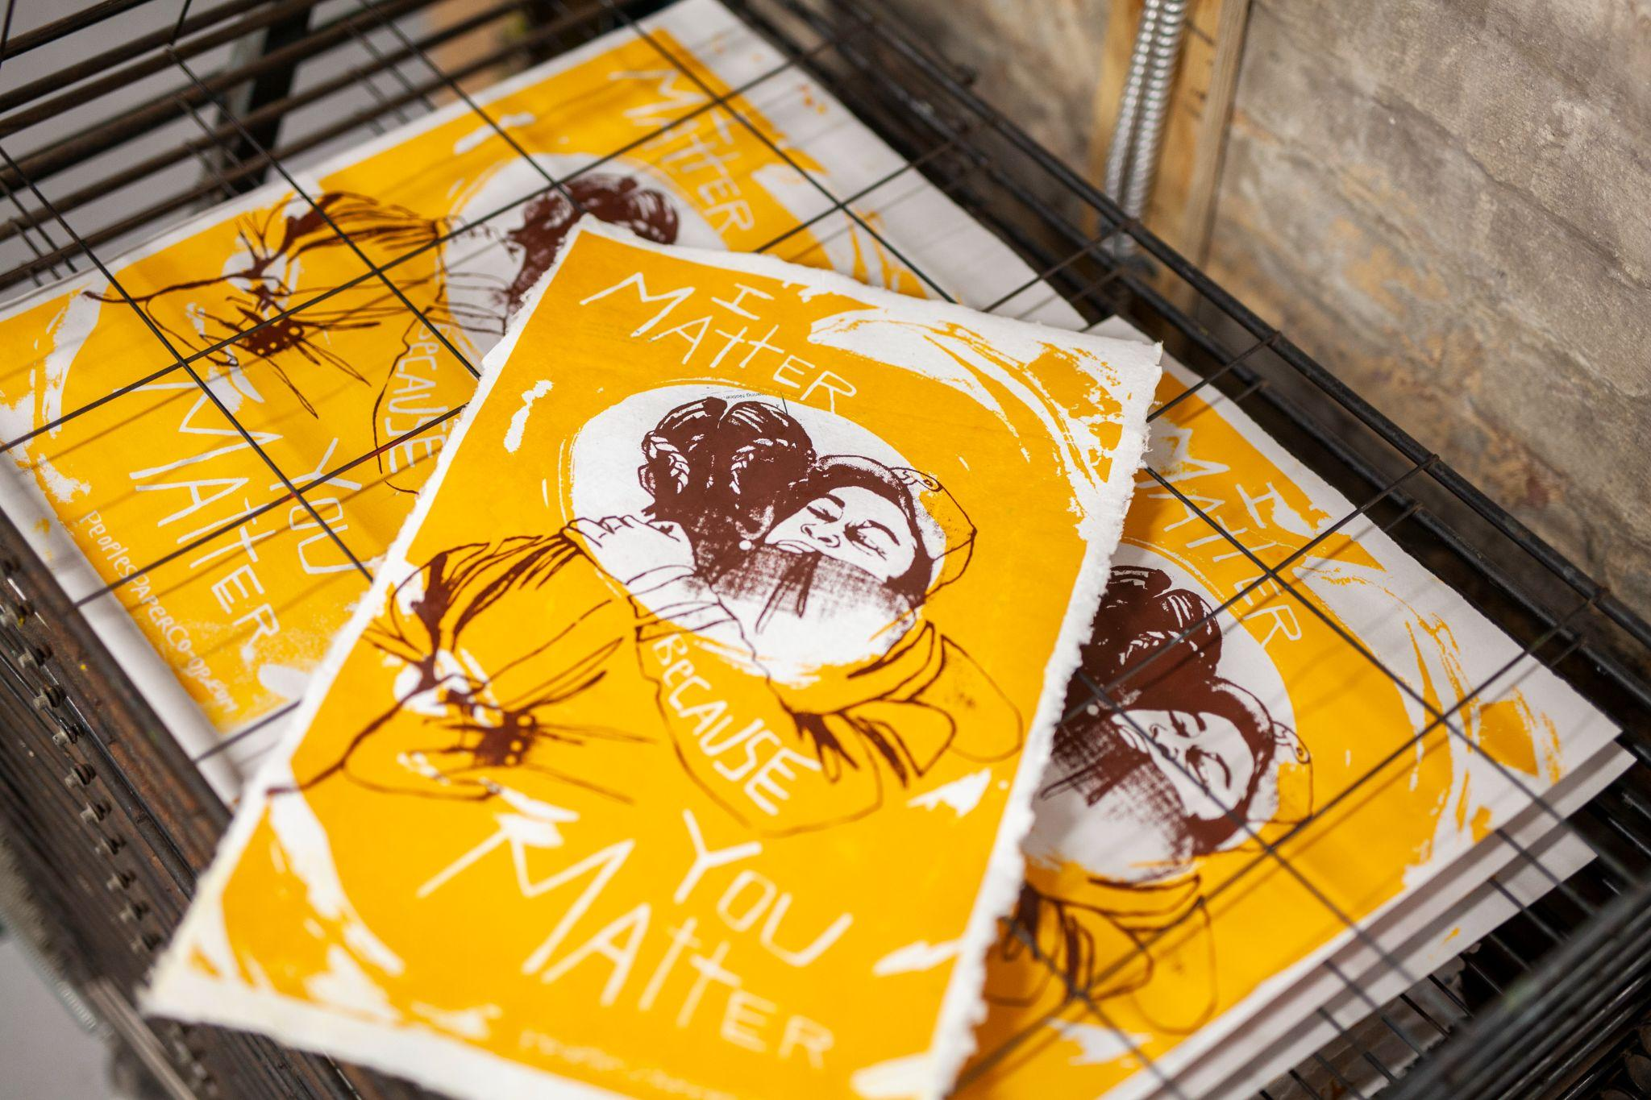

Slide 29
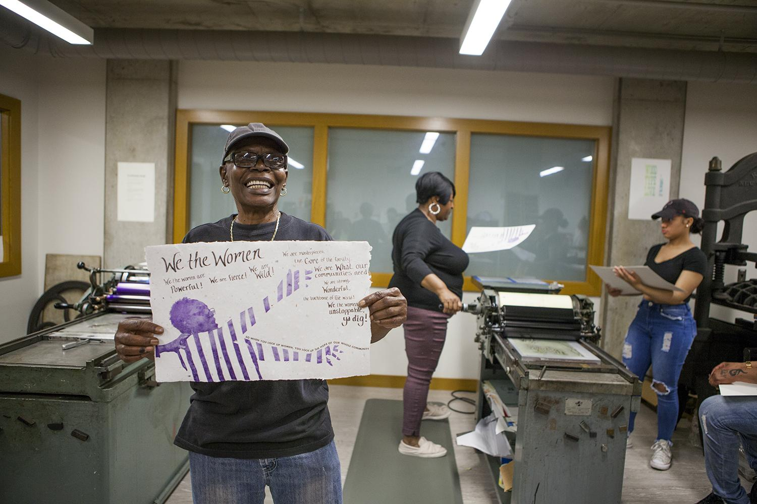
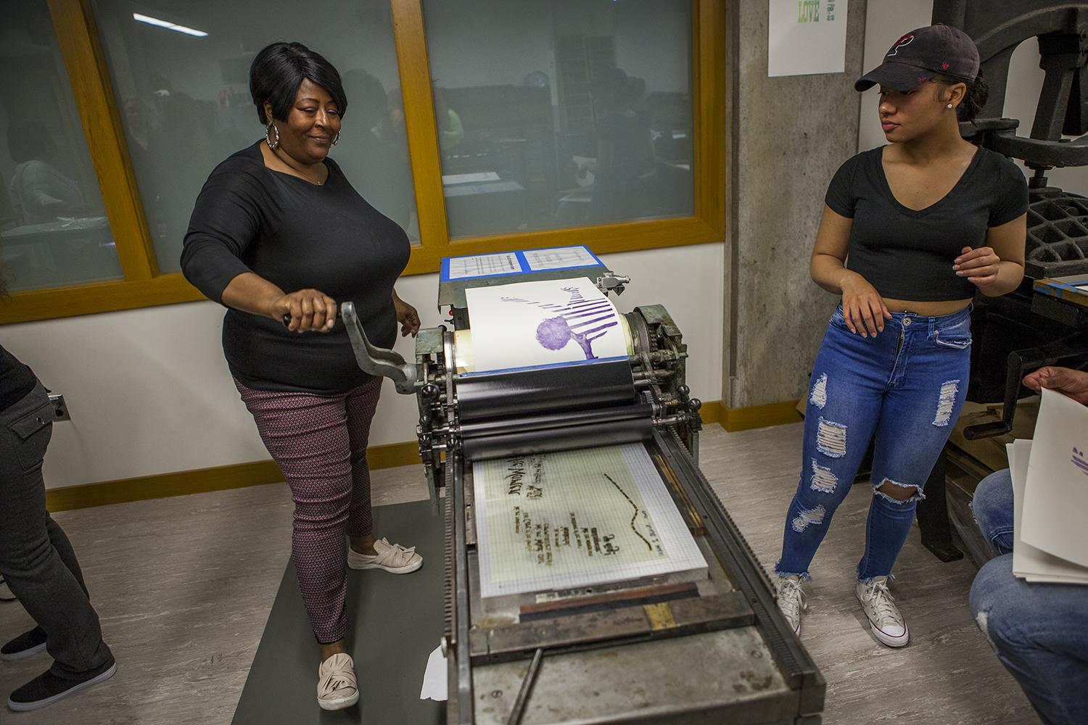

Slide 30
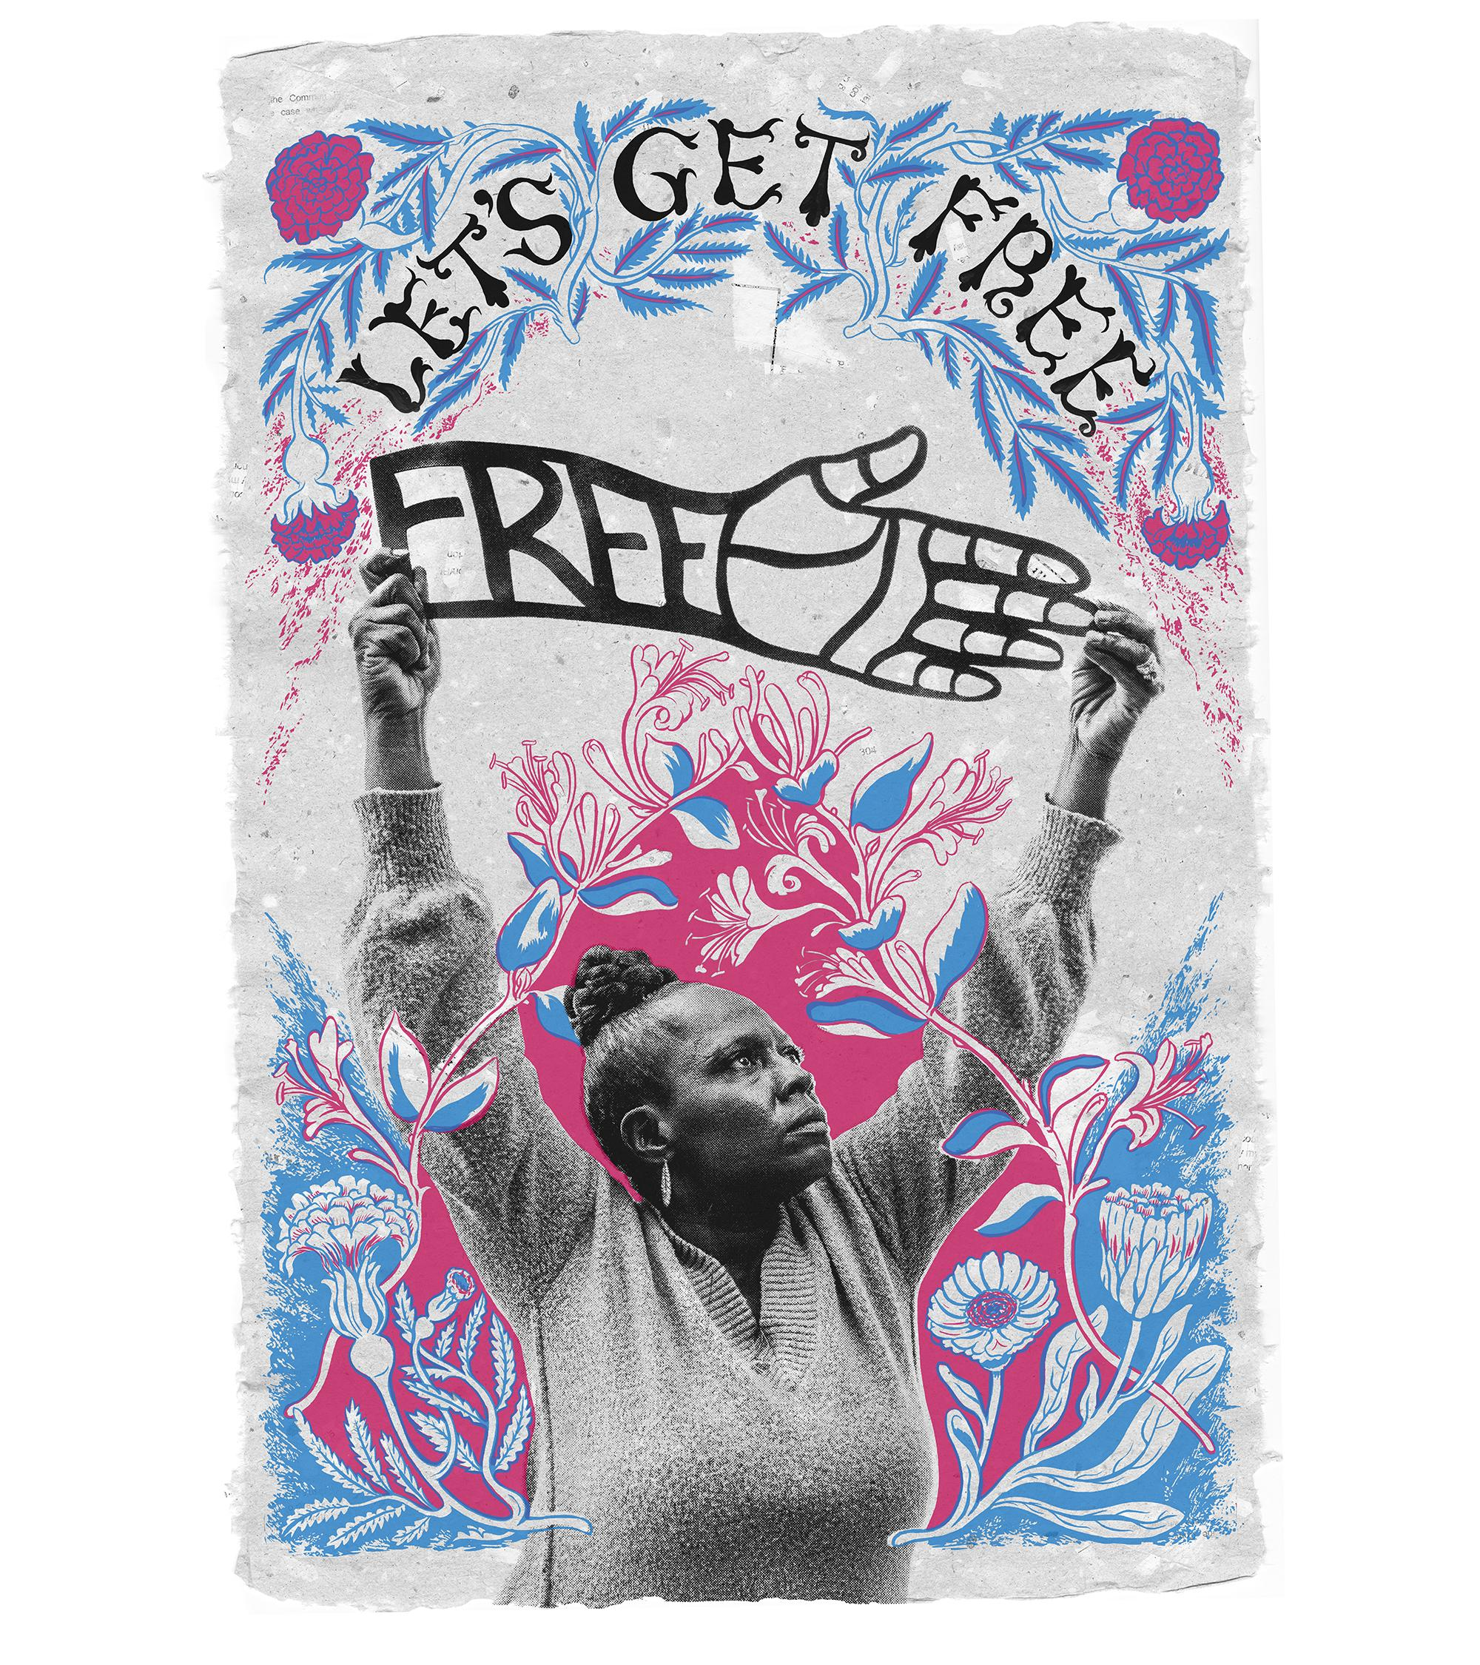
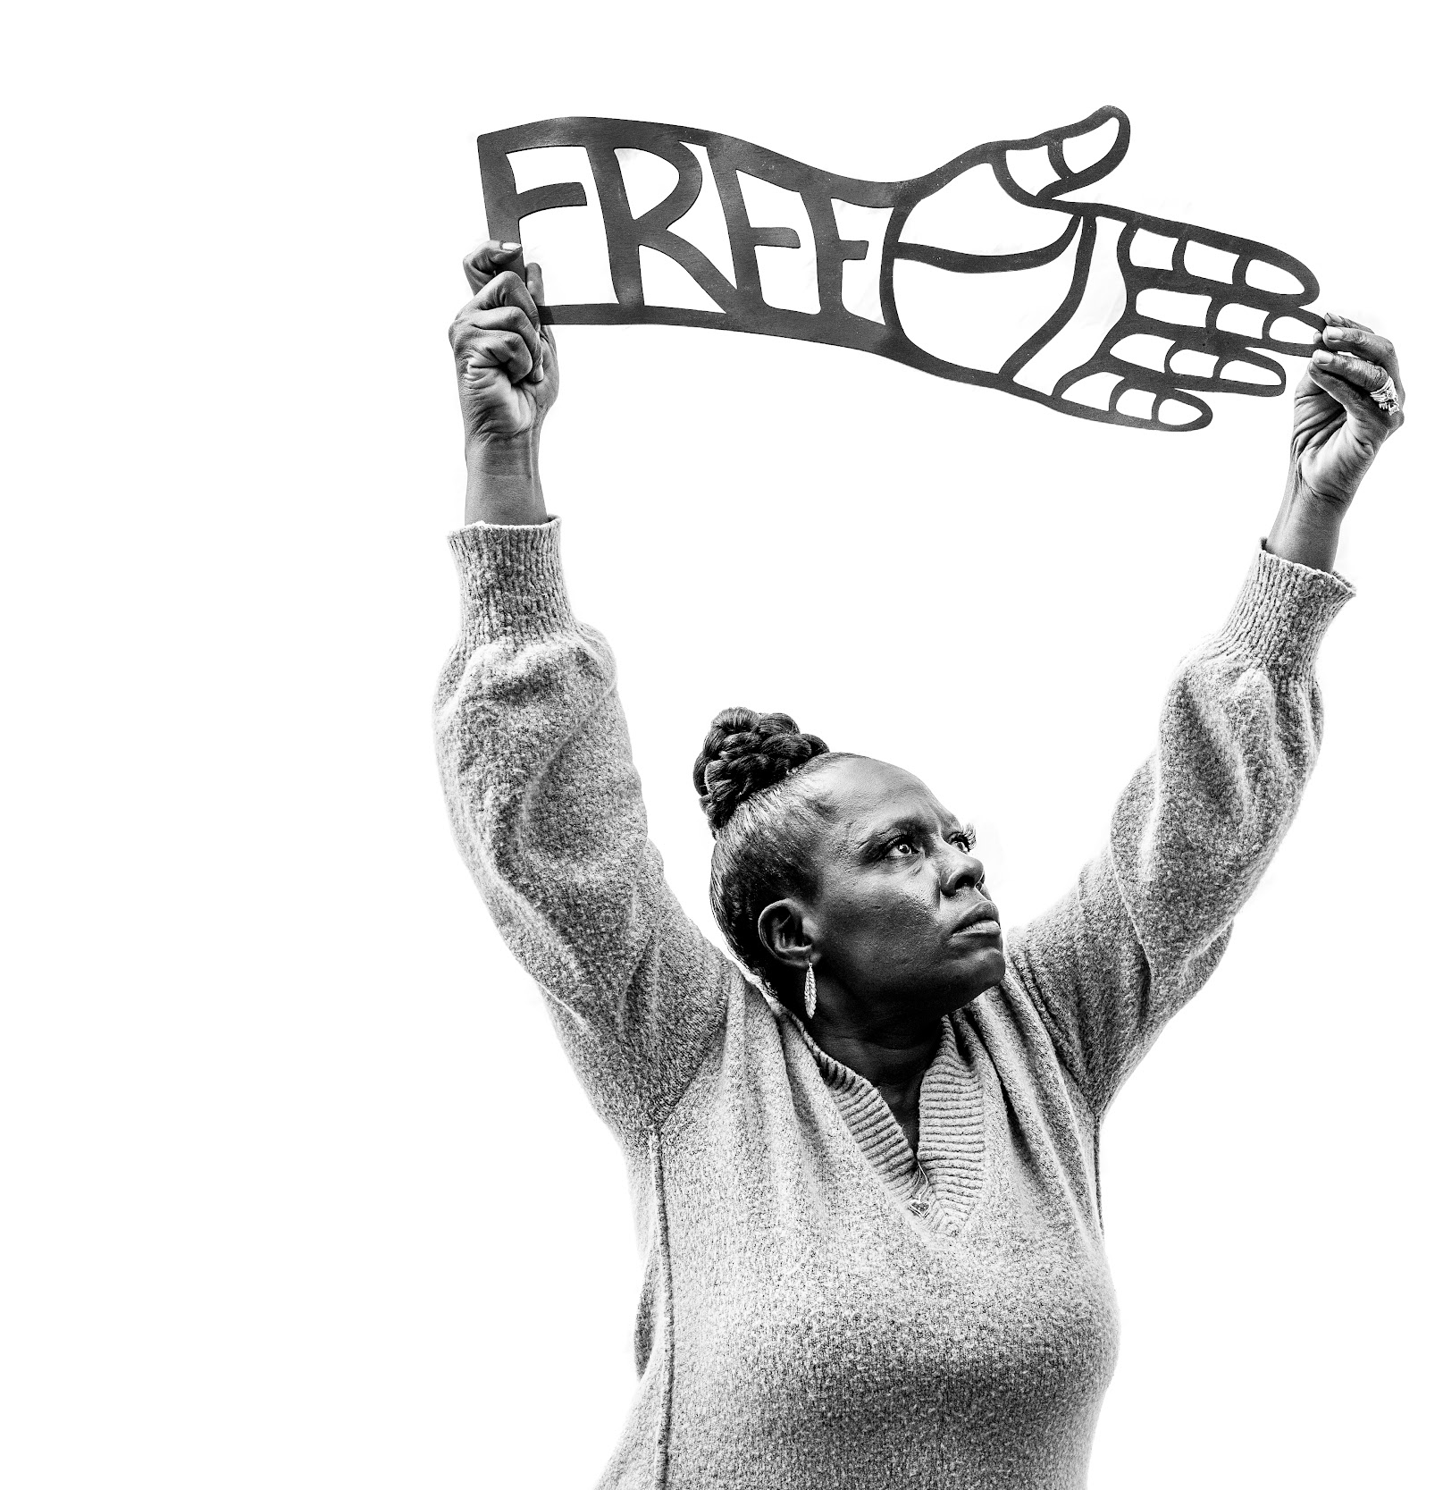
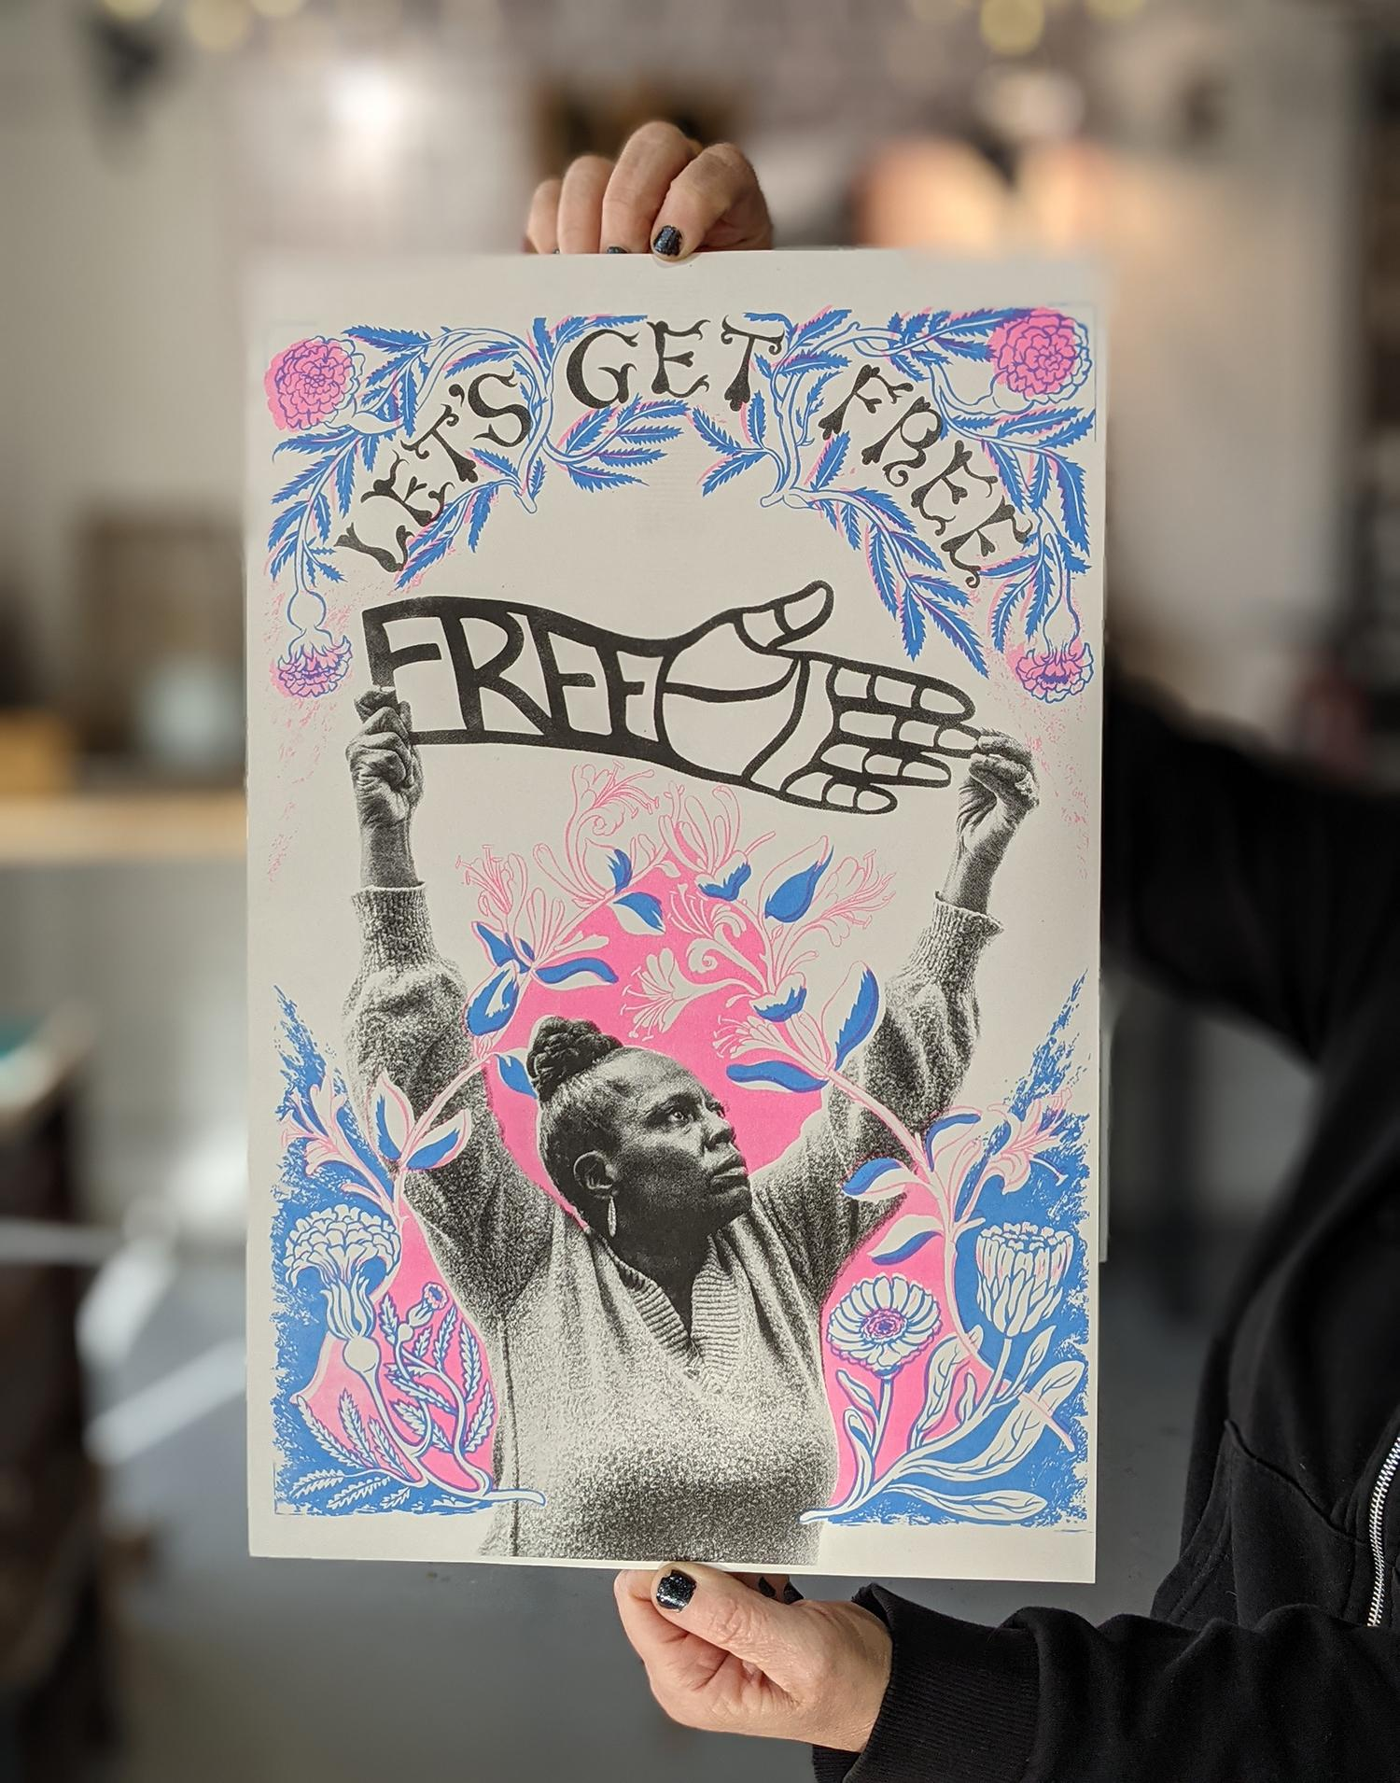
From photo to riso poster, to limited edition print

Slide 31
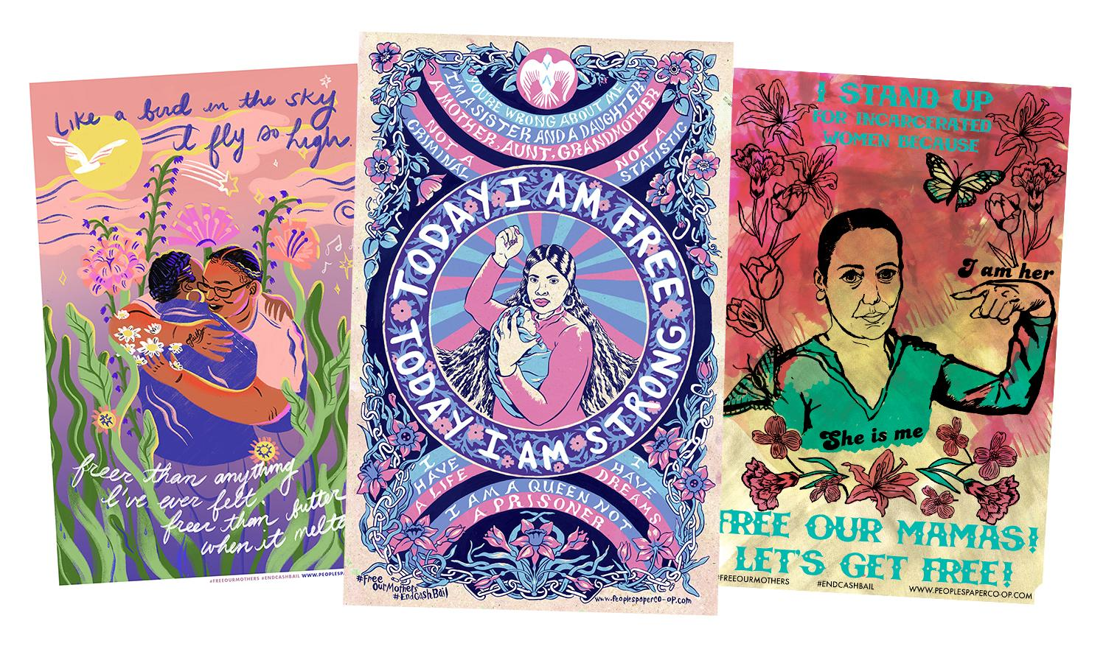

Slide 33
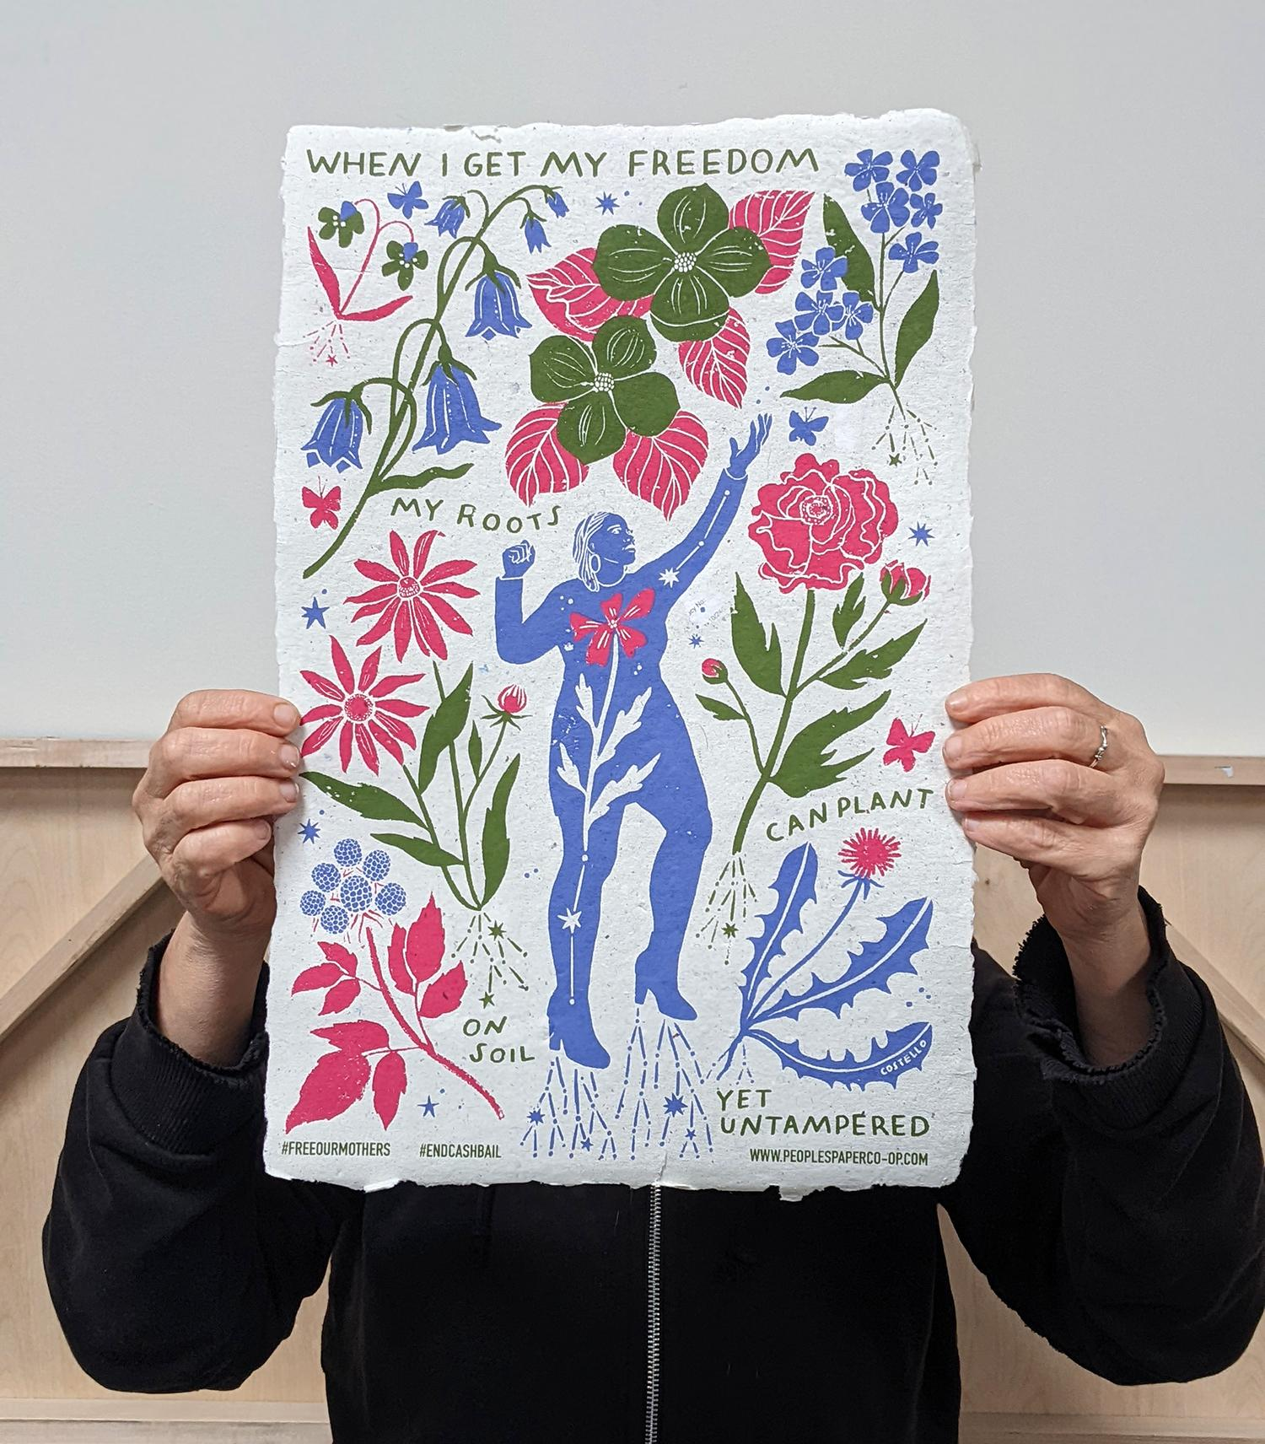
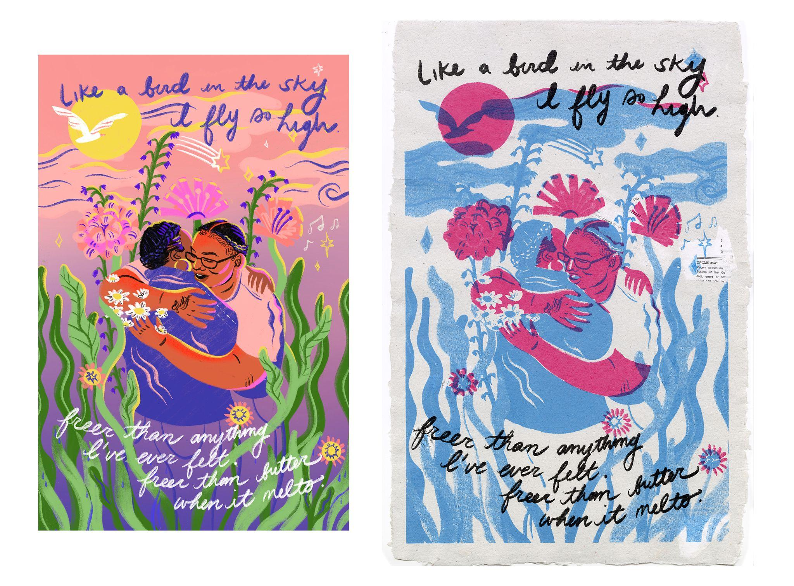

Slide 34
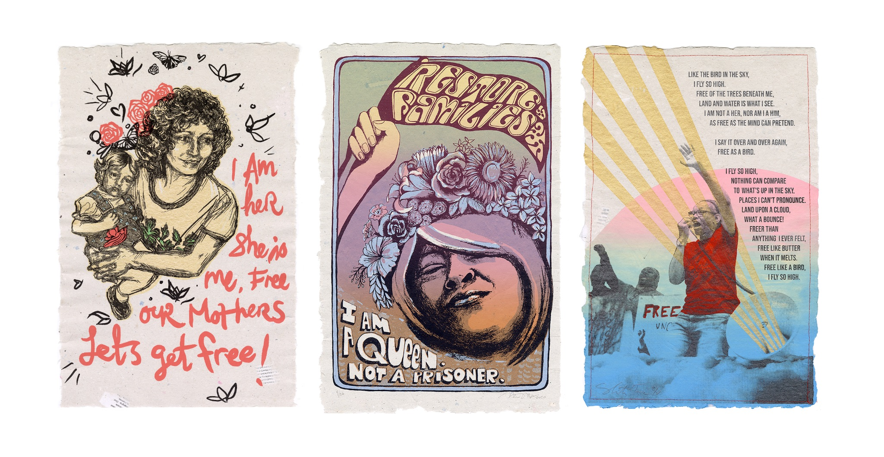

Slide 35
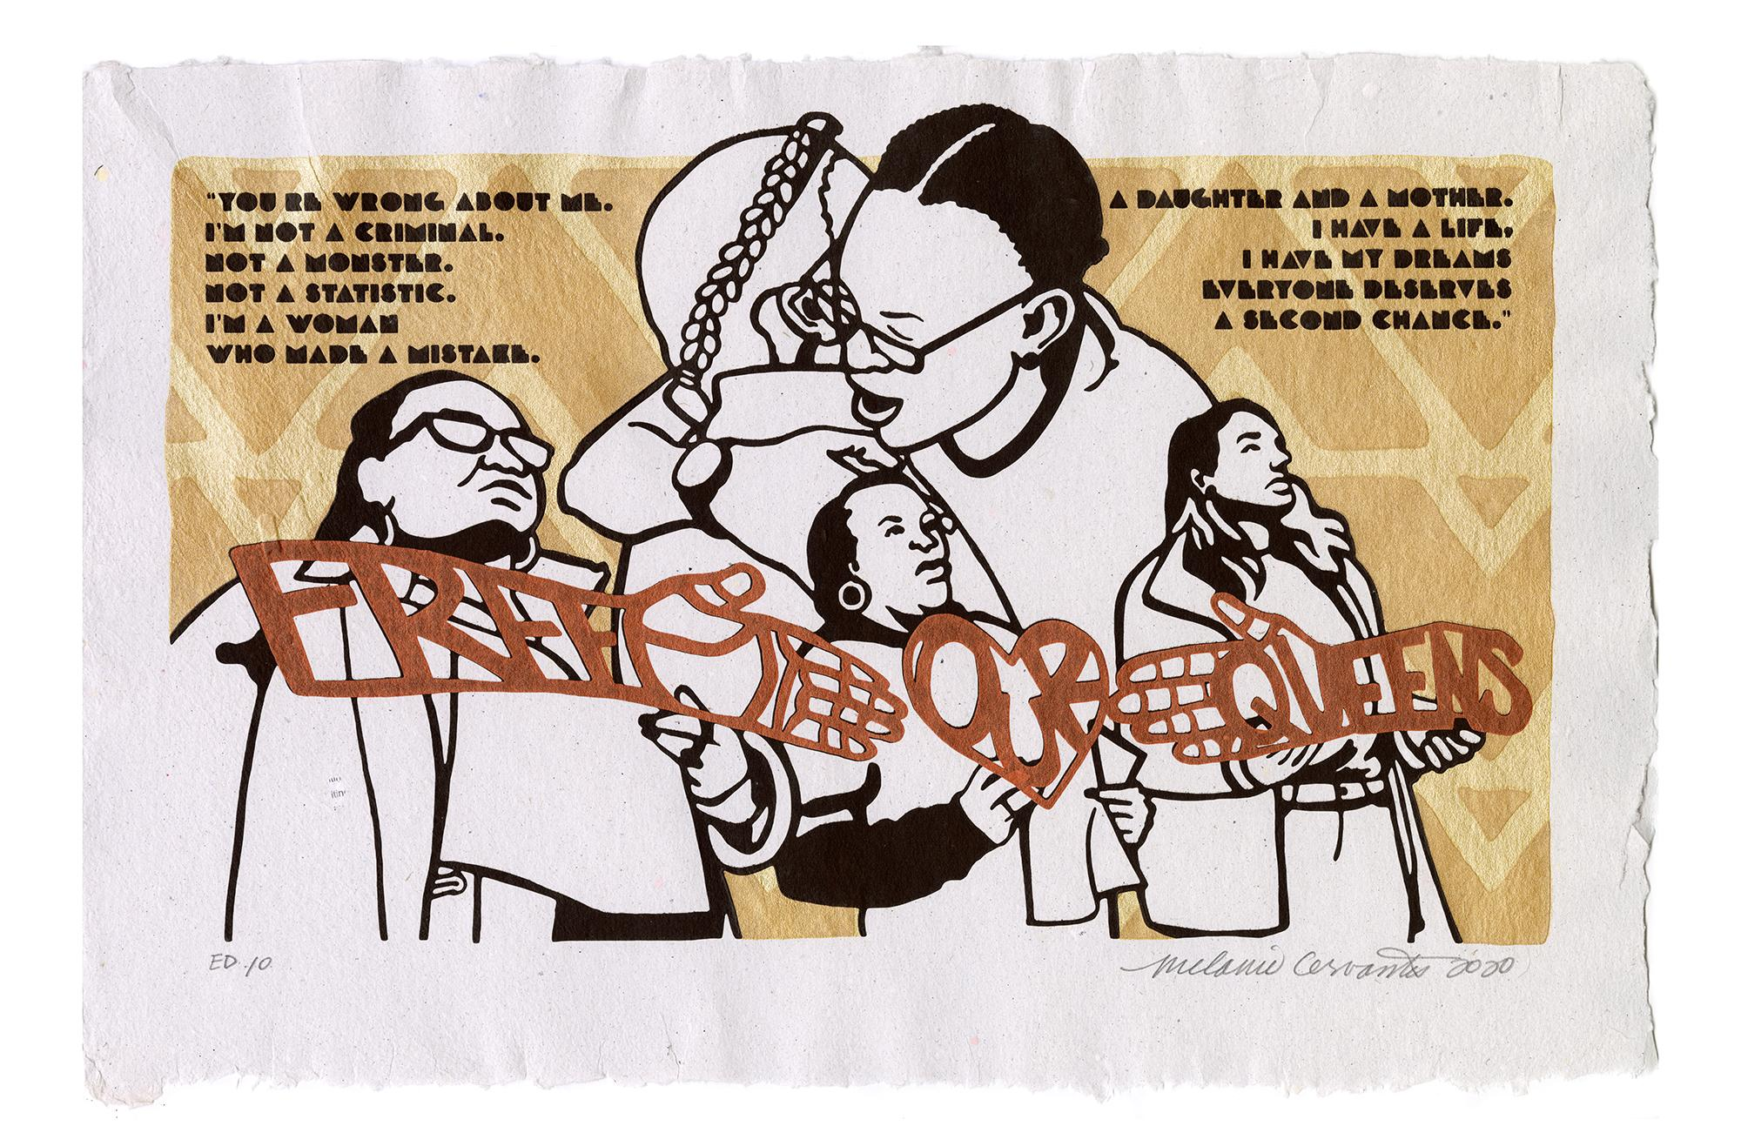

Slide 36
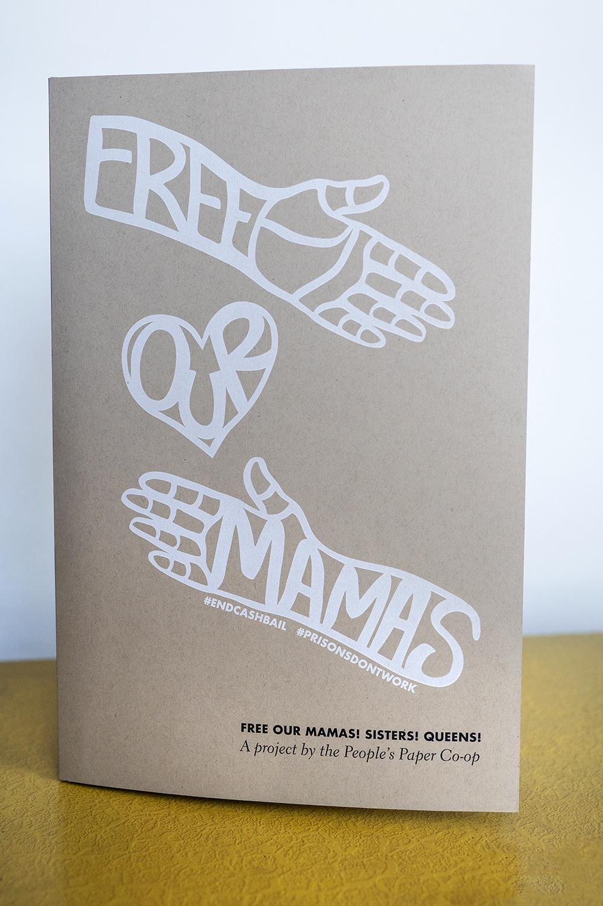
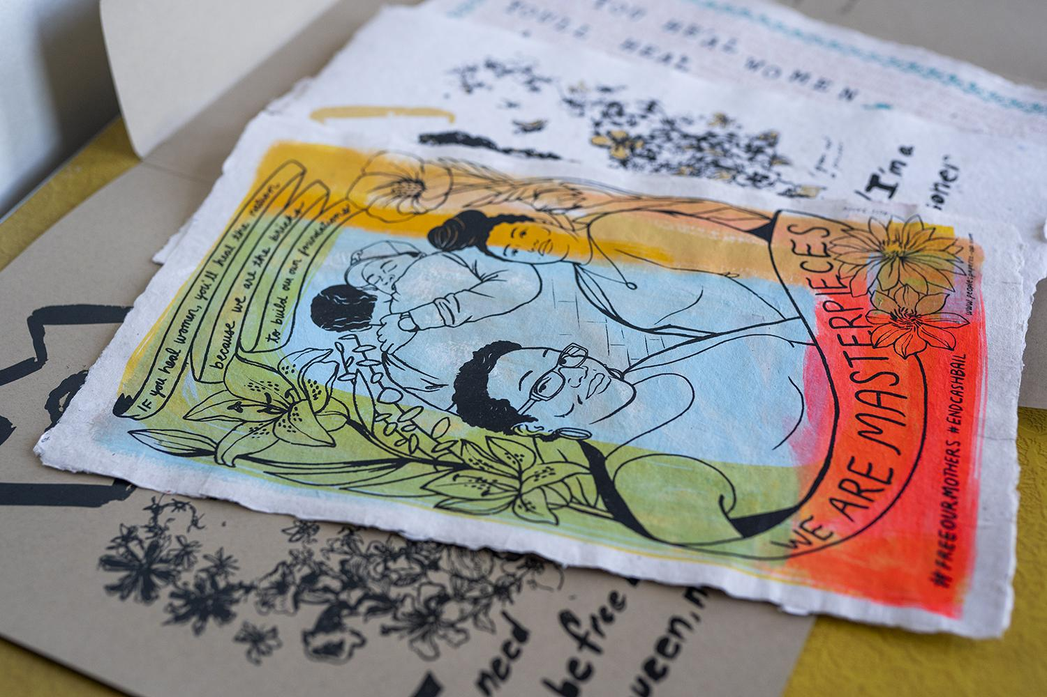
Limited edition portfolios create avenues for raising larger amounts of funds through acquisitions into the permanent collections of museums, libraries, and universities.

Slide 37
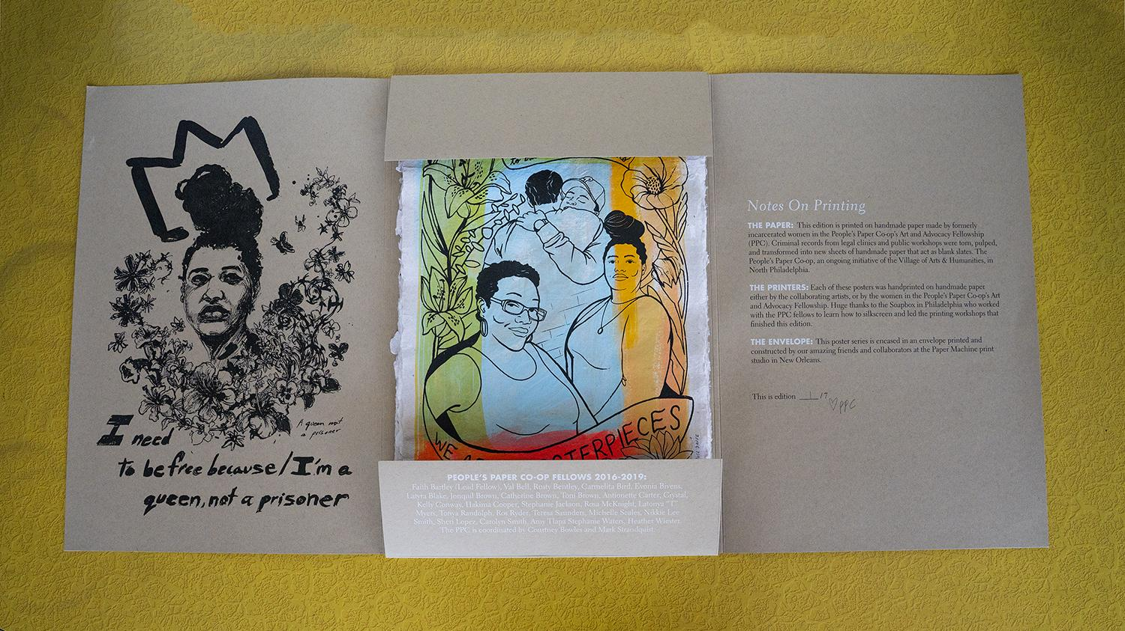

Slide 38
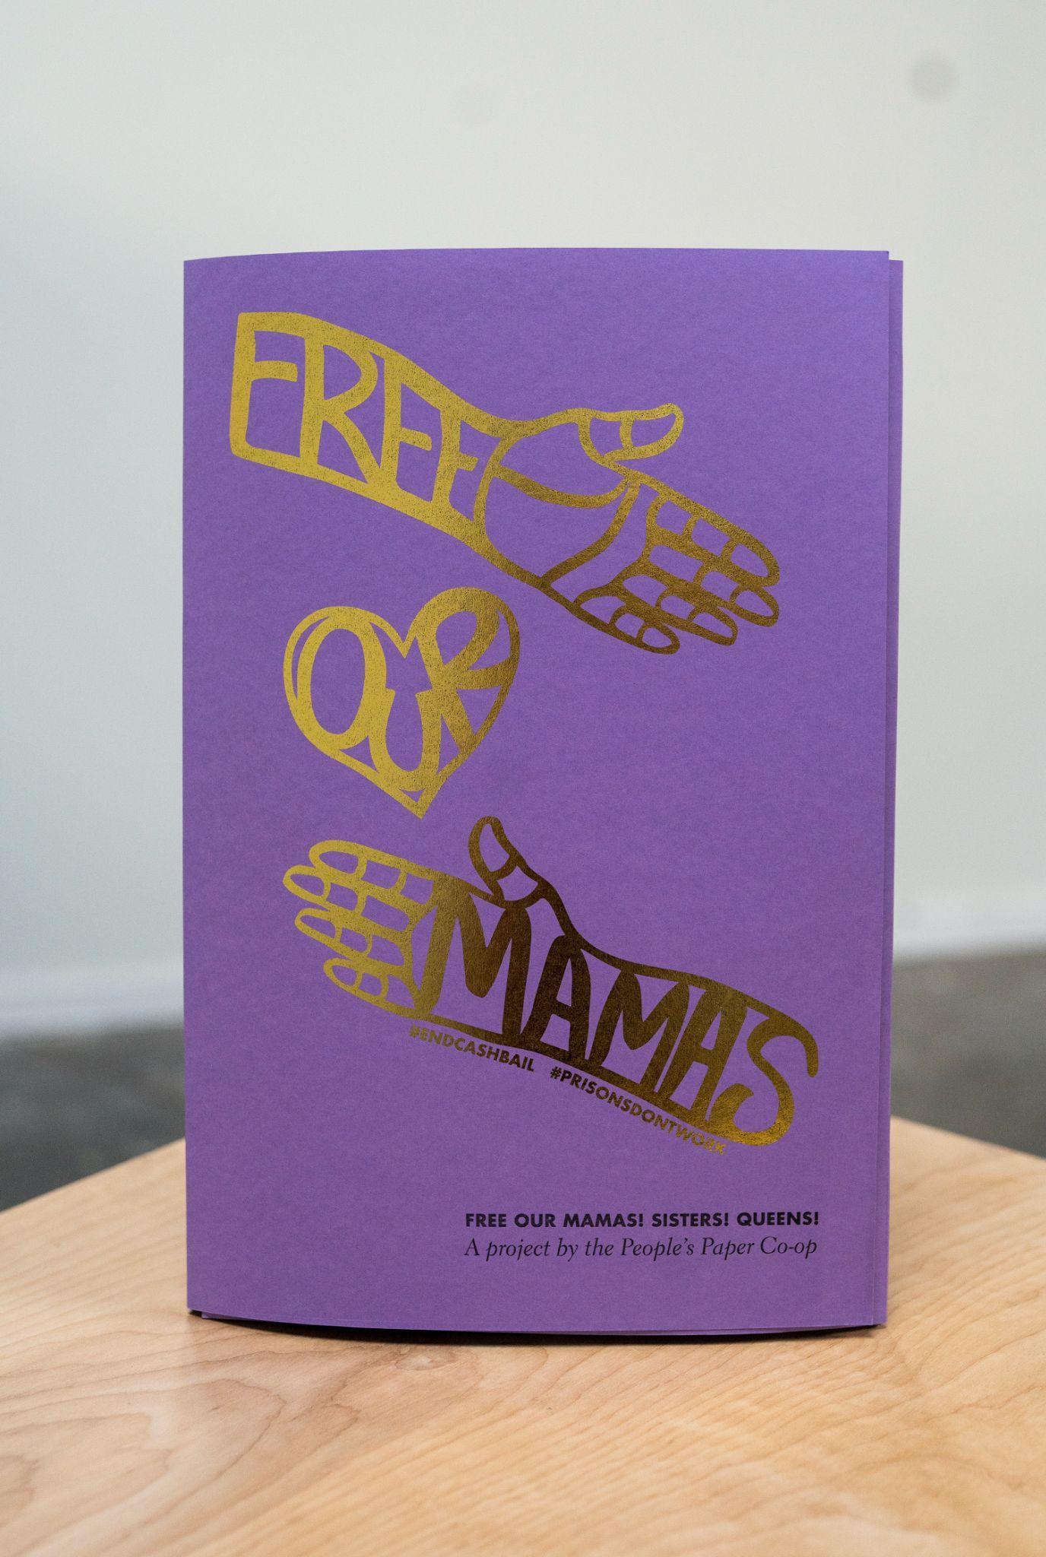


Slide 39


Slide 40



Slide 41


Slide 42


Slide 43


Slide 44


Slide 45


Slide 47



Slide 48


Slide 49




Slide 50


Slide 51



Slide 52


Slide 53


The art that raised money to free women, then becomes a pop up exhibition outside the jail to welcome them home

Slide 54


Slide 55


Slide 56


Slide 57


Slide 58

Then that art is used as parade props for a action calling for the end to cash bail

Slide 59


Slide 60


Slide 61


Slide 62



Slide 63


Hundreds of women in reentry, advocates, and system stakeholders come together to write a bill of rights for formerly incarcerated women

Slide 64


Slide 65

Oscar Romero Award from Rothko Chapel and Haverford Retrospective - leads to 10 year archival book

Slide 66


Slide 67


Slide 68


Slide 69


Slide 70


Slide 71

Until They Come Home

Slide 73


Slide 74


Slide 75


Slide 76



Slide 77


Slide 79
Other projects

Slide 80


Slide 81


Slide 82



Slide 83


Slide 84


Slide 85


Slide 86


Slide 87


Slide 88


Slide 89


Slide 90


Slide 91


Slide 92


Slide 93


Slide 94


Slide 95


Slide 96


Slide 97


Slide 98


Slide 99


Slide 100


Slide 101


Slide 102


Slide 103


