Slide 1
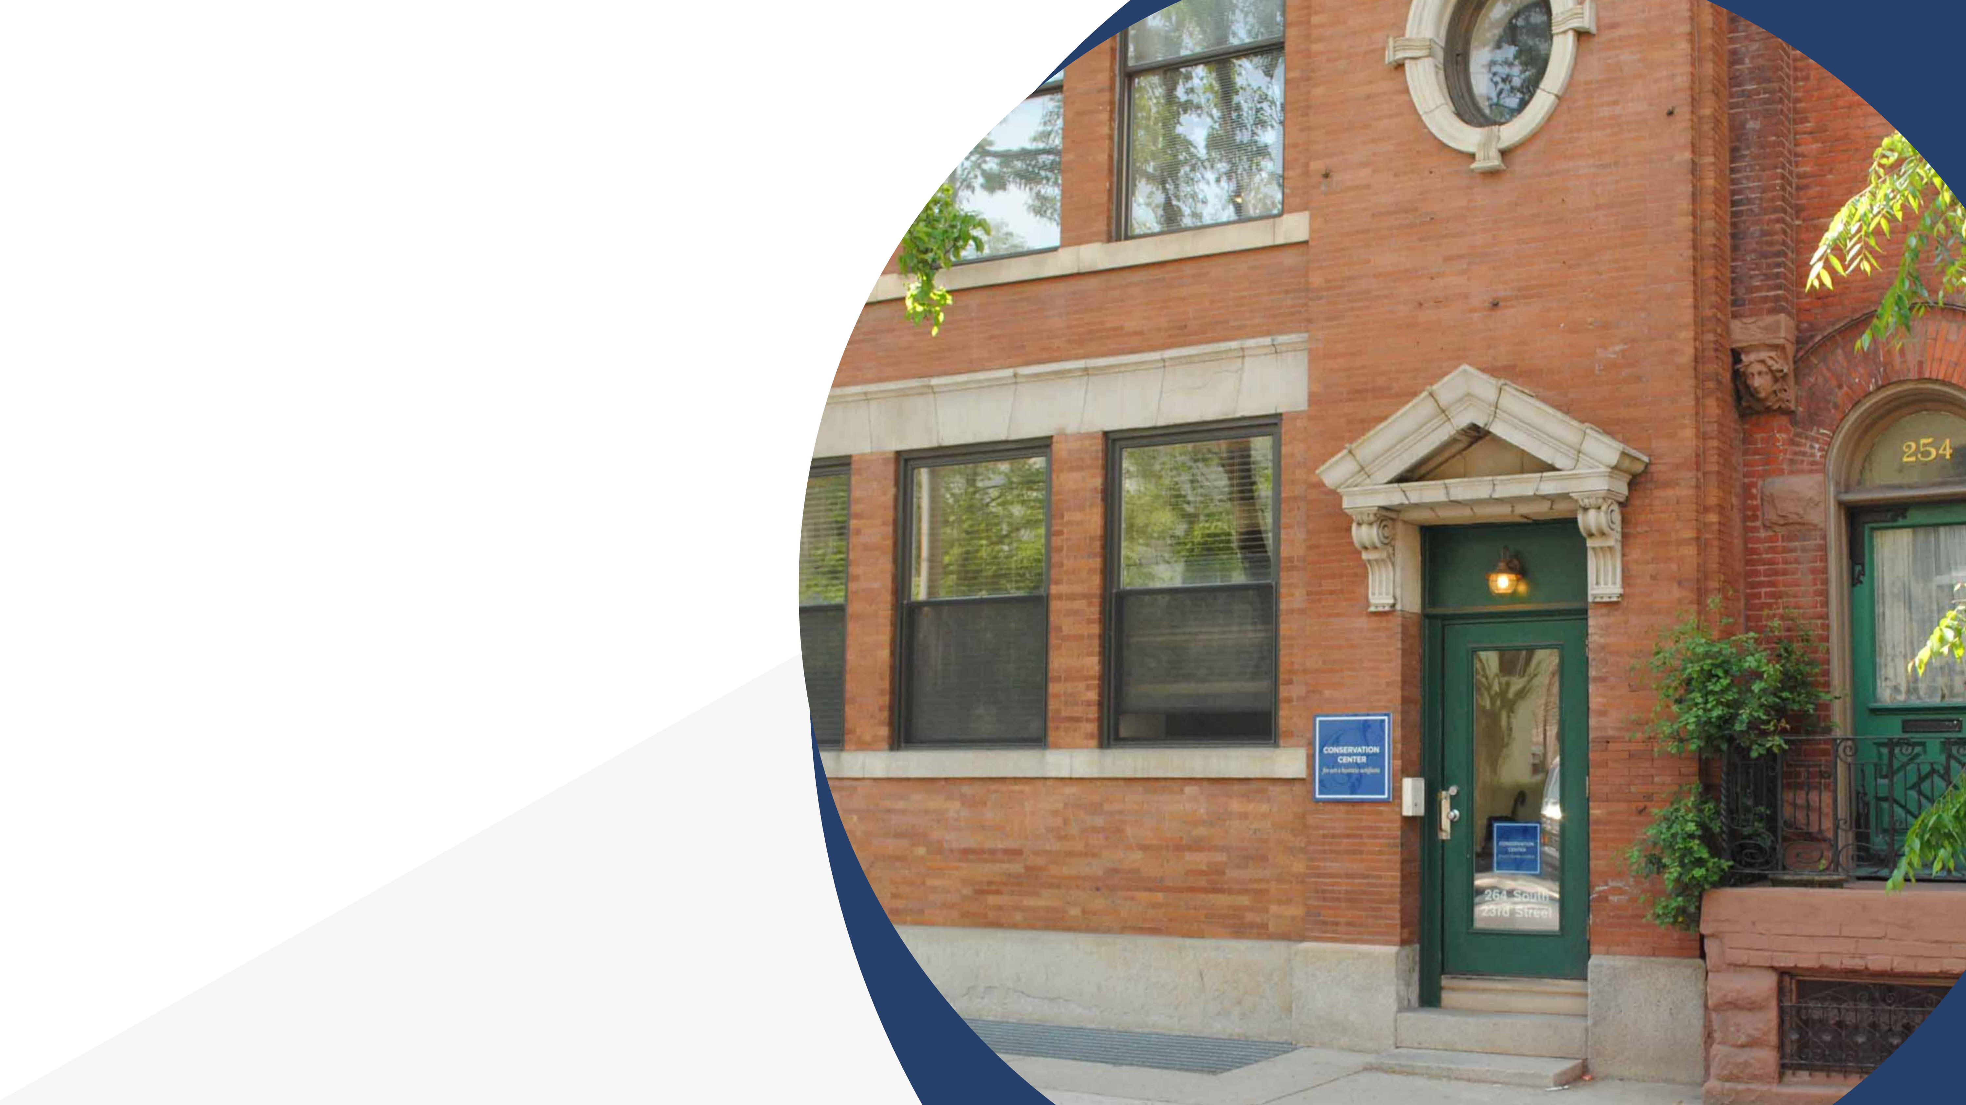
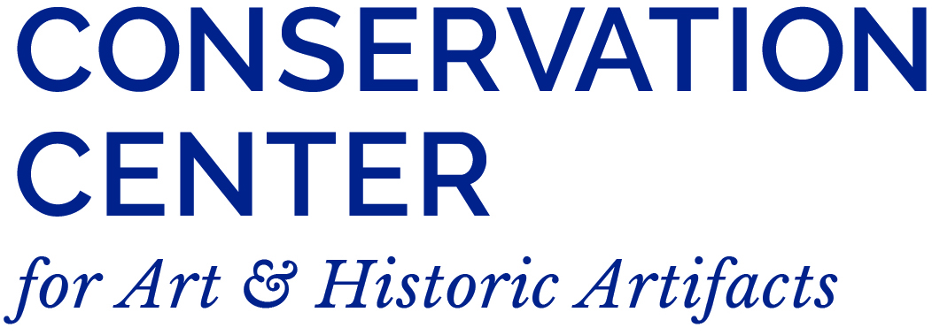
Inventorying Archives
Collections
Kate Philipson, Archives Specialist
Documentary Heritage and Preservation
Services for New York (DHPSNY)

Slide 2
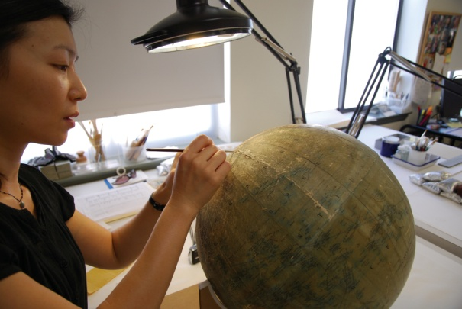
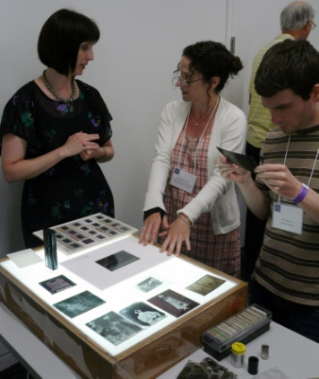
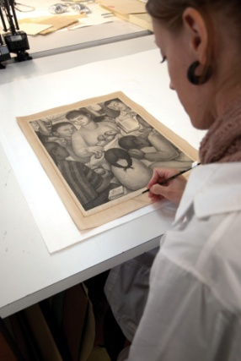
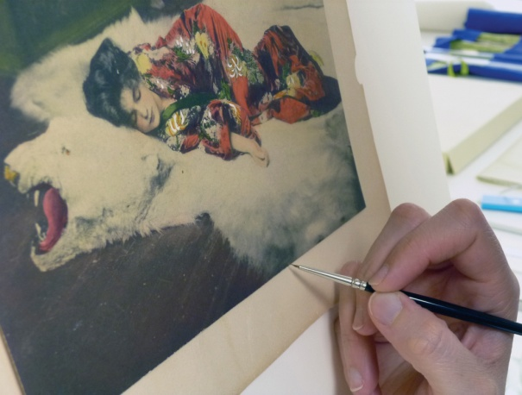
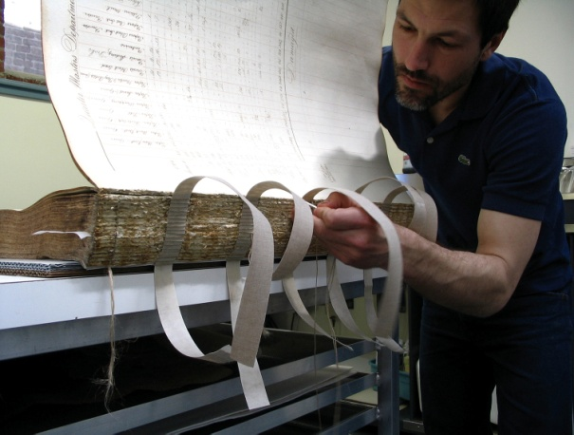
Conservation Center for Art & Historic Artifacts
In a typical year:
Preservation Services specialists complete over 50 survey projects.
Approximately 60 CCAHA-sponsored workshops, conferences, webinars, and training sessions are presented.
The Digital Imaging Services staff digitizes thousands of pages
of fragile archival documents, books, and photographs.
Conservators assess and treat more than 6,000 individual
artifacts, from over 400 clients.
Housing & Framing Services house approx. 75% of the artifacts treated (folder, sleeve, box, mat and frame, or sealed package).

Slide 3


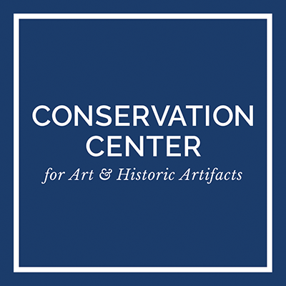
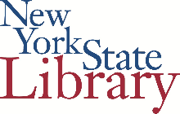
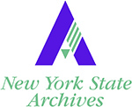

Slide 4
DHPSNY Services
Educational Services
Communications & Outreach
Planning & Assessment Services
* DHPSNY services are provided FREE of charge in NYS

Slide 5
AGENDA
5
Agreements & Understandings
Museum vs. Archives
The Inventory Process
Sticky Situations
Resources
Questions

Slide 6
Agreements
6
Be gentle with yourself
Be realistic with yourself
Don’t panic (you’re not behind)

Slide 7
Understandings
You won’t leave this session an expert (and that’s not your job)
You don’t need to reinvent the wheel, but modification is welcome
Perfectionism isn’t your friend
Stress is an excellent motivator, until it isn’t
Knowledge is power
“The dishes are never done”
7

Slide 8
Museums vs. archives
(collections)
8

Slide 9

What is an inventory?
9
Basic
Comprehensive
A list of objects and their locations
A complete report of the status of collections.
A list of the property held by a collecting organization, ideally connecting each object to an identification number, a physical location, and an intellectual record.

Slide 10
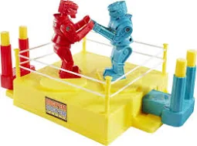
Museums vs. archives
10
Museums
Archives
Works, objects, artifacts, specimens
Individual items
Collect
Preserve
Interpret / provide context
Make available/ accessible
Things with continuing / permanent value
Unique materials created by a person, family, or organization
Collected groups of records

Slide 11
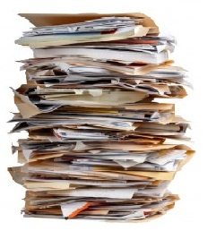
What are archives?
Unique records; often unpublished records
Permanently valuable records of people, businesses, and government (or subjects)
  Collections have a unifying characteristic, either from a common source or as a natural product of activity or function
Arranged and described in the aggregate
“Collections that preserve contextual relationships between records”
  ^^This is what defines their significance and importance!
11

Slide 12
Archival principles
…help to determine collections
Provenance
  dictates that the records of one person or organization are not to be mixed with records of another person or organization
Original Order
  the organization and sequence of records established by the creator of the records; strive to maintain this in all collections
12

Slide 13
Archival principles
Levels of Arrangement
Repository
Collection
13
Series
File
Item

Slide 14
The Inventory Process
14

Slide 15
What
Basic / Broad Inventory
An overview of your entire repository, list all collections
Always in the aggregate
Used as an internal tool
15
Detailed Inventory
Per collection
Reviewing materials within each collection - on a folder or item level
Inventory information would help populate “descriptive records”

Slide 16
Who
Collections Manager (staff)
Collections Committee
Familiarity with collections (or with the institution)
Cross-training
Teams of at least 2 people
Ensure student/intern/volunteer oversight
16
Long-term volunteer

Slide 17
Why Conduct one?
“[the objects in our collections] are not ours; they are not even “our museum’s.” These objects belong to current and future generations and, as such, are not ours to lose track of or misplace.”
- Museum Registration Methods, 5th Edition.
17
AKA:
Know what you have; know where it is; take good care of it

Slide 18
Other Reasons
Intellectual control
  Collections scope – policy, guidelines, accessioning/ deaccessioning
  Research accessibility, interpretation, exhibits, outreach
  Save time! Improve resource allocation!
Preservation
  Security, emergency preparedness, insurance claims
  Identify collections health concerns; identify mitigating actions
Funding opportunities
why
18

Slide 19
The Process
Make a plan
  Purpose & scope
  Timeline & workflow
  Consider physical space
  Other logistics
Gather your tools
Train (if-needed)
Trial / Test Run / Modify
Inventory!
Next steps
how
19

Slide 20
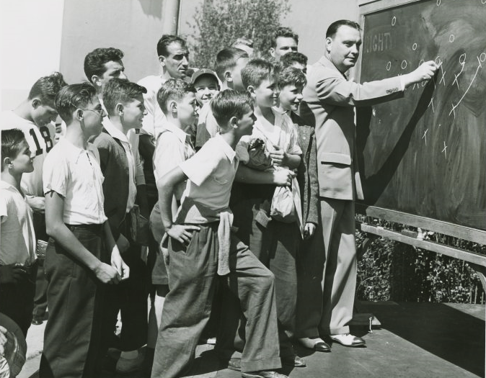
Make a Plan
Establish purpose & scope
Estimate timeline & workflow
Consider physical space
Use what you already have
Other logistics
how
20
‘Sports - Football - Jim Crowley writing on blackboard.’
The New York Public Library Digital Collections. 1935 - 1945.

Slide 21
Physical Space
g
Organize your storage area if possible or necessary
  Can you define discrete areas within the room? Can you safely move around? Is there anywhere to set a laptop or clipboard?
Will the materials remain here, where they are stored at the time of inventorying?
  Do you need to have an improved or additional space to move things into? What about a quarantine area?
Plan how you will name or designate each room, space, shelf, drawer – you will have to record a location field, and it must be clear!
  Hierarchical Location Authority
21

Slide 22
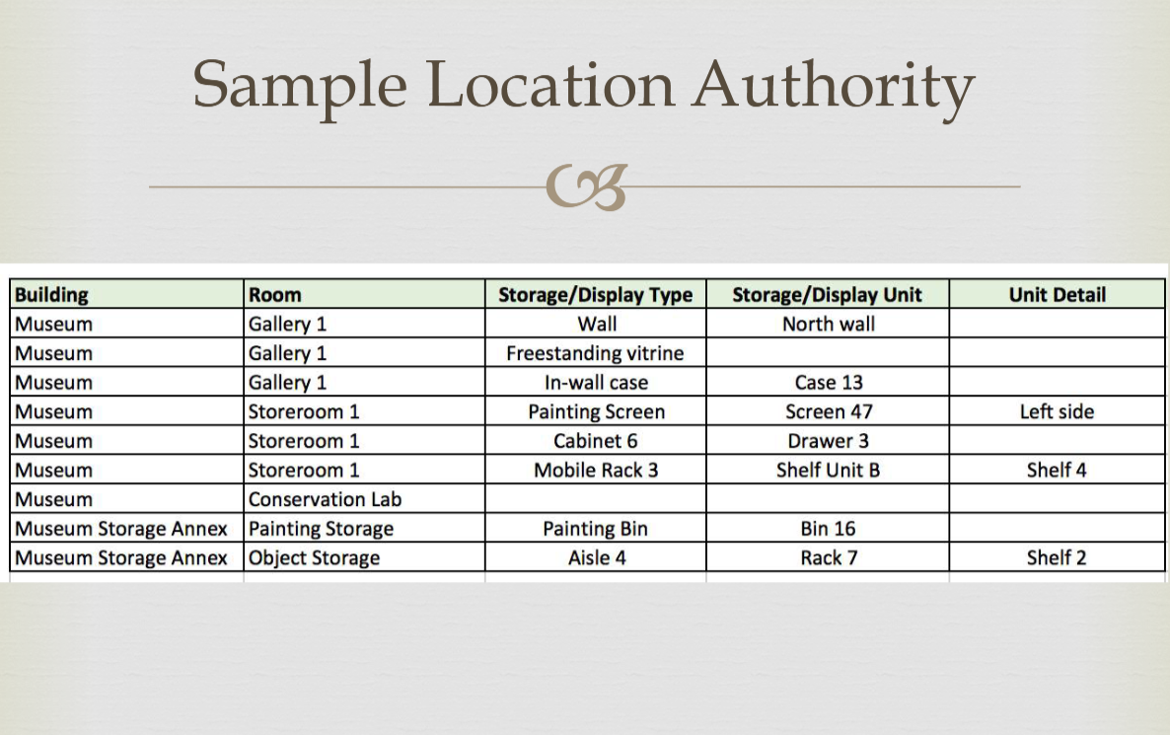
Physical Space
22
FAIC - Connecting to Collections Care Webinar: “A Place for Everything and Everything in Its Place: Conducting (and Maintaining!) a Collection Inventory”

Slide 23
Intellectual Tools
Practical Tools
Policies & Procedures
  Collections Scope
  Data entry procedures
  Accessioning & Deaccessioning
  Undocumented materials, etc.
  Flagging procedures – condition issues, rehousing needs
Numbering System
Standard vocabulary – shared and consistent terminology
Existing collection records
Labeling tools
  Temporary – applied to housing
Collection Management System (database)
Spreadsheets
Physical workspace
23

Slide 24
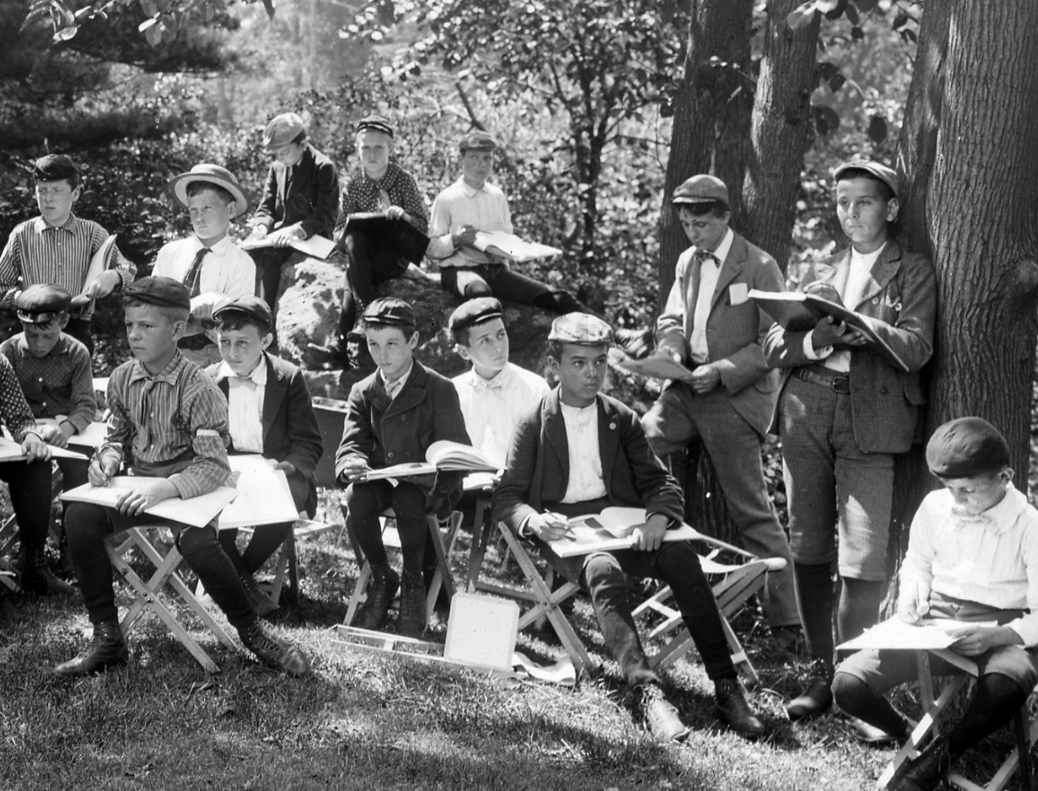
Information to Include
24
‘New York City. Central Park. Boys sketch class at work’, New York State Archives, 1900.
*Which data fields you record will be different depending on your goals (both inventory-wise and institutional), your institutional history, and the types of materials that are held in your collection*

Slide 25
Information to Include
Staff/volunteer name
Date of inventorying work
Location information
What requires follow-up?
  Condition Issues
  Rehousing needs or special storage needs
  If there is missing information
Identifying number (accession, etc.)
Creator/donor
Collection title / VERY basic description
Medium/ format (all)
Quantity (shelves, boxes, drawers – big picture)
[Measurements]
Inventory data
25
Collection record

Slide 26
Next Steps
Address your flags
Back it up!
Establish a maintenance system
Consider which collections will
get more detailed description
Spread the word & celebrate!
  make the most of this huge project!
Fundraise
  Future projects can be more specific
26
Goat Island, The Steps, Winter. New York State Archives. C. 1910

Slide 27
Sticky situations:
When inventory work is extra complex
27

Slide 28
Archives & Objects
Your collection includes both:
  archival collections (of records, considered in the aggregate)
  Museum collections (of objects/artifacts, considered individually)
28

Slide 29
‘chicken and egg’
How do you inventory on a collection level, if collections aren’t yet defined?
How do you define collections if you don’t know what you have (because you haven’t inventoried!)?
29

Slide 30
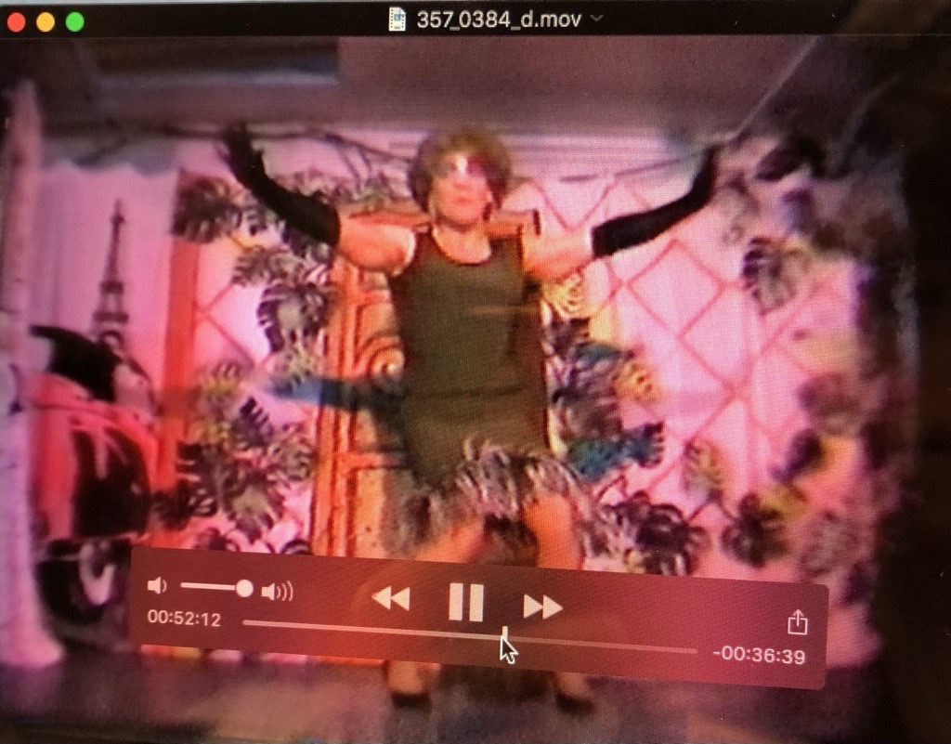
Audiovisual (AV) materials
Audio cassette tapes + VHS tapes (magnetic media), film reels (8mm, 16mm)
Typically considered ‘archives’ materials – especially when comprised of unique, primary source records
Start on a broad level
Must *eventually* inventory AV materials on an item level; use labels in the meantime (as best as possible) to understand contextual relationships
La MaMa Experimental Theatre Club Archive
Open Reel Video Collection

Slide 31
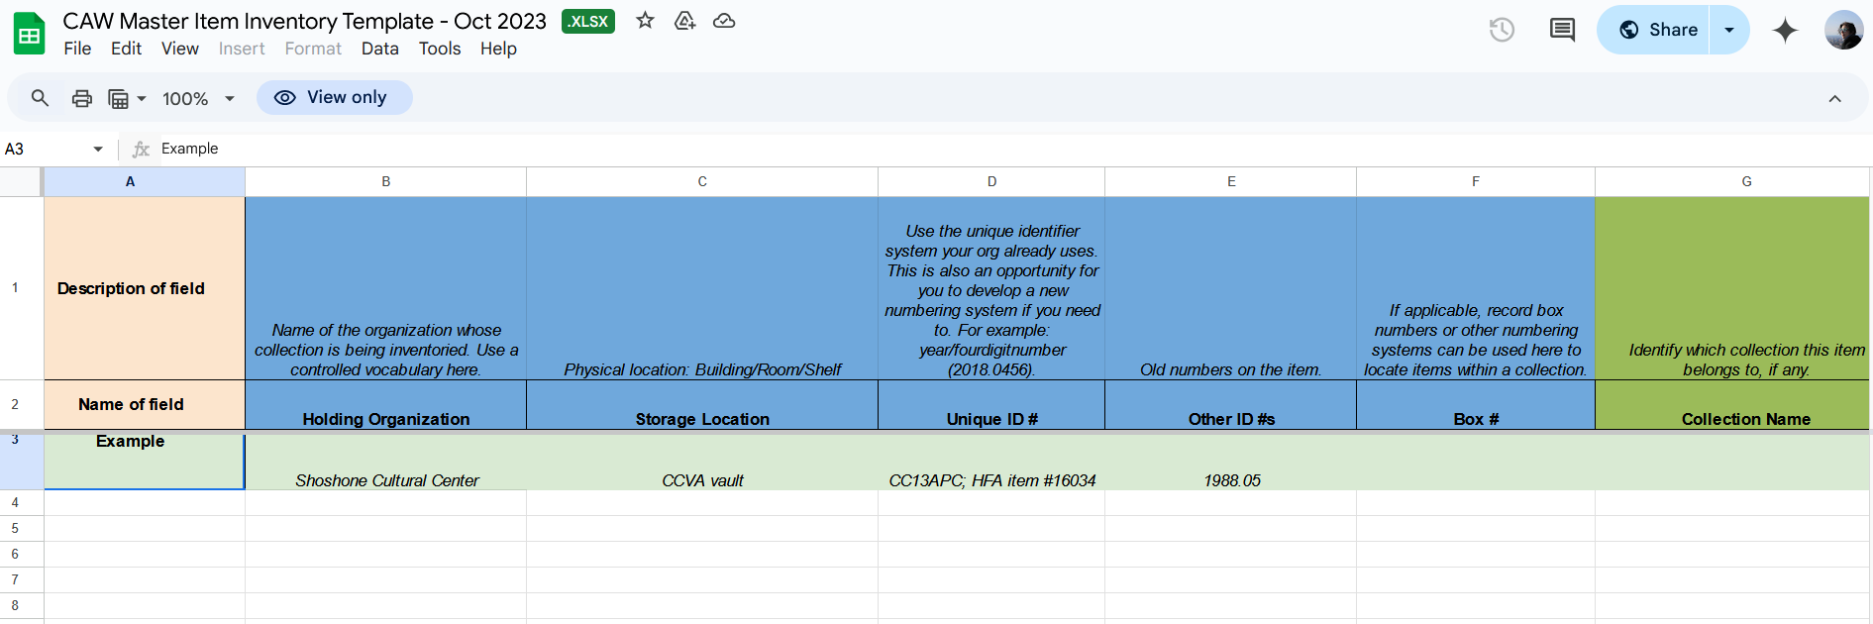
Audiovisual (AV) materials resources
Digital Readiness Toolkit – created by Recollection Wisconsin, in collaboration with the Community Archiving Workshop (CAW)
  Detailed Audiovisual Collection Inventory Template and Instructions, complete with a guide to identify AV formats – Spreadsheet first!
AVCompass – created by Bay Area Video Coalition (BAVC) – Airtable database
  Many other AV collections resources are on this page too

Slide 32
Hazards
  “Flag” the collection record and label. Restrict handling.
  Put on your PPE!
  Mold and pests: isolate immediately
    Freeze, if possible
    Upgrade to a respirator
    Follow IPM procedures, consult a conservator if necessary
  Research & confirm
    If confirmation is not possible, assume hazardous
  If hazardous or unconfirmed, follow appropriate storage & handling procedures; consider deaccessioning as-needed
  If not hazardous, return to normal operations; indicate safety on the collection record/ in the inventory
  Update records, labels, and CMP accordingly

Slide 33
SAA Archival Repatriation Committee
Principles in Indigenous Archival Repatriation (PINAR)
  drafted in June 2024 by the Society of American Archivists Archival Repatriation Committee
  Centering Indigenous communities, highlighting archivists’ responsibilities to these records, and centering relationships
What to do?
  “Flag” the collection record
  Stop. Do not perform any further research into the object.
  Take off exhibit; take off online catalogue.
  Keep an eye on the Archival Repatriation Committee ‘microsite’ for updates and final publishing of the Principles

Slide 34
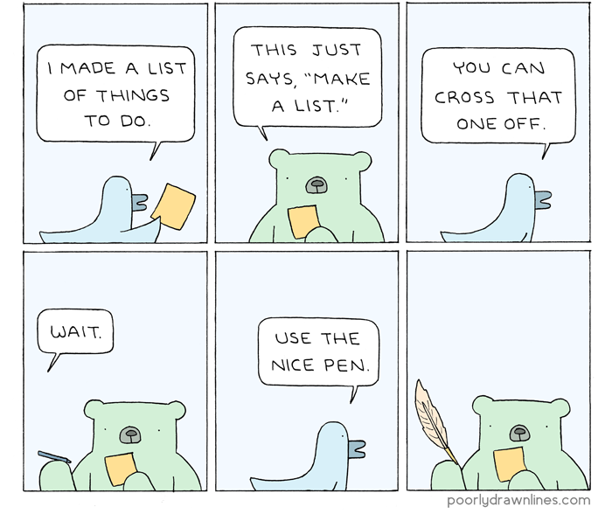
Final Thoughts
It doesn’t have to be scary! Utilize free resources and planning opportunities. (And use the nice pencil.)
Poorly Drawn Lines, by Reza Farazmand. “Kevin is Self Employed”

Slide 35
Further Resources
Foundation for Advancement in Conservation (FAIC). Connecting to Collections Care Webinar: “A Place for Everything and Everything in Its Place: Conducting (and Maintaining!) a Collection Inventory,” by Maureen McCormick, 2016.
Collections Care & Conservation Alliance. “Know it All: Inventory 101,” by Eileen Corcoran and Rachel Onuf, 2021. Description at this link. Watch recorded webinar at this link.
Simmons, John E.: Things Great and Small: Collections Management Policies. Washington DC: The AAM Press, 2006.
Controlled vocabularies exist in a variety of standards, what you use will depend on your institution and collections: commonly used ones include Library of Congress Subject Headings (and others), Virtual International Authority File, GeoNames, and the Getty Art and Architecture Thesaurus
Collections size/extent calculator tools: UNLV Rebel Archives Calculator and Yale Beinecke Library Linear Footage Calculator

Slide 36

Kate Philipson
Email: kphilipson@dhpsny.org
Questions?
DHPSNY staff is available to answer your questions. Contact us at info@dhpsny.org or (215) 545-0613.
Connect with us!
facebook.com/dhpsny
@dhpsny
@dhpsny

