Slide 1
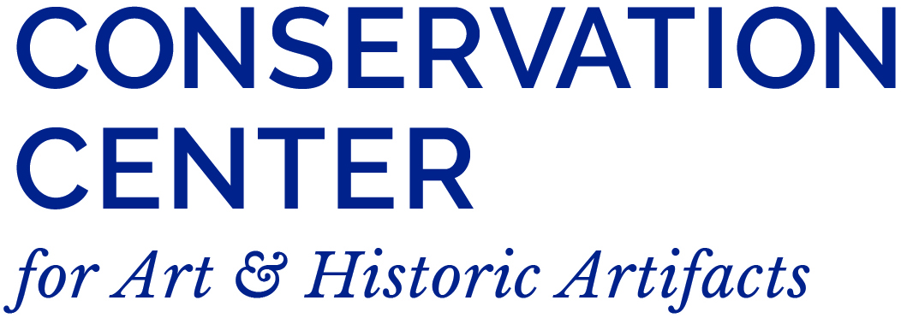
The Florence Price Archives: A Case Study

Slide 2
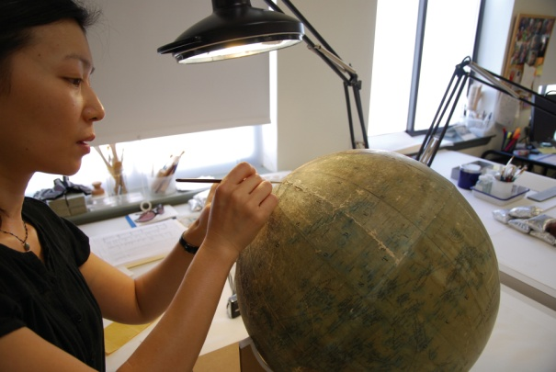
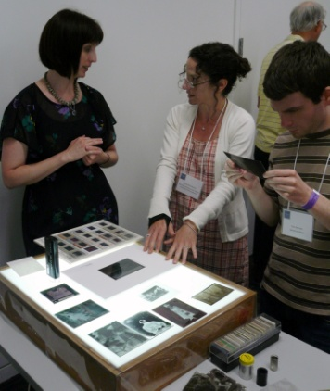
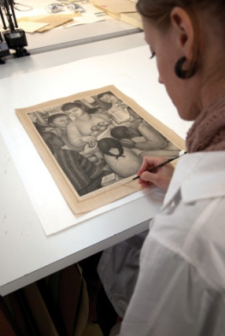
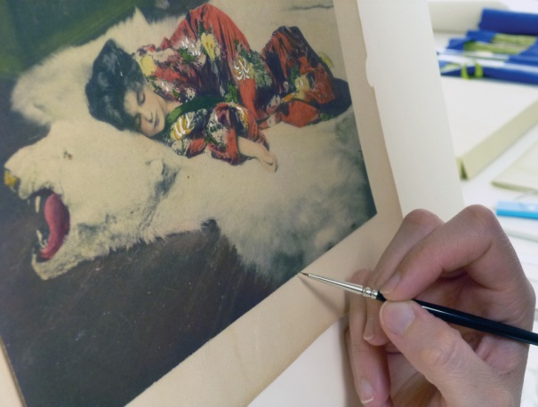
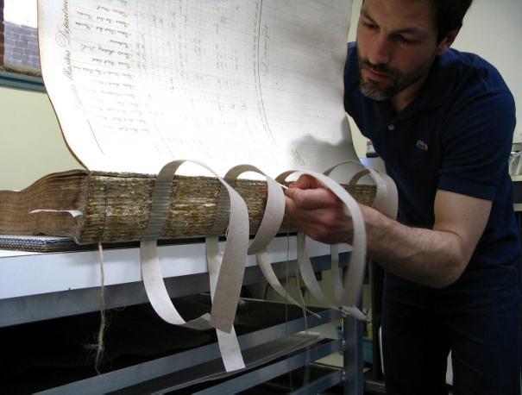
Conservation Center for Art & Historic Artifacts
In a typical year:
Preservation Services specialists complete over 50 survey projects.
Approximately 60 CCAHA-sponsored workshops, conferences, webinars, and training sessions are presented.
The Digital Imaging Services staff digitizes thousands of pages of fragile archival documents, books, and photographs.
Conservators assess and treat more than 6,000 individual artifacts, from over 400 clients.
Housing & Framing Services house approx. 75% of the artifacts treated (folder, sleeve, box, mat and frame, or sealed package).
Notes:
And one quick note about the organization I work for, the Conservation Center is a regional conservation lab and preservation services facility. We are based in Philadelphia, but we work with organizations and clients all across the country. Our conservators treat paper-based objects like books, photographs, documents, artwork on paper, and more. Our preservation services staff work in the field, providing education programs and helping institutions plan for the future of their collections.
As a preventive conservator, I work with both the conservation department and the preservation department to support preventive conservation projects and teaching. CCAHA also offers a wide range of digitization services, as well as fundraising assistance, housing and framing, and more. You can learn more about us and what we do at our website, ccaha.org.

Slide 3
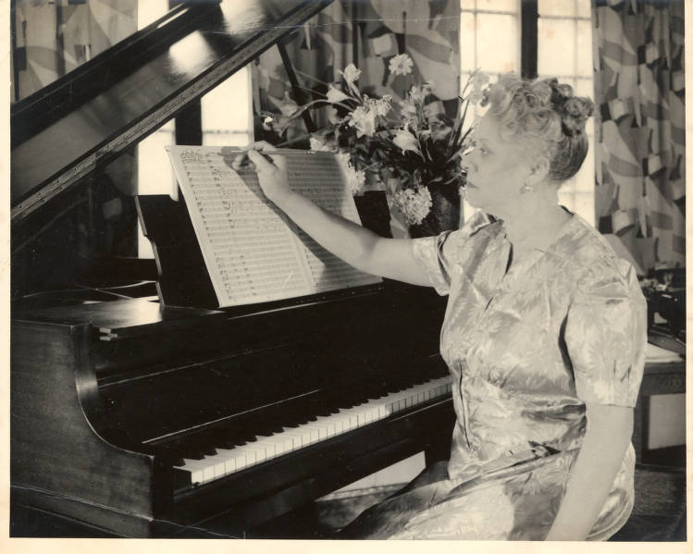
After the Treasure Trove
2009
Discovery of Price material by Gatwoods in St. Anne, Illinois
2010
Tom Dillard and Tim Nutt negotiated acquisition and transfer
2014
Separation of damaged material; processing coordinated with Barbara Jackson, Jim Greeson and other devoted scholars of Price locally
2014
Additional material made available from granddaughter
2015
MC988a released to immediate use; many requests for access to separated material
2016
Waiver in place and other precautions; assessment and preservation work; MC988b finally available
2018
Violin Concerto No. 2 and other premiers helped garner international attention
2019
Schirmer exerts rights negotiated with Price descendants; new publications ensue as well as scholarly concern
2022
New material acquired, processed and released

Slide 4
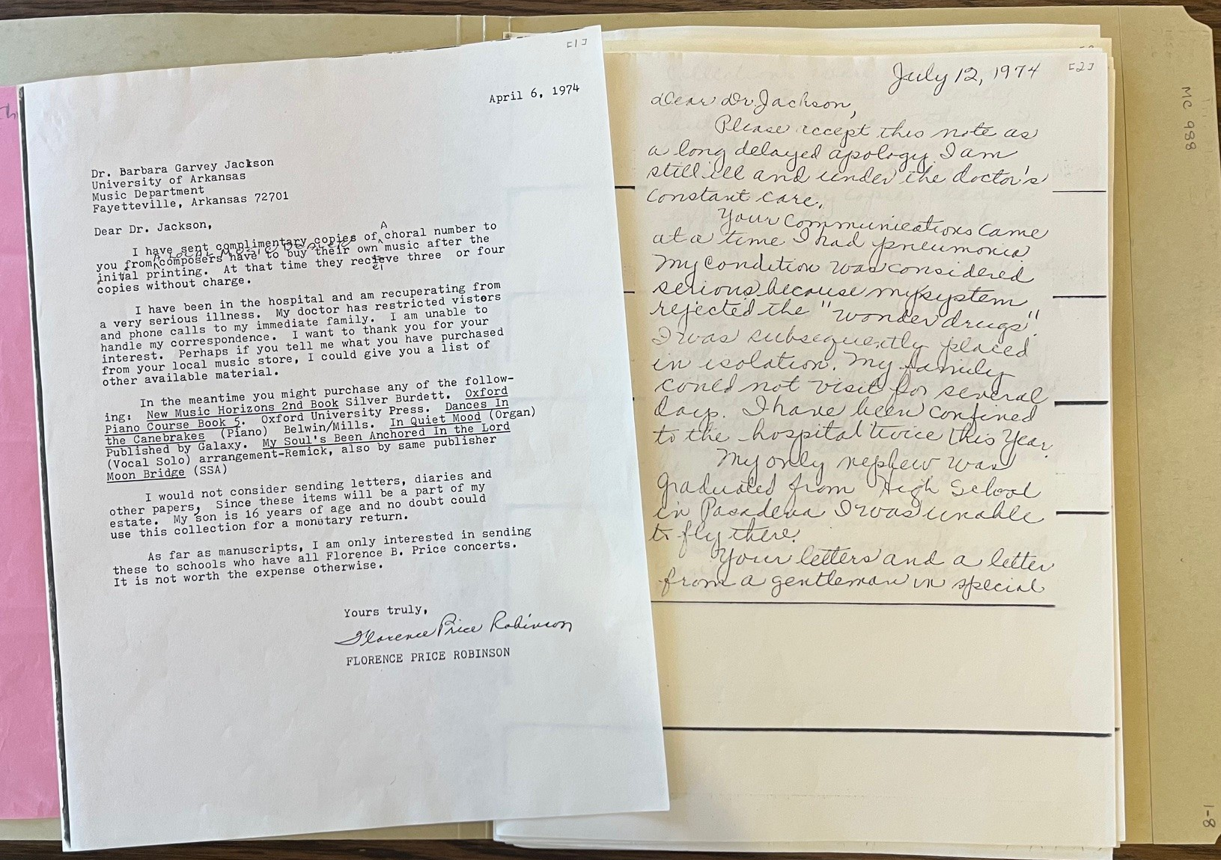
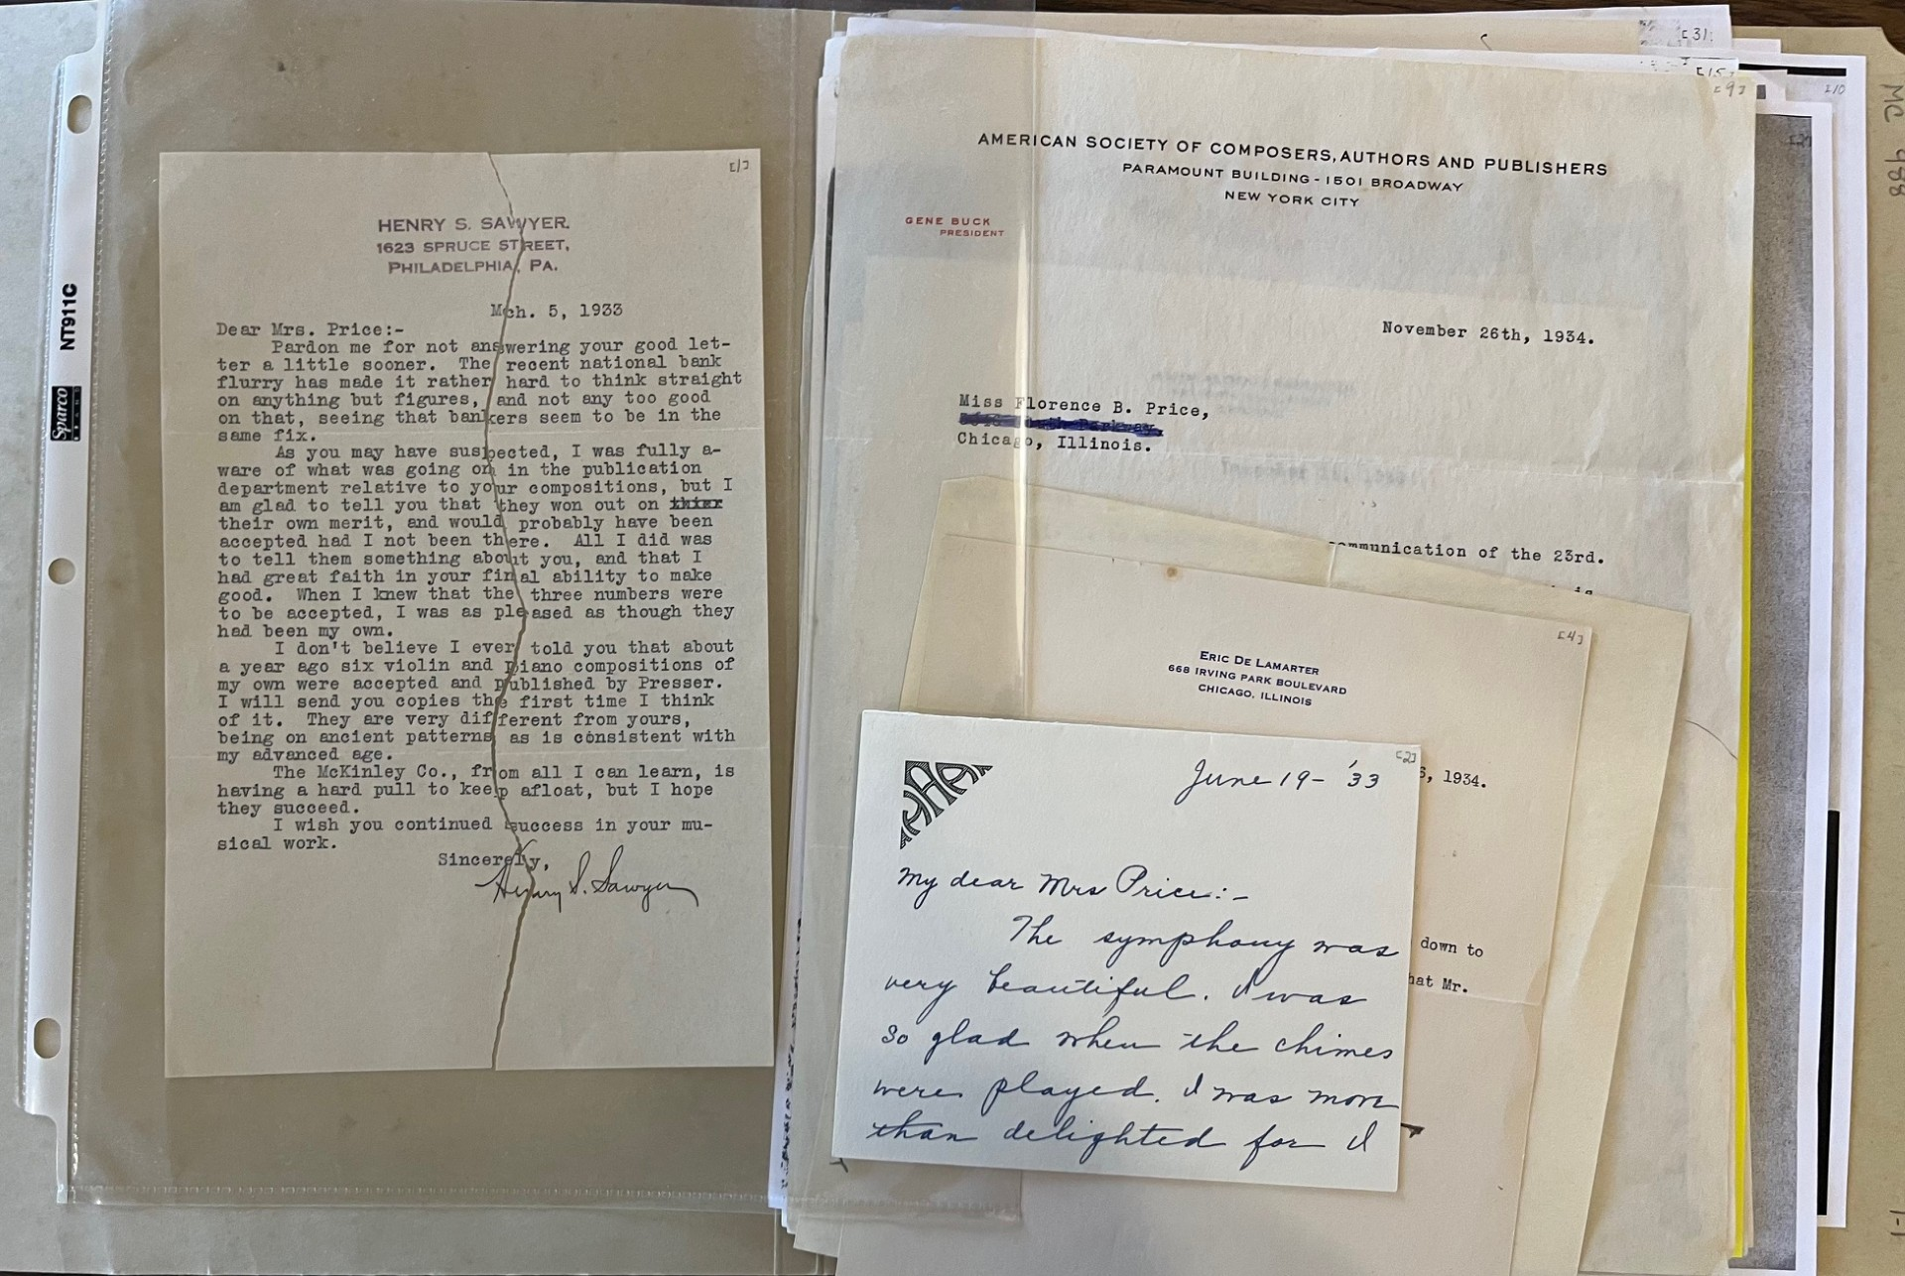
Groundwork Laid Earlier
Mary Hudgins and Barbara Jackson facilitated donation of material from Florence Price Robertson in 1975
Special Collections made limited number of scores, professional documents, and images available then
Symphony E Minor orchestration incorporated after
Close relationships with Jackson, Jim Greeson, and others for years to add published collections.
Photocopies and stabilized originals from first Price accession, rehoused and redescribed a few times.

Slide 5
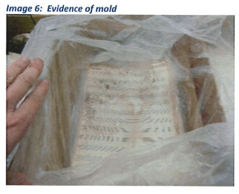
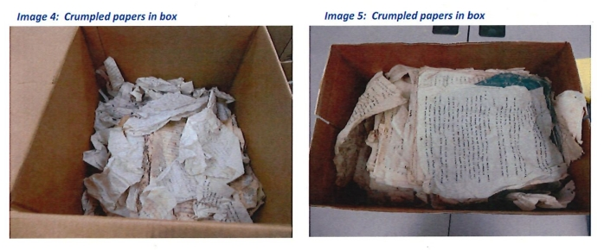
“MC988b”: the Troubled Material
Processing of addenda partially completed in 2015
Vice Chancellor for facilities worked with Dean and Division responding to many, many requests for access
Waiver form and safety equipment used to allow limited use.

Slide 6
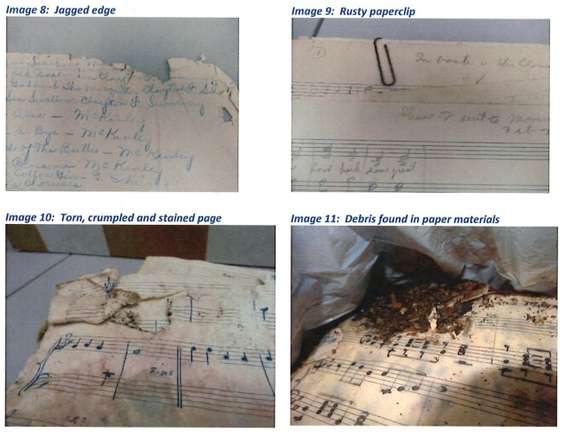
Assessment and Treatment
Worked with Rebecca Elder to assess and provide conservation 2016.
Images from her treatment report.
MC988b release allowed new wave of research.

Slide 7
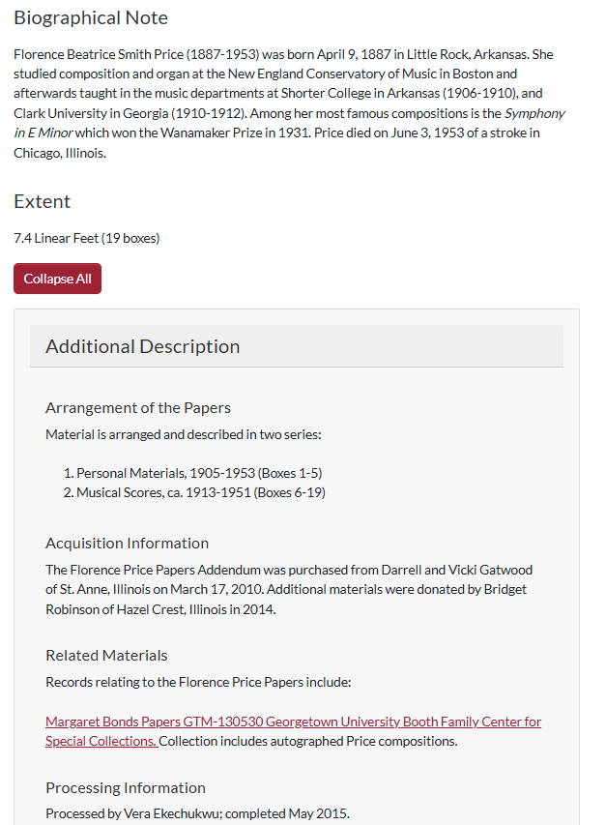
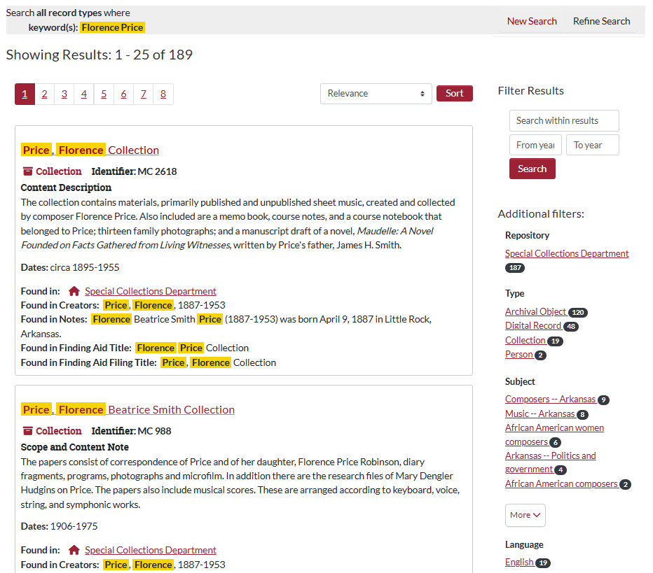
Collecting and Accessibility
Robust, clear, dynamic, and integrated archival description.

Slide 8
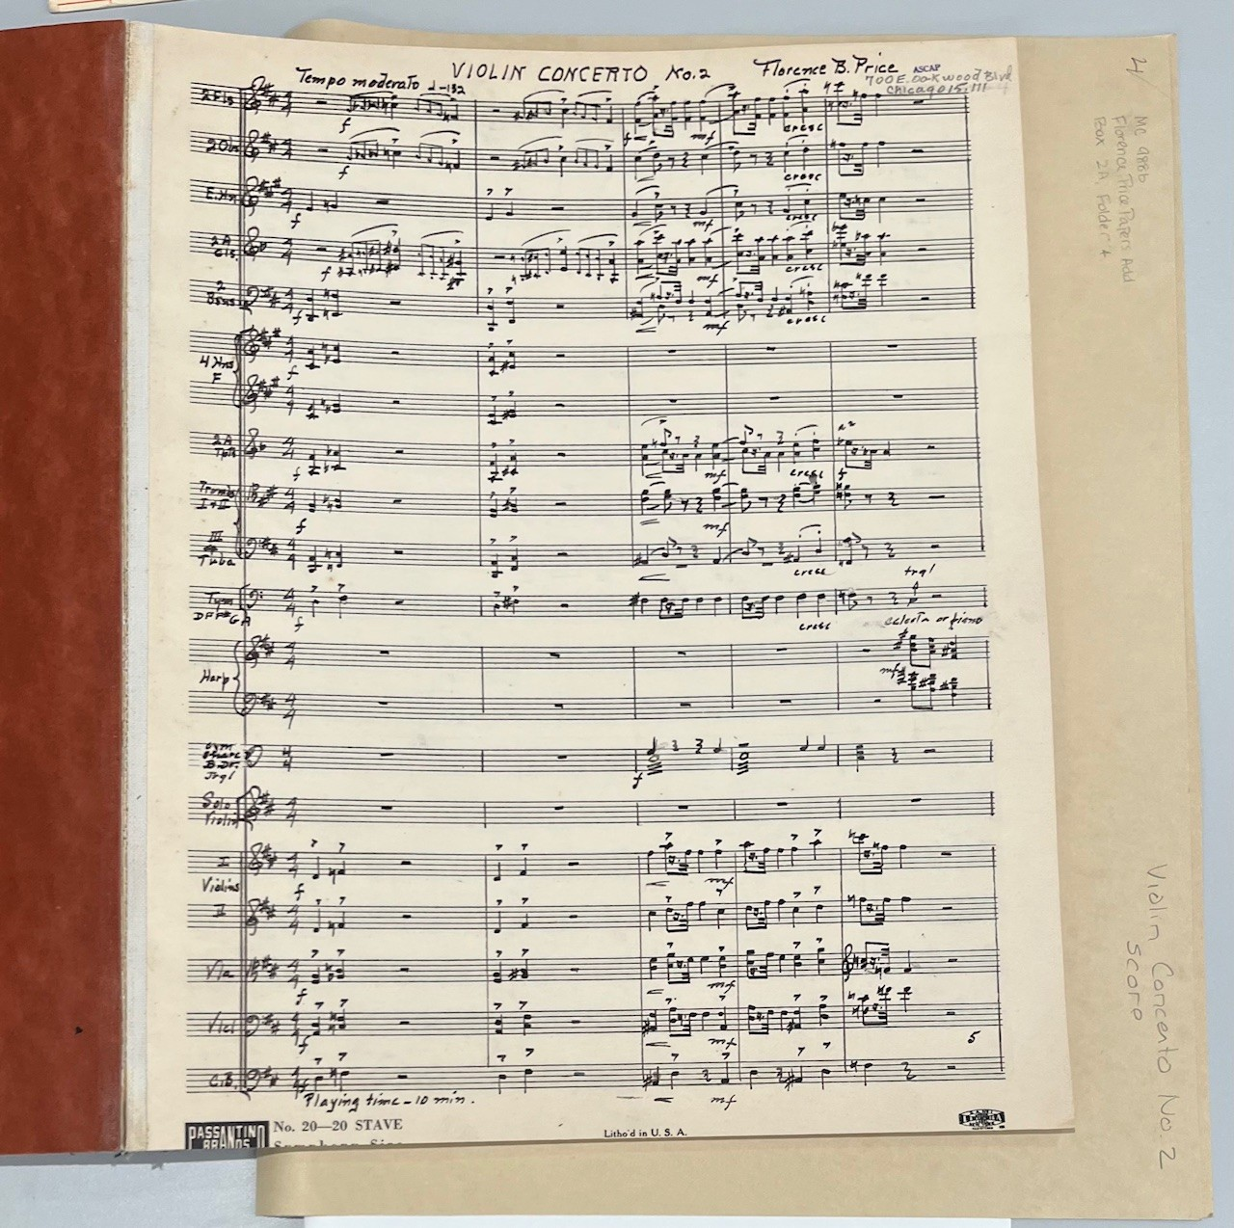
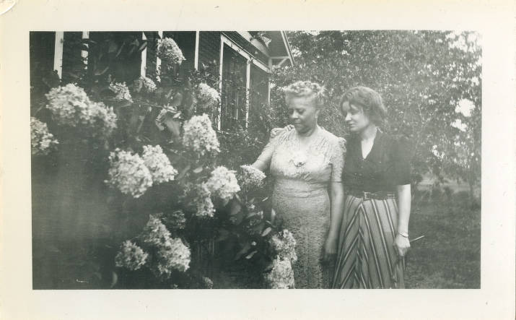
Sharing As Much as Possible
Violin Concerto No. 2 (MC988b), foldered and accessible; Price and her daughter and Price’s diary digitized and open to the public (MC988a).

Slide 9
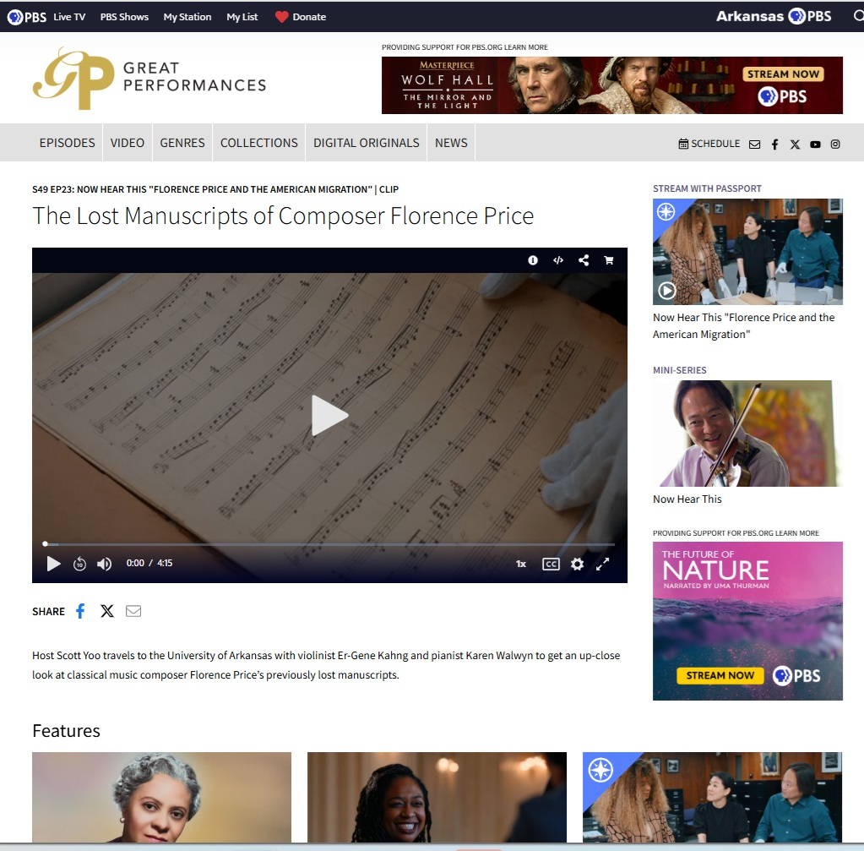
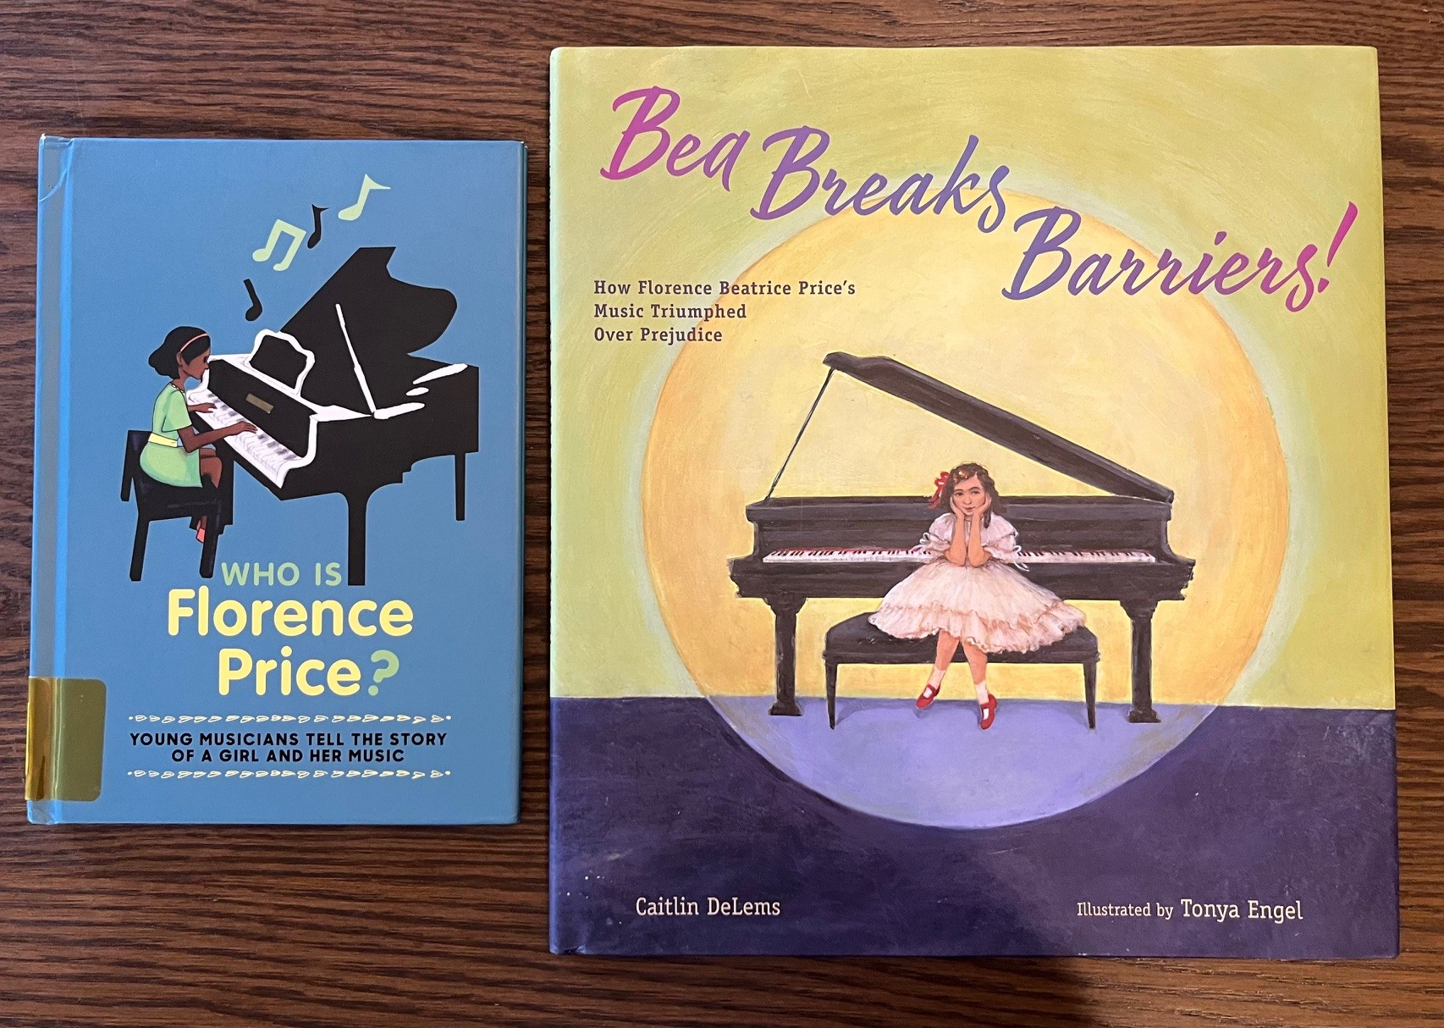
Continued Growth and Use

