Slide 1
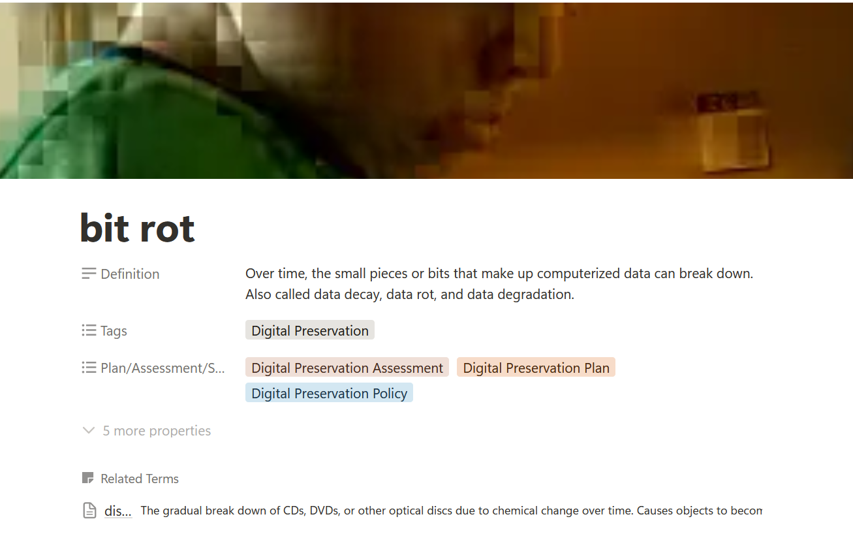
Say What?
DEMYSTIFYING PRESERVATION & CONSERVATION TERMS WITH CCAHA’S NEW GLOSSARY
Katie Lowe
Preservation Specialist, The Conservation Center for Art & Historic Artifacts

Slide 2
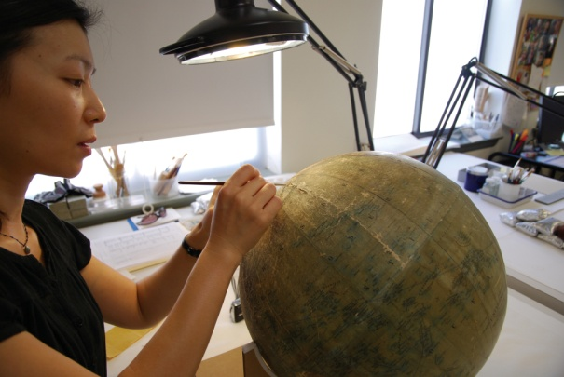
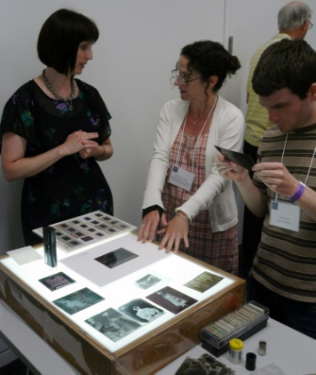
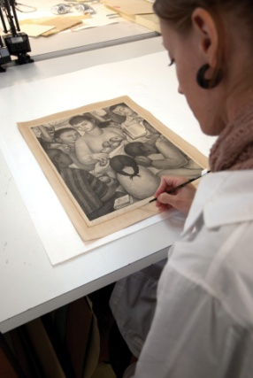
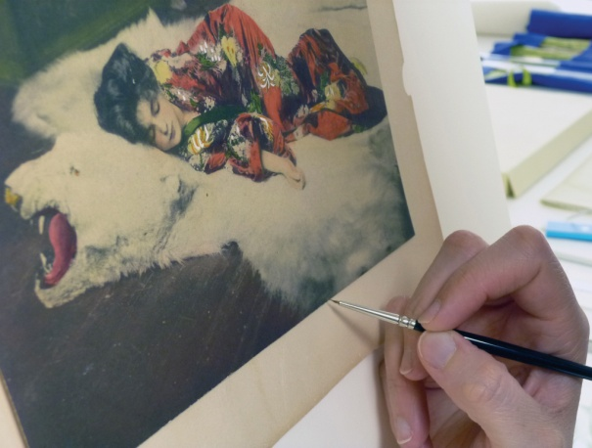
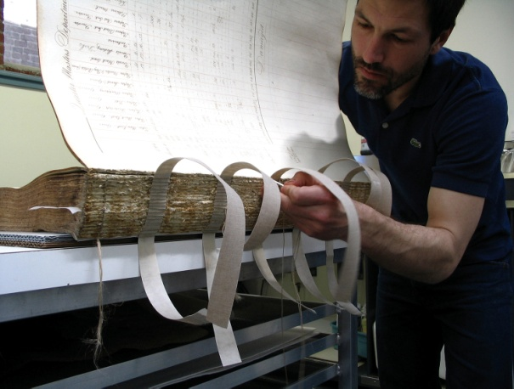
Conservation Center for Art & Historic Artifacts
In a typical year:
Preservation Services specialists complete over 50 survey projects.
Approximately 60 CCAHA-sponsored workshops, conferences, webinars, and training sessions are presented.
The Digital Imaging Services staff digitizes thousands of pages
of fragile archival documents, books, and photographs.
Conservators assess and treat more than 6,000 individual
artifacts, from over 400 clients.
Housing & Framing Services house approx. 75% of the artifacts treated (folder, sleeve, box, mat and frame, or sealed package).
Notes:
And one quick note about the organization I work for, the Conservation Center is a regional conservation lab and preservation services facility. We are based in Philadelphia, but we work with organizations and clients all across the country. Our conservators treat paper-based objects like books, photographs, documents, artwork on paper, and more. Our preservation services staff work in the field, providing education programs and helping institutions plan for the future of their collections.
As a preventive conservator, I work with both the conservation department and the preservation department to support preventive conservation projects and teaching. CCAHA also offers a wide range of digitization services, as well as fundraising assistance, housing and framing, and more. You can learn more about us and what we do at our website, ccaha.org.

Slide 3
Agenda
1. Background
3. Goals
2. The Team
4. Use
5. Let’s Take A Tour!
6. Next Steps
7. Additional Resources

Slide 4
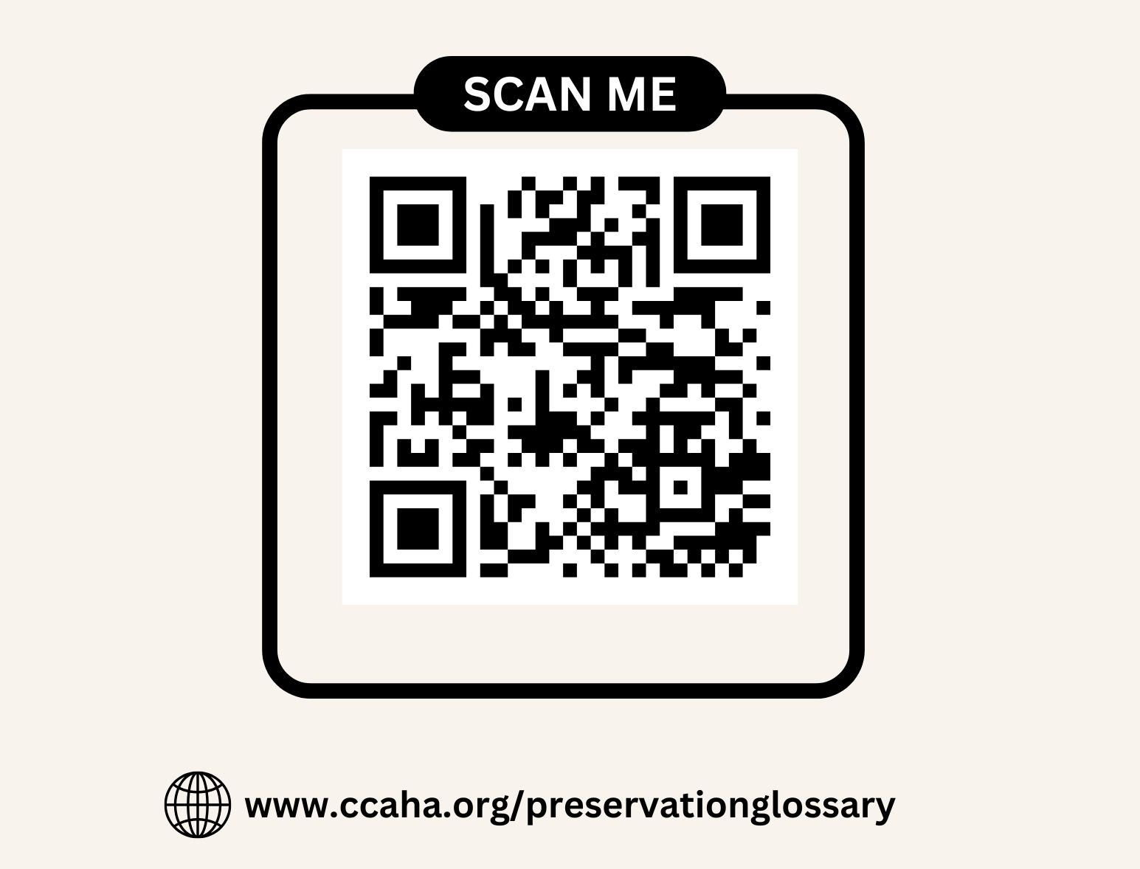
Follow Along!

Slide 5
Background
Theory: Preservation is for All
First version
  NEH-funded
  Collaboration with A4BLiP
  PDF
Feedback
  Definitions
  No images
  Not comprehensive

Slide 6
Goals
Image heavy
Interactive, comprehensive, & intuitive
Closing the “shared knowledge” gap
Interdisciplinary
Free & accessible

Slide 7
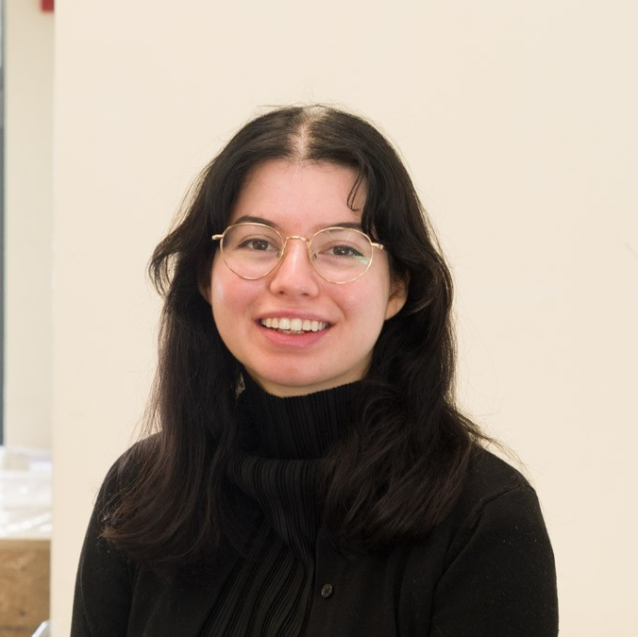
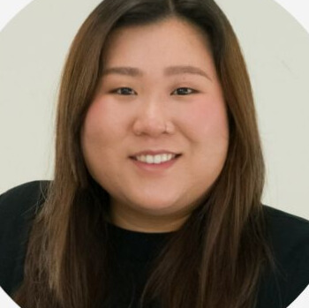
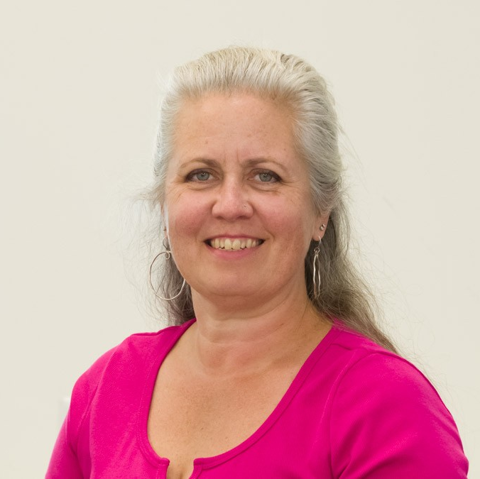
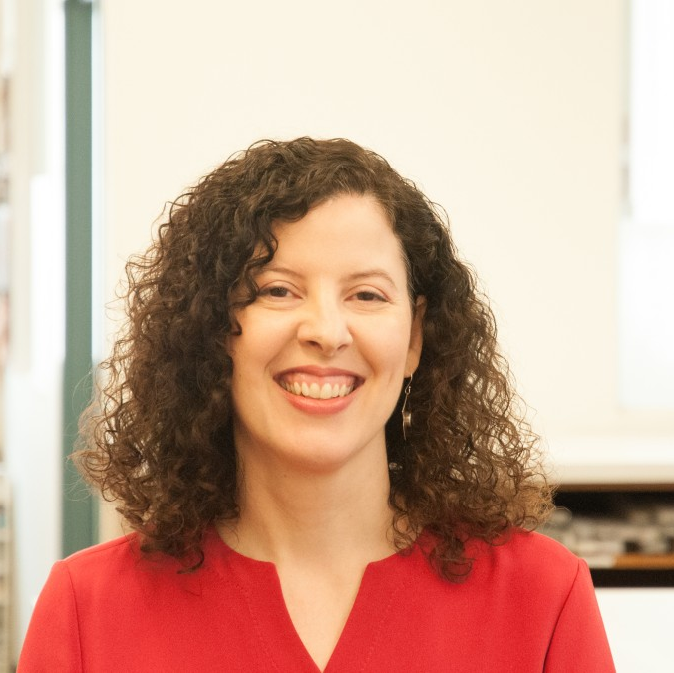
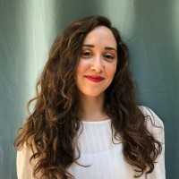
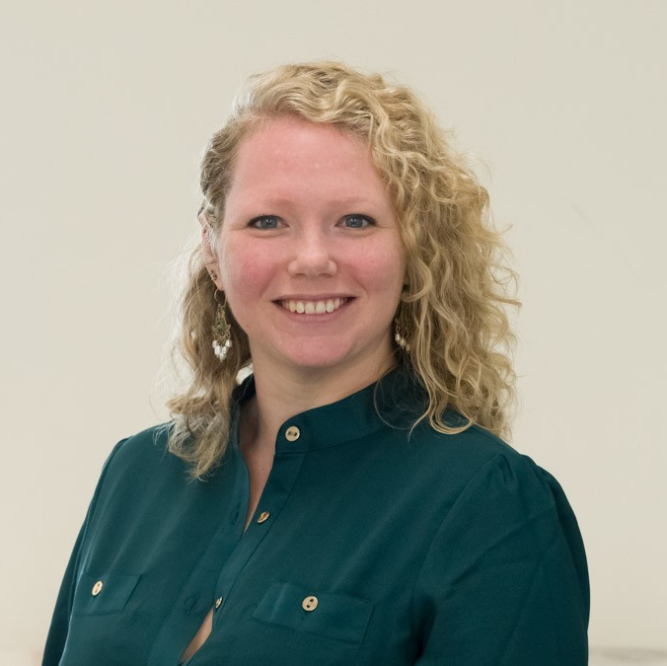
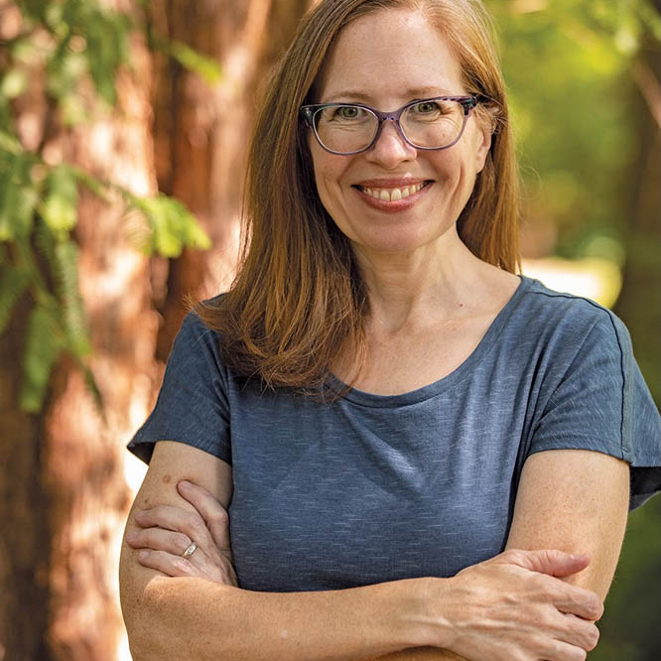
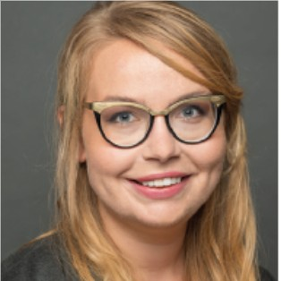
Our Team
Camilla Dawson
Dria Lai
Eliza
Gilligan
Jessica Silverman
Katie Lowe
Preservation Services Administrator
NEH Post-Graduate Preservation Specialist
Director of Conservation
Preservation Specialist
Senior Book Conservator
Kaitlyn Pettengill
Lori Litchman
Maddie Cooper
Consultant
Preventive Conservator
Digital Archives Specialist

Slide 8
Tour: Key Features
1
2
Database format
Searchable tags
3
4
Filter by assessment/service type
Image heavy
5
6
Linked Definitions
8th Grade reading level

Slide 9
Users
Uses
1. Students & Researchers
Supplemental education
2. GLAM professionals
3. Private owners/non-traditional stewards
Support for collections care activities & Ongoing education
4. Volunteers
Understanding collections management & Preservation priorities
5. Board Members
6. CCAHA Clients
Understanding reports, webinars, & workshops
7. Your Aunt Carol
(anyone!)
Learning is fun, preservation is cool

Slide 10
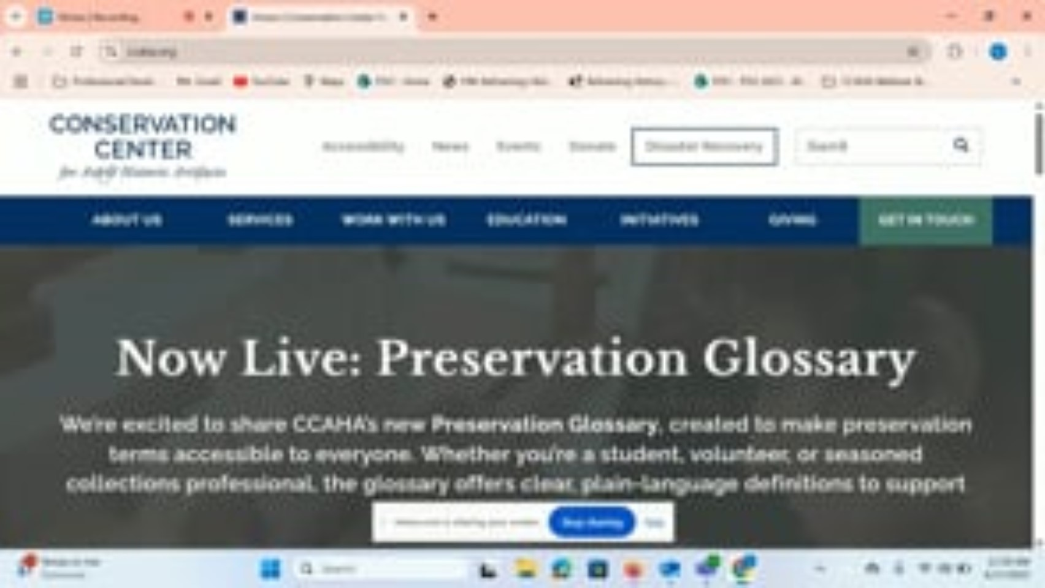

Slide 11
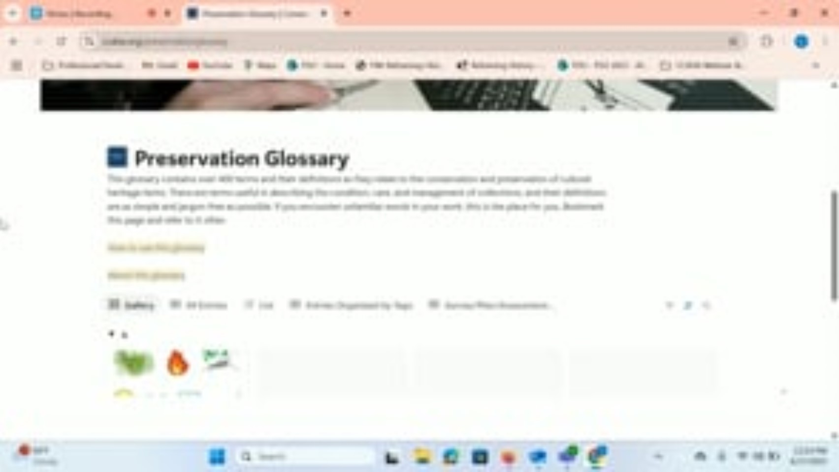

Slide 12


Slide 13
What’s Next?
Feedback
Quarterly review & revision
Plan for ongoing maintenance
Secure funding
Be responsive – what should the next version be?

Slide 14
Resources
  SAR Guidelines for Collaboration: Glossary
  Canadian Conservation Institute: Agents of Deterioration
  SAA: Dictionary of Archives Terminology
  MFA Boston: Conservation & Art Materials Encyclopedia Online (CAMEO)
  American Institute for Conservation (AIC): AIC Wiki

Slide 15

Glossary
Feedback Form

