Slide 1
Lost, Found, & Everything in Between: Surviving Inventory Surprises
Katie Lowe, Preservation Specialist

Slide 2


In a typical year:
Preservation Services specialists complete over 50 survey projects.
Approximately 60 CCAHA-sponsored workshops, conferences, webinars, and training sessions are presented.
The Digital Imaging Services staff digitizes thousands of pages
of fragile archival documents, books, and photographs.
Conservators assess and treat more than 6,000 individual
artifacts, from over 400 clients.
Housing & Framing Services house approx. 75% of the artifacts treated (folder, sleeve, box, mat and frame, or sealed package).
Notes:
Conservators: medical specialists
PSO: Good to think of us as a combination of your PCP and The World Health Organization – we’re doing routine care and community education
Everything in-between: digitization, housing, contracted assessments like CAP

Slide 3
AGENDA
Agreements & Understandings
The Inventory Process
Sticky Situations
Resources
Questions

Slide 4
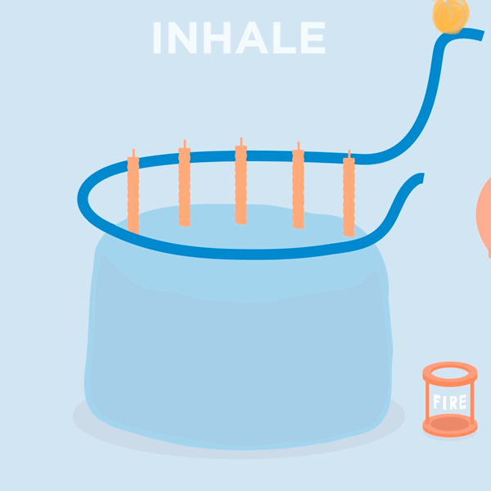
breathe

Slide 5
Remember:
You won’t leave this session an expert (and that’s not your job)
Perfectionism isn’t your friend
Stress is an excellent motivator, until it isn’t
Knowledge is power
“The dishes are never done”
Notes:
Be gentle: All systems have space for improvement. Just because something can be improved doesn’t mean it is bad, wrong, or insufficient.
Be realistic: your capacity is what it is. It isn’t going to magically grow when you decide to start this project, and that’s okay. Either work with the time and energy you have (and accept this for what it is) or consider options for increasing capacity, even if it’s just temporarily. Also, this is a complex system of competing ideas, definitions, and methodologies. That, combined with the fact that many of us inherit collections that were either previously mismanaged or managed different from the current standard can cause us to feel immense pressure – like we’re responsible for keeping up with this hugely intricate system and undoing decades of past work all by ourselves. It’s not possible! Accept that and relax.
Don’t panic
Perfectionism is not your friend

Slide 6
Respond, don’t react

Slide 7
What is an inventory?
Basic
Comprehensive
A list of objects and their locations
A complete report of the status of collections.
A list of the property held by a collecting organization, ideally connecting each object to an identification number, a physical location, and a record.

Slide 8
Complete Inventory
Includes objects in the permanent collection, acquired objects that have not been accessioned, objects in temporary custody, loans, and external loans. Good to perform routinely.
Partial Inventory
Focused on one part of the collection and usually precipitated by museum activity. Ex.: objects in one storage room, objects on exhibit, objects gifted by a specific donor.
Spot Inventory
Most limited in scope – Monitors record accuracy and overall collection health through a representative sampling of objects. Good to perform routinely.

Slide 9
Why Conduct one?
“[the objects in our collections] are not ours; they are not even “our museum’s.” These objects belong to current and future generations and, as such, are not ours to lose track of or misplace.”
- Museum Registration Methods, 5th Edition.

Slide 10





Sticky situations
“Old Loans”
Undocumented Objects & Missing Objects
Missing or incorrect information
Hazards
Condition issues & rehousing needs
NAGPRA

Slide 11

Reminder:

Slide 12
Old Loans
  1. Expired loans (meaning the loan contract has ended);
  2. Loans of unlimited duration…
  …where lenders are not in contact with the museum and cannot be located

Slide 13
Old Loans: Causes
Staff turnover at the lending institution
Staff turnover at YOUR institution
Incomplete/inconsistent record-keeping
No loan policy
Deaths
Lost contact
TIME!

Slide 14
Old Loans: Response
Resume/Return/Acquire
NOTE IN RECORD
Attempt to locate lender
Attempt to contact lender
Determine legal obligations
Old Loan Laws
Common Law
Resume/Return/Acquire

Slide 15
Undocumented objects
Objects with no identification number or record;
Undocumented Object + Inability to Reconcile = Found-in-Collection (FIC)

Slide 16
Undocumented objects: Causes
Staff turnover
Poor intellectual control
Inconsistent/incomplete record-keeping
No processing procedures
NEW processing procedures OR Collections Management System (CMS)

Slide 17
Undocumented objects: Response
Return to original number; add tracking number to record
Reconcile
Assign tracking # and temporary record
Attempt to reconcile
Can’t reconcile
Consult state property law (w/ counsel)
Accession
Create FIC # and record
Keep or deaccession

Slide 18
missing Objects
An object that has a record but cannot be located

Slide 19
missing Objects: Causes
Staff turnover
Poor intellectual control
Inconsistent/incomplete record-keeping
No processing procedures
NEW processing procedures OR Collections Management System (CMS)
No exhibit policy
No loan policy
Theft
No system for object tracking

Slide 20
Undocumented objects: Response
Rehouse & log new location
Located
Designate “lost” or “missing” in record
Attempt to locate (document!)
Determine last known location (document!)
Cannot locate
Located
Cannot locate
Rehouse & log new location
Make insurance claim
(DO NOT DELETE OBJECT RECORD)

Slide 21
MISSING/INCORRECT INFORMATION: CAUSES
Staff turnover
Poor intellectual control
Inconsistent/incomplete record-keeping
No processing procedures
NEW processing procedures OR Collections Management System (CMS)
New research
New standards

Slide 22
Missing/incorrect information: response
Research & modify
“Flag” the object record
If publicly searchable:
Temporarily unpublish OR
Keep but delete inaccurate info OR
Return record to normal
Research & modify
Keep as is, indicate ongoing research

Slide 23
hazards
Mold
Pests
Sharps & protrusions
Toxic materials
  Lead
  Arsenic
  Asbestos
  Mercury
  Uranium
  Old medicine
Biohazards
Flame Risks
  Cellulose nitrate & acetate
  Ammunition

Slide 24
Mold & Pests: Response
“Flag” the object record & immediately restrict handling.
Isolate the item(s)
Research & confirm
Put on your PPE
Salvage, triage, & treat
Update handling procedures, CMP, record, & object label
Return to regular operations

Slide 25
Sharps & Protrusions: Response
“Flag” the object record & immediately restrict handling.
Put on your PPE
Protectively rehouse
Update handling procedures, CMP, record, & object label
Return to regular operations

Slide 26
Toxic Materials, flame risks, & biohazards: Response
“Flag” the object record & immediately restrict handling.
Put on your PPE
Isolate the item(s)
Research & confirm
Update handling procedures, CMP, record, & object label
Protectively rehouse
Unconfirmed OR confirmed hazardous
Confirmed NOT hazardous
Return to regular operations
Deaccession, follow disposal laws.
Indicate safety on object record
Return to regular operations

Slide 27
Condition Issues & Rehousing
Leak
Embrittlement
Crushing/warping
Archival slump
Yellowing
Cockling
Fatty spue
plasticizer migration
efflorescence
Too small for original housing

Slide 28
Condition issues: Response
“Flag” the object record & immediately restrict handling.
Perform a condition report
Indicate response or treatment needed
Consult CMP & relevant staff
Salvage, triage, & treat
Log any treatment, rehousing, or relocation in the object record
Return to regular operations

Slide 29
NAGPRA
Native American Graves Protection and Repatriation Act (NAGPRA): A federal law mandating the protection and return of Indigenous human remains, funerary objects, sacred objects, and objects of cultural patrimony. Applicable only to:
  federal agencies (not counting The Smithsonian)
  organizations receiving federal funds
  organizations that HAVE received federal funds

Slide 30
NAGPRA: Response
“Flag” the object record & immediately restrict handling.
Immediately isolate in storage. Remove from exhibit & website.
Label the object housing
STOP. Perform no further research.
Consult the NPS official NAGPRA website

Slide 31


Final Thoughts
It doesn’t have to be scary! You have lots of free resources, and new information can only be helpful.
Good policies will create a super smooth runway for you moving forward.
And remember:
klowe@ccaha.org

Slide 32
klowe@ccaha.org

