Slide 1
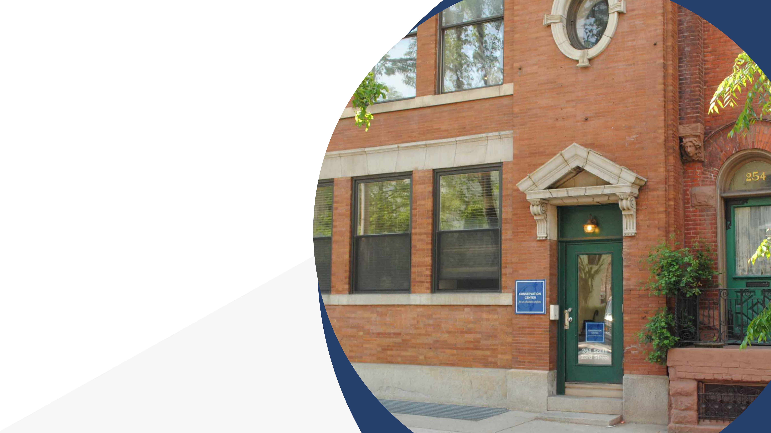
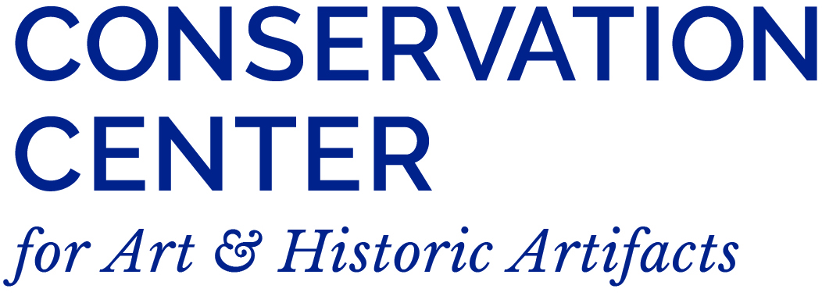
Turning Assessment Recommendations into Actions
How to Make Practical Use of Assessment Reports

Slide 2
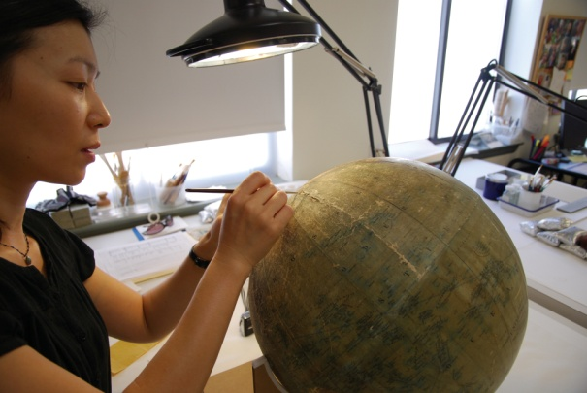
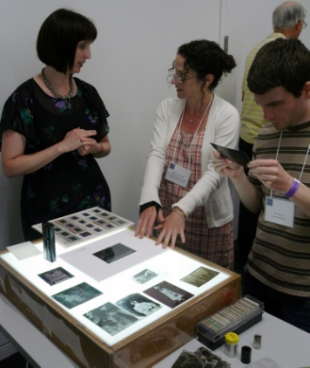
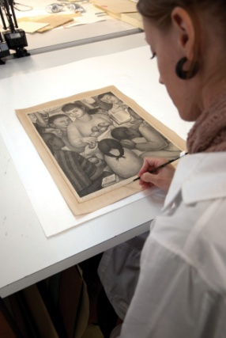
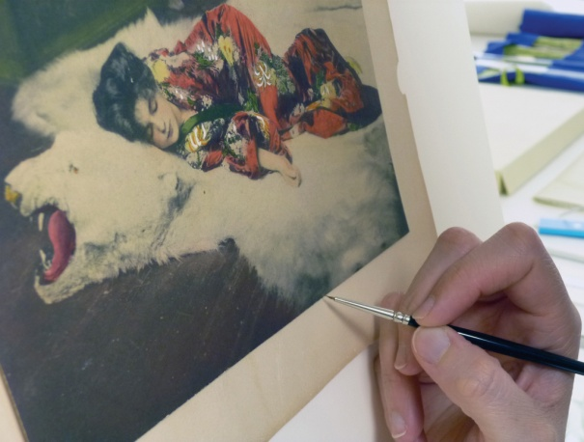
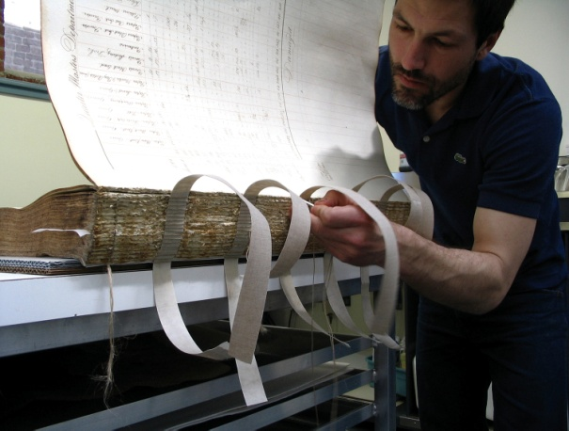
Conservation Center for Art & Historic Artifacts
In a typical year:
Preservation Services specialists complete over 50 survey projects.
Approximately 60 CCAHA-sponsored workshops, conferences, webinars, and training sessions are presented.
The Digital Imaging Services staff digitizes thousands of pages
of fragile archival documents, books, and photographs.
Conservators assess and treat more than 6,000 individual
artifacts, from over 400 clients.
Housing & Framing Services house approx. 75% of the artifacts treated (folder, sleeve, box, mat and frame, or sealed package).
Notes:
And one quick note about the organization I work for, the Conservation Center is a regional conservation lab and preservation services facility. We are based in Philadelphia, but we work with organizations and clients all across the country. Our conservators treat paper-based objects like books, photographs, documents, artwork on paper, and more. Our preservation services staff work in the field, providing education programs and helping institutions plan for the future of their collections.
As a preventive conservator, I work with both the conservation department and the preservation department to support preventive conservation projects and teaching. CCAHA also offers a wide range of digitization services, as well as fundraising assistance, housing and framing, and more. You can learn more about us and what we do at our website, ccaha.org.

Slide 3
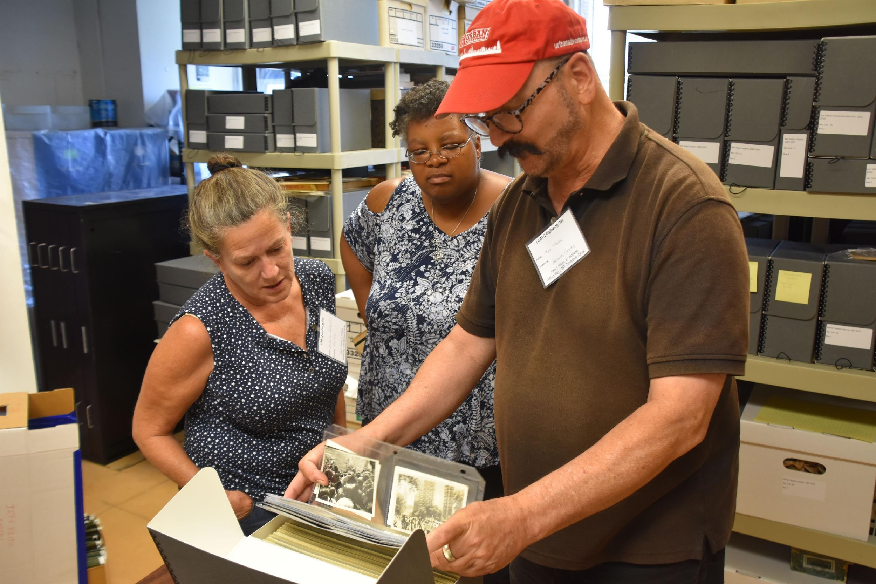
William Way LGBT Community Center
John J. Wilcox, Jr. Archives
Emerged in the late 1980s
Volunteer run until 2014
Current staff: 1.4 FTE
Mission: Maintain and provide lasting access to the Philadelphia-area LGBTQ+ community’s cultural heritage materials
Responsibility of holding and sharing the community’s memories
Open by appointment
Curator Bob Skiba assists community members during an Archives open house

Slide 4
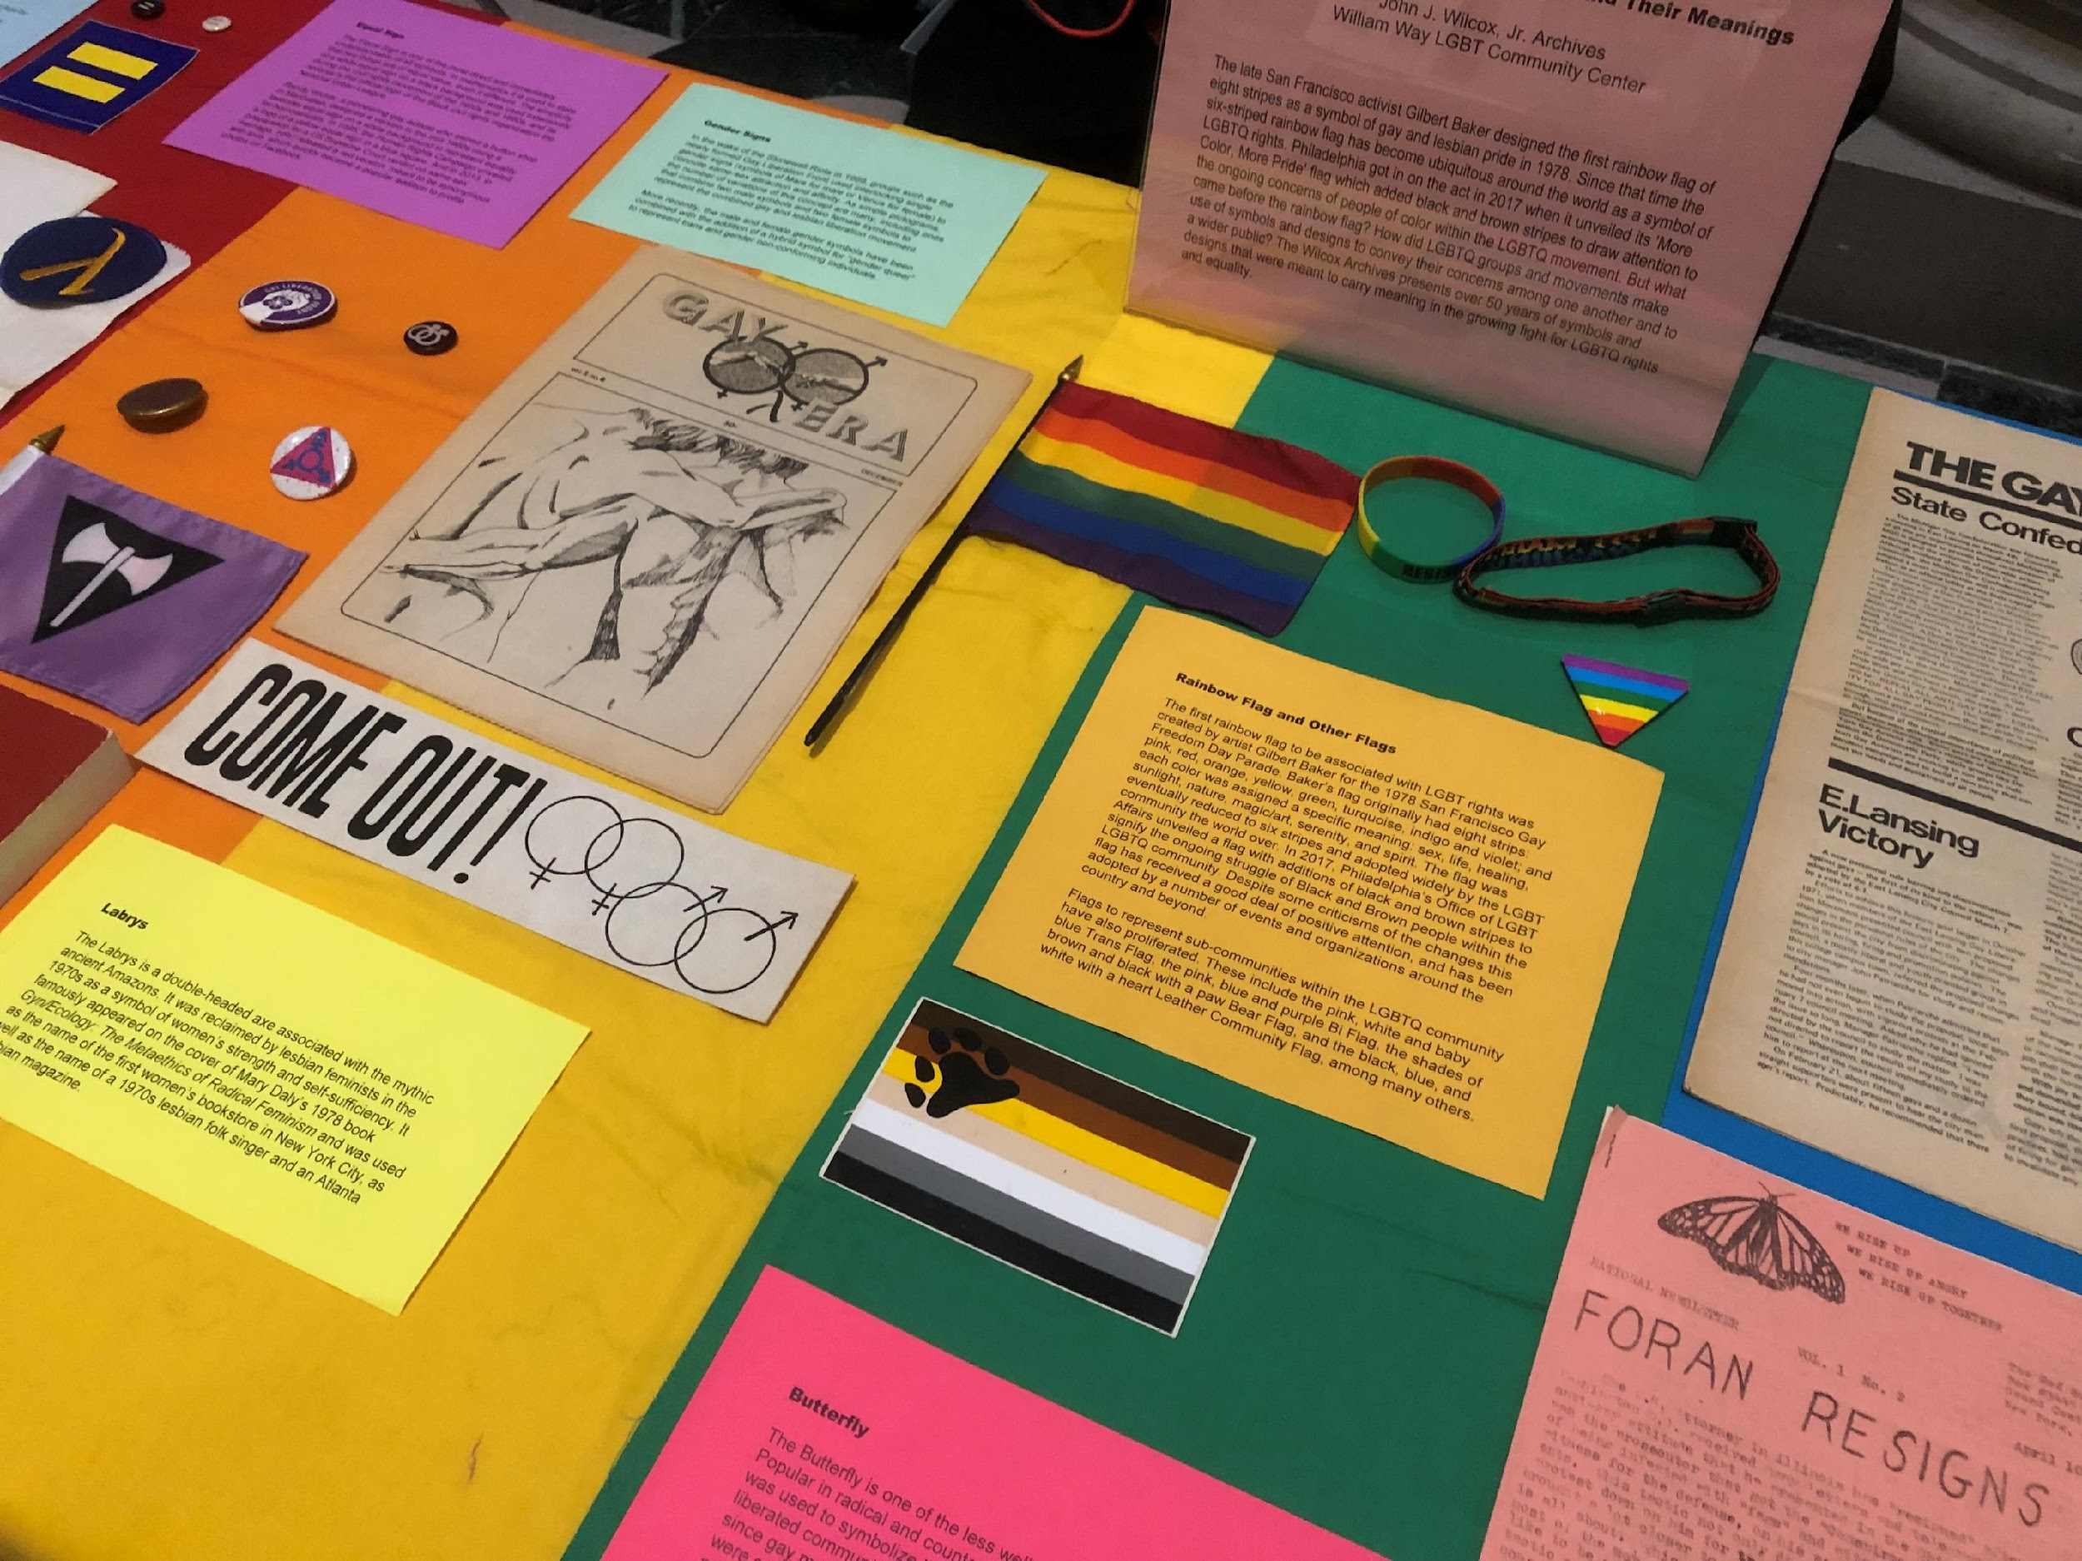
William Way LGBT Community Center
John J. Wilcox, Jr. Archives
2,000 linear feet of materials
LGBTQ+ history and culture
  Philadelphia
  Greater Philadelphia
  Delaware Valley
  Tri-State area
Philadelphia’s HIV/AIDS history
Personal and family papers
Organizational records
Periodicals
Ephemera
Audiovisual materials
Textiles
Objects
Materials on the history of LGBTQ+ symbols, for an Archives Month Philly event on Design in the Archives, 2019

Slide 5
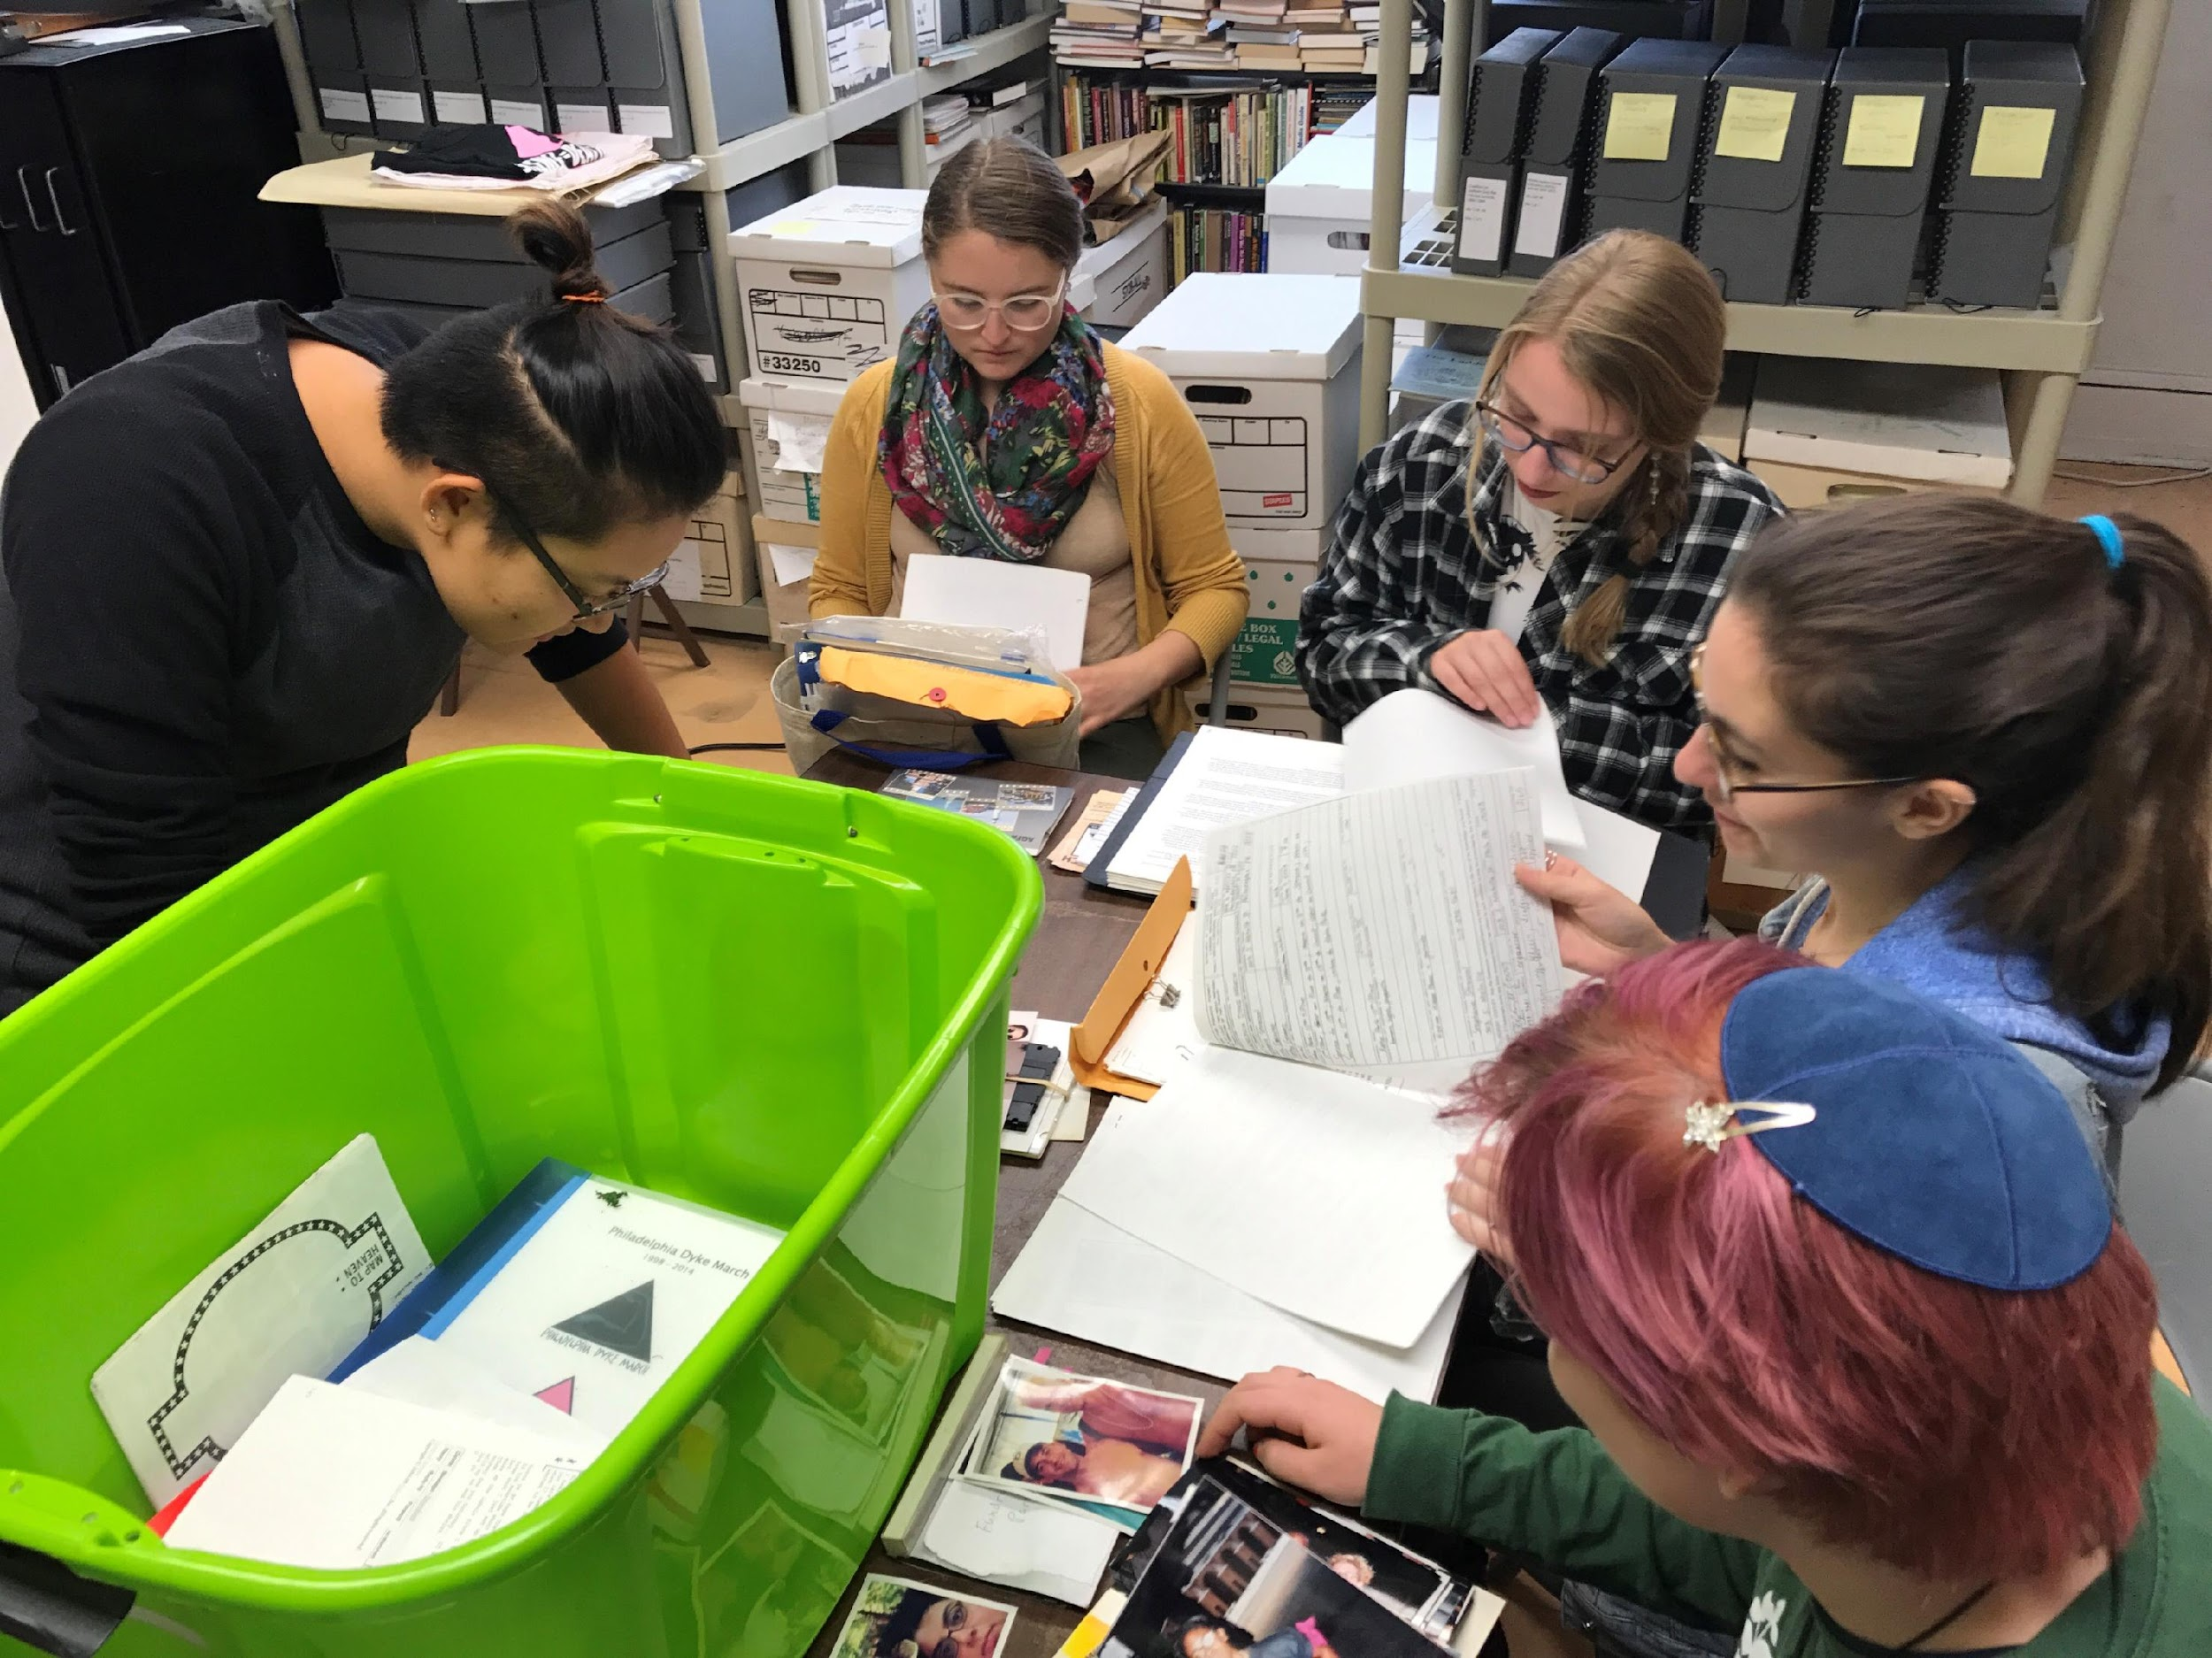
William Way LGBT Community Center
John J. Wilcox, Jr. Archives
100-250 research appointments per year
  Scholars/researchers from around the world
  Students from area K-12 schools, undergraduate and graduate students
  Teachers at area schools
  Activists
  Artists
  Local history researchers
  Journalists
  Documentarians
  Community members
25-30 class visits and tours per year
Students from Bryn Mawr College experience unboxing a new never-seen donation to the Archives, 2017

Slide 6
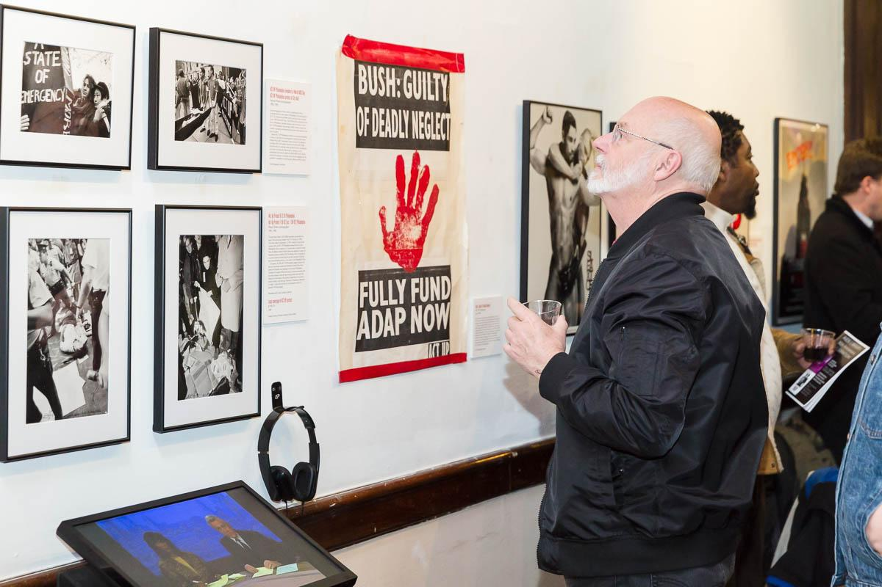
William Way LGBT Community Center
John J. Wilcox, Jr. Archives
Programming
  Exhibits on historical topics
  Philly LGBT Mapping Project
  Philadelphia AIDS Oral History Project
Staffing
  Director
  Curator (part time)
  Interns
  Volunteers
A community member views Archives materials in an exhibition on HIV/AIDS activism in Philadelphia called Still Fighting for Our Lives, 2017

Slide 7
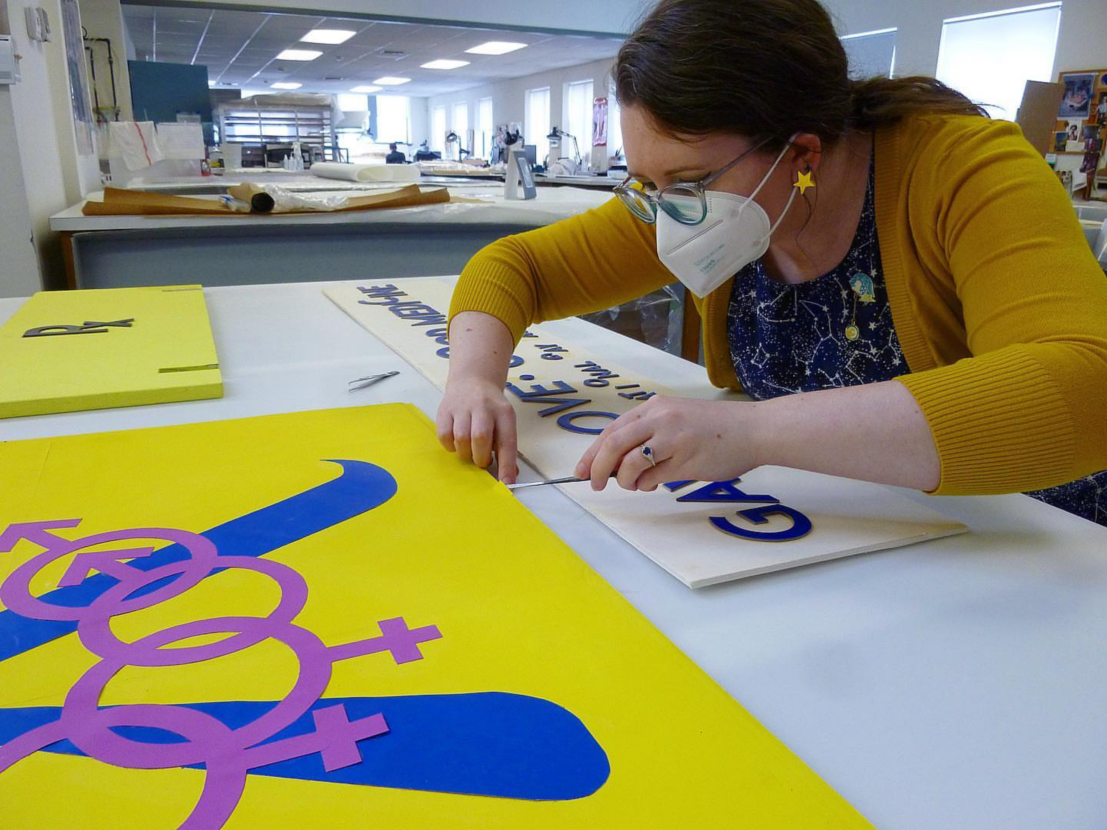
William Way LGBT Community Center
John J. Wilcox, Jr. Archives
Preservation Needs Assessment by CCAHA (2011)
Hidden Collections Initiative: Philadelphia Small Archival Repositories Survey by Historical Society of Pennsylvania (2012)
  Led to many improvements
  Numerous grants
  Treatment of materials by CCAHA
  Conference presentations with CCAHA
  Consulting from CCAHA
Cloe Houseman, CCAHA Paper Conservator, treating 1970s-era display panels from our Barbara Gittings and Kay Tobin Lahusen collection, for a Save America’s Treasures grant in 2023

Slide 8
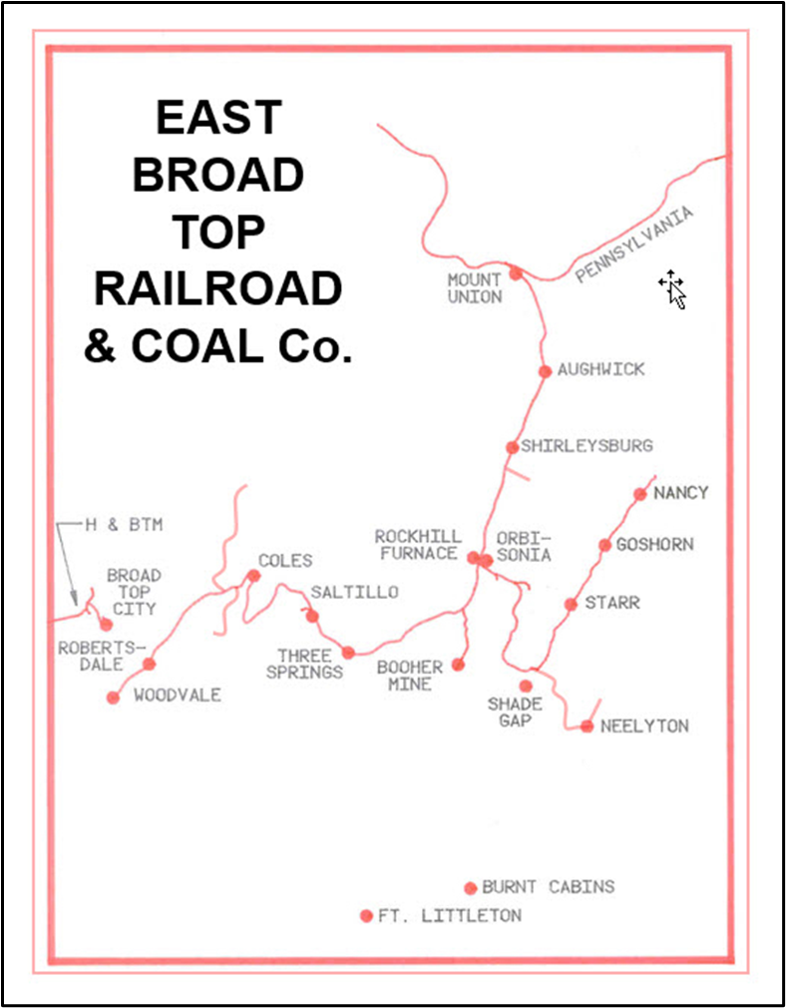
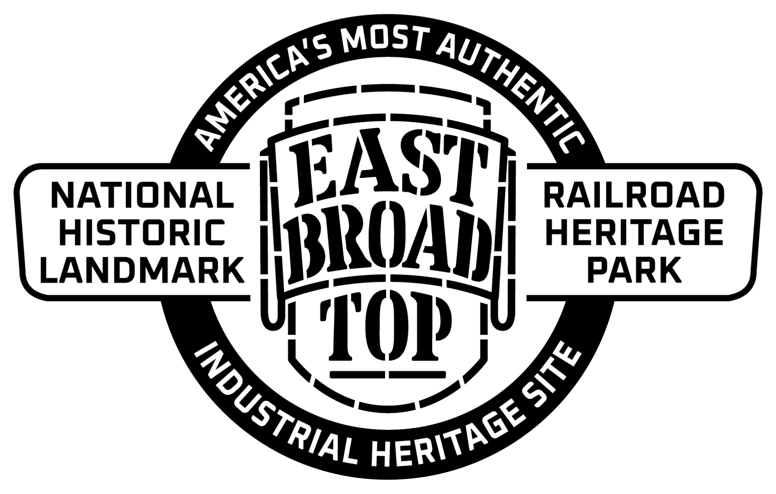
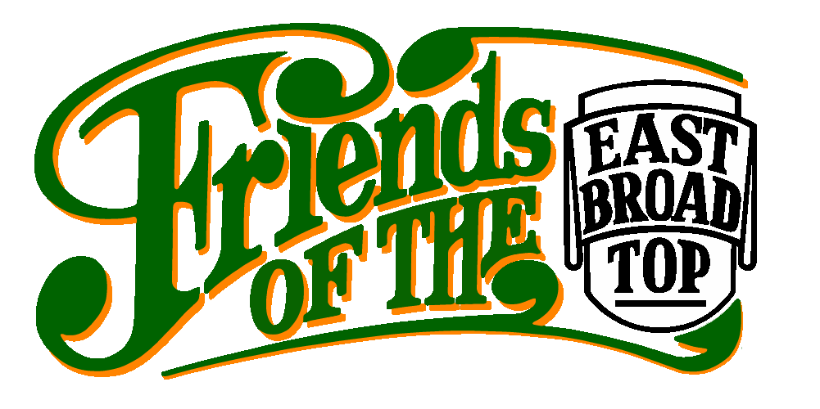
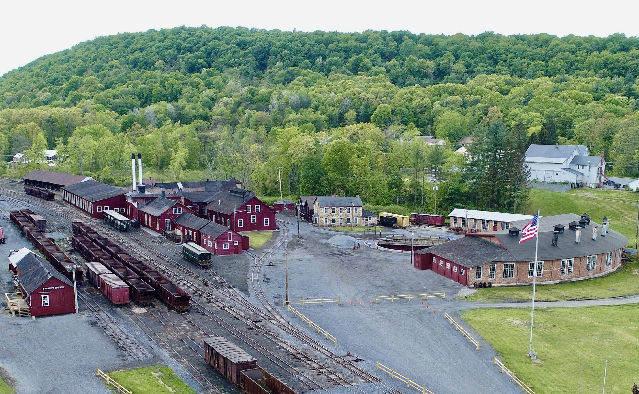
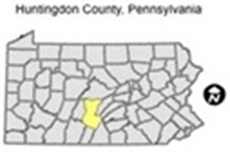
EBT Archives & Special Collections
SCOPE OF COLLECTIONS
The Common Carrier Era and its operational relations with other companies and organizations (1856-1956)
The EBT Kovalchick Tourist Railroad Era and its other operational relations with other companies and organizations, under the stewardship of the Kovalchick Family (1956-2020)
The EBT Foundation, Inc. (EBTF) Era (2020-future)
The Friends of the East Broad Top, Inc. (FEBT) Collections (1983-future), which capture content from each of the above eras, are also included in this representation and considered an integral part of the entire catalog of the EBT documentation.

Slide 9
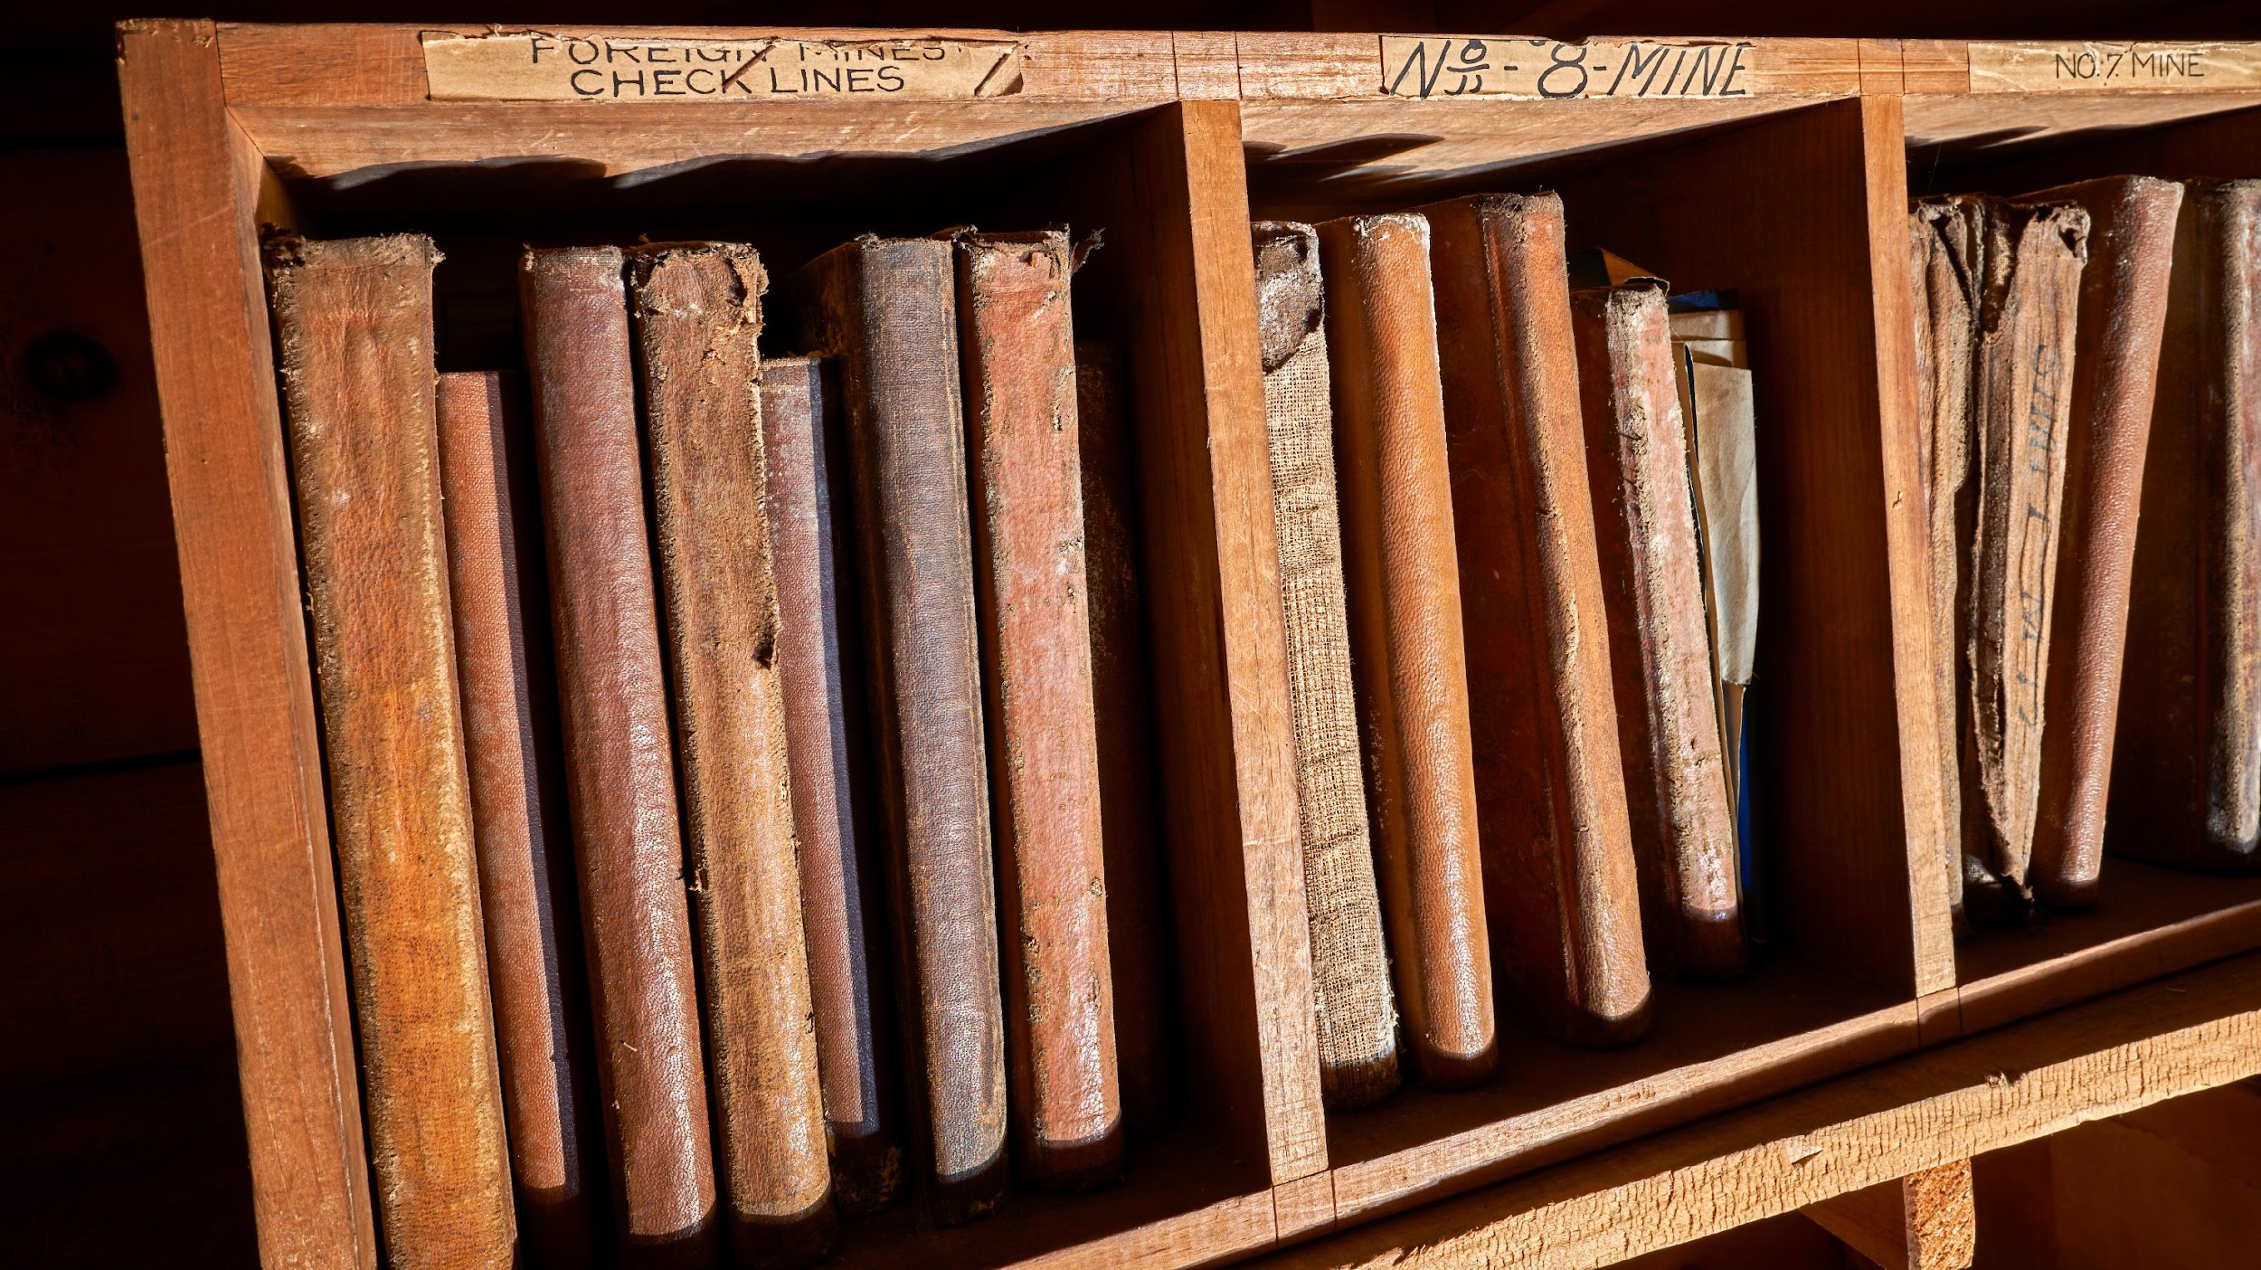
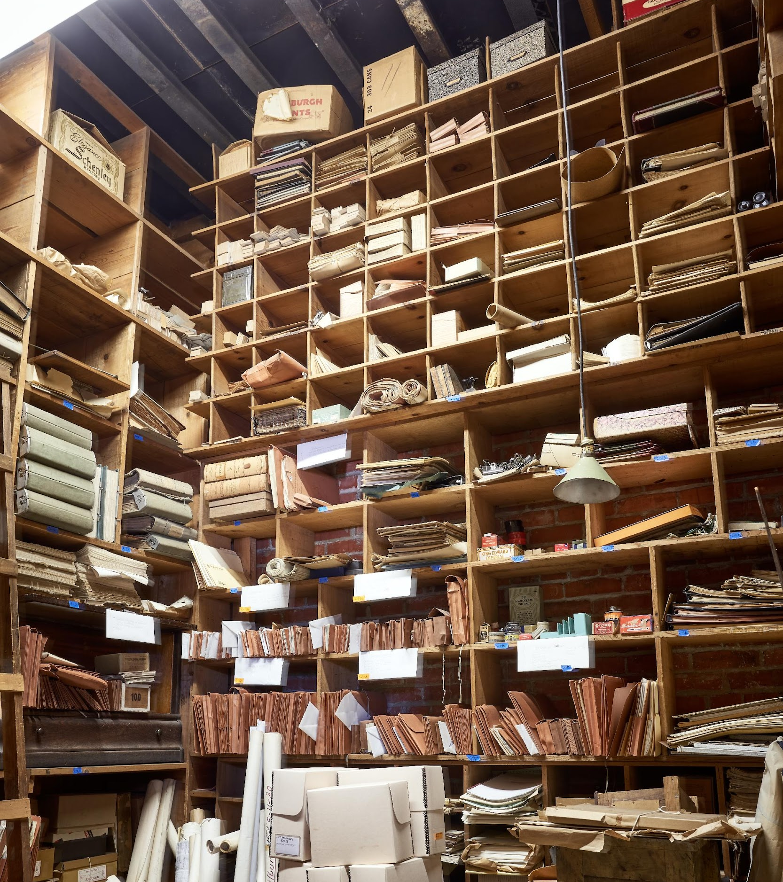
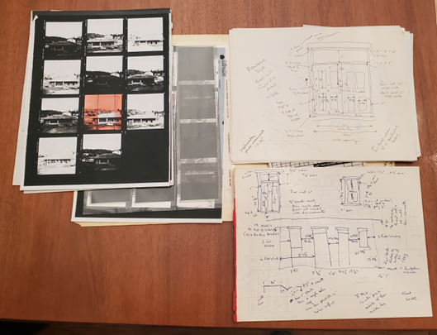
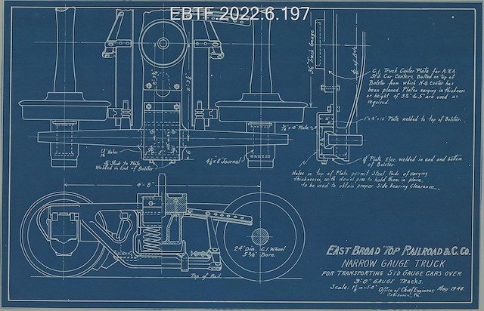
EBTF and FEBT COLLECTIONS
Estimate over 5,000 linear feet of paper-based records +

Slide 10
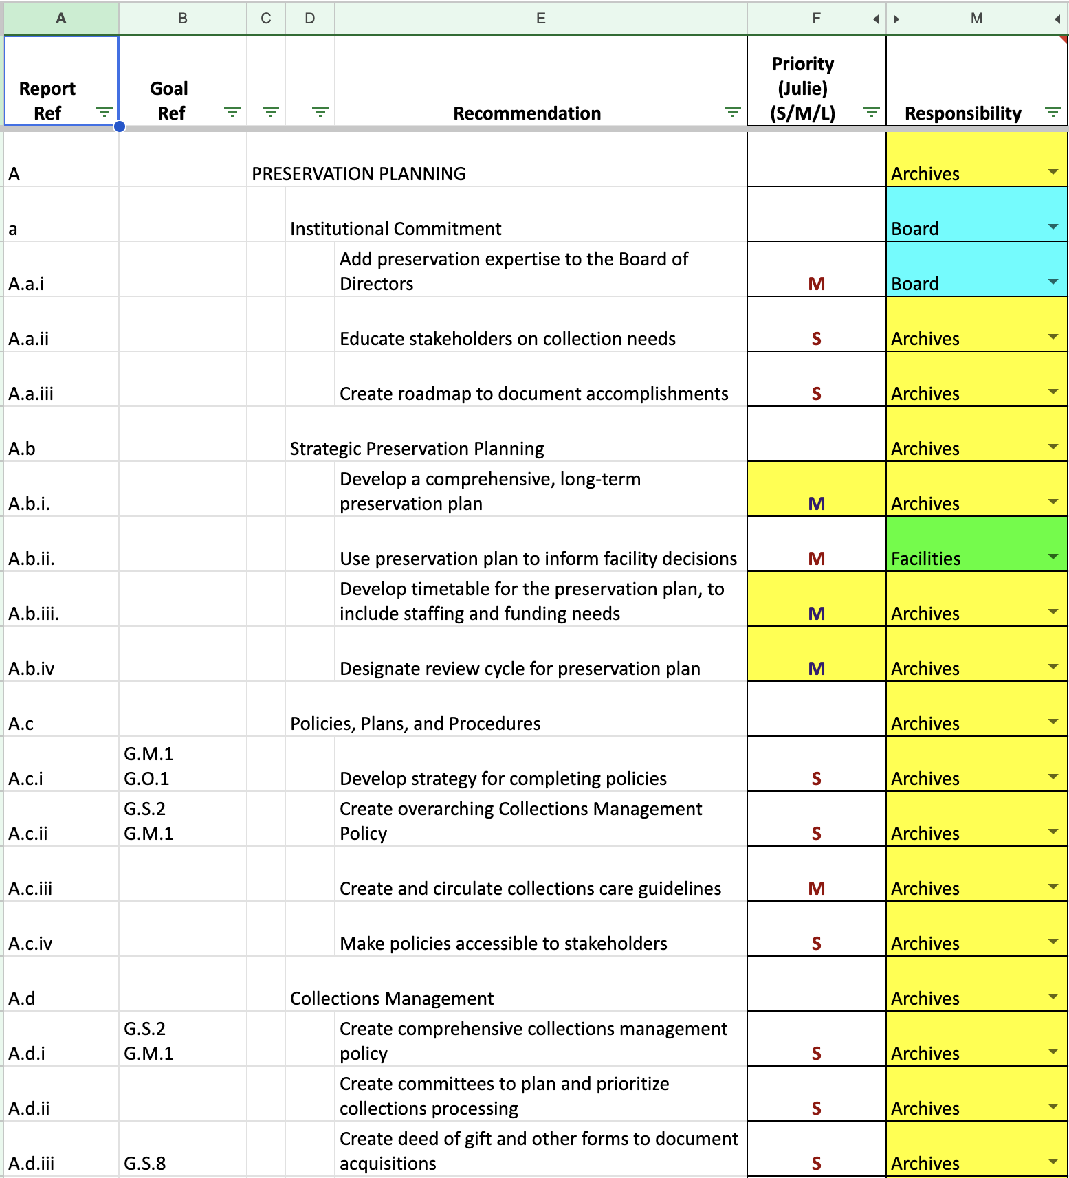
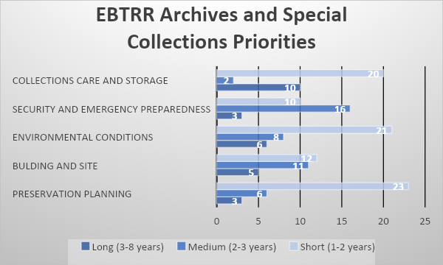
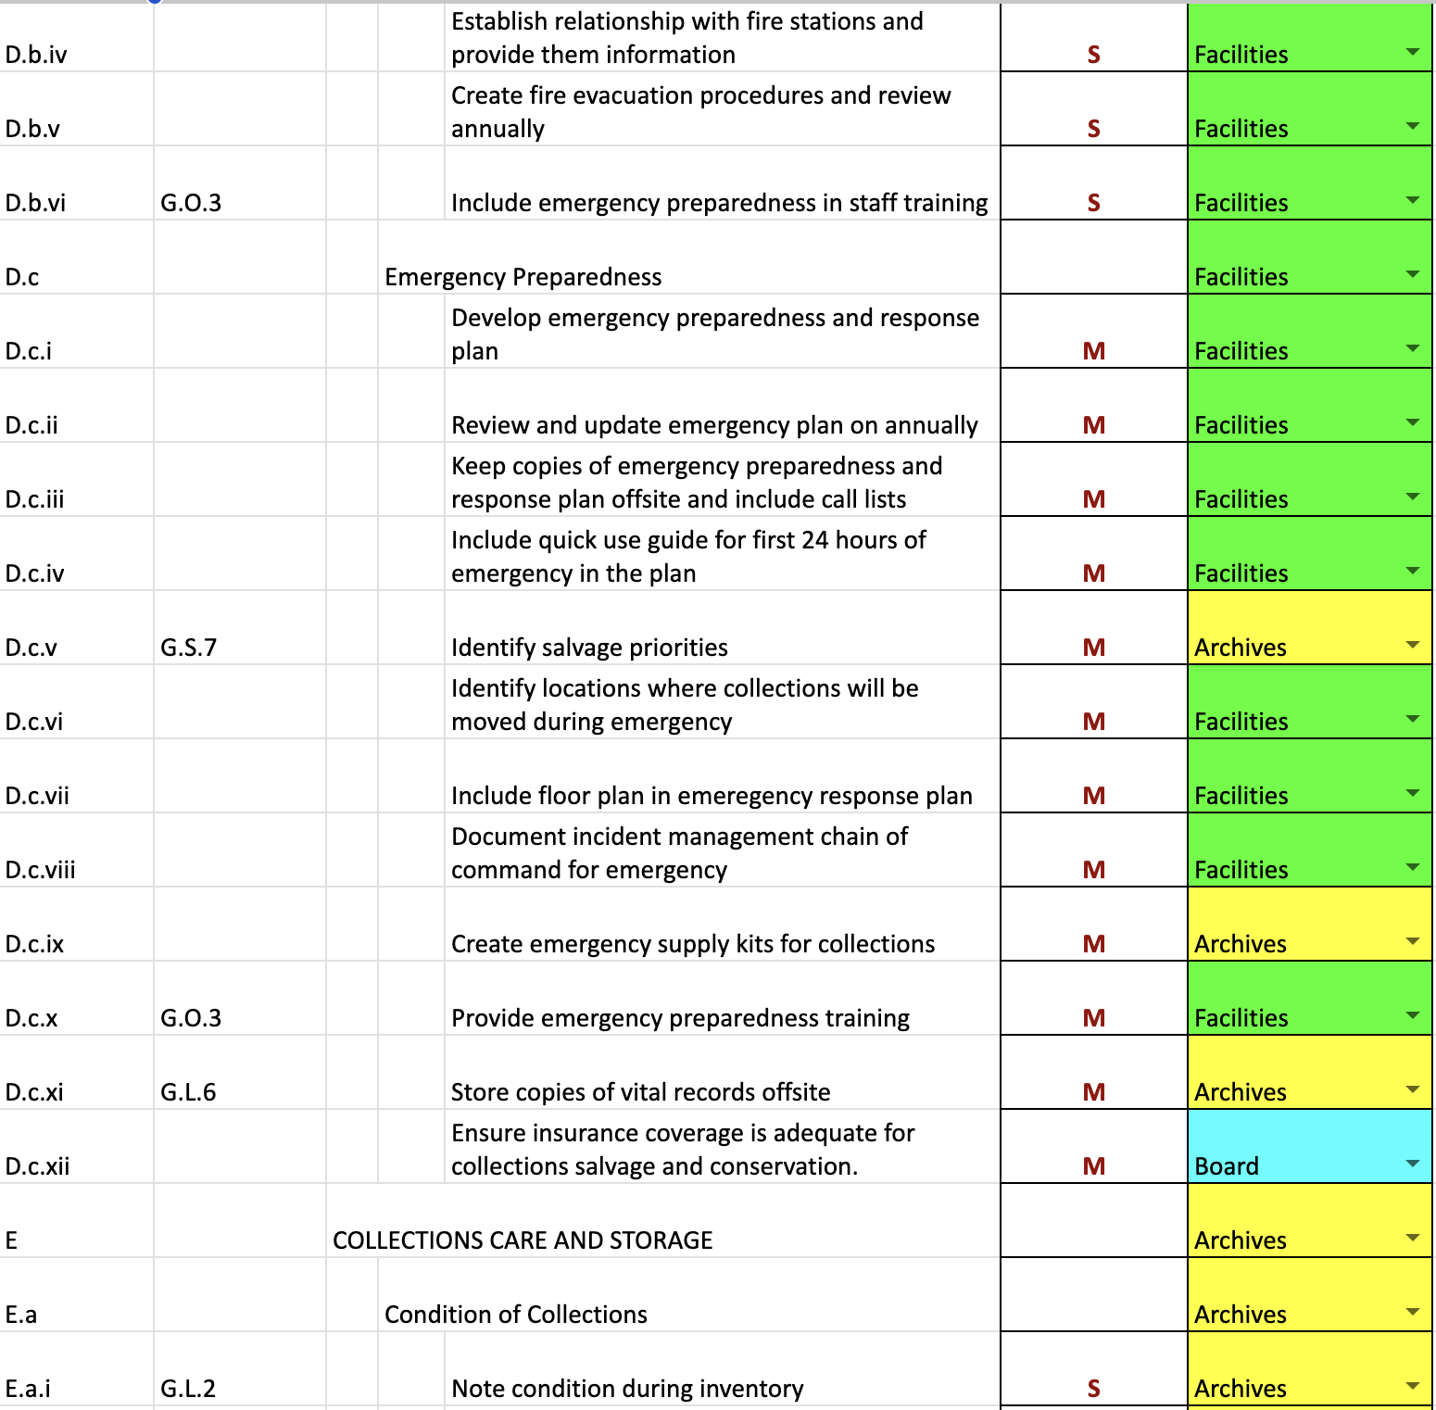
Conservation Center for Art and Historic Artifacts
Preservation Needs Assessment
Onsite Visit (October 2021); Report May 2022
156 Recommendations
Report provided a foundation for building the archive from the ground up, and a tool for communications with stakeholders.
Helped the team identify key priorities as short-term goals that could be achievable with limited human and financial resources.
Tool to leverage grant funding (especially the NEH Preservation Assistance Grant for another CCAHA partnership project).
Continues to provide guidance as the archive matures.
Graph and spreadsheet created by Scarlett Wirt (FEBT)

Slide 11
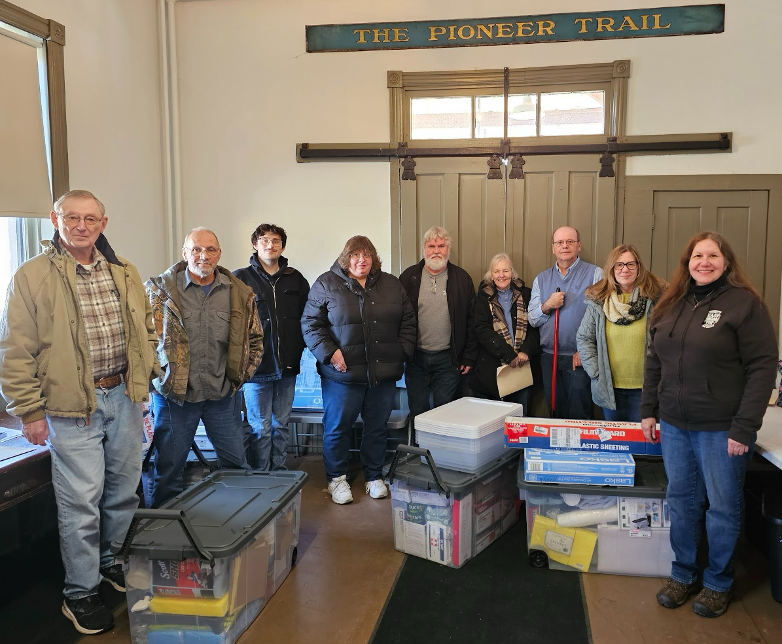
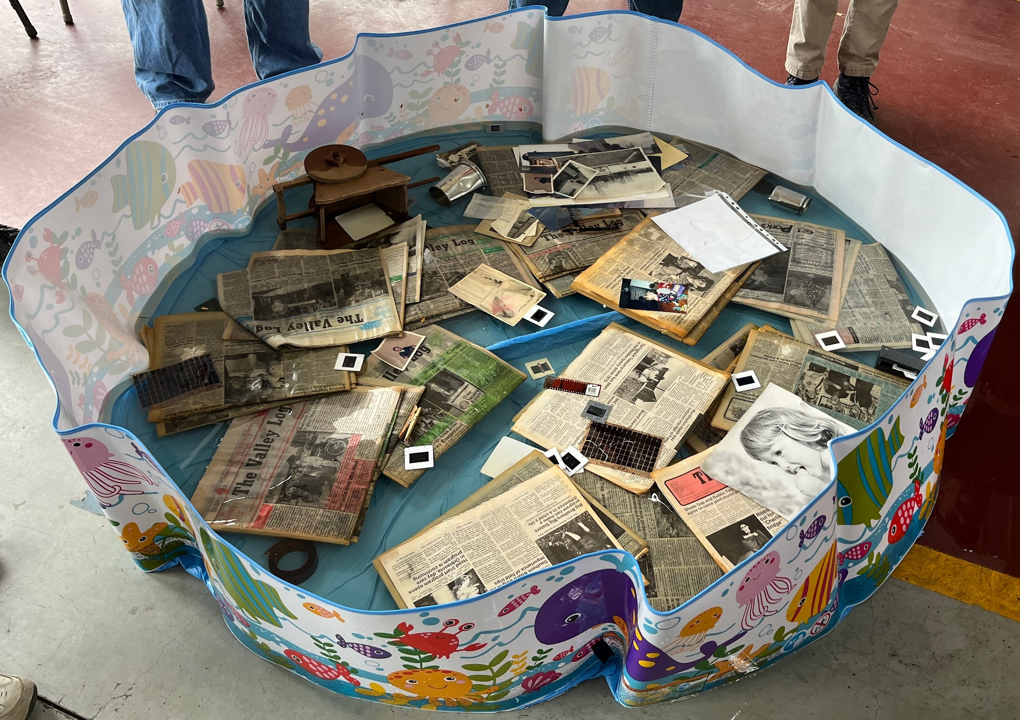
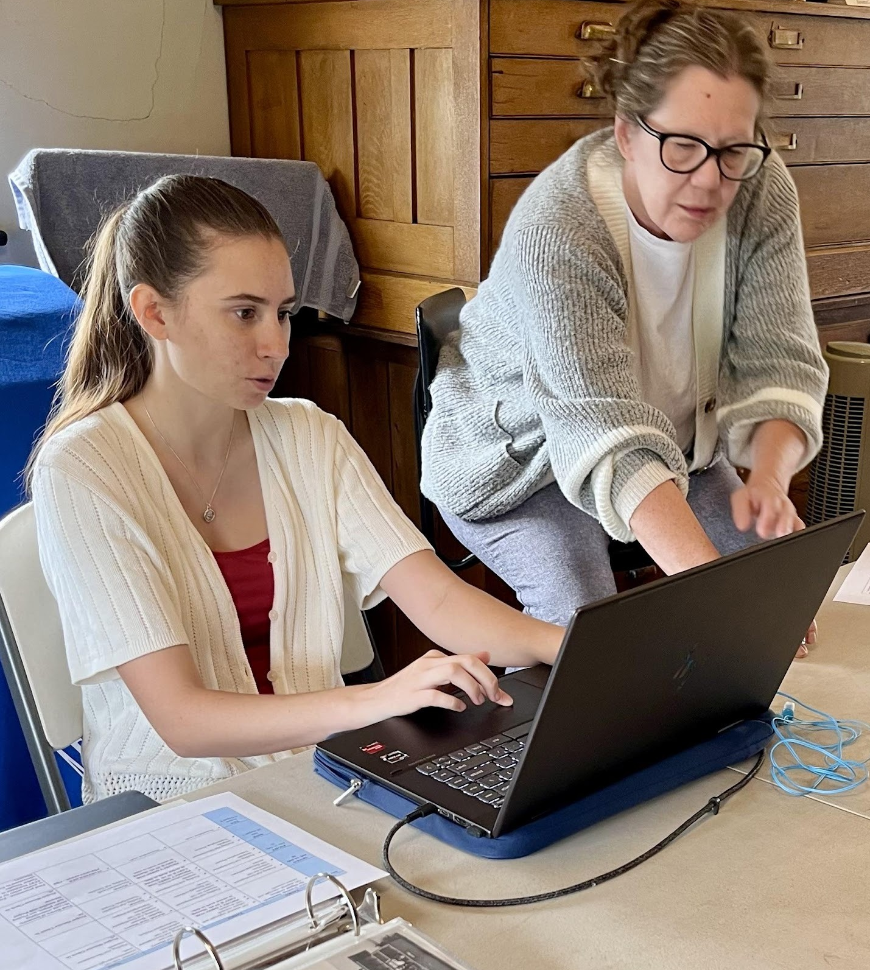
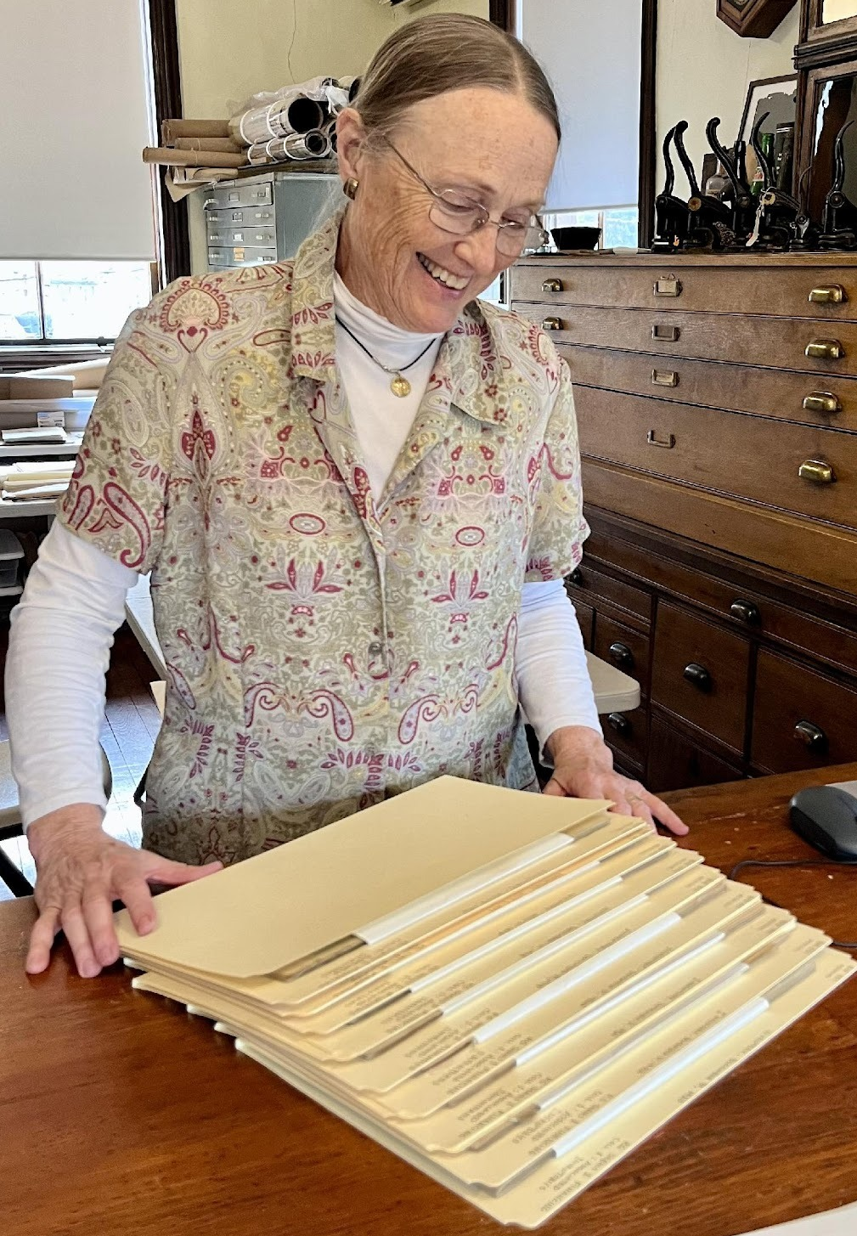
Paid Staff:
Archivist (35 hours weekly)
Archives Technician (35 hours weekly)
Volunteers:
2 core FEBT volunteers
4+ support FEBT volunteers
Interns:
6 summer Juniata College interns since 2021
UPITT MILS student intern 2026 (digital preservation)
ASSESSMENT INTO ACTION
GRANTS
NEH PRESERVATION ASSISTANCE GRANT ($10,000.00)
The East Broad Top Railroad Archives and Special Collections Disaster Response Planning and Environmental Monitoring Project [CCAHA Disaster Planning & Recovery Workshop]
NATIONAL RAILWAY HISTORICAL SOCIETY (2, $5,000.00 grants-equipment/supplies)
PA HISTORICAL AND MUSEUM COMMISSION ($15,000.00)
Oral History and Film Preservation Project
COLLECTIONS: PROTECT, PRESERVE, PROVIDE ACCESS
156 collections processed
2025: over 19,000 digital catalog searches from over 9,000 users
2026: Archival Arrangement Project – conducting full inventory
SHARING RESOURCES: key to community connections

