Slide 1
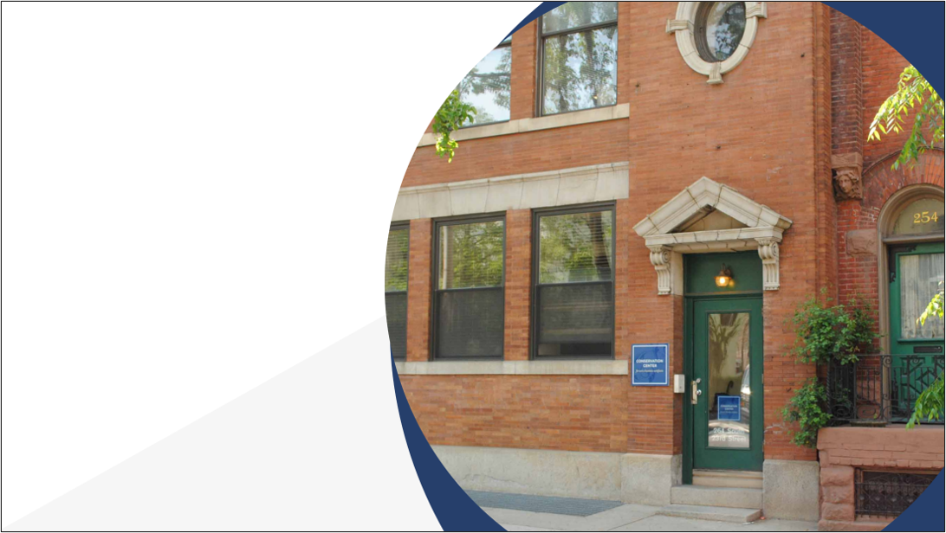

New Tools to Create Dynamic Collections Resources for Your Organization
Camilla Dawson
Preservation Services Coordinator

Slide 2
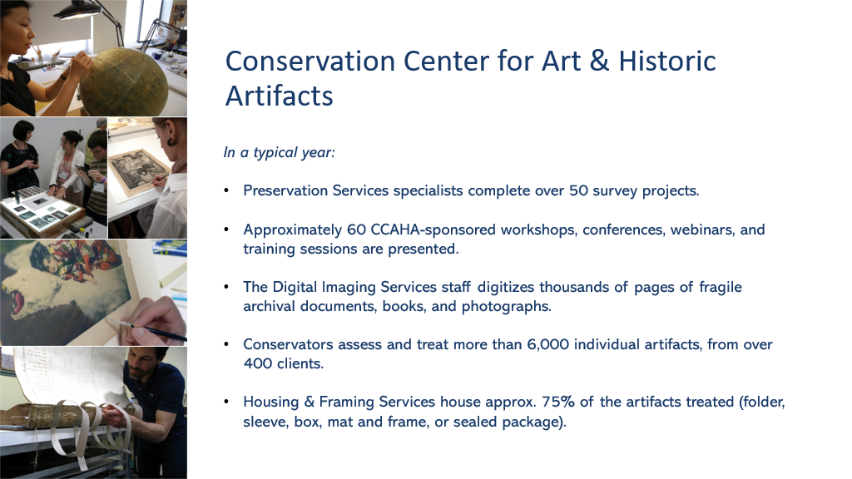

Slide 3
New Tools to Create Dynamic Resources for Your Organization
Camilla Dawson, Preservation Services Coordinator, CCAHA

Slide 4
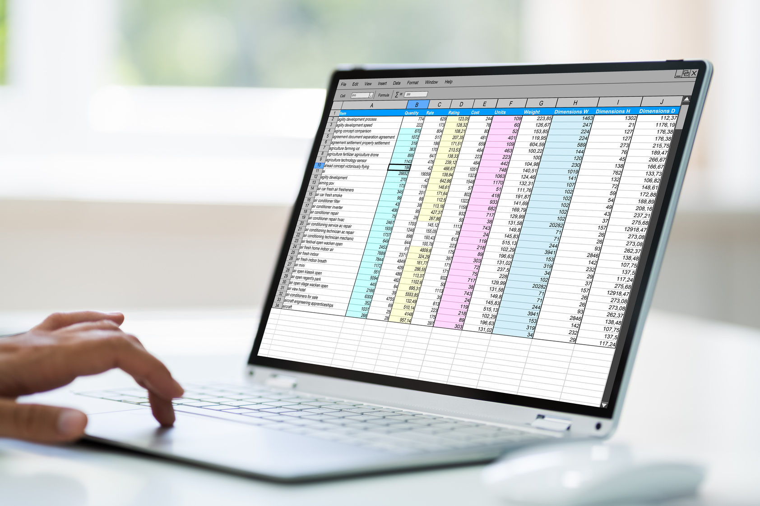
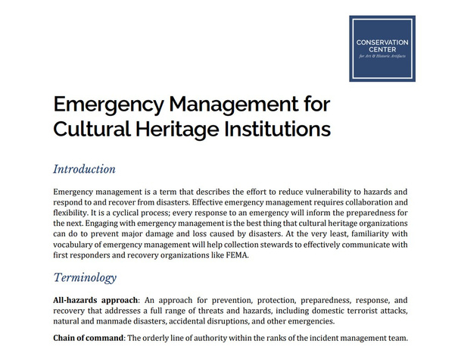
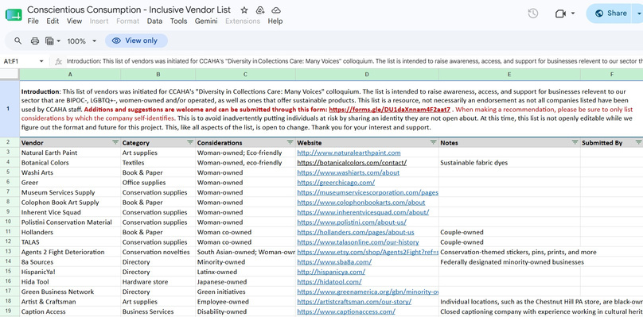
Introduction
CCAHA has a long history of developing resources for the preservation and conservation fields:
  Technical Bulletins
  Webinars
  Infographics
  Guides
  Reports
These resources need to be regularly updated to reflect the most current data, pricing, and research.

Slide 5

Background - Finding a Project Management Software
Needs:
  Ability to organize variety of complex, multi-structured projects
  Task structures that can meet the needs of these projects
  Not only a place to track projects, but a place to record institutional data and structures

Slide 6





Landscape of Options
Previously had used or tried more traditional project management platforms:
  Monday - straightforward software, but difficult to portray more complex projects
  Jira - similar to Monday
  Miro - great for brainstorms/idea dumps but not great for task tracking
  Airtable - well suited for more complex project tracking

Slide 7

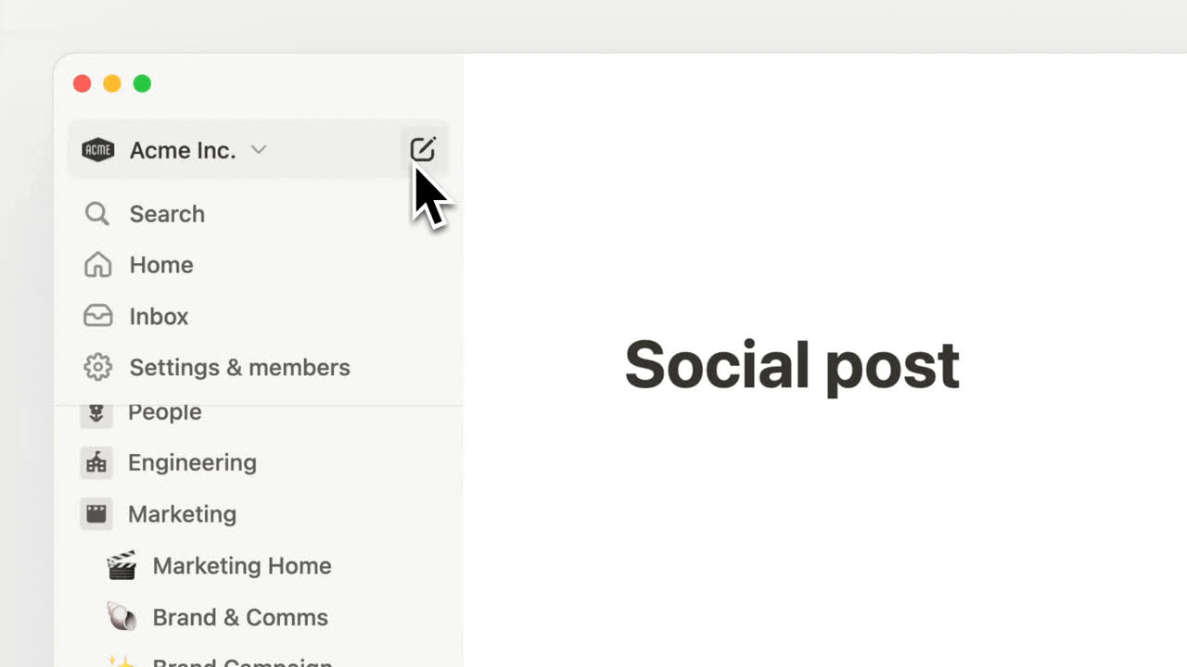
Choosing Notion
  First released in 2016
  Advertised as a “connected workspace”
  Highly customizable, with a lot of functions - notetaking, project and task tracking, knowledge management
  Found it useful for our department as it could portray complex and bespoke projects

Slide 8
Internal Uses
  Project Tracking and Archive
    Setting up customizable tasks and being able to look at filtered views of project archive
  Internal Resource Sharing
    Compiling and tagging frequently used resources cited in assessments and reports
    Database of meeting notes
  Automating Processes
    Able to submit expense reports, add events to department-wide calendar, track staff time

Slide 9

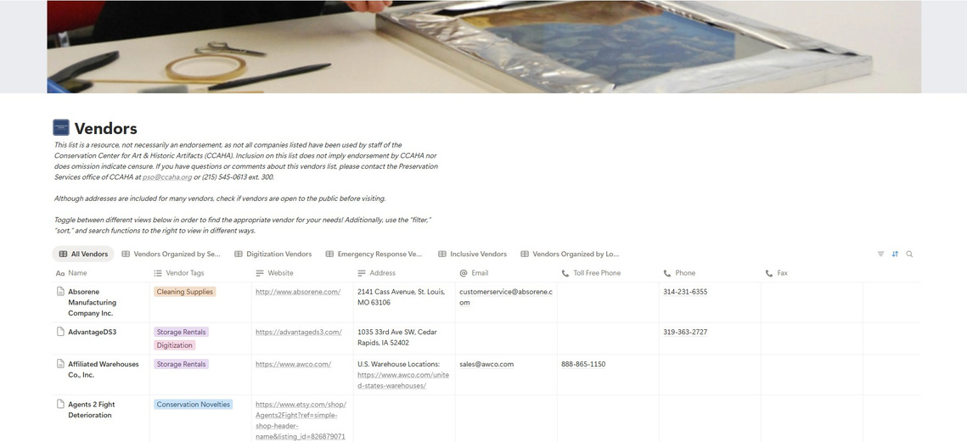
Case Study - Vendor Database
  Inital version of vendors list was developed in 2021, alongside other versions that had been created in the past
  With a new version, we wanted to include these lists but expand to have a list that spans all aspects of vendors and services that CCAHA gets inquiries about
  Once in Notion, we recognized the Vendor List as a good option for a test of importing resources into Notion

Slide 10


Case Study - Vendor Database
  Also used this project as an opportunity to crowd-source additional vendors from CCAHA’s staff
  Thought about different views that would be helpful to CCAHA’s wider audience (i.e., sections to see local vendors, emergency vendors, etc.)
  This database was built from scratch, while referencing the original spreadsheet, but Notion has the ability to build a database by uploading a spreadsheet file

Slide 11

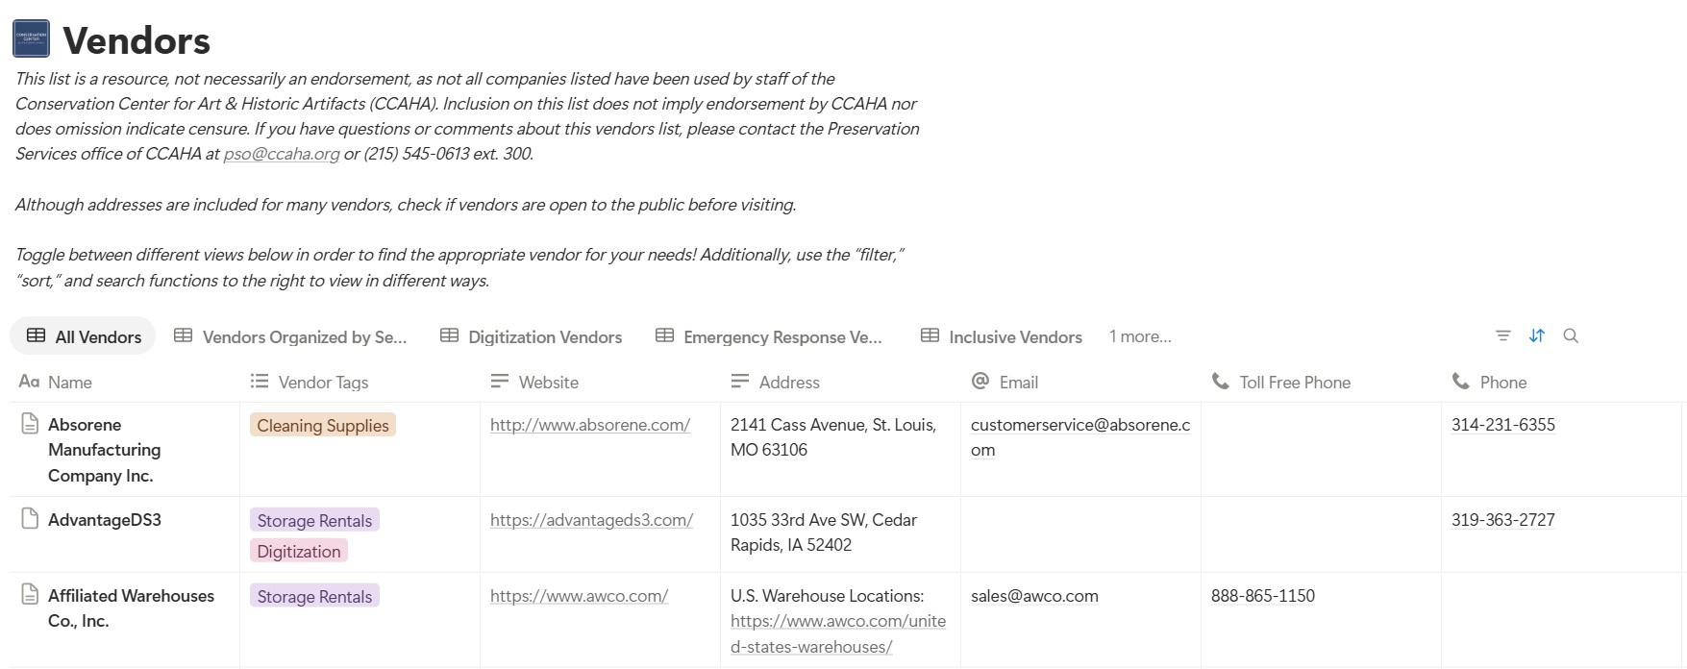

Slide 12
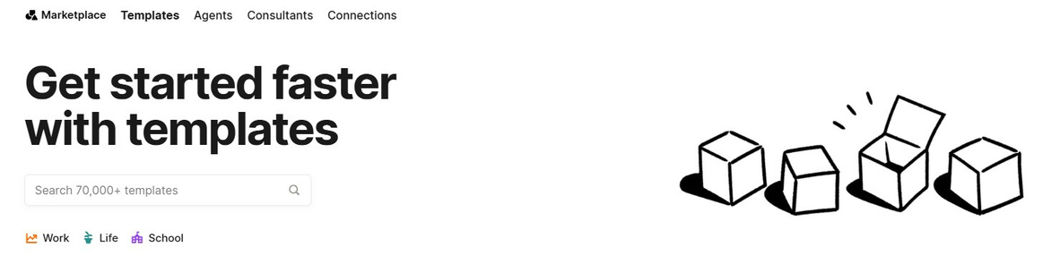
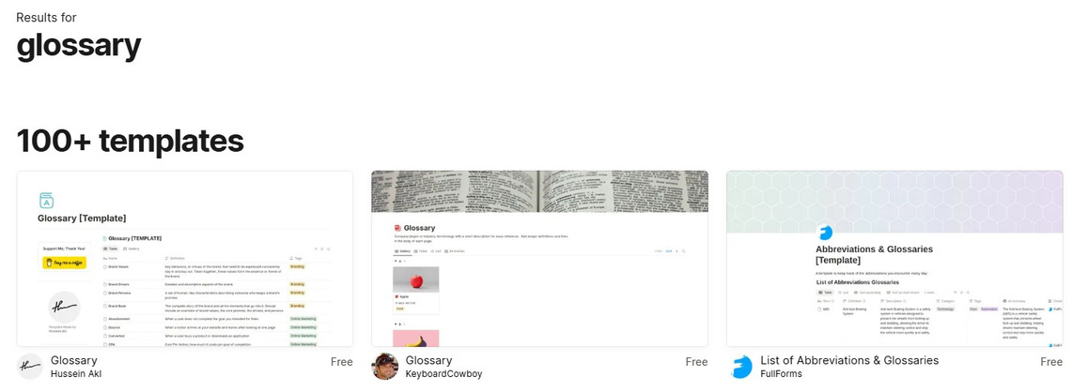
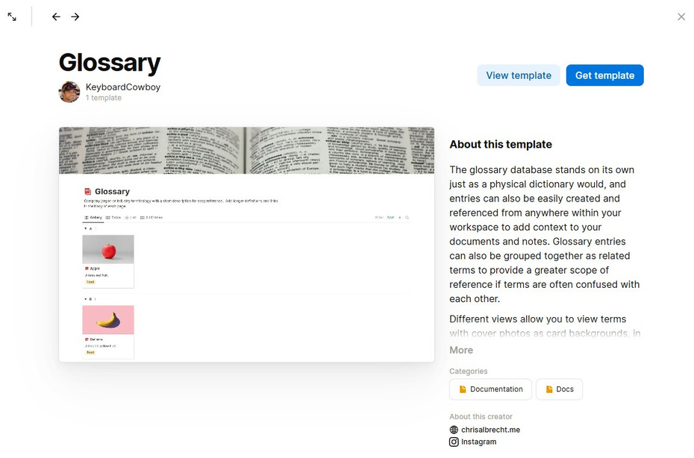
Notion Templates
  Notion offers a marketplace of templates that can be imported into your personal Notion workspace - created both by Notion and other creators
  They offer both free and paid templates that range from structured databases to functionalities that you can add to existing structures

Slide 13
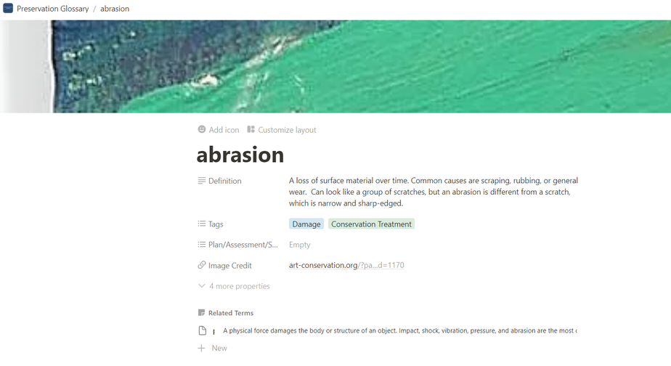
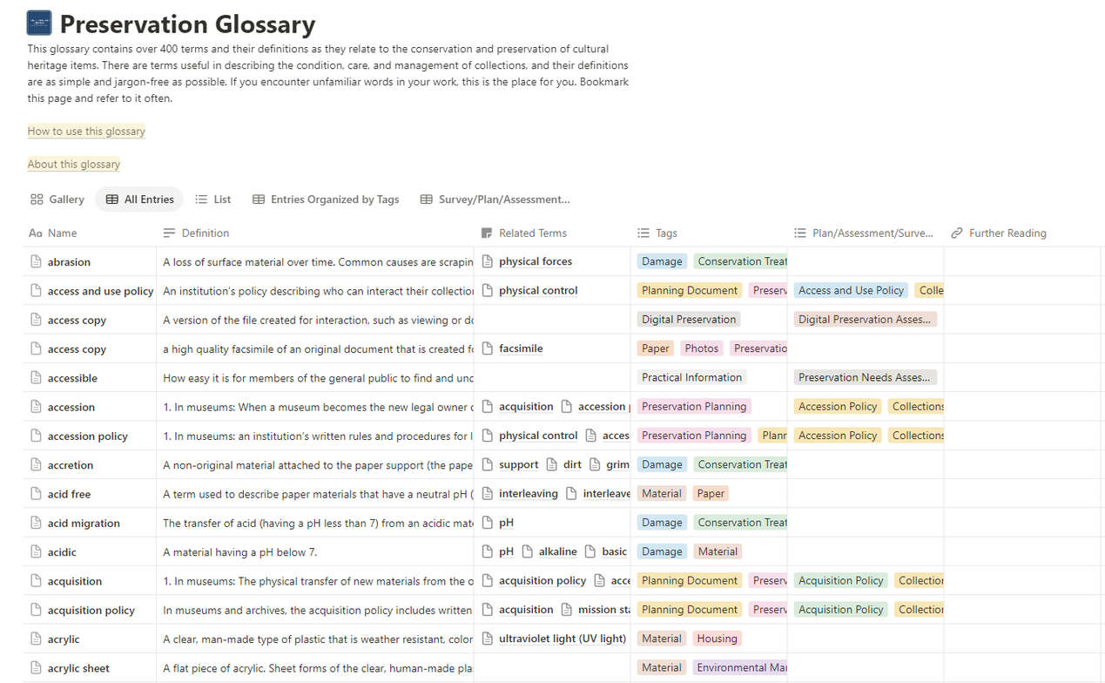
Case Study - Preservation Glossary
  First created through a collaboration with Archives for Black Lives in Philadelphia, we received additional funding to further build out the glossary in 2024.
  We wanted to build an intuitive, living, and easily navigable glossary with terminology covering many facets of conservation and preservation - including digitization, collections management, and conservation treatment

Slide 14
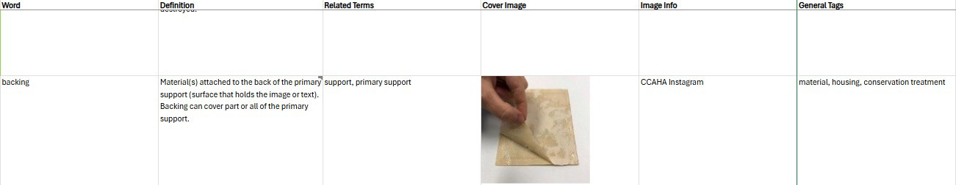

Slide 15
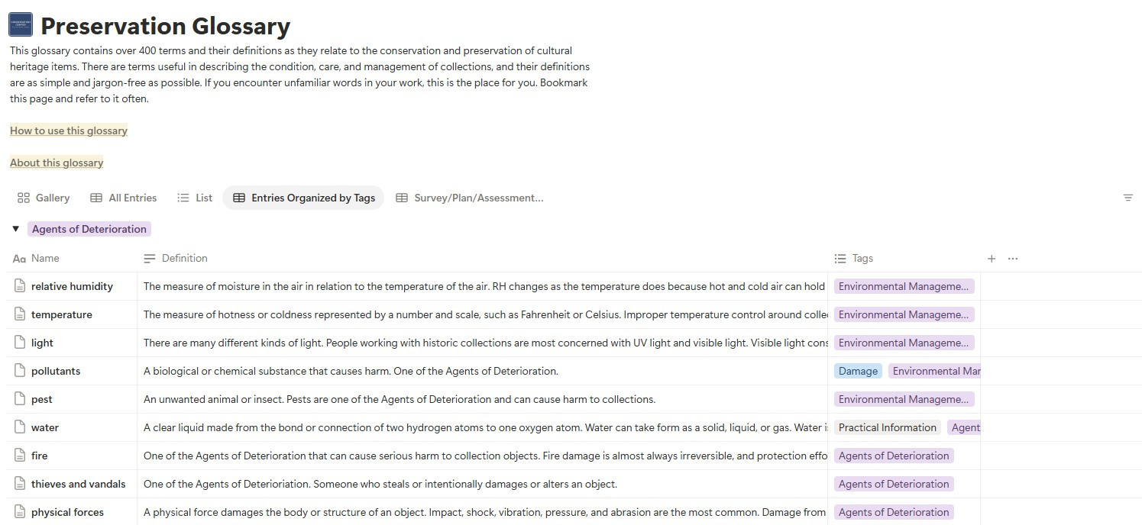
Case Study - Preservation Glossary
  CCAHA-wide collaboration that also brought in a technical writer as a consultant
  Initial list of terms generated that were then drafted, along with resources and photos (if applicable) by staff members with expertise in the subject matter
  Taxonomy and structure considered from the beginning

Slide 16
Case Study - Preservation Glossary
  Used glossary template to set initial structure and then adjusted to meet structural expectations - added additional views such as one filtered to show terms often encountered in surveys, assessments, and plans
  Added pages at the top that explain how to use the glossary and background information on the project/project team, with a place for users to submit feedback

Slide 17
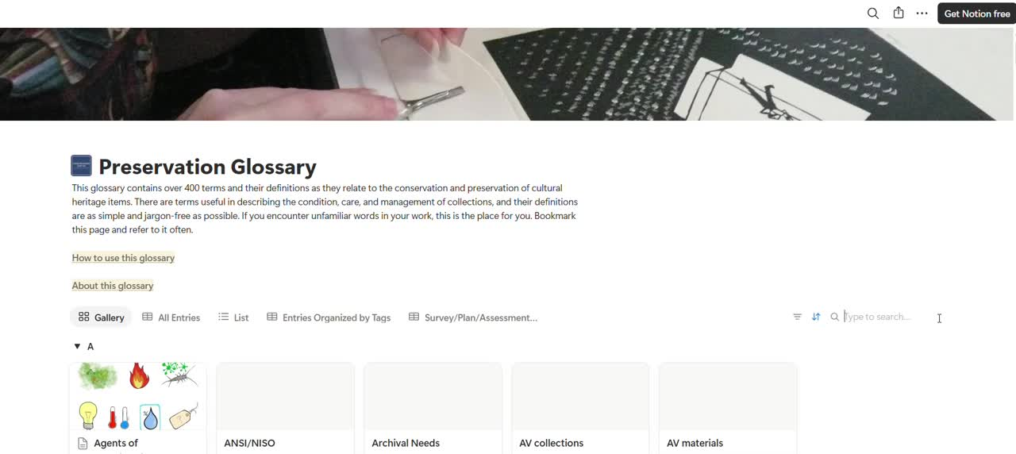

Slide 18
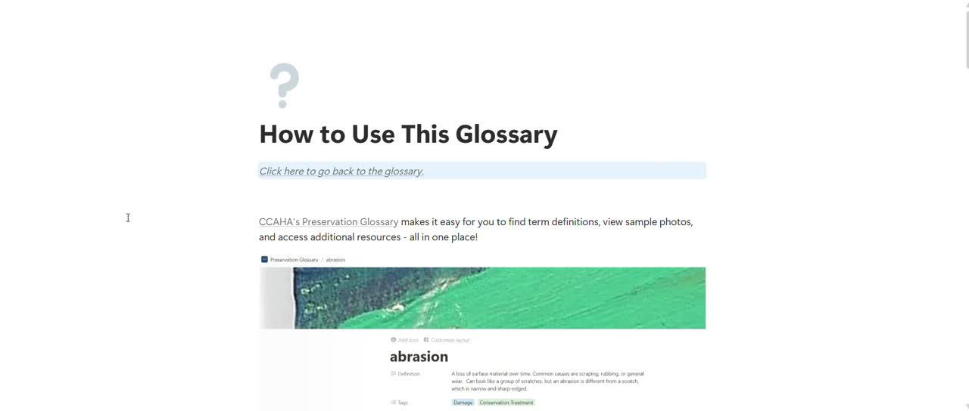

Slide 19
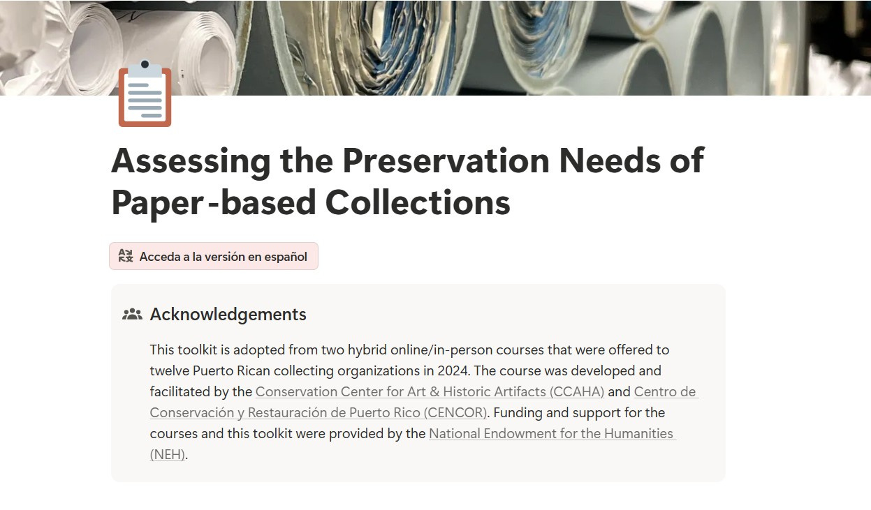

Slide 20
Conclusion
  New tools, such as Notion, can eliminate common issues seen when creating resources meant to be publicly shared
  Think about structure and ease of use from the start when building resources, particularly taxonomy if using tags
  Design elements can work to your advantage
  Programs like Notion and Canva have discounted pricing for non-profits

Slide 21

Resources
CCAHA’s Vendor List
CCAHA Preservation Glossary
Assessing the Preservation Needs of Paper-based Collections
Notion templates

Slide 22

Questions?
Camilla Dawson
cdawson@ccaha.org
Preservation Services
pso@ccaha.org

